Slide 1
Detecting Education Level Using Facial Expressions
Presented By:
HabebaElRahman Hesham
Mourad Ahmed Nabawy
Ola Mohamed Safwat
Youssef Mohamed Ahmed
Supervised By:
Dr. Ammar Mohamed
Eng. Haytham Metawea
10.10.19

Slide 2
OUTLINE
01
Introduction
02
Related Work
03
Problem Statement
04
Comparison
05
System Overview
06
Expected Results
07
Demo
1

Slide 3
Introduction
“
In our real-life, e-learning is improving and shows more. The examiners show every day a better way of detecting the level of education and the ground of education that student stands on. Although e-learning has some advantages in terms of information accessibility, time and place flexibility compared to formal learning, it does not provide enough face-to-face interactivity between an educator and learners. The main aim of proposed project is making the examinees' facial expressions as well as their answers contribute in determining which next level they should be passed to
“
2

Slide 4
Student Emotion Recognition System (SERS) for e-learning
improvement based on learner concentration metric^{[1]}
Related
Work 1/3
Motivation: Emotion plays an important role in analyzing the student's interest in classroom lectures. Out of the various ways to detect emotion, the quick way is to understand the emotional symptoms through facial expression.
Problem Statement: 1. Very long training time.
2. Slow progress in reaching any of classifying that emotion
Tools: Viola-Jones, Local Binary Pattern (LBP), Ada Boost and Neural Network.
Results: The different concentration levels have been observed throughout the
video i.e. High, medium and low, the student wasn't attentive in reading the
content which was displayed at that time period.
[1]LB Krithika. \Student emotion recognition system (SERS) for e-learning improvement based on learner concentration metric". In: Procedia Computer Science 85 (2016), pp. 767-776.
3

Slide 5
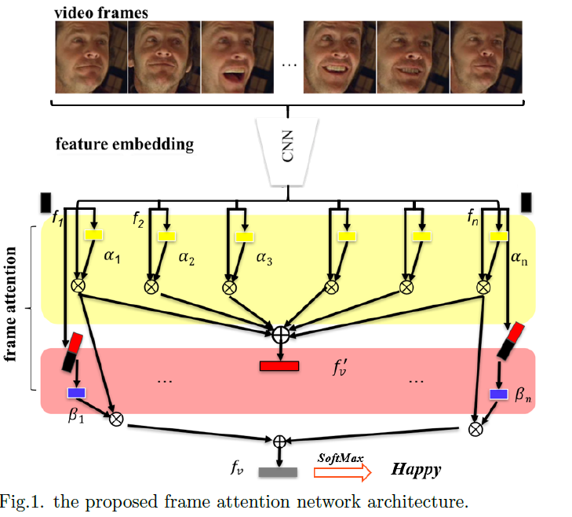
Frame Attention Networks for Facial Expression
Recognition in Videos^{[2]}
Related
Work 2/3
Motivation: The video-based facial expression recognition aims to classify a
given video into several basic emotions, facial expression has recently attracted
increasing attention in academia and industry due to its wide range of the many applications nowadays.
Problem Statement: Facial expression recognition in the wild remains a challenging problem due to large head pose, illumination variance, occlusion, motion blur, etc.
Tools: Convolutional Neural Network (CNN) , Frame Attention Networks.
Results: Very high accuracy 98 percent also that accuracy thanks to the meta datasets that they use as Cohen Kanade (ck+) and AFEW 8.0.
[2]Debin Meng et al. \frame attention networks for facial expression recognition in videos". In: 2019 IEEE International Conference on Image Processing (ICIP). IEEE. 2019, pp.
3866-3870.
4

Slide 6
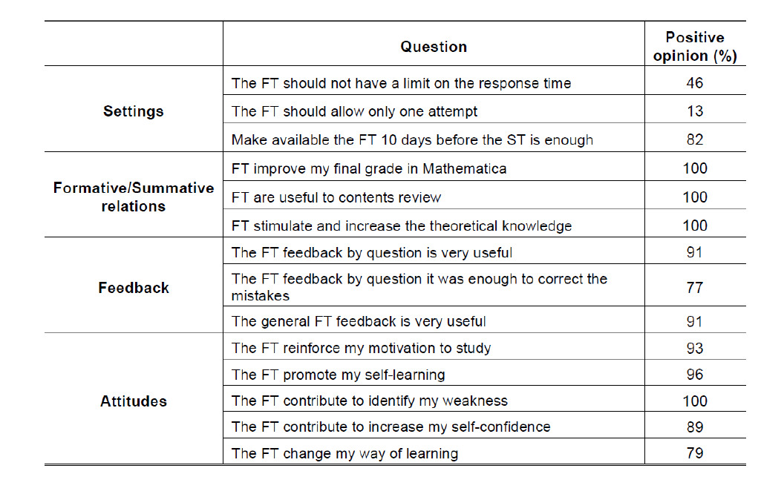
Formative Assessment In Higher Education: DetectionAnd Improvement On Learning Level^{[3]}
Related
Work 3/3
Motivation: The objective of this paper to progress learning and levels of success in the
subjects of Mathematics and develop a point of reflection around the
instructing and learning process of some mathematical contents, Based on formative and summative assessments.
Problem Statement: The problem is how to improve the education level about this course and to detect the education level for each student in each subject of mathematic..
Tools: Summative Assessment, Formative Assessment
Results: And they reach that the using summative
and formative together is better than using each
of them alone.
[3]Babo, Lurdes, & Azevedo, Jose Manuel & Torres, Cristina & Lopes,
Ana Paula. “Formative Assessment In Higher Education: Detection And Improvement On Learning Level.”ResearchGate, ResearchGate GmbH, March 2017, pp.1-10
5

Slide 7
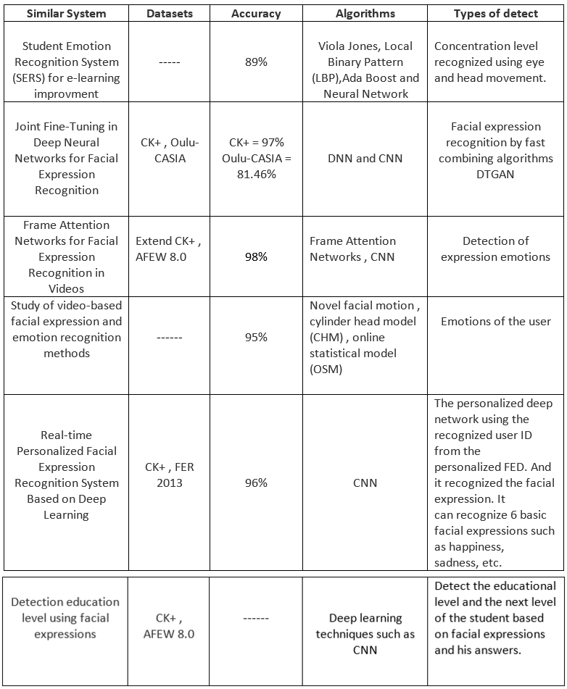
Comparison
6

Slide 8
Problem Statement
The E-learning system usually face problems in determining the accurate next level.
02
7

Slide 9
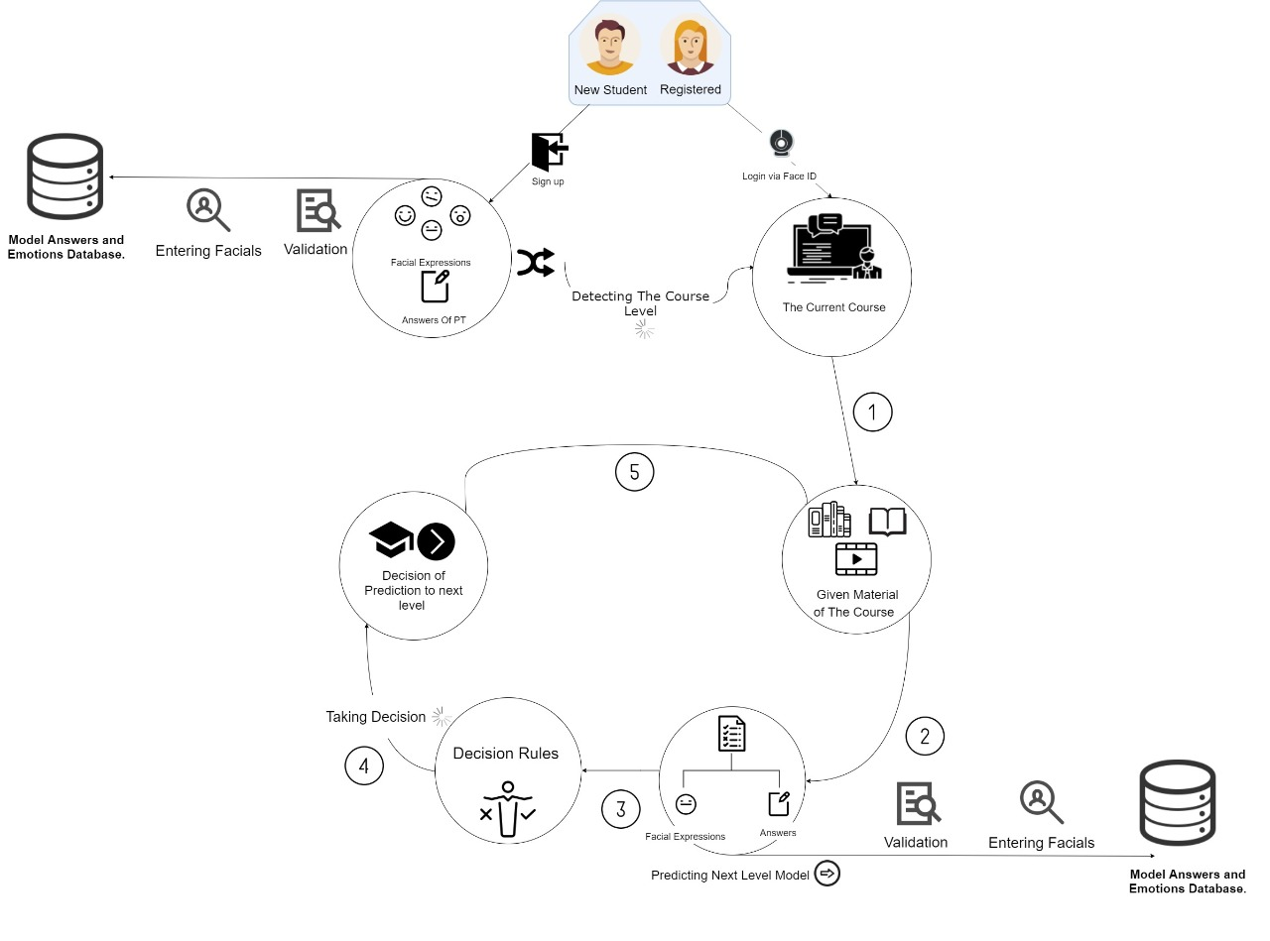
System Overview 1/4
8

Slide 10
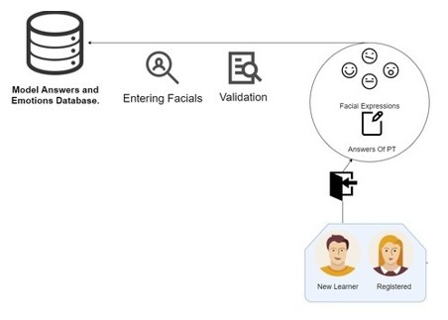
System Overview 2/4
Pre-processing
Sample of the dataset (ck+)
The facial expressions and the answers of placement test are the core of this stage.
And the output will be the current level of the course.
9

Slide 11
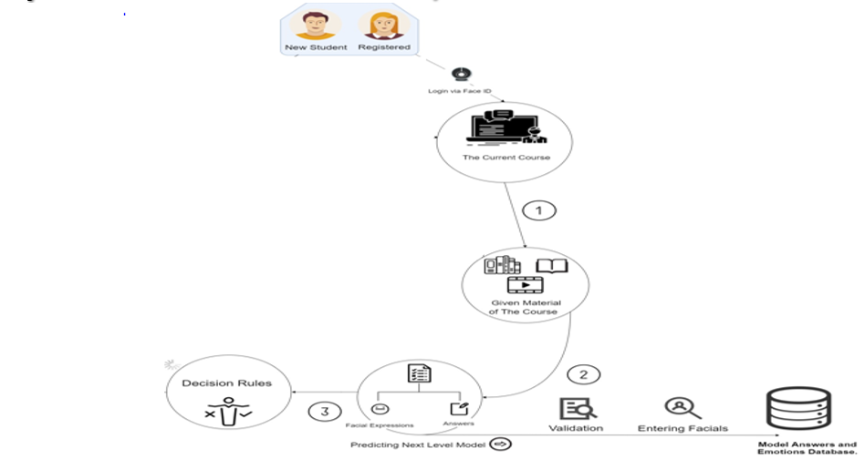
System Overview 3/4
Processing
By logging the learner the system, The given material of the course is qualifying the student to improve his knowledge. By testing the student and getting his facial expressions the system take all of them to take the decision using Decision rules.
10

Slide 12
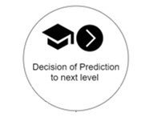
System Overview 4/4
Output
The output is the prediction of next level of the student.
11

Slide 13
Expected Results
01
Automatically determine the level of the student based on facial expressions and his answers after the online exam.
02
Accurate Next education level.
03
Automated recognition application for determining the next level in the E-learning.
12

Slide 14
Demo
13

Slide 15
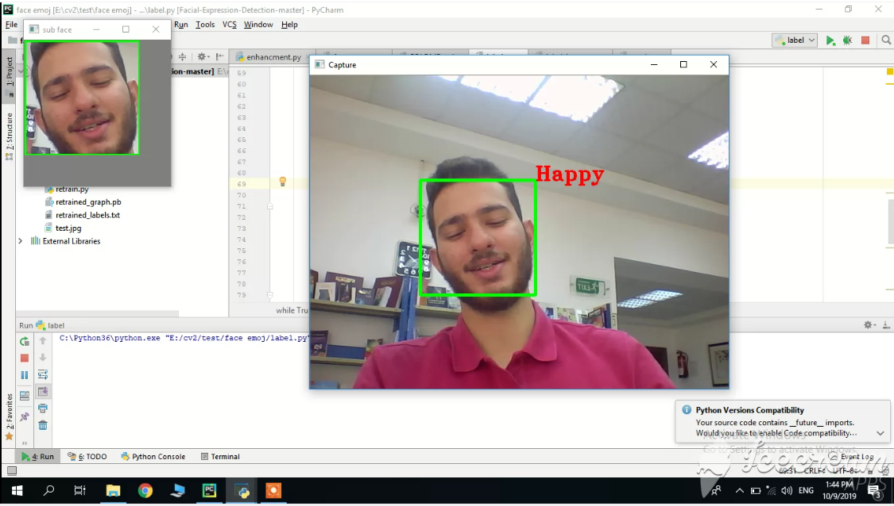

Slide 16
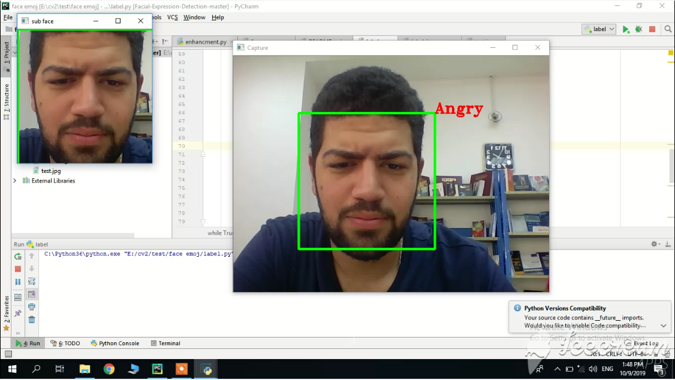

Slide 17
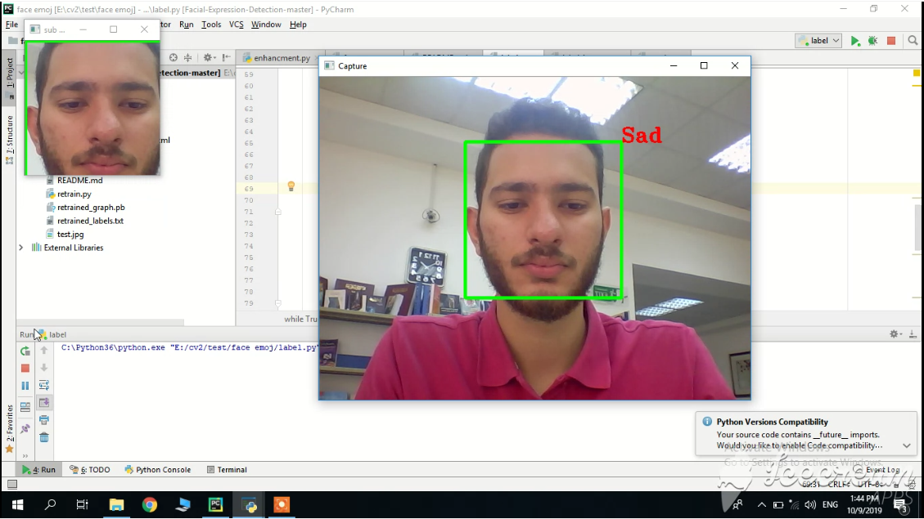

Slide 18
Thank you

