Slide 1
Tourism Management System Using GIS
Case Study Natural Protected Areas in Egypt

Slide 2
BY:
Ahmed Waleed – Eyad Fathy
Ahmed Mohamed– Mohanad Magdy
Under Supervision :
Prof: Abdel Nasser Zaied
TA : Menna Allah-Hassan

Slide 3

Table of Contents
4-6
8-15
16
17
Introduction
Objective
Problem statement
Related work
7
Google map vs
Gis
18-19
20
21
22-23
24-25
System Overview
Methodology
GIS Tourism Example &
Expected Result
Project Comparison
Supportive Doc &
Demo

Slide 4

Introduction
The success of any tourism business is determined by tourism planning
It provide strategic opportunities and powerful tools for economic growth

Slide 5
Introduction
Today, there are many national parks and protected areas in Egypt, of which perhaps the best known and one of the oldest is at Ras Mohamed on the tip of the Sinai Peninsula.
5

Slide 6
Natural Protected Areas in Egypt
Egypt has more than 30 Natural park which is may be unknown inside and outside of Egypt !!
6

Slide 7
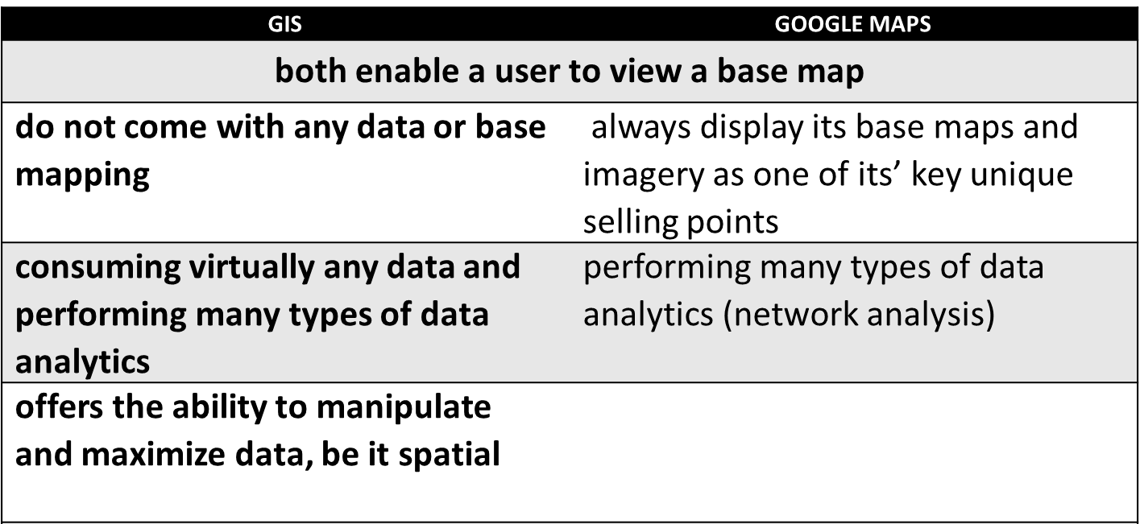
Gis VS Google Maps
7

Slide 8
Related Work 1 (1/2)
WEB BASED TOURISM INFORMATION SYSTEM USING GEOGRAPHICAL INFORMATION SYSTEM (GIS) - A CASE STUDY
●Main Objective Of System:
● helped the tourists in making arrangements before taking the tour.
● improve the quality and level of web information.
● Used as marketing tool for the city tourism management to promote and attract tourists.
● Data can be updated and maintained in real time.
● Data used : India Topographical map, Shape Files of maps and images of the city.
Mohan Lalit, Dhawan S. C. , Krishna A. P. “Web Based Tourism Information System Using Geographical Information System (GIS) - A Case Study ” Journal of Hospitality Application & Research, BIT Mesra, Ranchi Vol. 3 No.2

Slide 9
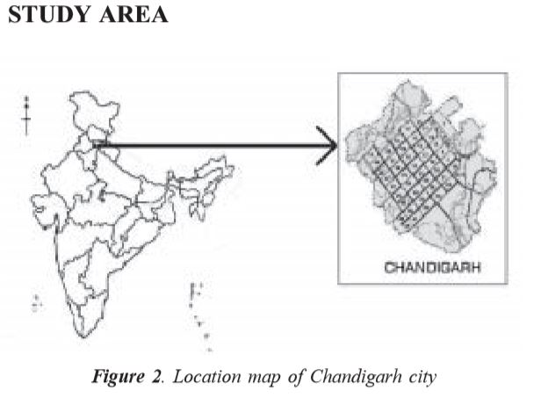
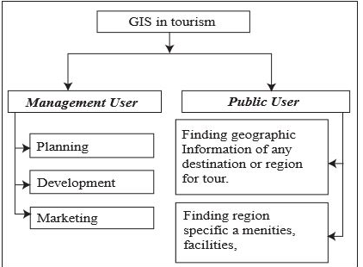
Related Work 1 (2/2)
WEB BASED TOURISM INFORMATION SYSTEM USING GEOGRAPHICAL INFORMATION SYSTEM (GIS) - A CASE STUDY
Mohan Lalit, Dhawan S. C. , Krishna A. P. “Web Based Tourism Information System Using Geographical Information System (GIS) - A Case Study ” Journal of Hospitality Application & Research, BIT Mesra, Ranchi Vol. 3 No.2
9

Slide 10
Related Work 2 (1/2)
Opinion Mining and Summarization of Hotel Reviews
● Important and useful information can be extracted from reviews.
● Reviews about hotel are retrieved from review websites such as:
www.tripadvisor.com .
● Review text is classified as positive or negative review using machine learning classifiers
● Used classifier: Naive Bayes , SVM , and Decision Tree for review text.
● Selected and labelled 1000 reviews from it for training and another 1000 reviews for testing
Vijay B. Raut , D.D. Londhe “Opinion Mining and Summarization of Hotel Reviews”. 2014 Sixth International Conference on Computational Intelligence and Communication Networks.
10

Slide 11
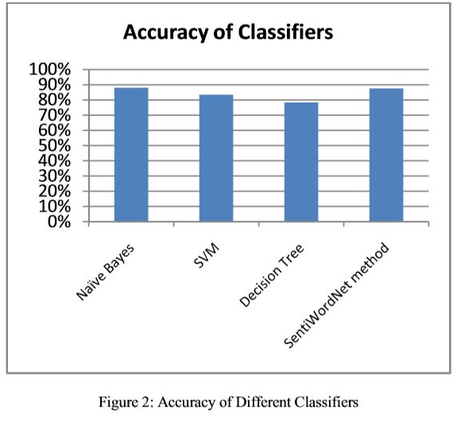
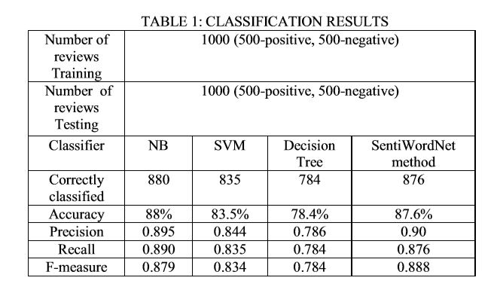
Related Work 2 (2/2)
● Obtained about 87% accuracy for classification of hotel review text as positive or negative opinion review by machine learning Naïve Bayes algorithm.
Vijay B. Raut , D.D. Londhe “Opinion Mining and Summarization of Hotel Reviews”. 2014 Sixth International Conference on Computational Intelligence and Communication Networks.
11

Slide 12
Related Work 3 (1/2)
ROLE OF GEOINFORMATION IN ENHANCING TOURISM IN NATIONAL PARKS
This System was designed to facilitate Amboseli National Park, Kenya.
A topographic map and other data was used to create a geodatabase and a digital map of the Park using GIS software (ArcGis).
Features were digitized on the scanned map and other data in form of shapefiles added as overlays.
J. Mwenda, Mr. Mutero and Mr. Hongo (2008). “ROLE OF GEOINFORMATION IN ENHANCING TOURISM IN NATIONAL PARKS CASE STUDY: AMBOSELI NATIONAL PARK”. Department of Geospatial and Space Technology 2008.
12

Slide 13
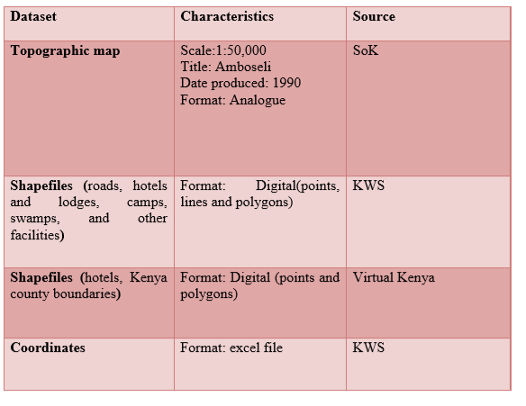
Related Work 3 (2/2)
ROLE OF GEOINFORMATION IN ENHANCING TOURISM IN NATIONAL PARKS
An attribute table was created to link the data with their characteristics in order to provide more information for analysis.
Challenges:
1)lack of information, statistics
2)Data acquisition is time
consuming and costly.
J. Mwenda, Mr. Mutero and Mr. Hongo (2008). “ROLE OF GEOINFORMATION IN ENHANCING TOURISM IN NATIONAL PARKS CASE STUDY: AMBOSELI NATIONAL PARK”. Department of Geospatial and Space Technology 2008.
13

Slide 14
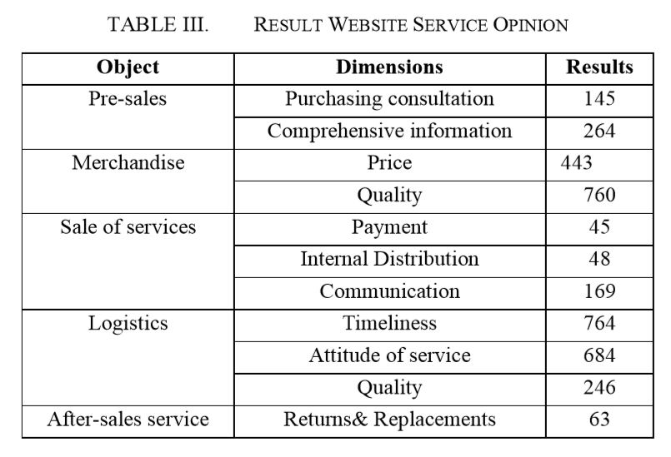
Related Work 4
Objective of paper:
  reviews for merchandise and online shopping services
Dataset used:
  1000 reviews of customers from Amazon.cn and DangDang.
classification used SVM algorithm, Naive Bayes to classify topics of reviews.
consumers are concerned about three topics are:
  timeliness, quality and attitude of service.
Deng Bin, Shao Peiji, Zhao Dan,” E-Commerce Reviews Management System Based on Online Customer Reviews Mining ”. 2010 International Conference on Innovative Computing and Communication.
14

Slide 15
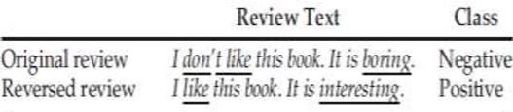
Related Work 5
Importance of sentences is decided based on linguistic features of sentences
Sentiment analysis of Movie Reviews
Example of Reviews on a novel:
Naive Bayes Classifier and Support Vector Machine(SVM) for comparing the results with their model and classifier
Pankaj Gupta, Ritu Tiwari and Nirmal Robert ‘Sentiment Analysis and Text Summarization of Online Reviews: A Survey’. International Conference on Communication and Signal Processing, April 6-8, 2016, India.
15

Slide 16
Objective of our System
Deployment of Tourism Management System Using GIS for natural protected areas in Egypt to help tourists to plan their trips to visit these Protected areas.
Rate the Tourist experience in Protective Parks.
Sub Objective :
  provide description as well as contact and address info of the place.
  allow user to review Feedback of other tourist about protected area
  provide information of nearby Public Service close to the user’s location.
  give information about how to navigate from source spot to desired destination.
16

Slide 17
Problem Statement
• Increase the accuracy of Identifying locations suitable to tourists based on Detailed information & Generate RATING to give best decision.
17

Slide 18
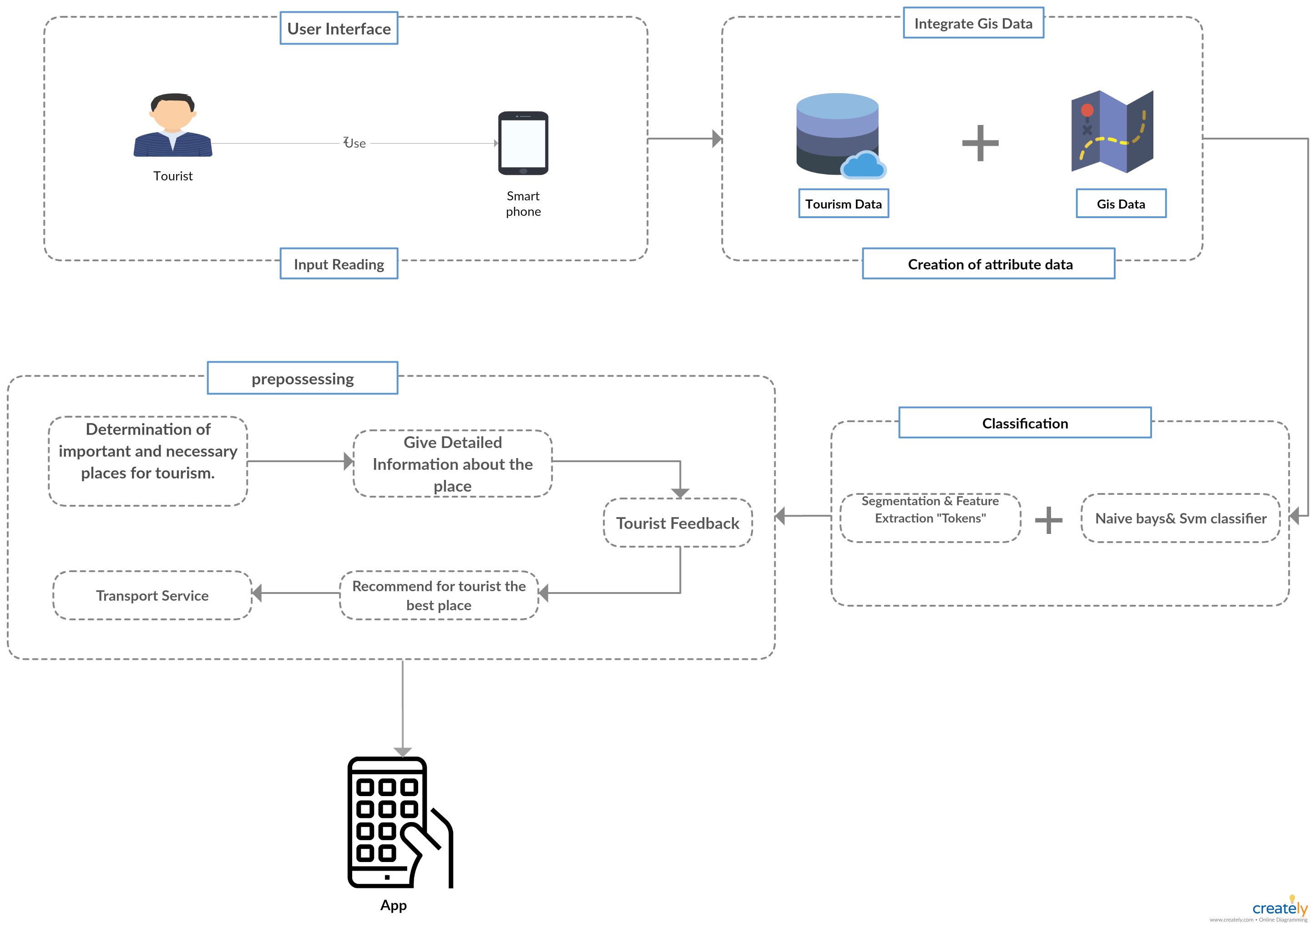
System Overview
18

Slide 19
System Overview -Classification
Use Naive Bayes [1]
Use SVM [2]
Combinations between classifiers.
[1] Vijay B. Raut , D.D. Londhe “Opinion Mining and Summarization of Hotel Reviews”. 2014 Sixth International Conference on Computational Intelligence and Communication Networks.
[2] Pankaj Gupta, Ritu Tiwari and Nirmal Robert ‘Sentiment Analysis and Text Summarization of Online Reviews: A Survey’. International Conference on Communication and Signal Processing, April 6-8, 2016, India.

Slide 20
Comparison
Systems | Classifier Used | Accuracy | Platform | Dataset Used
Opinion Mining and Summarization of Hotel Reviews | Naive Bayes , SVM , and Decision Tree | 88%,84%,78% | Mobile Application | 2000 reviews
E-Commerce Reviews Management System Based on Online Customer Reviews Mining | SVM, Naive Bayes | 81%,87% | Web Application | 2000 reviews
ROLE OF GEOINFORMATION IN ENHANCING TOURISM IN NATIONAL PARKS (GIS) | - | - | Mobile Application | Shapefiles, analog map of Kenya
Our System | SVM + Naive Bayes | - | Mobile Application | Natural Reserves Reviews& Shapefiles

Slide 21




Methodology
Firebase
ArcGis
Ranking using data classification
Android Studio
Application
In the form of shapefiles, analogue maps and coordinate data.
The data then will be processed using tools
21

Slide 22
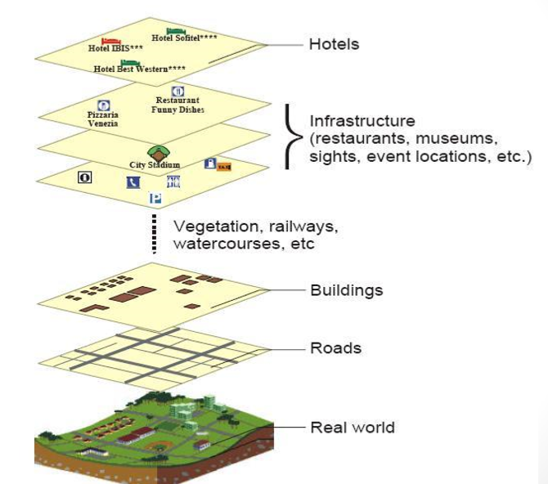
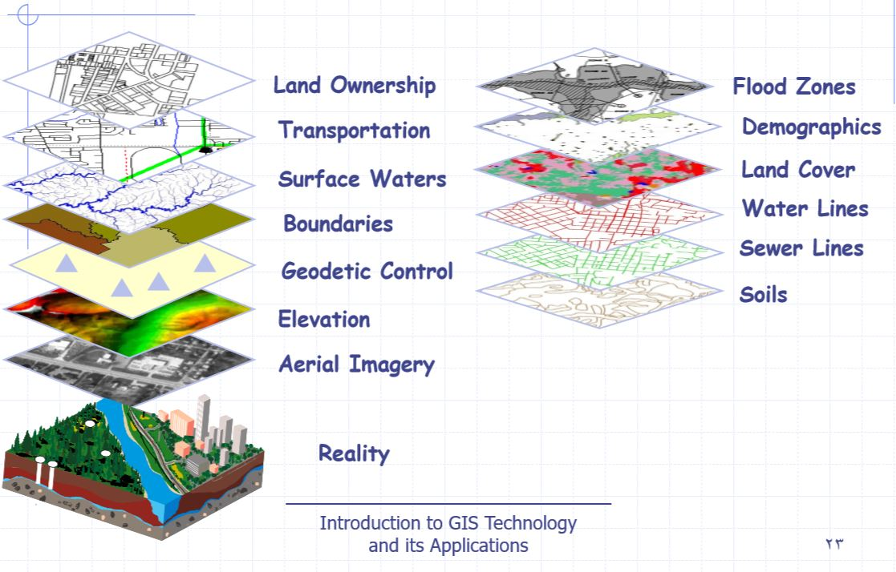
GIS Tourism Example
22

Slide 23
Expected Result
Full Tourism Management System Focused on Protective Parks.
The System will rate the Tourist experience in Protective Parks.
The System will rate the Tourist experience in Protective Parks in Arabic.
Our System will Plan the whole journey of Tourist it will include:
  Transportation
  Accommodation
  Trips
Future Work
23

Slide 24
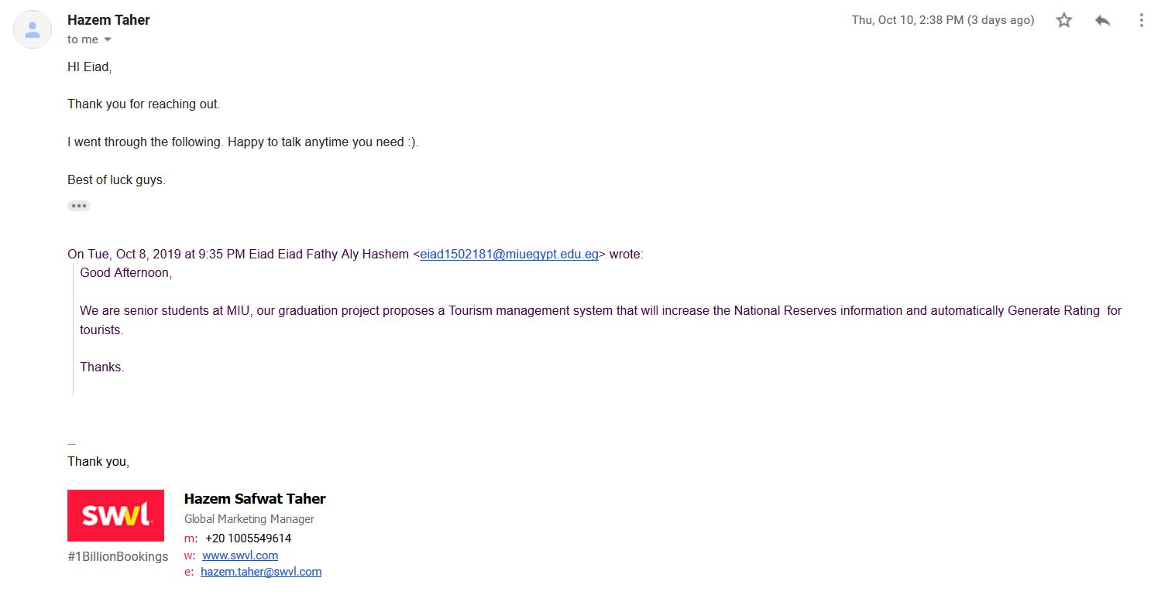
Supportive Doc
24

Slide 25
Demo
25

Slide 26
Thank you
26

