Slide 1
Detecting Education Level Using Facial Expressions
Presented By:
HabebaElRahman Hesham
Mourad Ahmed Nabawy
Ola Mohamed Safwat
Youssef Mohamed Ahmed
Supervised By:
Dr. Ammar Mohamed
Eng. Haytham Metawea
1

Slide 2
Objective
The aim of our system is improving the method that detects the educational level by using facial expressions in addition to his answers. Our system will declare which level is possible and accurate for the learner. Finally, our system will predict the next level in the course for each learner by using fuzzy logic engine.
2

Slide 3
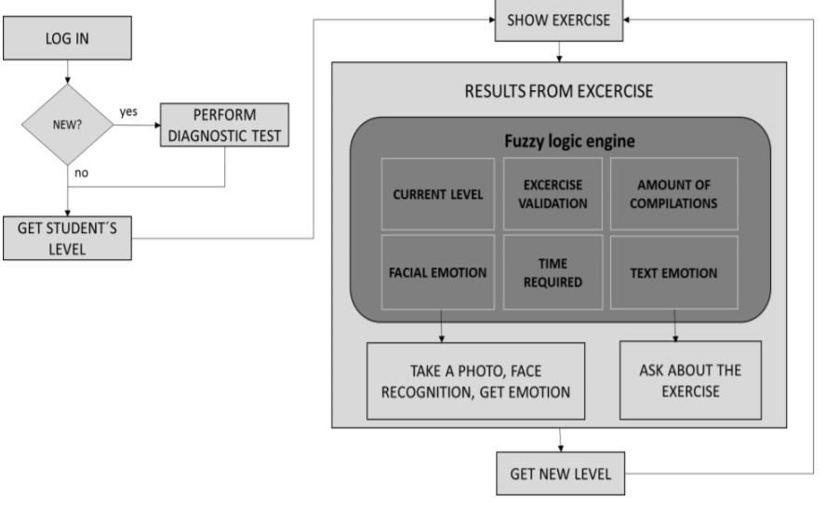
Similar System
The system give the learner placement test
to determine the learner level.
The student take the exercise for his current
level. After finishing the exercise he takes the
exam for this level and the system get (the
validation, amount of compilations and time)
as exercise variables and facial emotion (They
take only one facial expression) and text
emotion as emotion state.
They take the emotion state , exercise variables
and current level as an input to fuzzy logic
engine. After that the student get new level.
Our proposed system use the aggregation functions to calculate all facial expressions of the learner in certain time to detect the final mood during the exam. And use different input for fuzzy logic engine.
[1] Ram ́on Zatarain-Cabada et al. “Java Tutoring System with Facial and Text Emotion Recognition.” In:Research in Computing Science106 (2015),pp. 49–58),pp. 2–10.
3

Slide 4
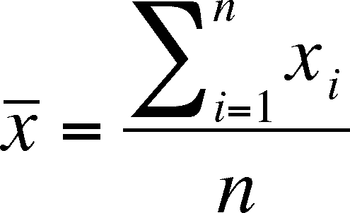
Aggregation Functions
One of challenges in our approach is to take set of facial expressions using aggregation functions.
Aggregation Functions such as mean (average) , Mode and maximum.
Ex: Mean formula
4

Slide 5
Fuzzy Inference System
5

Slide 6
Comparison between our CNN model and other related work
Related work | Accuracy
FPGA Platform applied for Facial Expression Recognition System using Convolutional Neural Networks | 60%
Video-Based Facial Expression Recognition Using a Deep Learning Approach | 62%
Using CNN for facial expression recognition: a study of the effects of kernel size and number of filters on accuracy | 65%
Our proposed model | 67%
[2] Hanh Phan-Xuan, Thuong Le-Tien, and Sy Nguyen-Tan. “FPGA Platformapplied for Facial Expression Recognition System using Convolutional Neu-ral Networks”. In:Procedia Computer Science151 (2019), pp. 651–658.
[3] Mahesh Jangid, Pranjul Paharia, and Sumit Srivastava. “Video-Based Fa-cial Expression Recognition Using a Deep Learning Approach”. In:Ad-vances in Computer Communication and Computational Sciences. Springer,2019, pp. 653–660
[4] Abhinav Agrawal and Namita Mittal. “Using CNN for facial expressionrecognition: a study of the effects of kernel size and number of filters onaccuracy”. In:The Visual Computer(2019), pp. 1–8
6

Slide 7
System Overview
7

Slide 8
Block Diagram
8

Slide 9
Most Important Functional Requirement (1/4)
9

Slide 10
Most Important Functional Requirement (2/4)
10

Slide 11
Most Important Functional Requirement (3/4)
11

Slide 12
Most Important Functional Requirement (4/4)
12

Slide 13
Non-Functional
Availability
Reliability
Performance
Usability
13

Slide 14
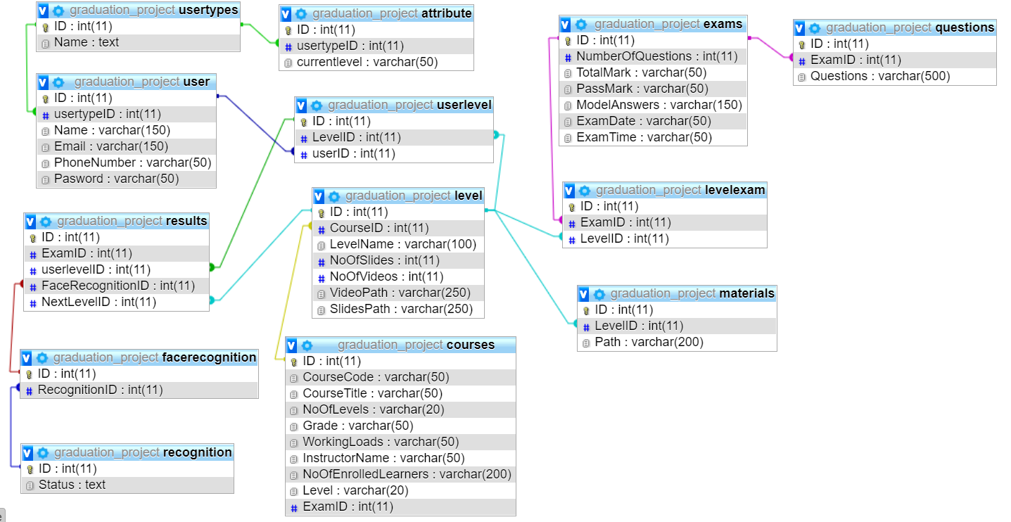
Database Diagram
14

Slide 15
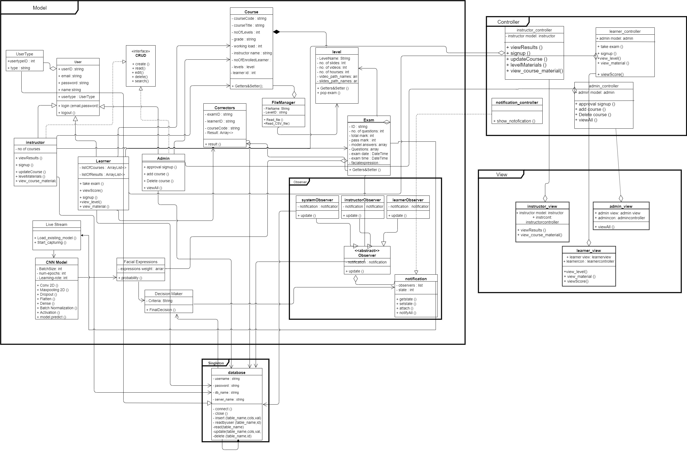
Class Diagram
15

Slide 16
Demo
16

