Slide 1
Detecting Education Level Using Facial Expressions
Presented By:
HabebaElRahman Hesham
Mourad Ahmed Nabawy
Ola Mohamed Safwat
Youssef Mohamed Ahmed
Supervised By:
Dr. Ammar Mohamed
Eng. Haytham Metawea
1

Slide 2
Introduction
The aim of our system is improving the method that detects the educational level by using facial expressions in addition to his answers. Our system will declare which level is possible and accurate for the learner.
2

Slide 3
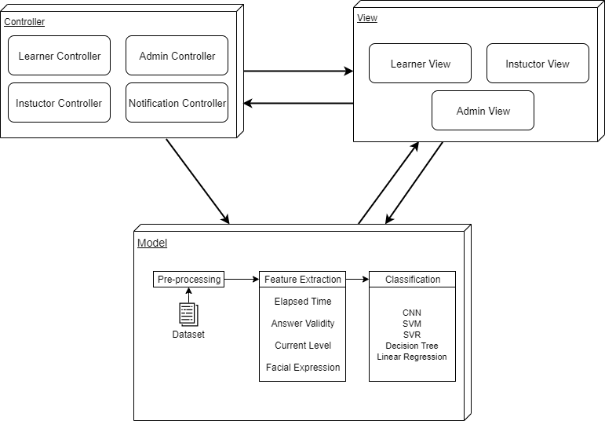
Architecture diagram
3

Slide 4
Sequence Diagram
4

Slide 5
System Overview
5

Slide 6
Activity Diagram
6

Slide 7
Algorithms
SVM | Decision Tree
A support vector machine is a classification algorithm where a set of examples is collected and each one has a known class. The algorithm divides the classes byline and puts each value to his class. The Accuracy of this classifier : 87% That’s our choice ! | The tree contains decision nodes and leaf nodes. The decision nodes are those nodes represent the value of the input variable(x). It has two or more than two branches. The leaf nodes contain the decision or the output variable(y). The decision node that corresponds to the best predictor becomes the topmost node and called the root node. The Accuracy of this classifier : 81%
7

Slide 8
Algorithms
SVR | Linear Regression
It uses the Support Vector Machine(SVM, a classification algorithm) algorithm to predict a continuous variable. While other linear regression models try to minimize the error between the predicted and the actual value, Support Vector Regression tries to fit the best line within a predefined or threshold error value. Mean Squared Error = 0.01798 | Linear regression is a statistical approach for modeling a relationship between input a dependent variable (response) with a given set of independent variables(features) which is output. It’s given us the predict values of the training model. Mean Squared Error = 0.00377
8

Slide 9
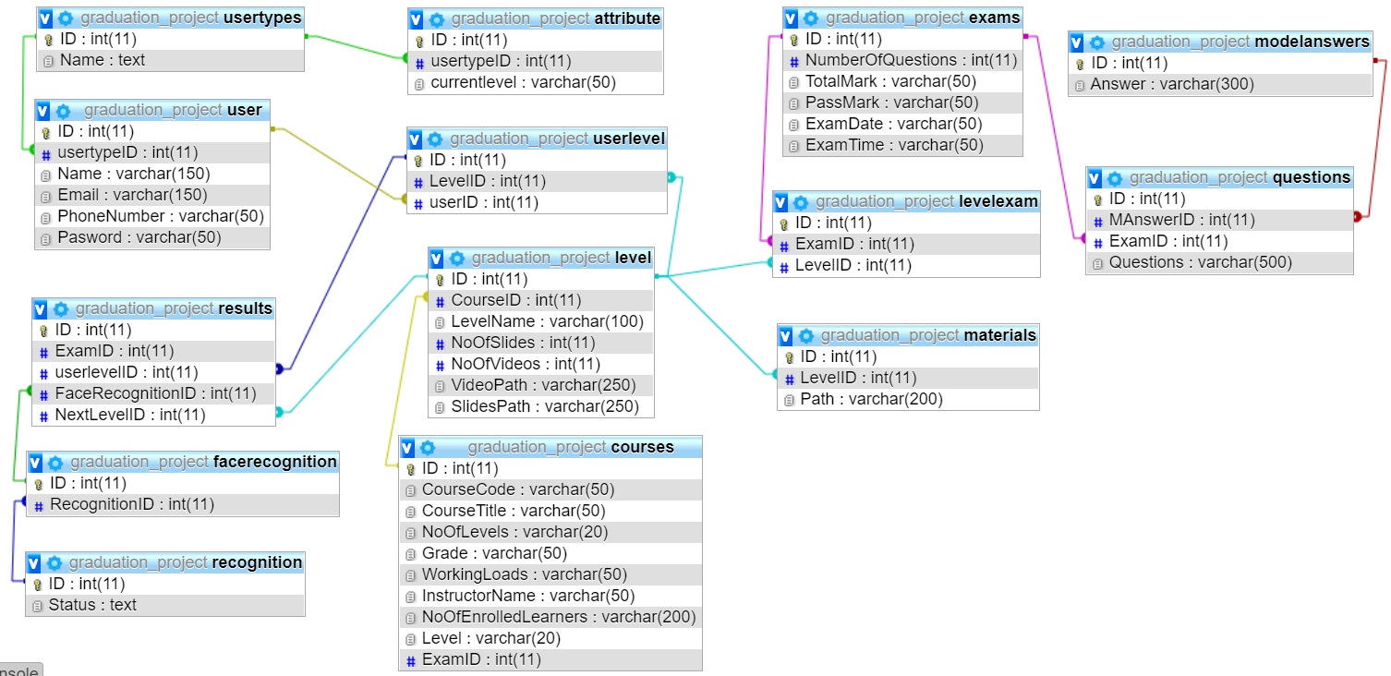
Database Diagram
9

Slide 10
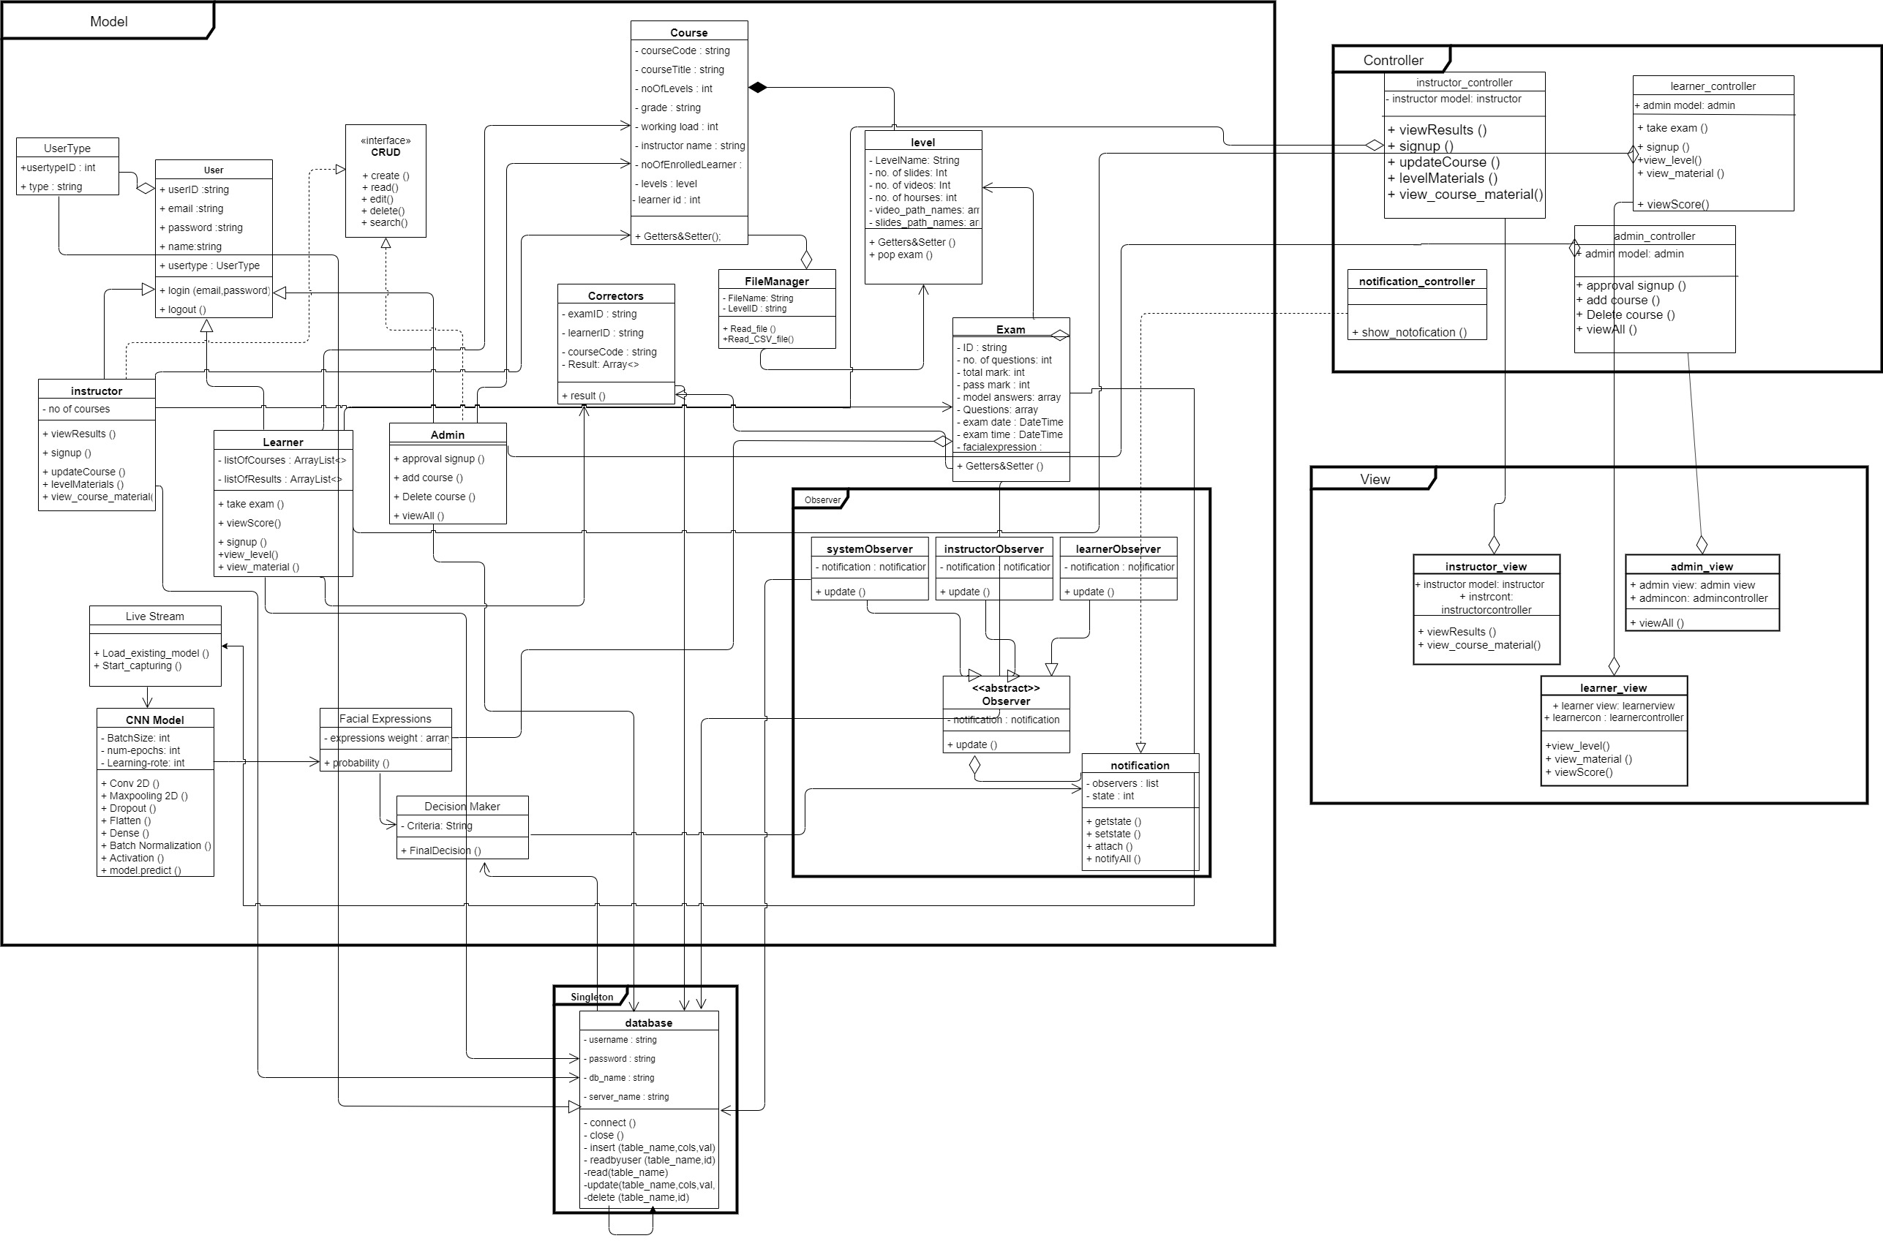
Class Diagram
10

Slide 11
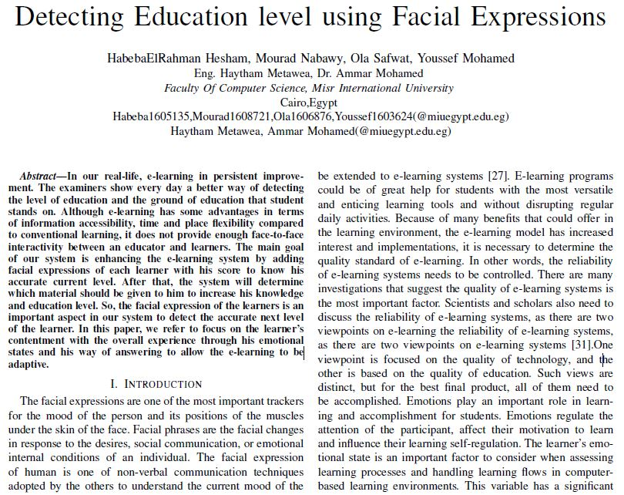
11

Slide 12
Demo
12

