Slide 1

Tourism Management System Using GIS
Case Study Natural Protected Areas in Egypt

Slide 2
Our Team
BY:
Ahmed Waleed – Eyad Fathy
Ahmed Mohamed– Mohanad Magdy
Under Supervision :
Prof. Dr. : Abdel Nasser Zaied
TA : Menna Allah-Hassan

Slide 3

Our objective
Increase the accuracy of Identifying locations suitable to tourists based on Detailed information & Generate RATING to give best decision
1

Slide 4
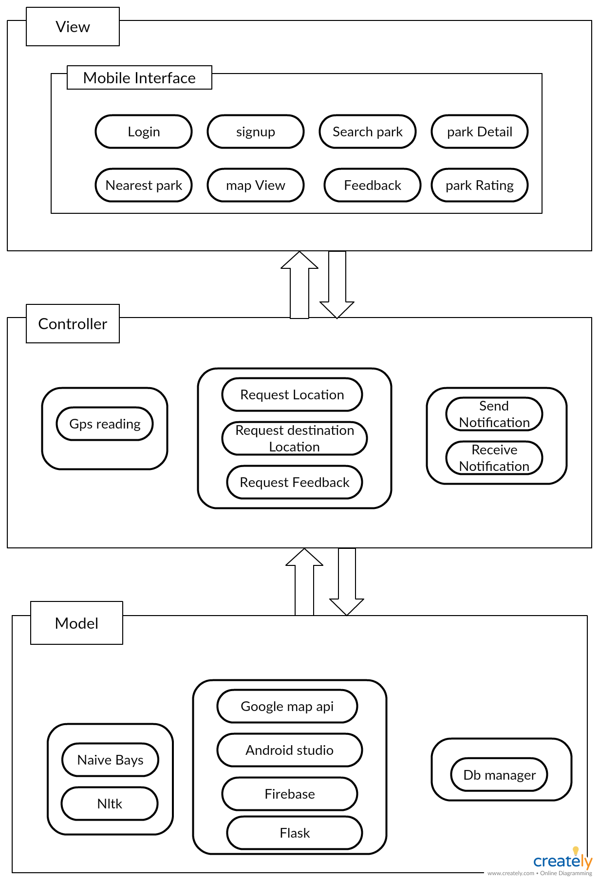
Architecture Diagram
2

Slide 5
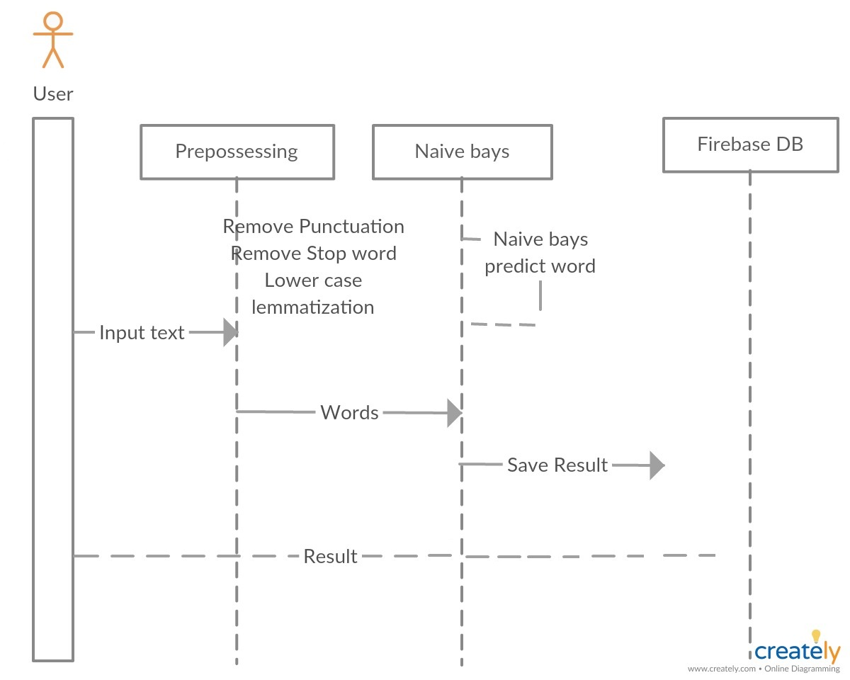
Sequence Digram 1
3

Slide 6
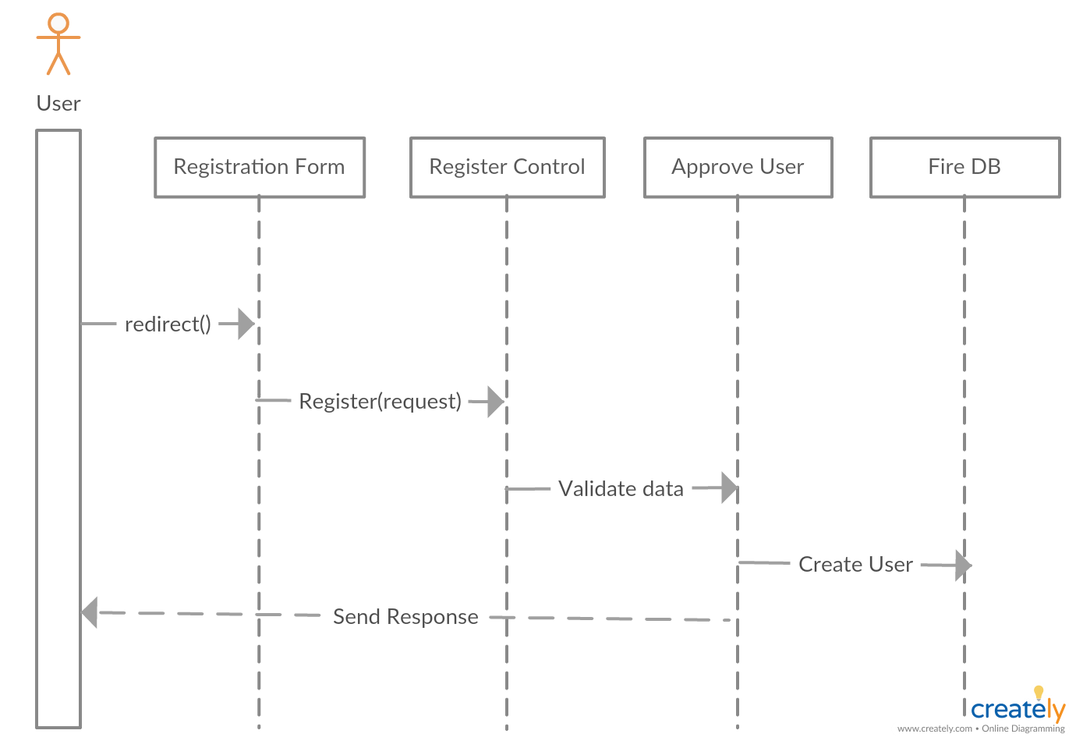
Sequence Digram 2
4

Slide 7
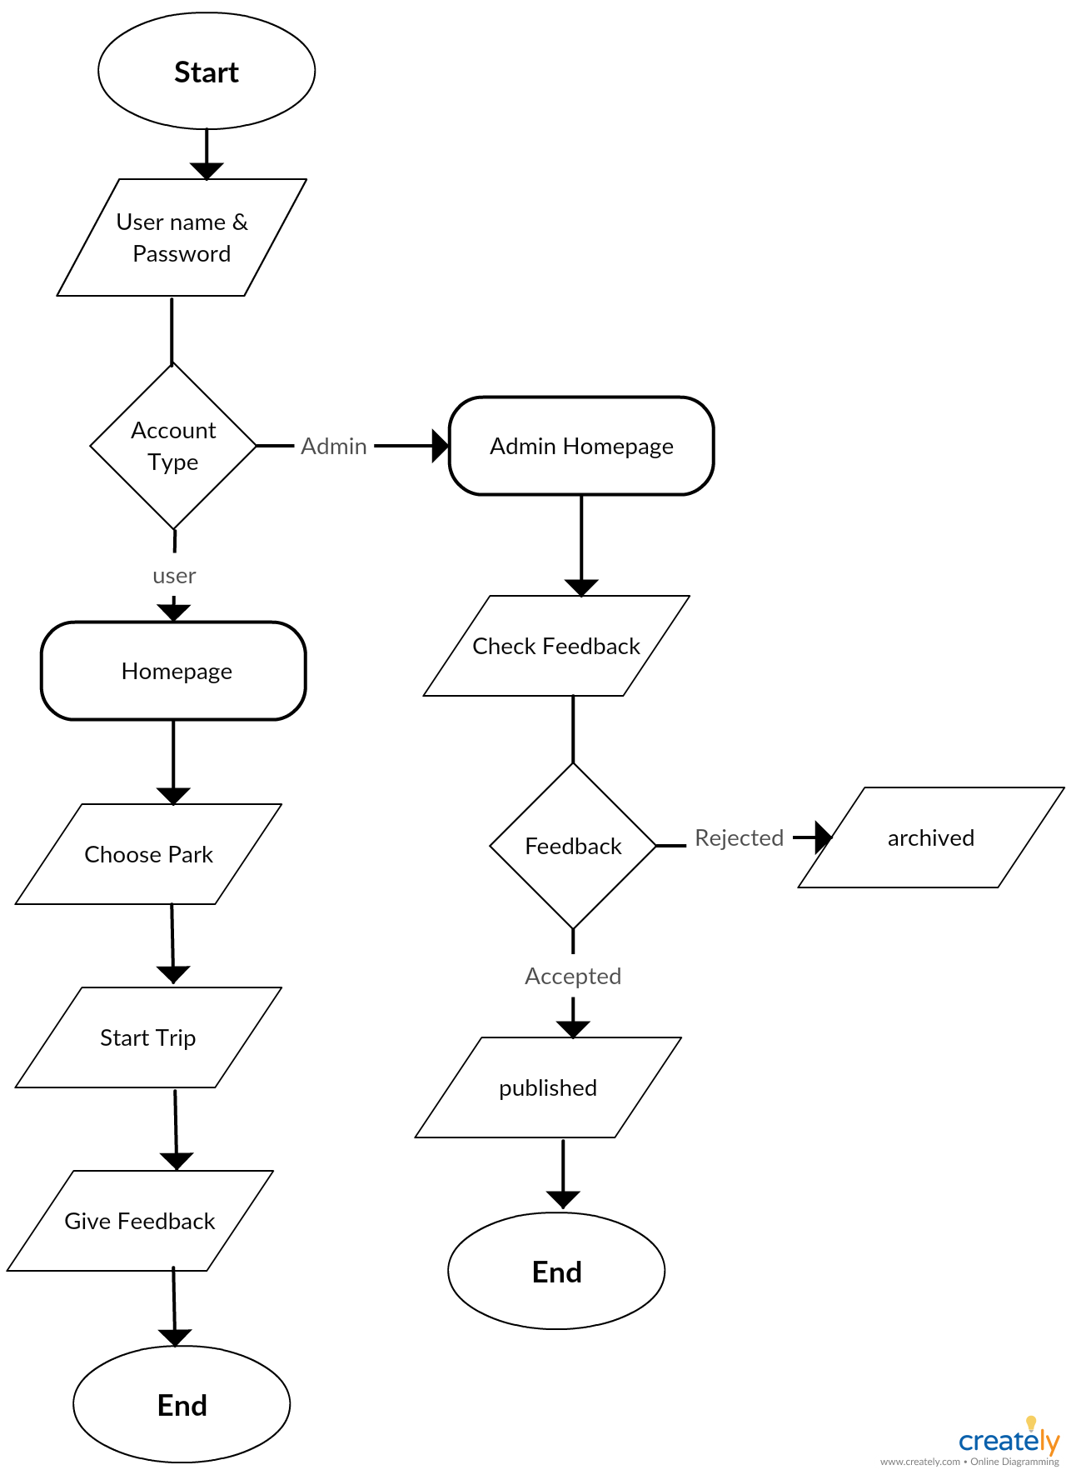
Process Diagram
5

Slide 8
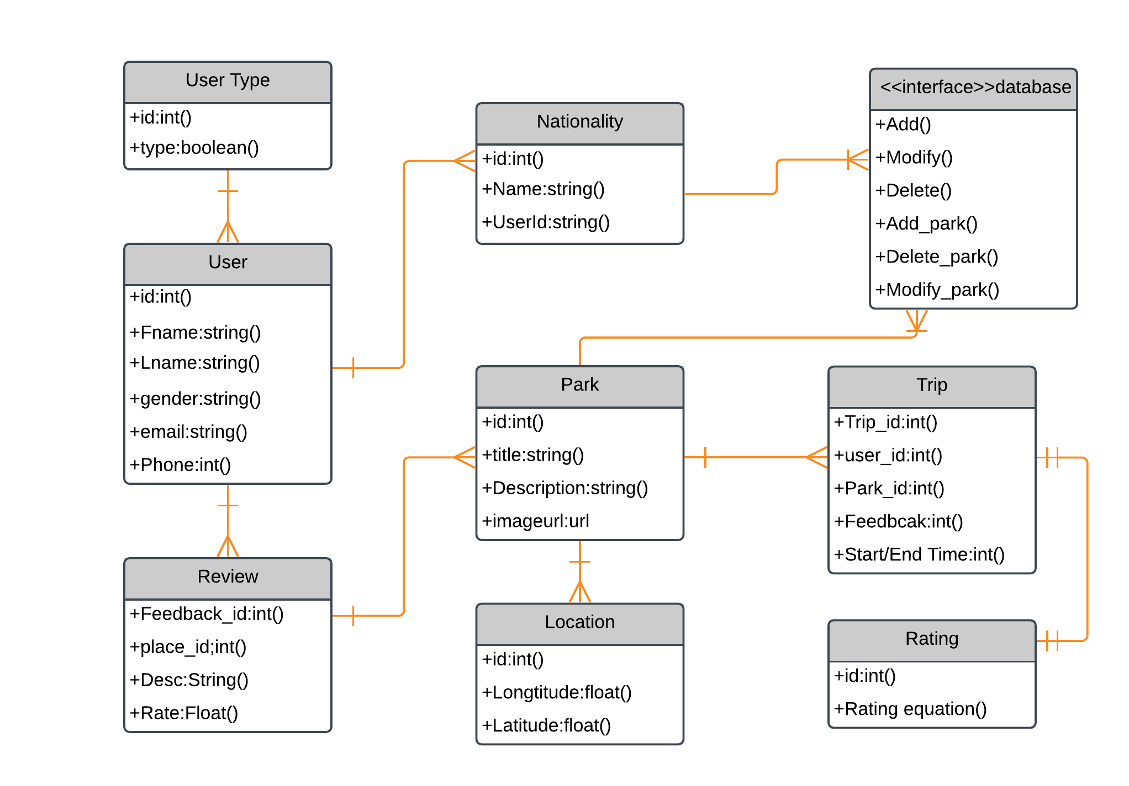
Database
6

Slide 9
Demo
Using Naive Byes Classifier to get accurate review results of tourists(user).
Using Gis by Arcmap Tool to execute Georefrence layer to
7

Slide 10
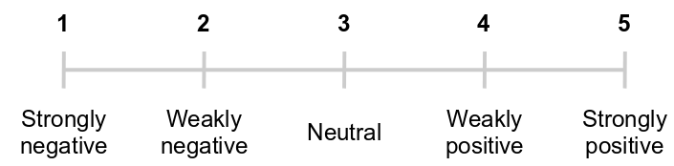
Rating
8

Slide 11
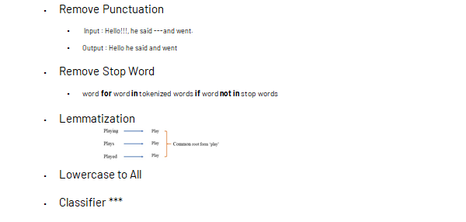
Sentiment analysis
9

Slide 12
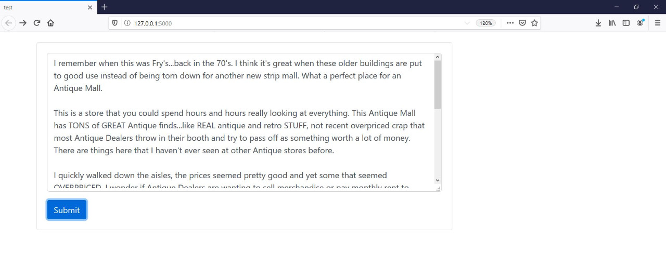
Tourist panel
10

Slide 13
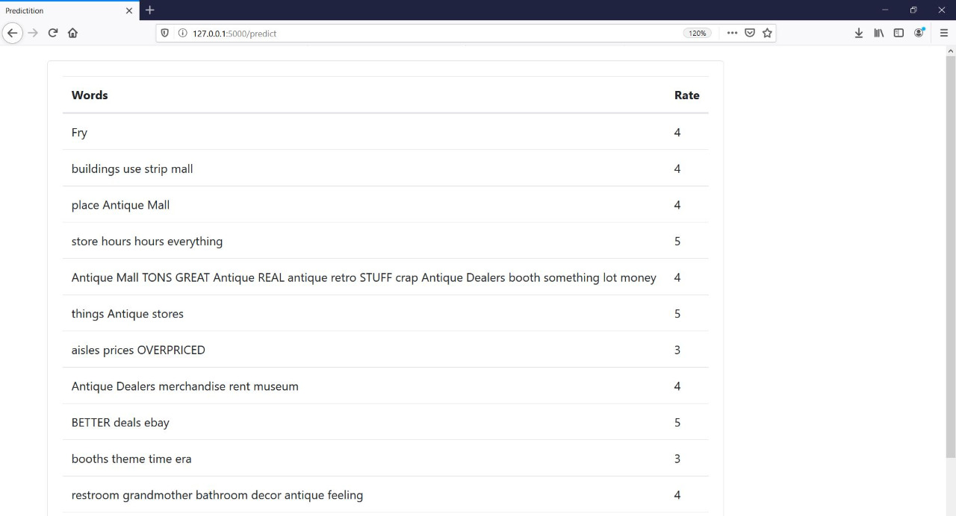
Admin panel
11

Slide 14
Text Classifcation Demo

Slide 15
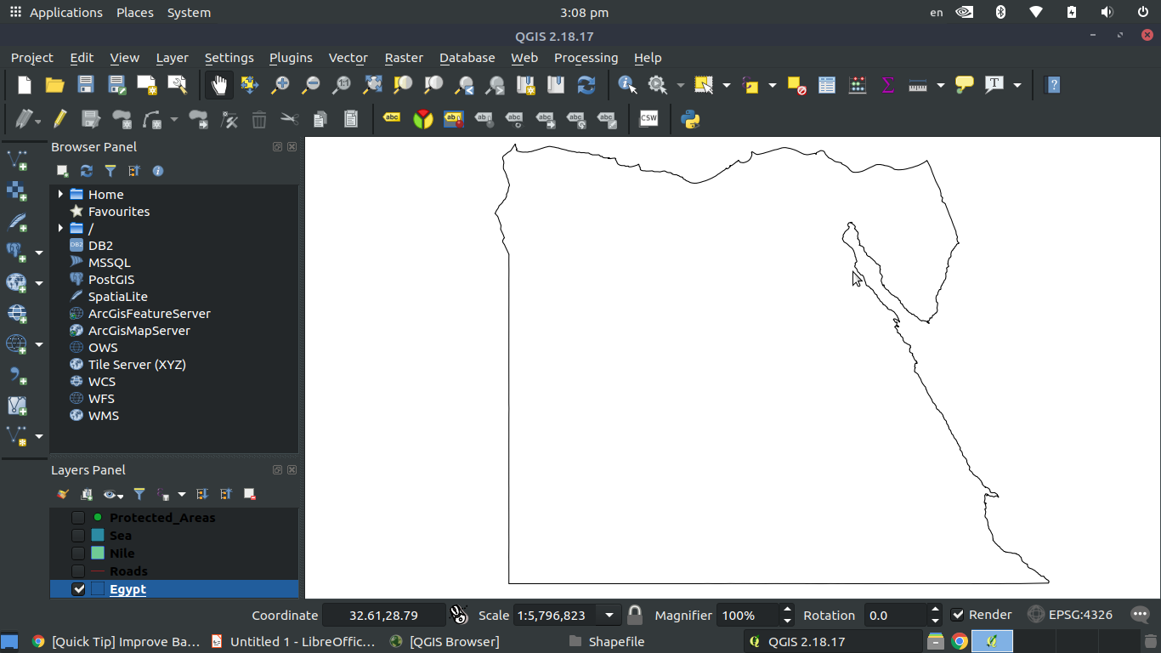
Egypt base map
13

Slide 16
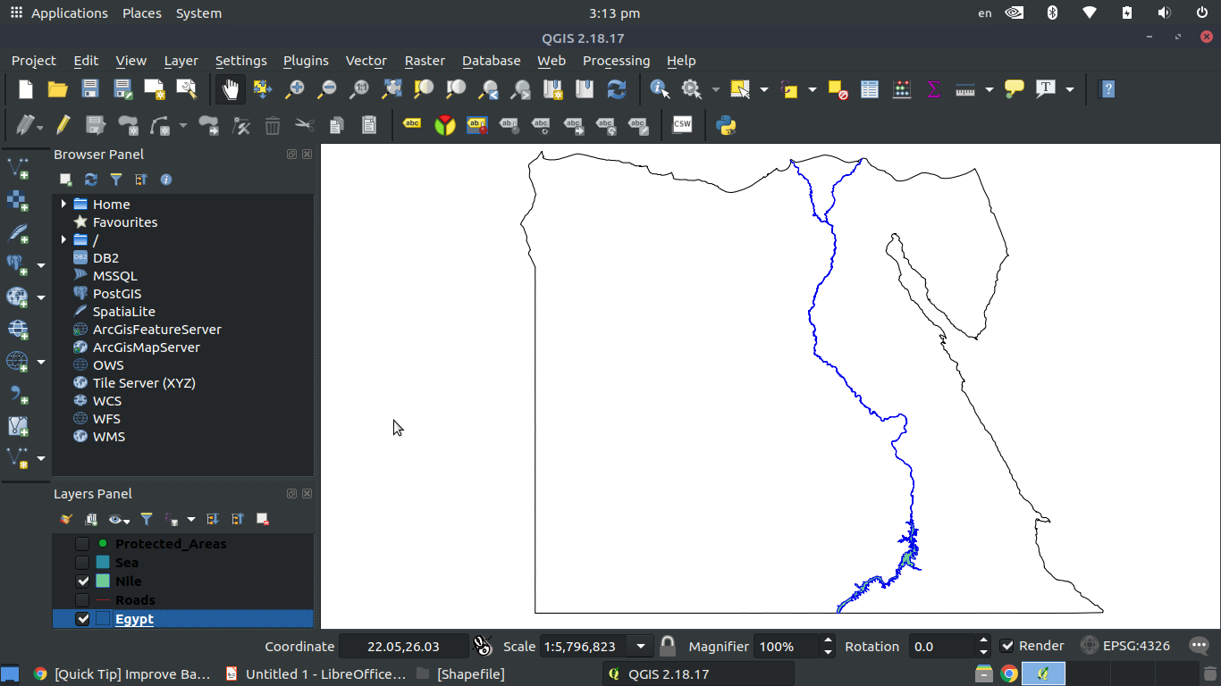
Nile River (2nd Layer)
14

Slide 17
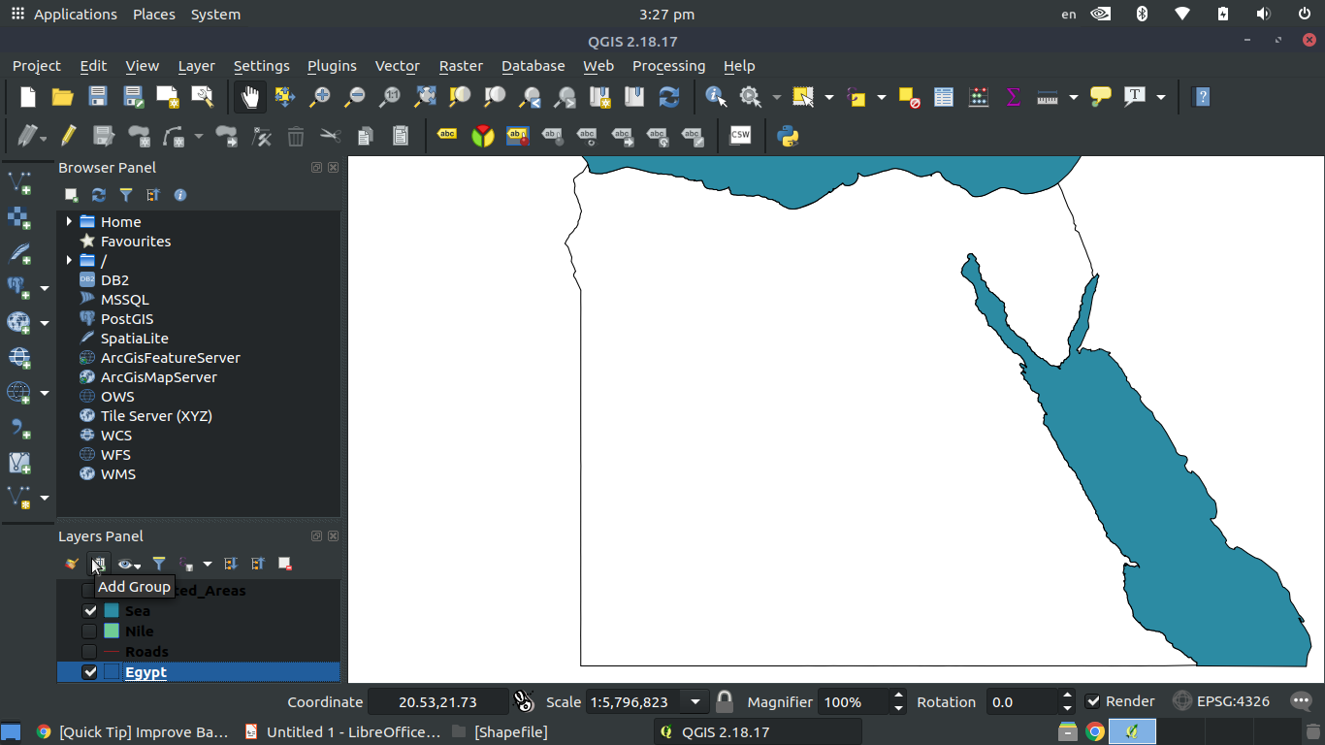
Sea Layer (3nd Layer)
15

Slide 18
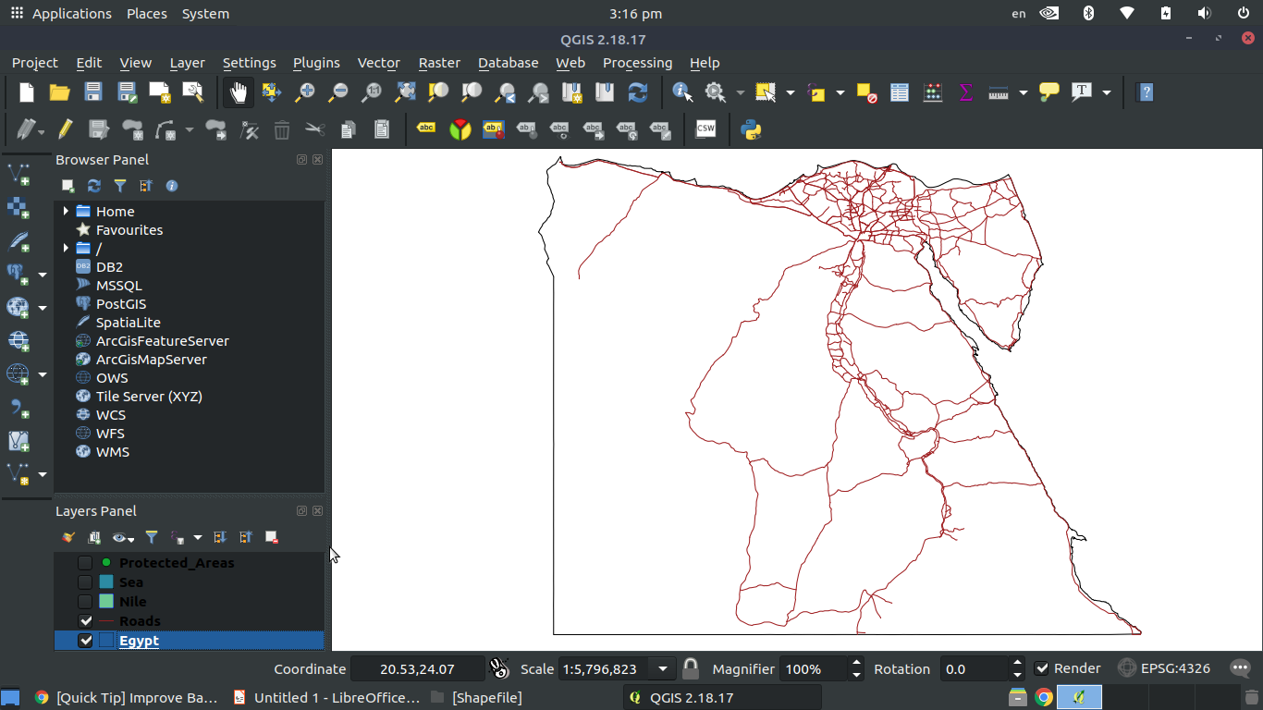
Roads (4nd Layer)
16

Slide 19
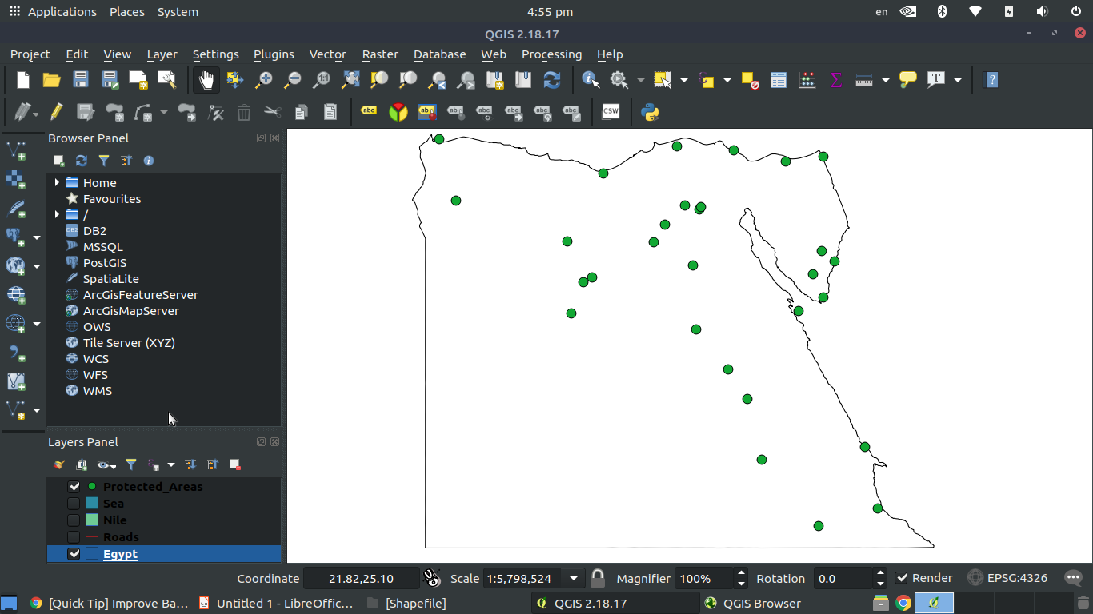
National park (5nd Layer)
17

Slide 20
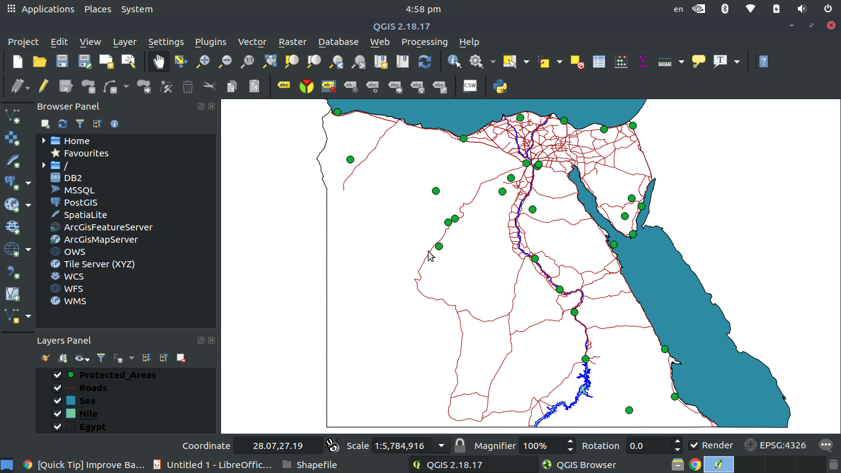
Map
18

Slide 21
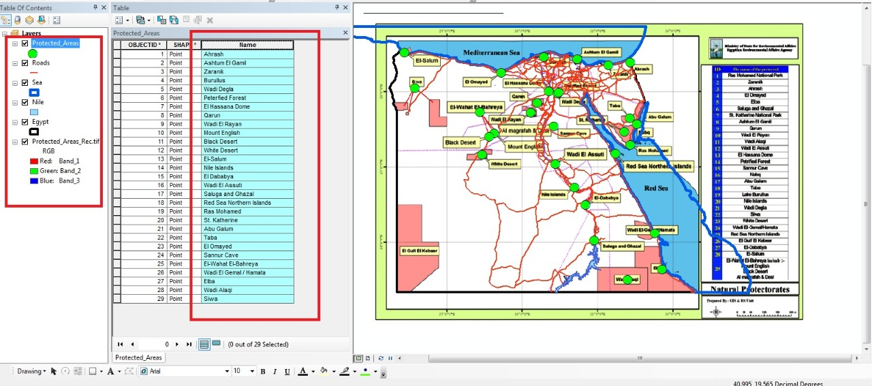
Gis
19

Slide 22
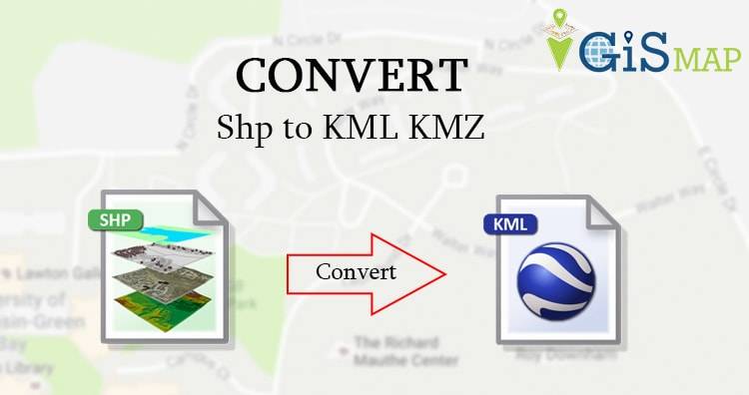
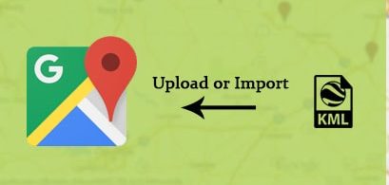
Gis
20

Slide 23
Thank you
20

Slide 24
Appendix
19

Slide 25
Dataset
Dataset Conatins:10,000 Record
Dataset is labeled.
From www.yelp.com
5 classes
What is yelp? (DataSet)
Yelp is a business directory service and crowd-sourced review forum, and a public company of the same name that is headquartered in San Francisco, California. The company develops, hosts, and markets the Yelp.com website and the Yelp mobile app, which publish crowd-sourced reviews about businesses.

