Slide 1
InMovie recommendation
Aly Mekawy, Amr Sherif, Foad Osama, Youssef Roshdy
Supervisor: Dr. Eslam Amer
Teacher Assistant: Eng. Menna Hassan
Date: 16/10/2019

Slide 2
Table of content
Introduction
Related work
Problem statement
System overview diagram
Pre processing
Challenges
Demo
Survey
Info about the client
Appendices

Slide 3
Introduction I
On most video streaming platform, users get their recommended videos based on some algorithms, calculations ,implicit feedbacks ,watch and search behaviors, Also new videos suffer from cold-start problem in which they have no data or reviews, so its harder to deal with

Slide 4
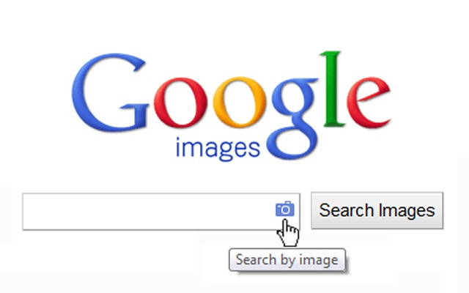
Introduction II
Its like having a google search but not with text or images , but with videos
Imagine inserting a small clip or a scene instead of text
New creative tools for developers, content creators and the possibilities are infinite
As shown here the only technologe available todate is only to search by image

Slide 5
Related work I
By utilizing deep features for video frame representation
For each video, by sampling some of the frames to extract their vision feature and further compute their final signature.
Technically, we extract frame-level features using a state-of-the-art deep model
Based on audio ,text, and vison
Li, Y., Wang, H., Liu, H., & Chen, B. (2017). A study on content-based video recommendation. 2017 IEEE International Conference on Image Processing (ICIP).doi:10.1109/icip.2017.8297150

Slide 6
Related work II
This paper explains how videos are recommended on the biggest video platform , explains what are the problems facing the current algorithm and their way of getting data like candidate generation and data normalization to be applicable for calculation
Covington, P., Adams, J., & Sargin, E. (2016). Deep Neural Networks for YouTube Recommendations. Proceedings of the 10th ACM Conference on Recommender Systems - RecSys ’16.doi:10.1145/2959100.2959190

Slide 7
Related work III
Rapid multimedia growth that continues to raise new challenges in the image processing world, and a reliable system is needed for it.
-Shot Boundary Detection: Modifications done on the algorithm proposed by: Frame Blocking, MI Normalization and Block Weighting.
-Hierarchical Video Summarization: Researchers introduce a static summarization technique.
-Video Retrieval and Indexing: Researchers used two level indexing method. Fuzzy color histogram of each frame is adapted.
-Results achieved: Complete system for shot boundary detection, summarization, indexing and retrieval has been analyzed, experiments done on TRECVID2006 database which includes 7.5 hours news TV broadcasts, performance evaluation shows promising results.
Fuzzy color histogram
Clustering

Slide 8
Problem statement
Enhancing the video recommendation system and the ability to Retrieve highly relevant videos with respect to users input video.

Slide 9
System overview

Slide 10
Pre-Processing
YOLO library takes a part of the frames inserted from the video 5 to 10 % to save processing time and power , usually no filters or enhancements are used as the frame is visible to the algorithm

Slide 11
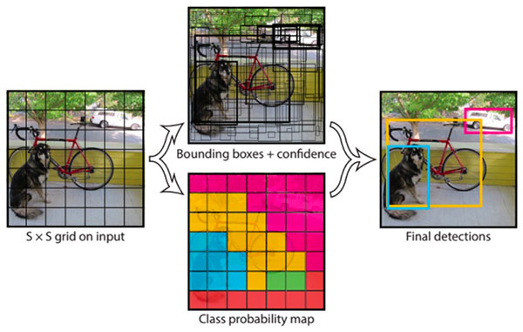
Classification and detection
Use YOLO Library
Automatic Object Detection
Identifying the object features
Object Classification
Compare the object's features with other objects' features already identified
Classify the object with the nearest objects to it in terms of features

Slide 12
Expected results and output
From a scene imported from the user another similar scene is recommended to the user
Getting more personalized results not just based on given values for a video
Enhancing accuracy and user satisfaction

Slide 13
Challenges
Enhance recommendation accuracy
Add video searching feature

Slide 14
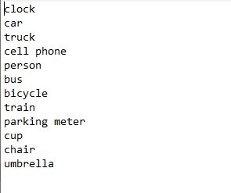
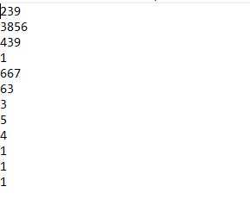
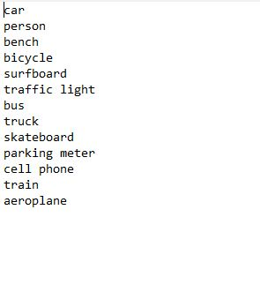
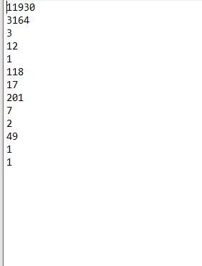
Number of Occurences between two Similar Videos

Slide 15
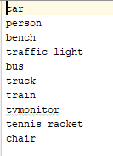
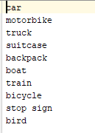
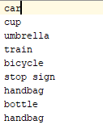
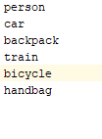
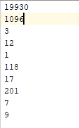
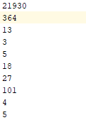
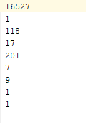
Other videos

Slide 16
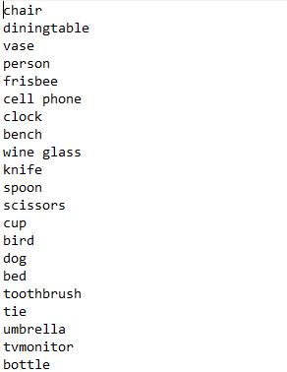
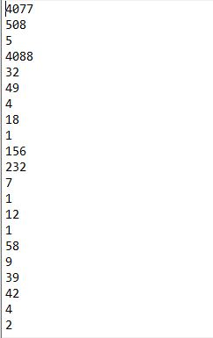
Number of Occurences of a different Video

Slide 17
Getting Similarity
Form this results we conclude that scene 1 is recommended but not scene 2 as the similarity between the input video and scene 1 was higher than scene 2

Slide 18
Unseen Video

Slide 19
Survey
How users are satisfied with current recommendations
Time spent by users per day
Not satisfied
satisfied

Slide 20
Survey
Parents would let their kids watch movies online without companionship

Slide 21
Survey
If a tool for filtering and searching scenes in a video is introduced to the market would you be interested

Slide 22
Info about the client
Watch it is a Egyptian based streaming platform which was founded to make users able to watch their favorite videos

Slide 23
Communication with clients

Slide 24
Any QUESTIONS

Slide 25
THANK YOU !

Slide 26
Appendix
R-CNN and their variants, including the original R-CNN, Fast R- CNN, and Faster R-CNN have a common issue in which they are much slower in terms of processing the data and detecting the object also its not a complete end-to-end object detector.

Slide 27
Appendices
While R-CNNs tend to very accurate, the biggest problem with the R-CNN family of networks is their speed — they were incredibly slow, obtaining only 5 FPS on a GPU
While yolo is slightly less accurate than traditional CNNs, however its much faster as it can obtain up to 45 FPS on a GPU in real time

