Slide 1
Workout assessment
By Abdelrahman Tarek,
Poula moheb,
Ahmed Mohamed and
Ahmed Nagy
Supervised by Dr. Diaa
and Eng.Hager Sobeh

Slide 2
Introduction 1/2
“Introduces an efficient approach to recognize and correct the motion in workout movements using machine learning and image processing techniques, and the medical perspective of injuries ”

Slide 3
Introduction 2/2

Slide 4
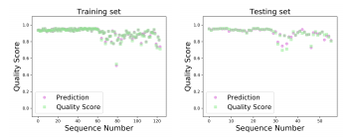
Similar System 1/3
A deep learning Framework for assessing physical rehabilitation Exercises.
CNN, RNN, HNN are repurposed for the task and are validated by using a dataset of rehabilitation exercises.

Slide 5
Similar system 2/3
Fitness training driven by image target detection technology
Uses FCM clustering algorithm as the fuzzy image background segmentation algorithm
Uses k-means clustering analysis propose a composite classification feature tracking

Slide 6
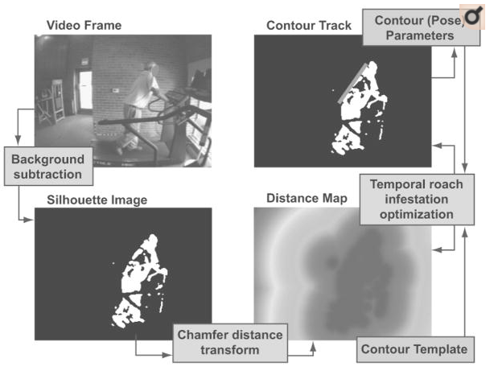
Similar system 3/3
Tracking Exercise Motions of Older Adults Using Contours
Human Silhouette Extraction for detection
Swarm intelligence methods to track the location of the spine and shoulders during exercises

Slide 7
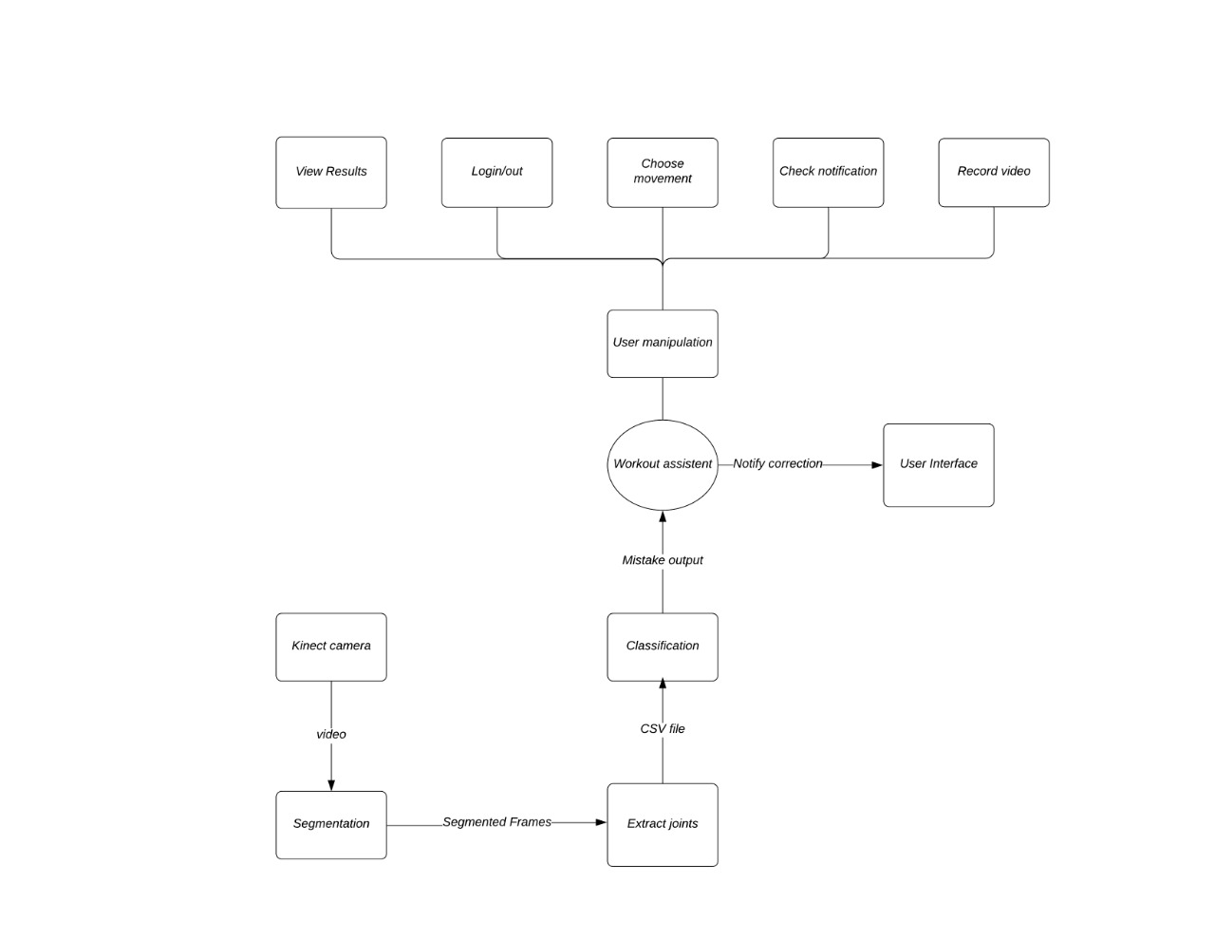
Context Diagram

Slide 8
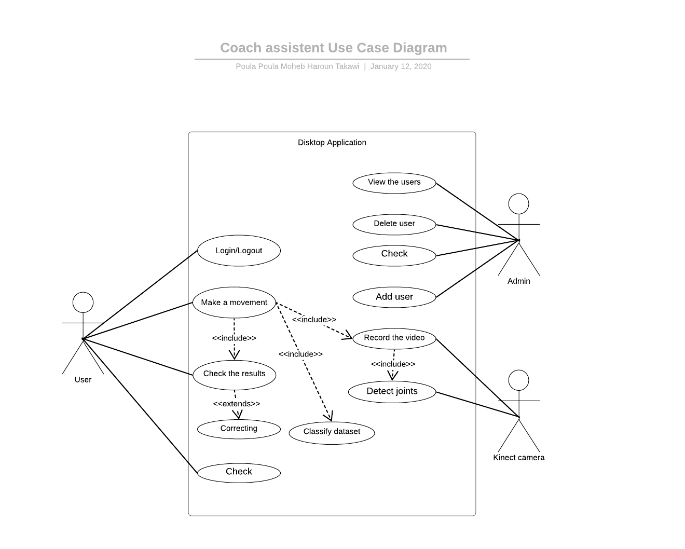
Use-Case Diagram

Slide 9
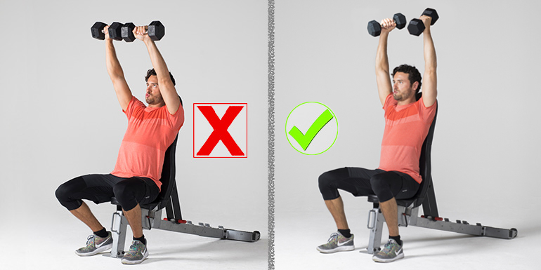
Problem statement
Tracking of body motion in real time using deep learning and detection of improper movements in workout technique

Slide 10
Functional Requirements
Choose movement | the user will choose one the movements start capturing the video to be sent to the classifier to be analyzed . Priority :10/10
Extract joints | take the features from the video as points in 3D X,Y,Z Priority:10/10
Classification | KNN,SVM and FAST-DTW are used to train and calculate accuracy Priority:10/10

Slide 11
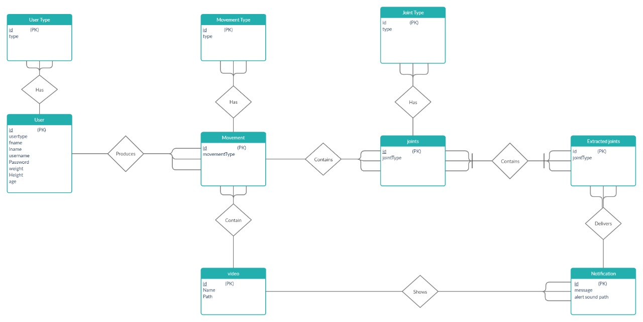
Database

Slide 12
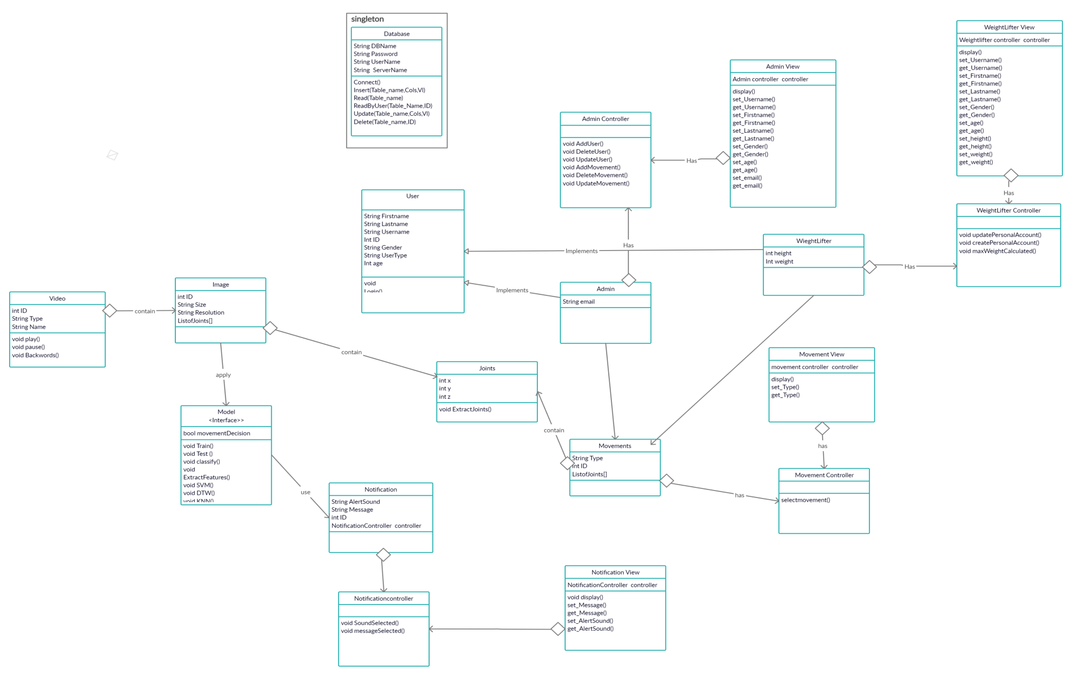
Class Diagram

Slide 13
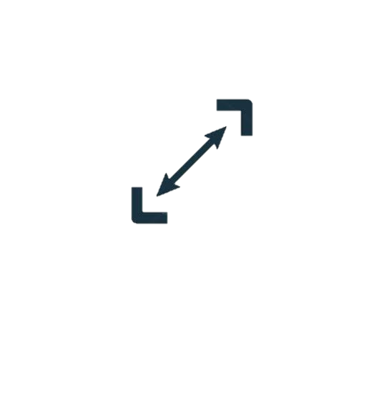
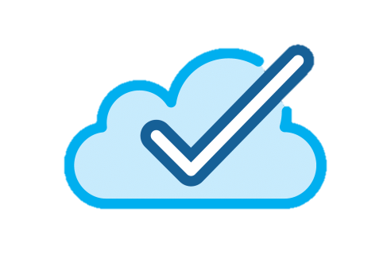
Non-Functional Requirements
Security | Maintainability | Portability | Scalability | Availability
Each user details and information should be saved securely, correct video of movements should be accessed by the owner of it only | The system could be improved by adding more movements to the application and enhancing the accuracy over time , and adding more features as in-body data calculations and other features as more details about the injuries that my happen . | The system could be accessed by any user or trainee who has user id on any platform. | The system is able to change in size or scale . | The system would be available to the user, all the time and work perfectly without any drop down and undergoing repair action will be done whenever it is needed

Slide 14
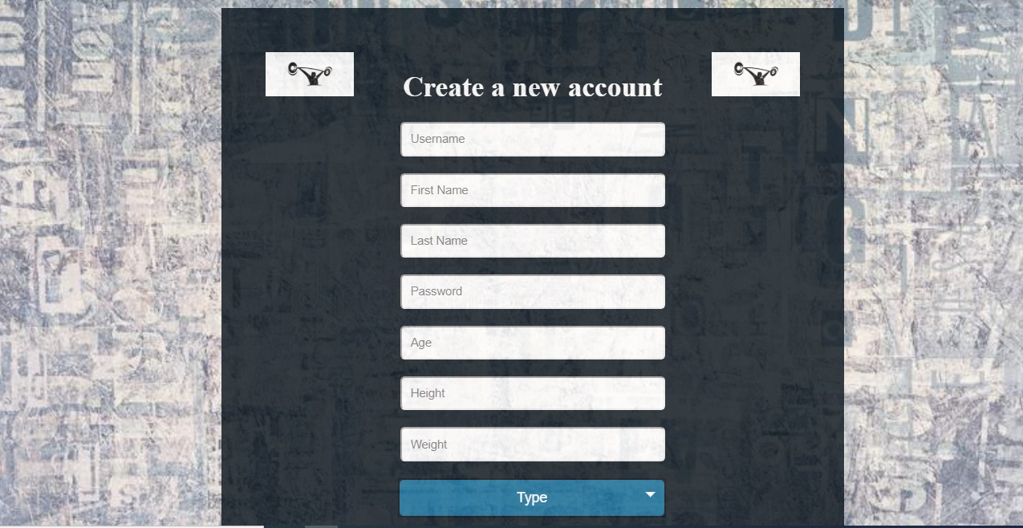
GUI for user data and in-body

Slide 15
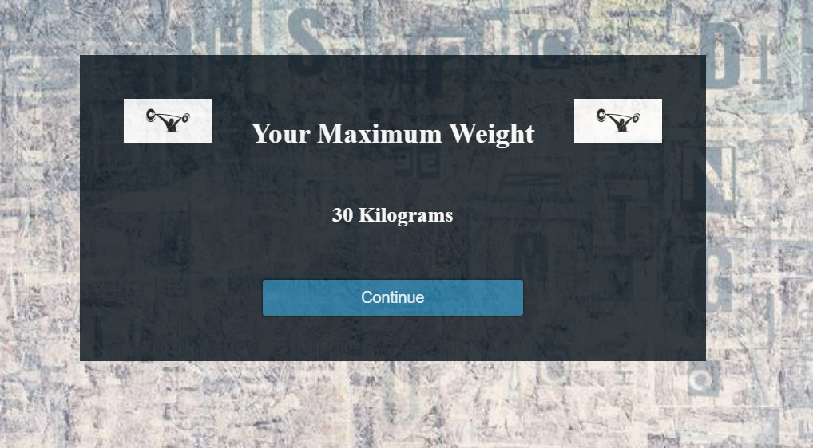
Calculation of the max-weight the user can lift to avoid injury

Slide 16
GUI for choosing video

Slide 17
Any question??!

Slide 18
Thank you

