Slide 1

Detecting Education Level Using Facial Expressions in E-learning Systems
Presented By:
Mourad Ahmed Nabawy
HabebaElRahman Hesham
Ola Mohamed Safwat
Youssef Mohamed Ahmed
Supervised By:
Dr. Ammar Mohamed
Eng. Haytham Metawie

Slide 2
Agenda
Introduction.
Problem Definition
Objective
Related Work
System Overview
Methodology
Dataset Description
Experimental Results
Our Contribution
Achievements
Demo
Appendix
2

Slide 3
Introduction
In our real-life, e-learning is improving and shows more. The examiners show every day a better way of detecting the level of education and the ground of education that student stands on. Although e-learning has some advantages in terms of information accessibility, time and place flexibility compared to in-person learning, it does not provide enough face-to-face interactivity between the educator and the learners.
3

Slide 4
Problem Definition
The environment of e-learning may be exposed a problem such as showing accurate decisions in upgrading or downgrading the learner in his learning process.
4

Slide 5

Objective
The aim of our system is improving the method that detects the educational level by using facial expressions in addition to his answers. Our system will declare which level is possible and accurate for the learner.
5

Slide 6
Related Work
Java Tutoring System with Facial and Text Emotion Recognition.
(Ramon Zatarain Cabada, October 2015)
Contribution:
Teaching JAVA, which can recognize the user's emotional state through facial expressions and textual dialogues.
Features: (Emotions : Facial and Text) , Validity Ratio and Time as Features
Classifiers: ASEM
Results: 80% as accuracy.
Challenges: The Accuracy
6

Slide 7
Related Work Cont.
Student Emotion Recognition System (SERS) for e-learning improvement based on learner concentration metric.
(Krithika L.B, June 2016)
Contribution:
- They detect concentration level recognized throw courses.
Features: Head and eye position.
Classifiers: Viola Jones, Neural Network.
Results: 89% as accuracy.
Challenges: Detecting emotional states
7

Slide 8
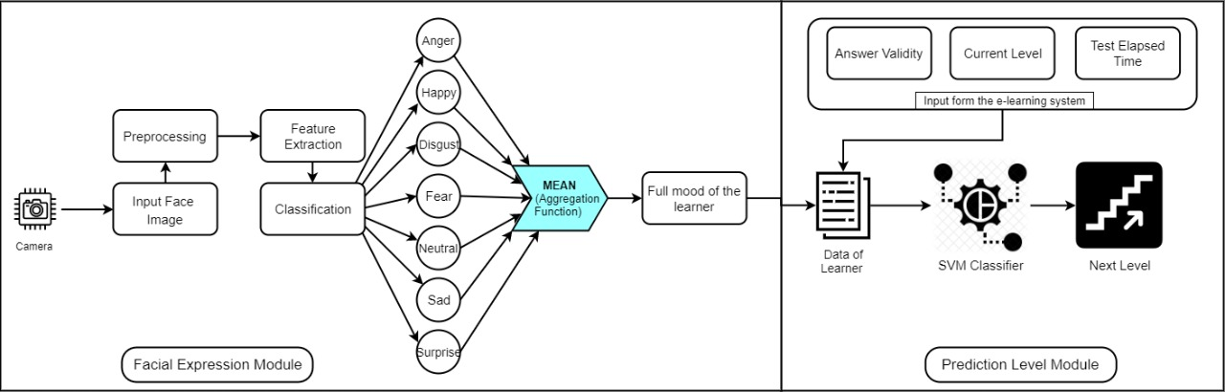
System Overview 1/3
Login
start exam
8

Slide 9
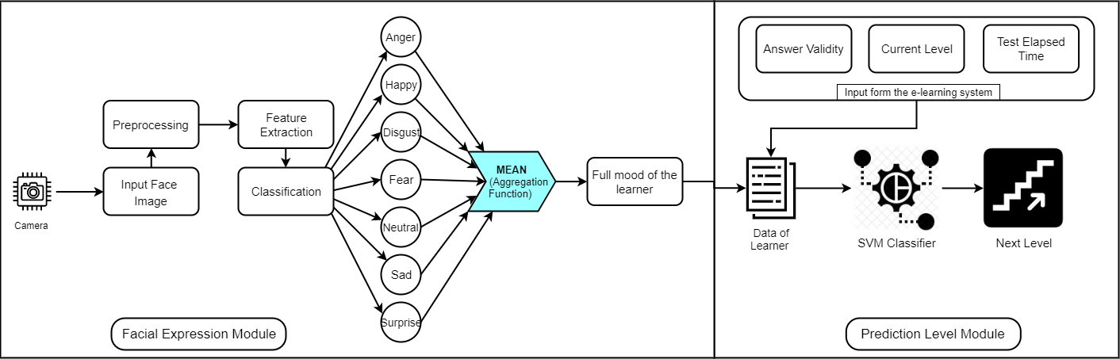
System Overview 2/3
- Facial Expression Module
9

Slide 10
System Overview 3/3
- Prediction Level Module
10

Slide 11
Methodology
11

Slide 12
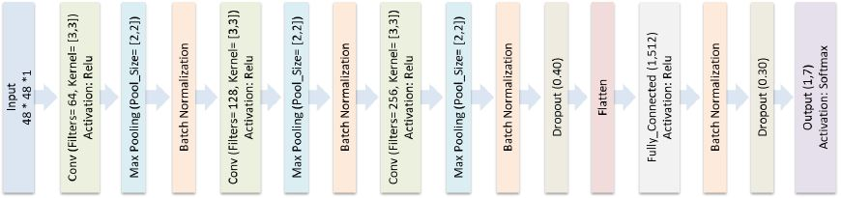
Algorithms
CNN
12

Slide 13
Algorithms
SVM
A support vector machine is a classification algorithm where a set of examples is collected and each one has a known class. The algorithm divides the classes byline and puts each value to his class.
13

Slide 14
Dataset Description
We used two datasets in our system works on it. First dataset is an available online dataset called FER2013 is the one that our system used on implementing our system. Our system used these dataset because of:
Challenging dataset with interesting research area.
35887 images with different classes of facial expressions as shown in this figure.
7 classes of facial expressions.
14

Slide 15
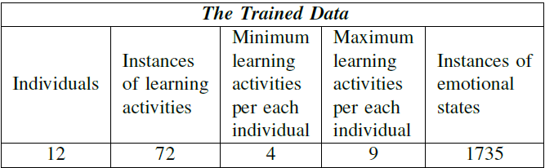
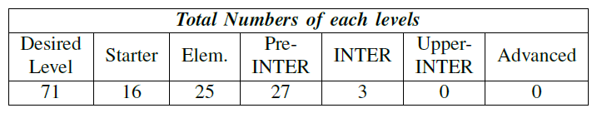
Dataset Description
The second dataset that our system used is called MeanOfEmotionalStates-DesiredLearningLevels and is formed of 1753 instance data of different emotional states of several learners of different skills.
The data contains 6 different levels of difficulties called Starter, Elementary, Pre-intermediate, Intermediate, Upper-intermediate, and Advanced with corresponding ranges [0, 0.15], [0.15, 0.35], [0.35, 0.55], [0.55, 0.75], [0.75, 0.95], [0.95, 1]. Table I summarizes the dataset.
This dataset contains in general 71 records of learning levels and contains features including Answer Validity, Test Elapsed Time, Seven Facial Expressions, Current Level, and labeled with Desired Level. The labeled class is an unbalanced distributed of Desired Level which has 6 different levels of difficulties it was continuous values then we used the discretization method to manipulate those values with interval numerical ranges, also removed from the dataset the unused features.
15

Slide 16
Experimental Results
16

Slide 17
Experiment 1: Comparing between CK+ and FER2013
17

Slide 18
Experiment 2: Testing Classifiers in terms of accuracy
The SVM classifier achieved the highest percentage in accuracy.
18

Slide 19
Our Contribution
Detecting the facial expressions of learner by capturing many emotions through exam and make on it aggregation functions (Mean).
Using SVM by training it on a specific data set for detecting the education level throw features as elapsed time , current level and validity ratio.
19

Slide 20
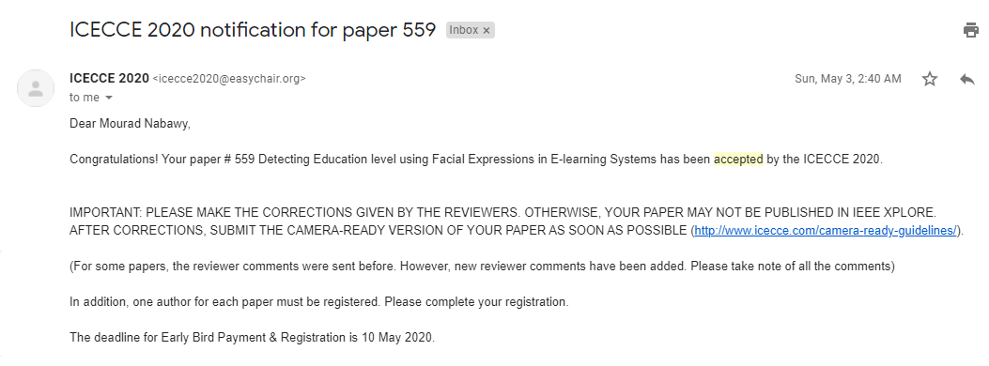
Scientific Contribution
Published a paper in (ICECCE) Proc. of the 2nd International Conference on Electrical, Communication and Computer Engineering 12-13 June 2020, Istanbul, Turkey.
20

Slide 21

DEMO
21

Slide 22
Any Questions ??
22

Slide 23
Appendix
23

Slide 24
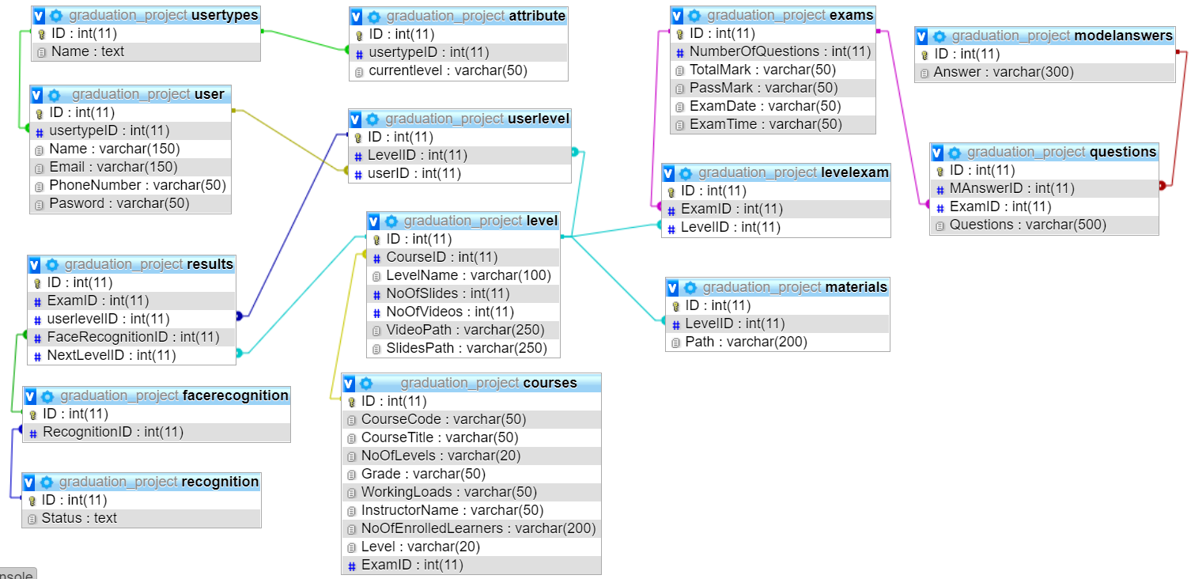
Database Diagram
24

Slide 25
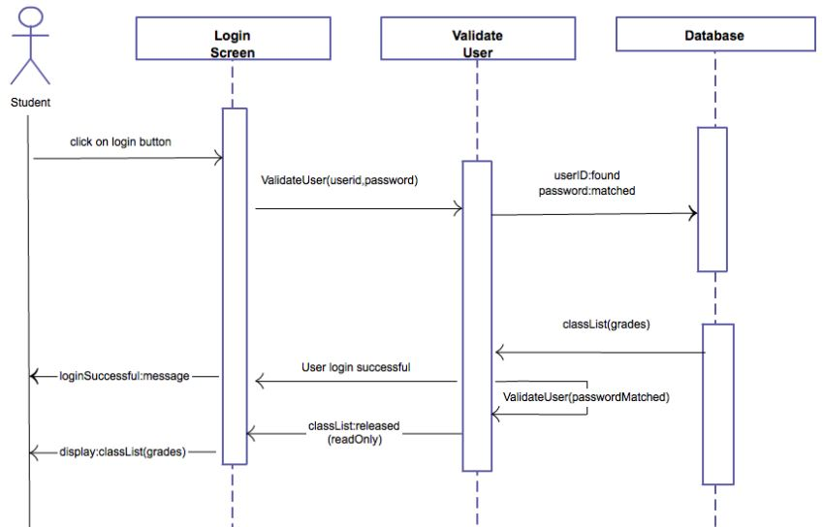
Sequence Diagram
25

Slide 26
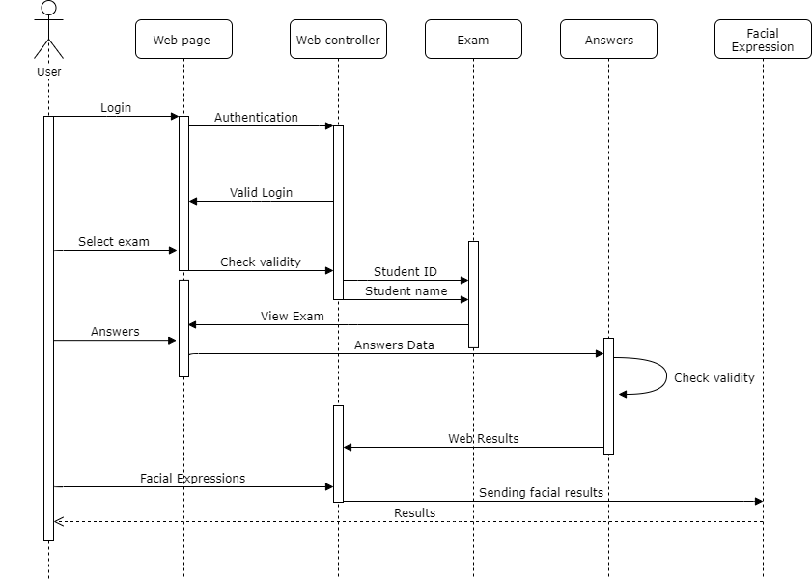
26

Slide 27
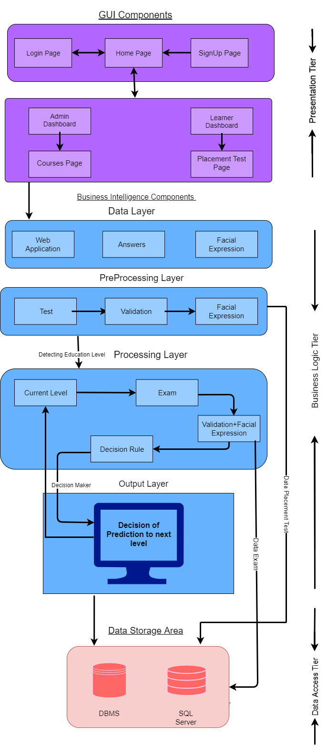
Block Diagram
27

Slide 28
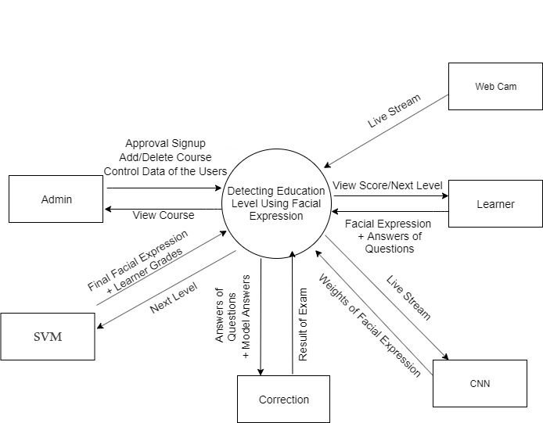
Context Diagram
28

Slide 29
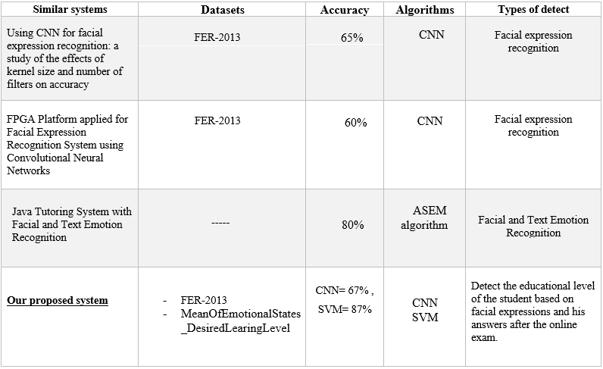
Comparison with Proposed Project
29

Slide 30
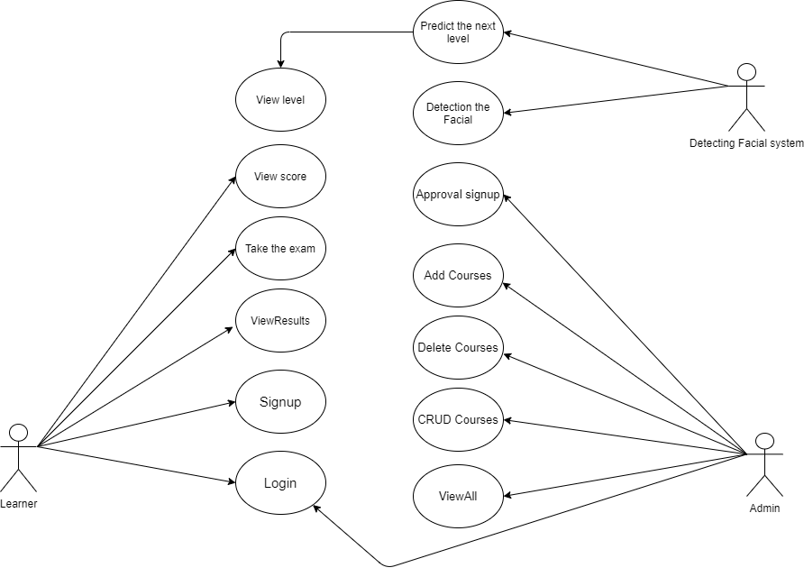
Use Case Diagram
30

Slide 31
Future Work
We would like to improve the system in the future by:
•Capturing one facial expression per question not during the whole evaluation.
•Adding more records of the learner’s features in the dataset to enhance the classification accuracy.
•Putting hints for the learner if the question is hard for him to increase learner knowledge.
31

Slide 32






Tools
32

Slide 33
THANK YOU
33

