Slide 1
Tourism Management System Using GIS Case Study Natural Protected Areas in Egypt
1

Slide 2
Introduction
2
The success of any tourism business is determined by tourism planning
It provide strategic opportunities and powerful tools for economic growth

Slide 3
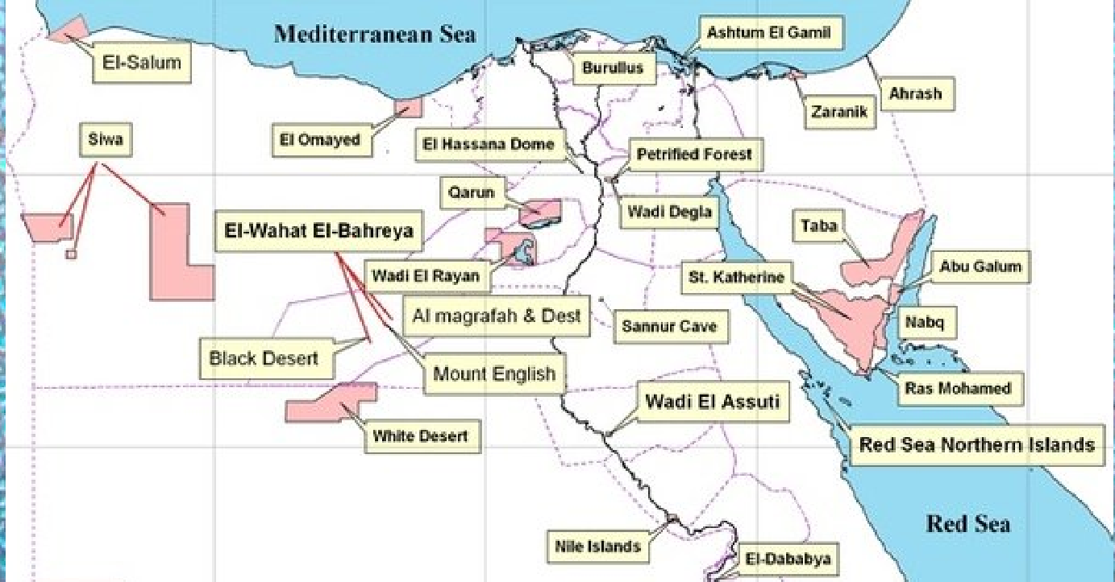
3
Natural Protected Areas in Egypt
Egypt has more than 30 Natural park which is may be unknown inside and outside of Egypt !!

Slide 4
Related Work 1 Opinion Mining and Summarization of Hotel Reviews
4
● Important and useful information can be extracted from reviews.
● Reviews about hotel are retrieved from review websites such as:
www.tripadvisor.com .
● Review text is classified as Positive & negative using machine learning classifiers
● Used classifier: Naive Bayes , SVM , and Decision Tree for review text.
Vijay B. Raut , D.D. Londhe “Opinion Mining and Summarization of Hotel Reviews”. 2014 Sixth International Conference on Computational Intelligence and Communication Networks.

Slide 5
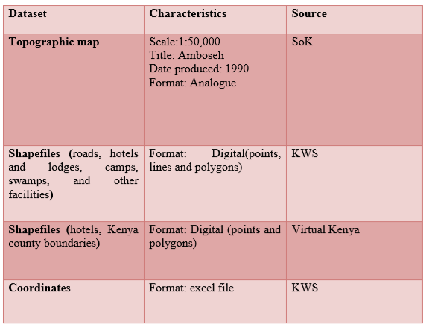
Related Work 2 (2/2)
5
ROLE OF GEOINFORMATION IN ENHANCING TOURISM IN NATIONAL PARKS
An attribute table was created to link the data with their characteristics in order to provide more information for analysis.
Challenges:
1)lack of information, statistics
2)Data acquisition is time
consuming and costly.
J. Mwenda, Mr. Mutero and Mr. Hongo (2008). “ROLE OF GEOINFORMATION IN ENHANCING TOURISM IN NATIONAL PARKS CASE STUDY: AMBOSELI NATIONAL PARK”. Department of Geospatial and Space Technology 2008.

Slide 6
Related Work 3
6
6
Importance of sentences is decided based on linguistic features of sentences
Sentiment analysis of Movie Reviews
Example of Reviews on a novel:
Naive Bayes Classifier and Support Vector Machine(SVM) for comparing the results with their model and classifier
Pankaj Gupta, Ritu Tiwari and Nirmal Robert ‘Sentiment Analysis and Text Summarization of Online Reviews: A Survey’. International Conference on Communication and Signal Processing, April 6-8, 2016, India.

Slide 7
Problem Statement
7
• Increase the accuracy of Identifying locations suitable to tourists based on Detailed information & Generate RATING to give best decision.

Slide 8
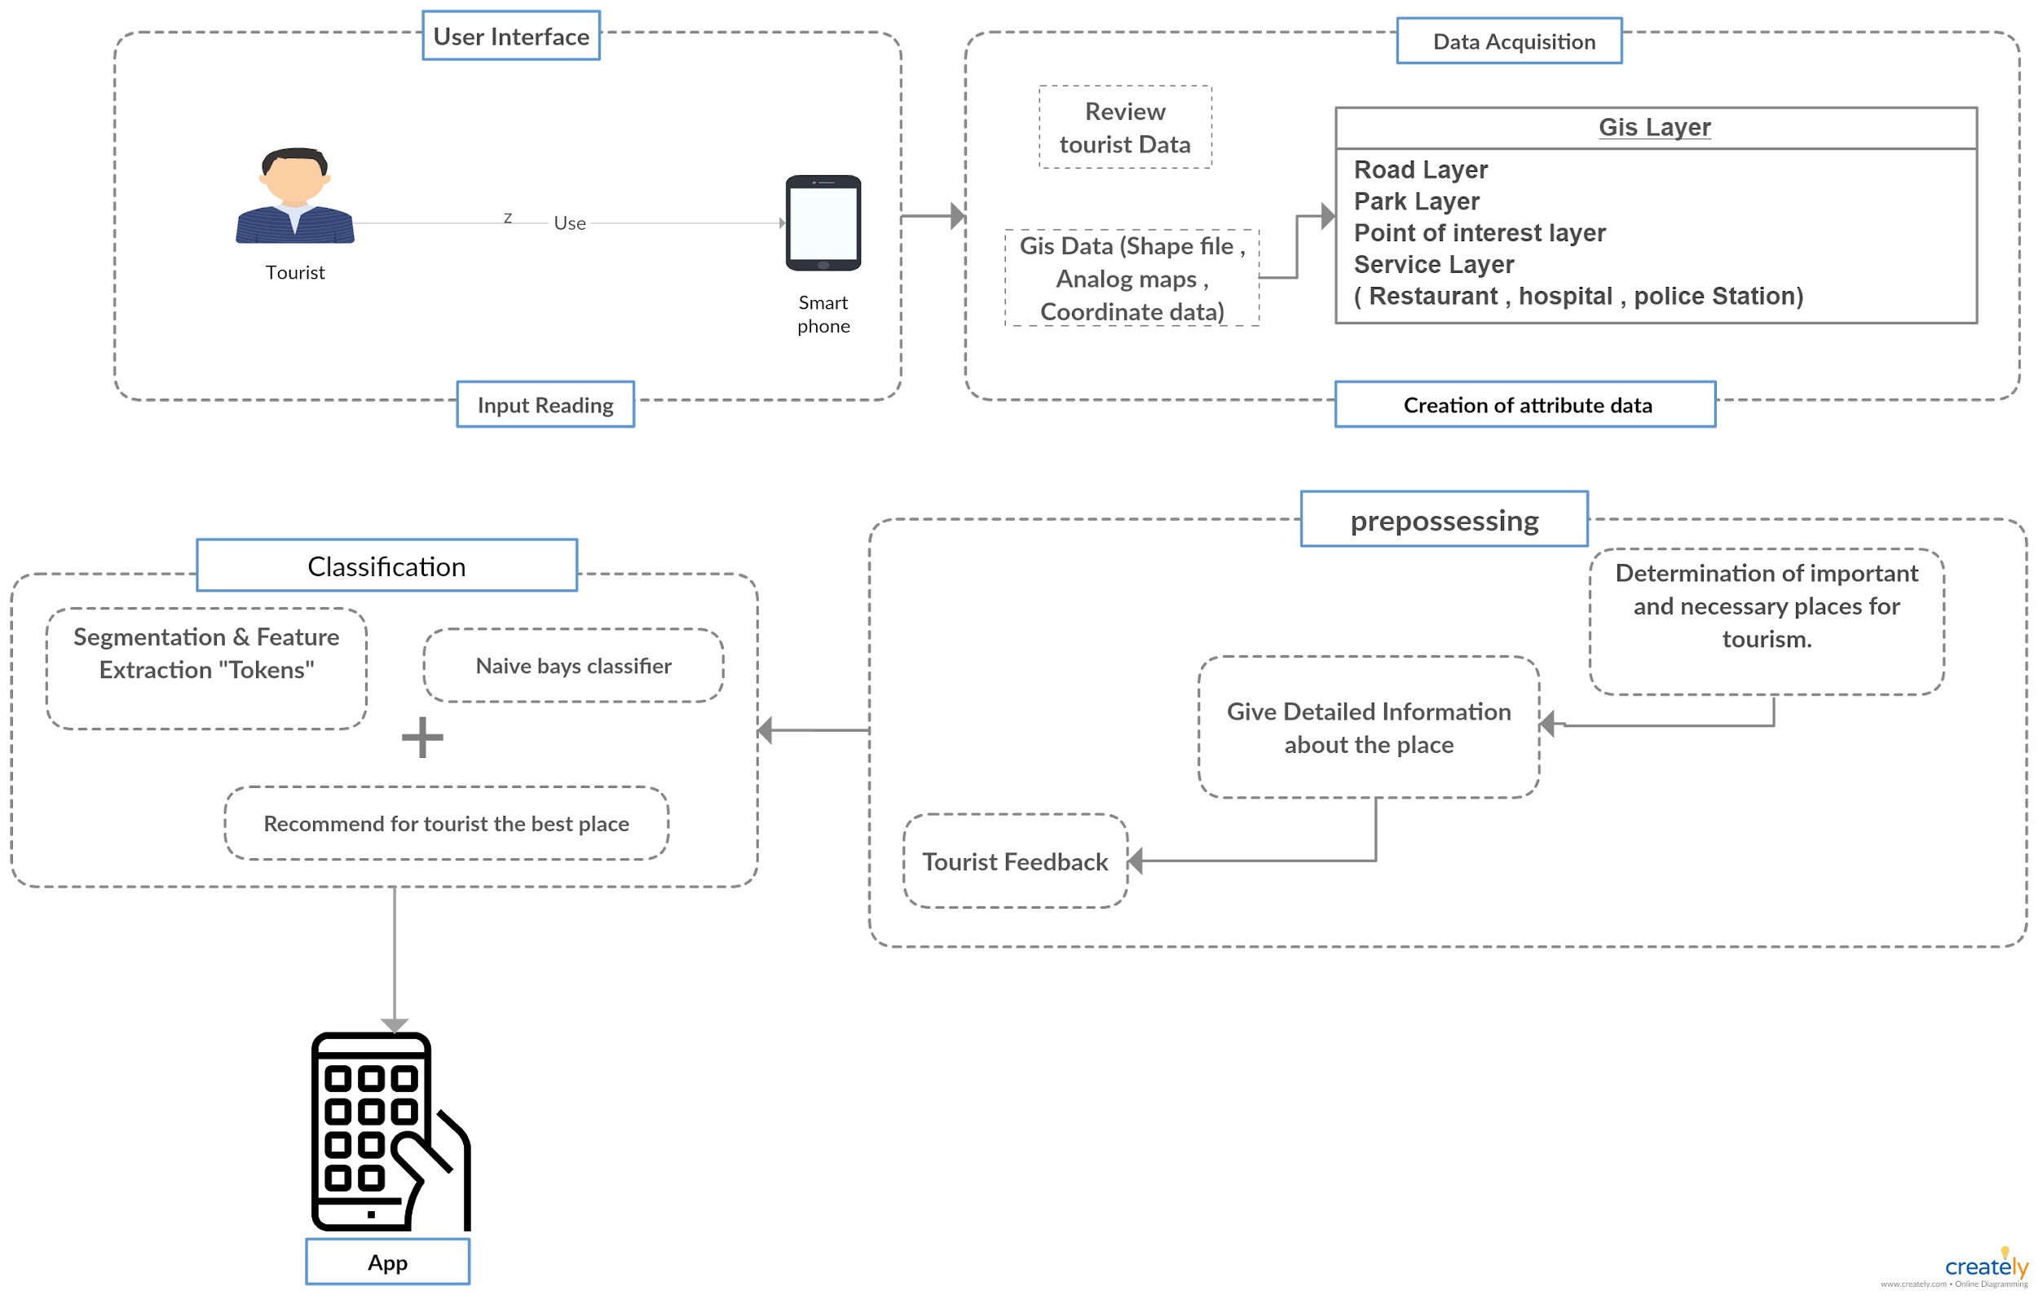
System overview
8

Slide 9
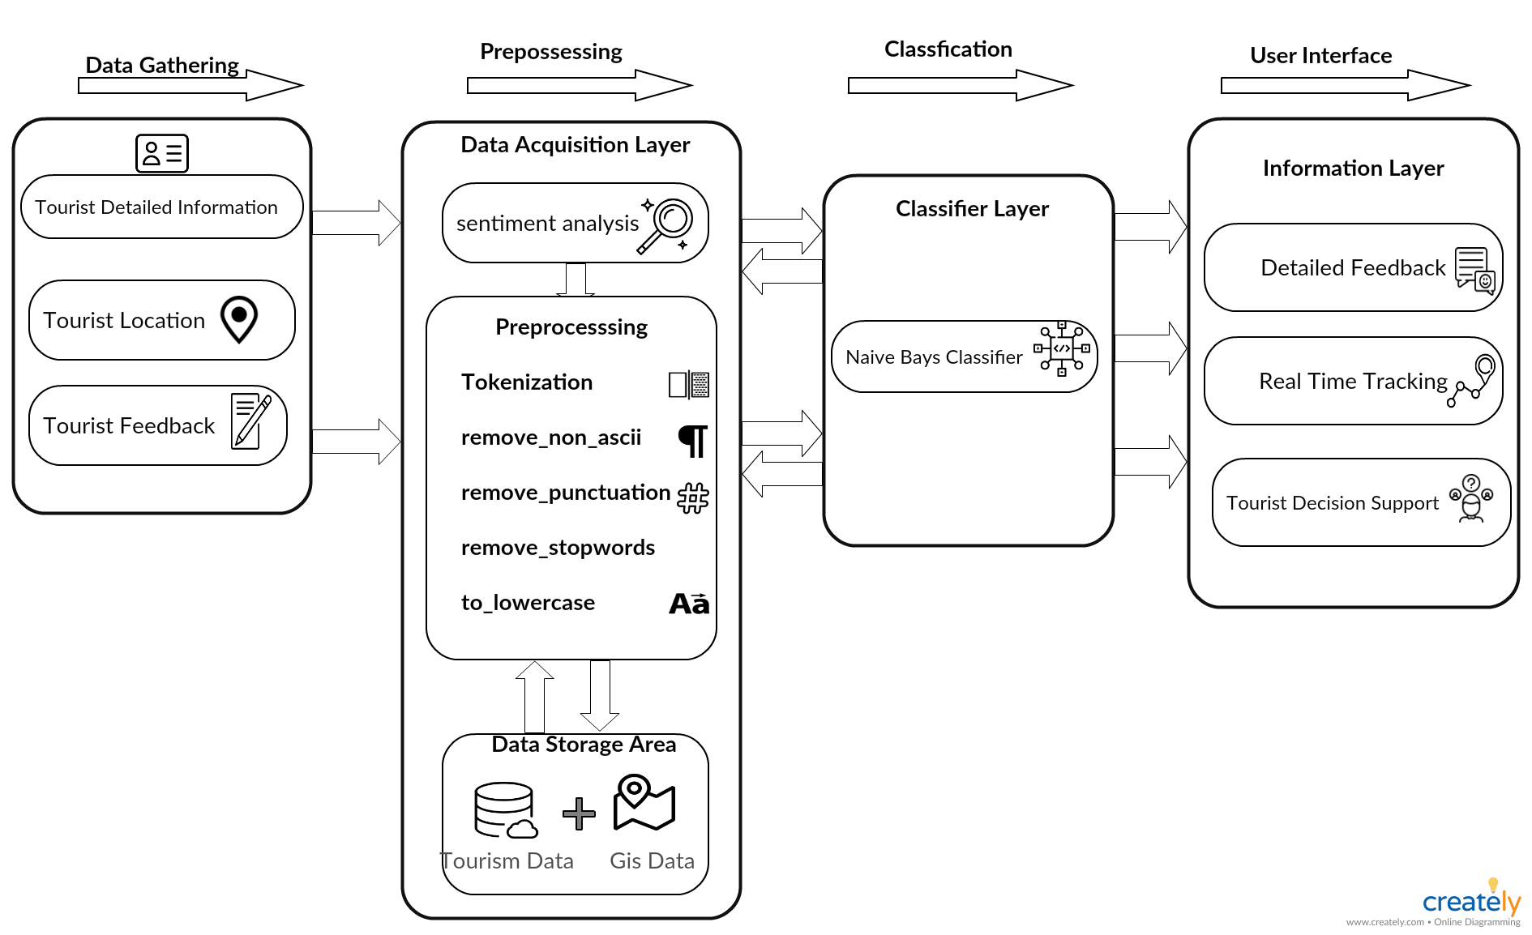
Block Diagram
9

Slide 10
10
Our Project
Using Naive Byes Classifier & NLP to get accurate review results of tourists(user).
Using Gis by Arcmap Tool to execute Georefrence layer
9

Slide 11
11
Sentiment analysis for text Classifier
12

Slide 12
12
Rating
10

Slide 13
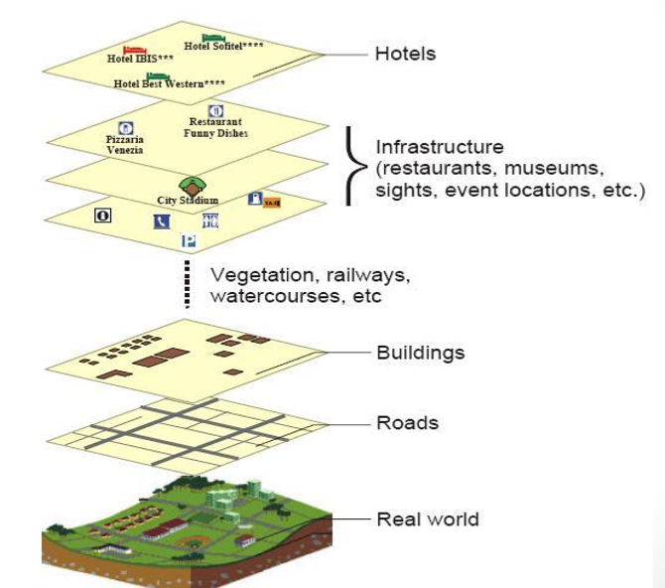
GIS Tourism Example
13

Slide 14
14
GIS Dataset
11

Slide 15
15
Egypt base map
14

Slide 16
16
Nile River (2nd Layer)
15

Slide 17
17
Sea Layer (3nd Layer)

Slide 18
18
Roads (4nd Layer)
17

Slide 19
19
National park
18

Slide 20
20
Full Map

Slide 21
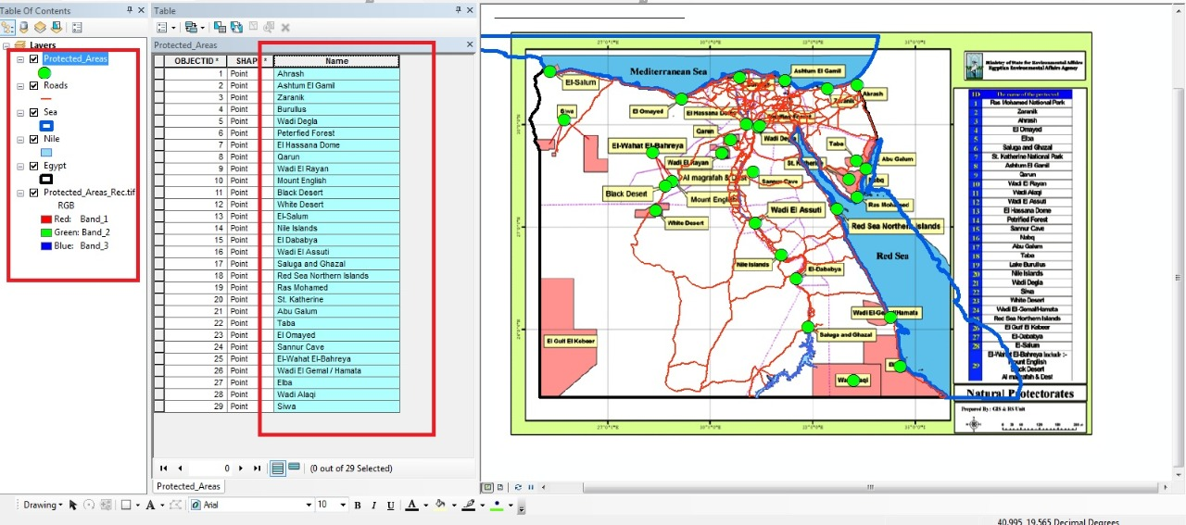
Arc GIS used to process GIS Data set
21
19

Slide 22
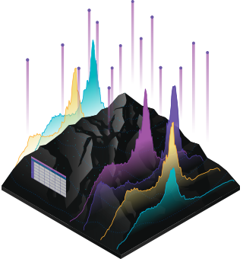
How It Work
22
Maps
Are the geographic container for the data layers that embedded in apps,
Data
includes imagery, features, and basemaps linked to spreadsheets and tables.
Apps
Apps work everywhere

Slide 23
Demo
23

Slide 24
THANK YOU
24

Slide 25
Appendix
25

Slide 26
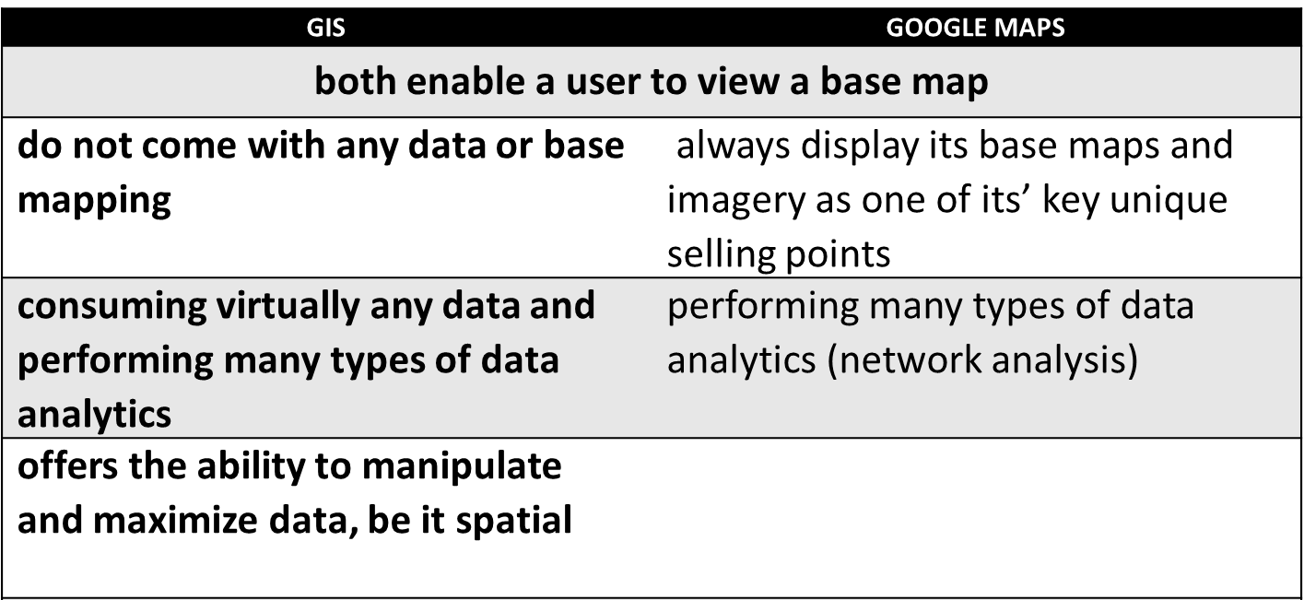
Gis VS Google Maps
26

Slide 27
Functional Requirements
27
8
Add/delete/Edit/list/search of any Tourist Account
View detailed ratings of any Tourist
Request Trip
View Park's location
Rate Park & Give Feedback
Tourist

Slide 28
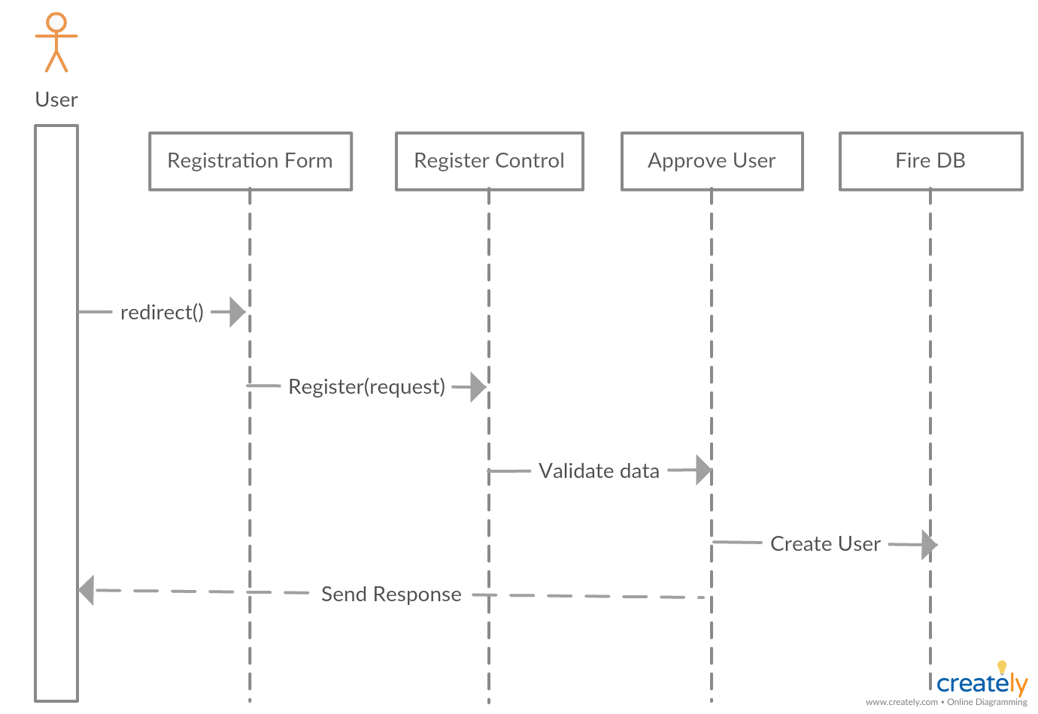
28
Sequence Digram 2
4

Slide 29
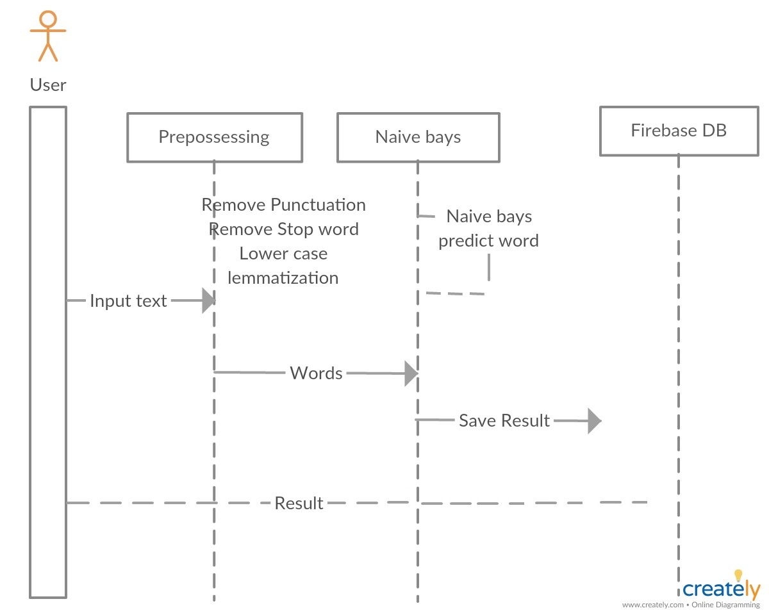
29
Sequence Digram 1
3

Slide 30
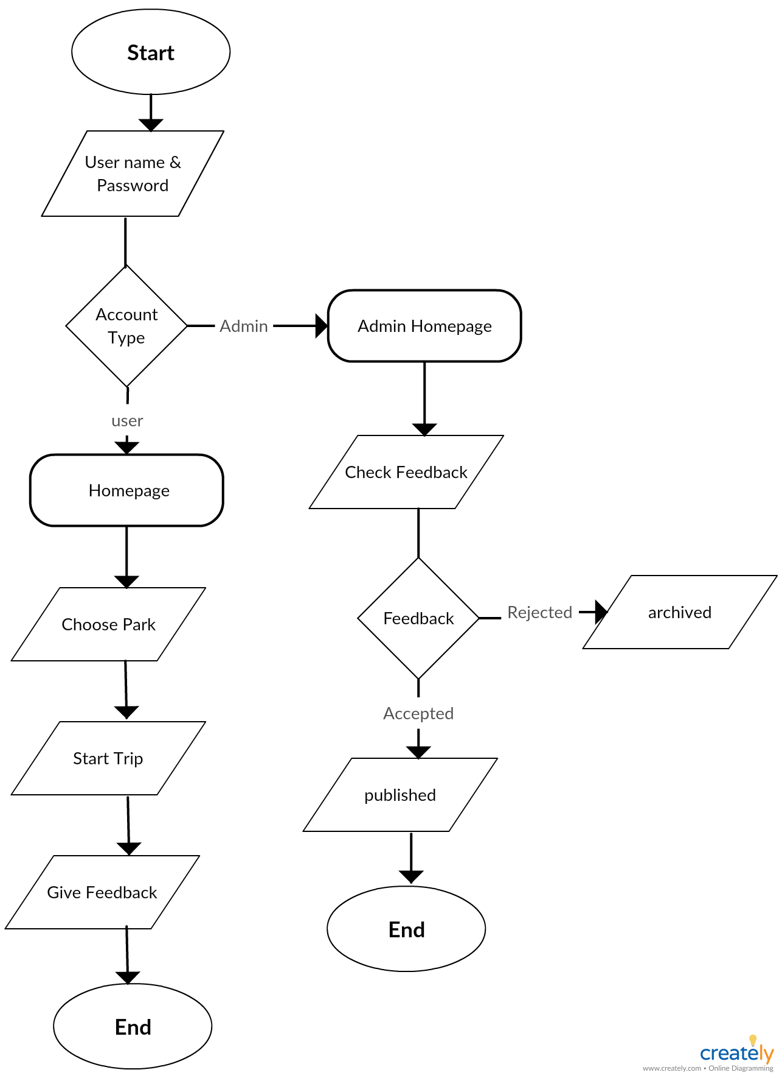
30
Process Diagram
5

Slide 31
Experiment 1 :Pre-experiment
31
Goal: This experiment aims to determine the algorithm that best fits our problem.
Setup: Datasets were obtained from ylep , Amzon , booking websites.Then dataset of all the sub-types was divided into test and train data.Different classifiers were tested with the same set of features computed per experiment.
Results : After testing several algorithms, it was clear that naive bays achieved the best accuracy among all the experiments that were done.
Explanation : Naive Bays was the best classiﬁer that ﬁts our classiﬁcation problem because the architecture that it is based on ﬁts our problem as we have opinion of tourists and users ranged from 1 to 5, 1 is very bad , 5 is excellent

Slide 32
Experiment 2 - Testing the classifier
32
Goal: This experiment aims to firstly test the classifier performance among different combinations of features and to reduce the confusion between the sub-types of the text to increase the accuracy.
Setup: Different combinations of features were prepared to be extracted from the text.
Results : After applying diﬀerent combinations of features on the text, categorising using the selected algorithm which is Naive Bays, the highest accuracy achieved was 81 percent.
Explanation :After splitting the text into two categories,then into ﬁve categories, it was expected that the accuracy increases as some of the text has similar text combination features which results in similar values of features being extracted aﬀecting the classiﬁcation process and splitting them will result in decreasing that confusion as each category will be processed separately. This experiment resulted in the ﬁrst approach in our system.

Slide 33
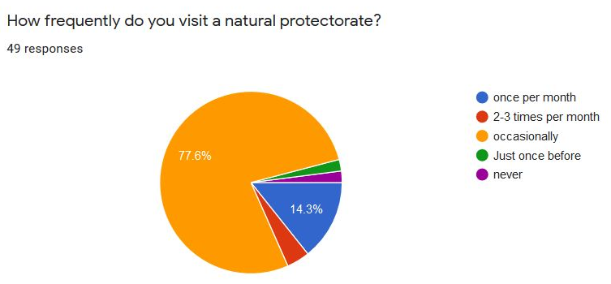
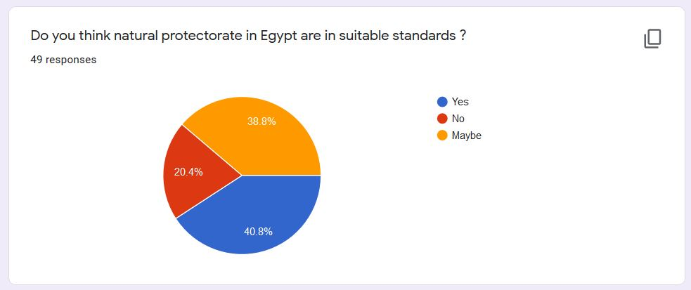
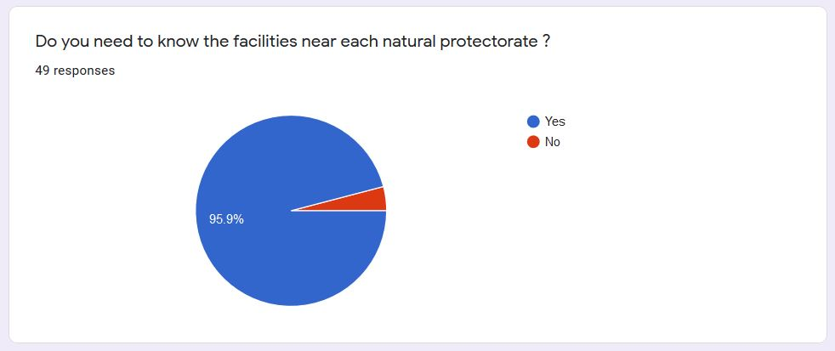
survey
33

Slide 34
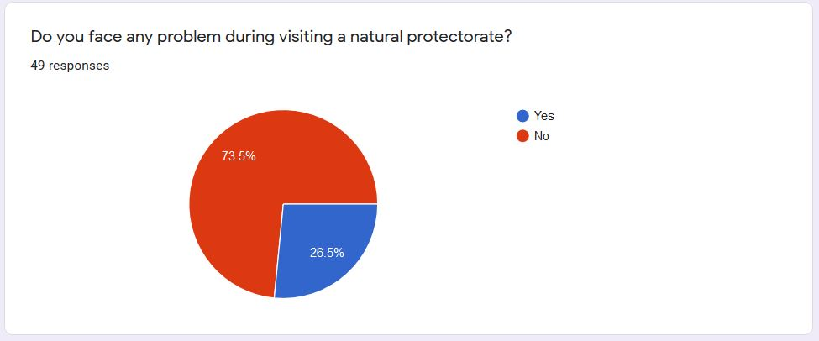
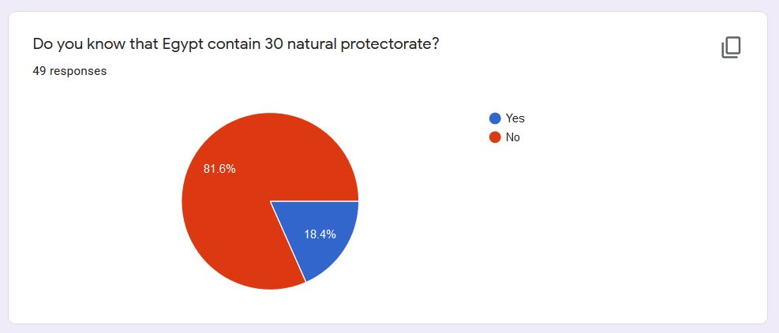
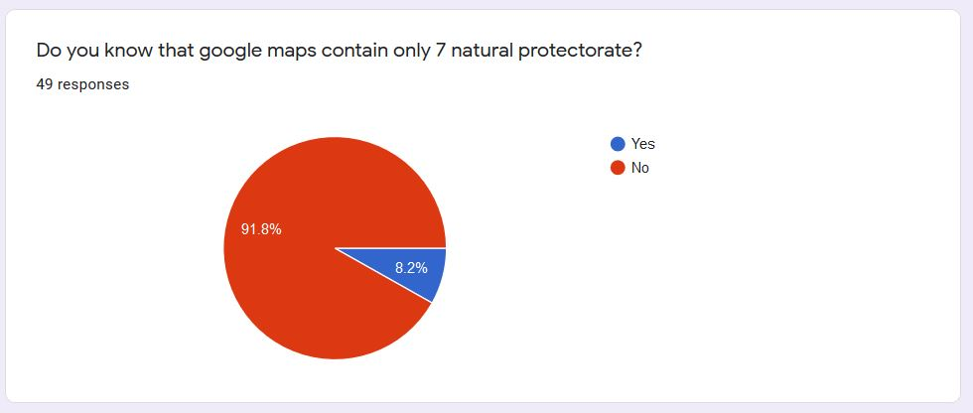
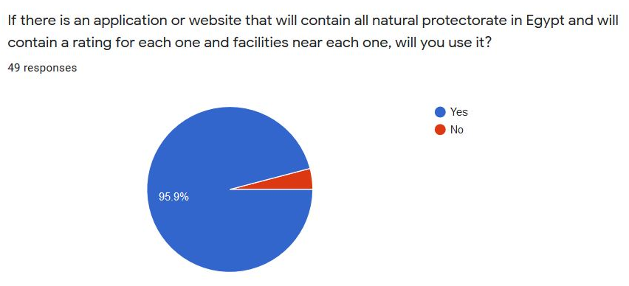

Slide 35
Not all national parks locations available on google maps
1. Coast Marshes Area in Rafah North Sinai Governorate (Ahrash Protectorate)
2. Ashtoom El-Gamil and Tenis Island Protected Area in Port Said Governorate
3. Wadi Al-Alaqi in Aswan Governorate
4. Wadi Al-Asioutty Protected Area
5. Taba Protected Area in South Sinai Governorate
6. El-Brolus Protected Area in Kafr El-Sheikh Governorate
7. El-Dababya
8. Mount Kamel Meteor Protectorate

Slide 36
Classifier Dataset
Dataset Conatins:10,000 Record
Dataset is labeled.
From www.yelp.com
5 classes
What is yelp? (DataSet)
Yelp is a business directory service and crowd-sourced review forum, and a public company of the same name that is headquartered in San Francisco, California. The company develops, hosts, and markets the Yelp.com website and the Yelp mobile app, which publish crowd-sourced reviews about businesses.
11

