Slide 1
Workout Assistant
Created by : Abdelrahman Khashaba,Ahmed Elmorabea, Poula Moheb, Ahmed Nagy
Supervised by: Dr. Diaa Salama
Teacher Assistant : Eng. Hager Sobeah

Slide 2
Motivation
Improper form and technique in a workout could be very harmful and potentially cause injuries
Injuries occur frequently in weightlifting exercises

Slide 3
Problem Statement
Detecting wrong movements during dumbbell excercises to avoid potential shoulder injuries

Slide 4
Idea
We are using kinect camera to extract 8 of the upper body joints to track their motion and detect any wrong ones by comparing them to our dataset

Slide 5
Related work
A Deep Learning Framework for Assessing Physical Rehabilitation Exercises used CNN , RNN, HNN are repurposed for the task

Slide 6
Dataset
The dataset consists of dumbbell exercises by 5 different male subjects with different age and height
There are 80 videos for each one exercising with 5 kg and 10 kg dumbbells

Slide 7
classification
For classification we used the Fast-DTW classifier.
Used libraries :
CSV for reading CSV files , Fast-DTW , Scipy.spatial for distance calculations

Slide 8
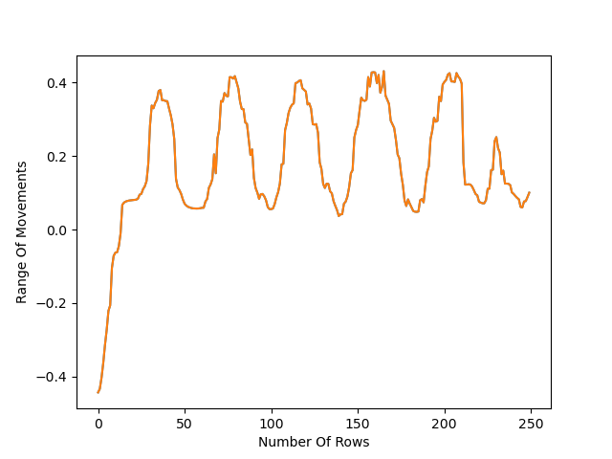
Cutting videos

Slide 9
Experiments
Testing on two male subjects with a total of 20 videos
A 73% accuracy was achieved by Fast DTW algorithm

Slide 10
Any questions?

