Slide 1
Palm Care Palm Tree Disease Detection using Image Processing and Machine Learning.
1

Slide 2
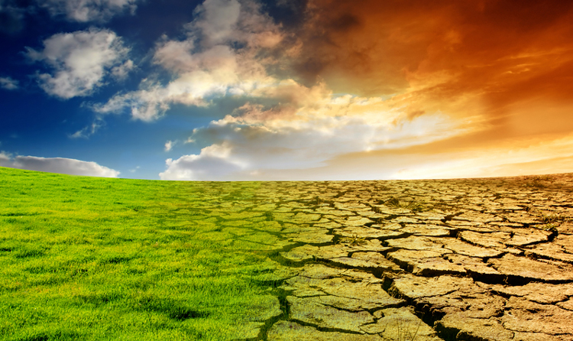
Palm Trees Importance
Social Importance
Industrial Importance
There are about 2600 species of palm trees that can produce more than 1000 products.
Palm’s Fruits provide: food, oil, dye, and sugar. Palm’s Trunk provides: fuel, building materials and wax.
Palm’s Sturdy fibers provides: paper and cloth.
Palm trees decrease the atmospheric temperature
Palm trees have high impact in combating desertification
2

Slide 3
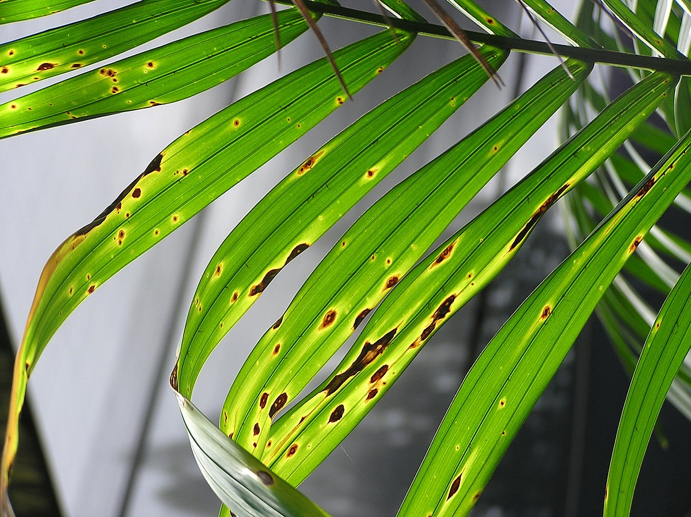
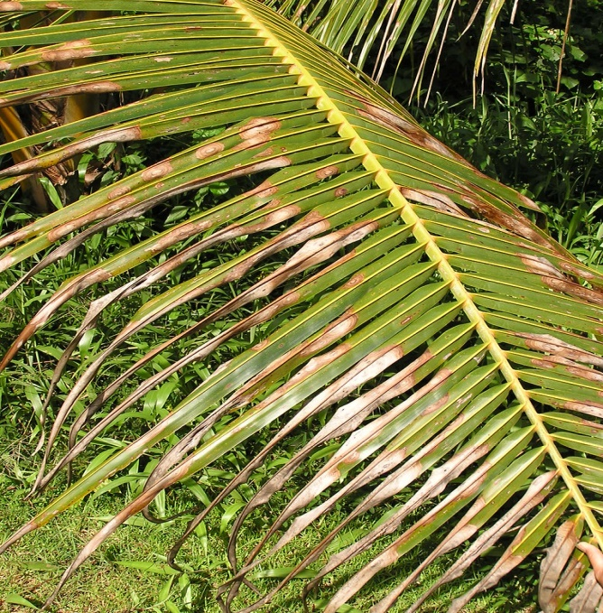
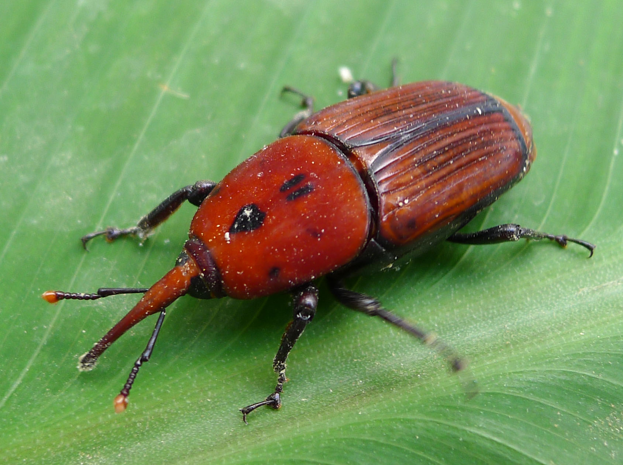
Project Scope
Introducing an android mobile application that can detect:
leaf spots and blight spots diseases by mobile cameras.
Red Palm Weevil by acquiring thermal images of palm trees using thermal USB camera connected to smartphones.
These images will be enhanced, then machine learning techniques will be applied to them.
3
Brown Leaf Spots
Bligh Leaf Spots
Red Palm Weevil

Slide 4
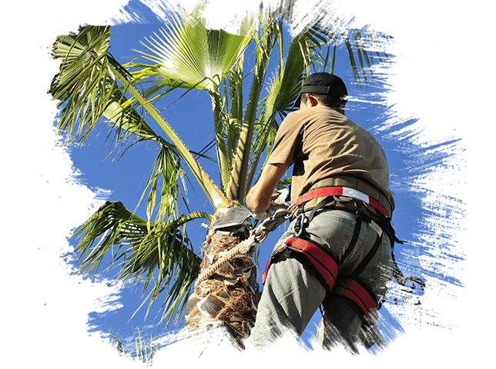
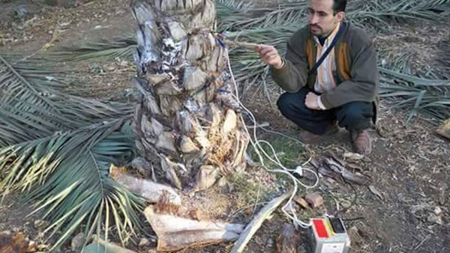
Current Traditional Methods
Experts
Vibration Sensors
4

Slide 5
Applicability
5

Slide 6
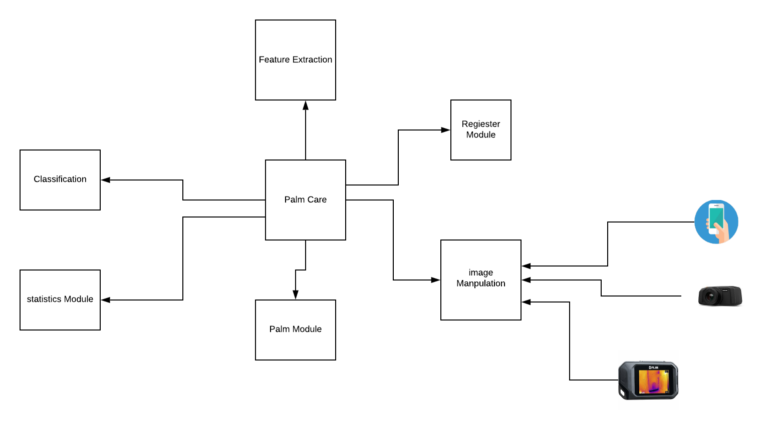
System Overview
6

Slide 7
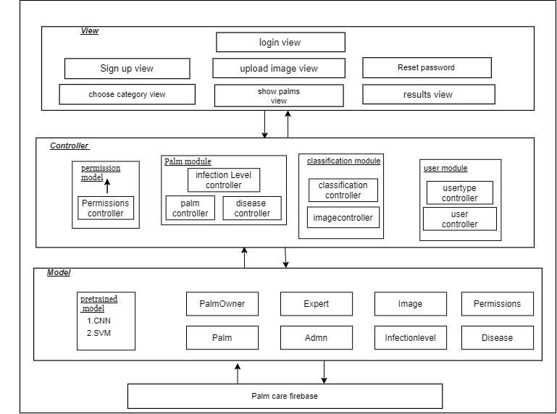
System Architecture
7

Slide 8
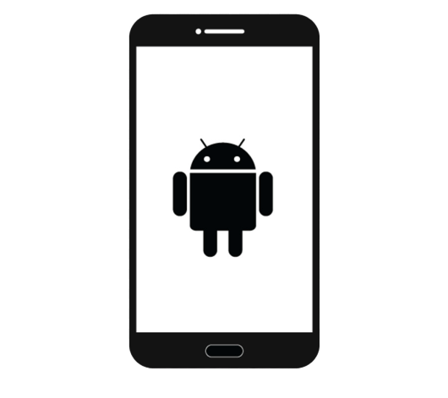
Innovative Aspects
Proposed Method (1):
Can Detect
Using
First Mobile Application
Brown Leaf Spots
Bligh Leaf Spots
Normal mobile camera,
Minimum 8 megapixels
Upload to server
Show Results
Classify
Suggest Treatments
Apply Artificial Intelligence Algorithm
Apply Image processing
8

Slide 9
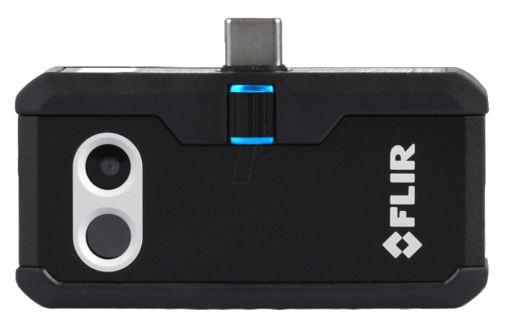
Innovative Aspects
Proposed Method (2):
Can Detect
Using
FLIR One Pro Thermal Camera
First Mobile Application
Red Palm Weevil
Upload to server
Show Results
Classify
Suggest Treatments
Apply Artificial Intelligence Algorithm
Apply Image processing
9

Slide 10
Solution’s Innovative Aspects
Contribution to the scientific society:
We’re considered to be the first users of an online dataset for leaf and blight spots palm diseases which we need to test our application.
We provide the first thermal datasets of palm trees for any future researcher.
10

Slide 11
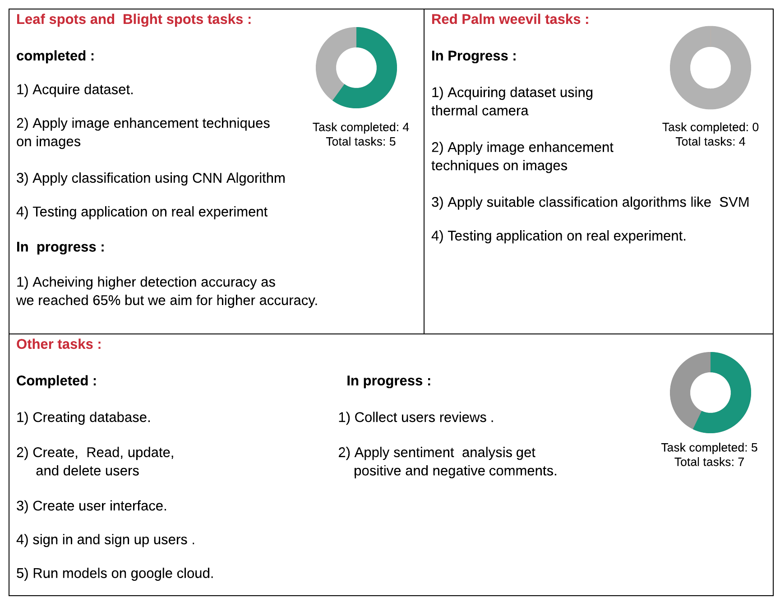
Current progress
11

Slide 12
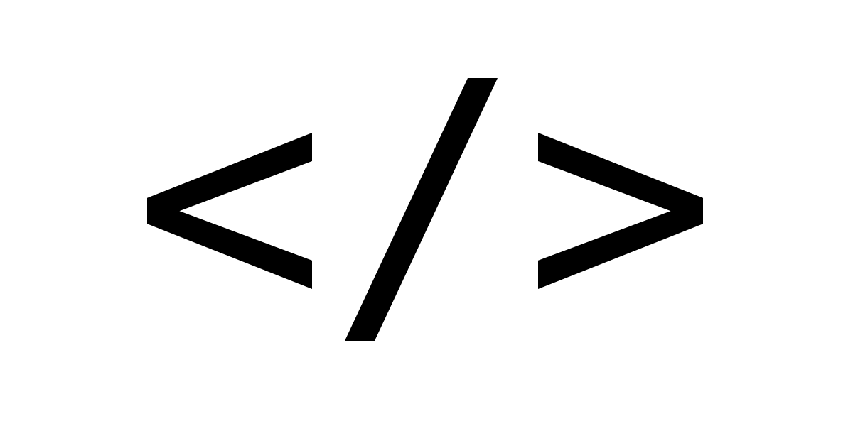
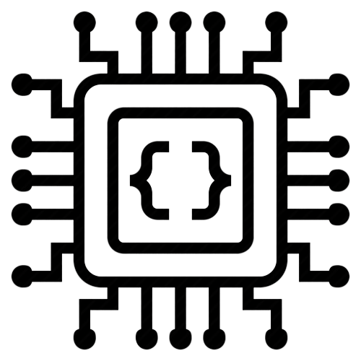
Technology used
mobile with minimum Android version 5.0
Java 8 used in
android Studio
Programming Languages
Python 3 is used
in Jupiter IDE
Hardware
Normal mobile camera
Minimum 8 megapixels
External Sources
- Matplotlib Library - Keras library - VGG16 - Flask API
Flir One Pro Thermal Camera
12

Slide 13
Thank You
13

