Slide 1
Thermal Face Recognition
Computer Science
18.07.17
Supervisor: Dr. Tarek Gaber Assistant: Eng. Taraggy Mohy
Presented By : Basil Essam Mohammed Amer Ahmed Essam
Dr. Tarek Gaber, Visiting Assistant Professor, MIU. Assistant Professor, Suez Canal University.

Slide 2
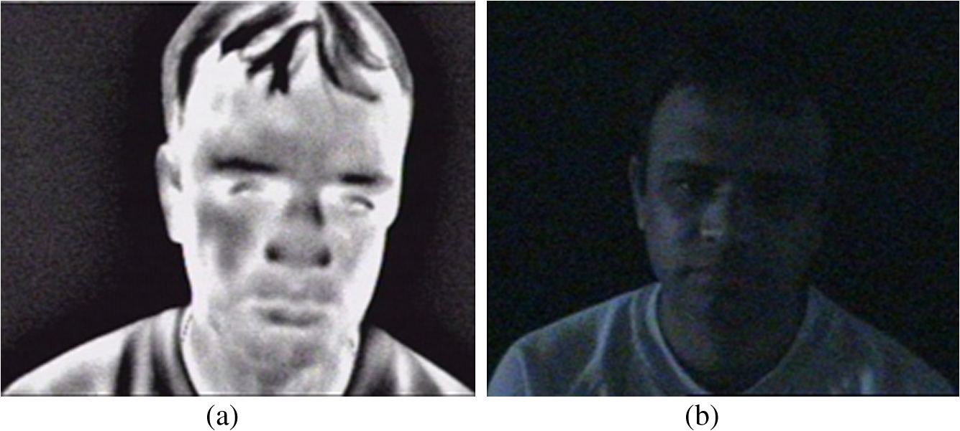
Introduction
What is classic Face Recognition.
What is Thermal Face Recognition.
Advantages of thermal face recognition.

Slide 3
Market Objective
Real-world applications.
Universities’ control rooms.

Slide 4
Related Work

Slide 5
Human Thermal Face Recognition Based on Random Linear Oracle (RLO) [1]
Challenges:
Image variation
Change of Facial expressions
Contribution:
Improving Recognition rate
Features extraction using (STFA).
Dimensionality reduction using (PCA) and (LDA)
Experimental Results:
They reached 94.12% recognition rate.
[1] Snasel, Valcav, et al. ”Human Thermal Face Recognition Based on Random Linear Oracle (RLO) Ensembles.” Intelligent Networking and Collaborative Systems (INCOS), 2015 International Conference on. IEEE, 2015.

Slide 6
Thermal Face Recognition Using Convolutional Neural Network (CNN) [1]
Challenges: - Learn effective features from the raw data using Neural Networks.
Contribution:
- Experiment results achieves higher recognition rate .
Experimental Results:
[1] Wu, Zhan, Min Peng, and Tong Chen. ”Thermal face recognition using convolutional neural network.” Optoelectronics and Image Processing (ICOIP), 2016 International Conference on. IEEE, 2016.

Slide 7
Problem Definition
Reach a comparative study between the related works and our work to use the higher recognition method.

Slide 8
System Overview

Slide 9
Architecture Diagram

Slide 10
Class Diagram

Slide 11
Algorithms used
Segmentation
- Adaptive Threshold:
- If g(x, y) is a thresholded version of f(x, y) at some global threshold T

Slide 12
Cont. Algorithms used
Features Extraction - SIFT: - Detecting and describing local features.
- Thermal Features: - Original thermal pixels are used as features.

Slide 13
Cont. Algorithms used
HOG: - Using Sobel for Edge Detection. - Applying Histogram Equalization.
KAZE: - Multi-scale 2D Feature detection. - Gaussain Scale.

Slide 14
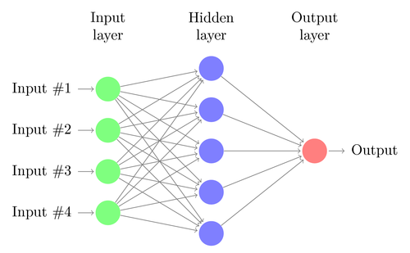
Classification
MLP Neural Networks: - Input Layer - Hidden Layer - Output Layer

Slide 15
Algorithms used
Segmentation: - Adaptive Threshold.
Features Extraction: - KAZE.
Classification: - Back-propagation Neural Networks.

Slide 16
Dataset
Terravic Facial Infrared Database[1].
Contains 20 classes of 20 persons, each person has thermal face images that ranges between 210-270 Images.
Images dimensions are 320*240
All faces include full frontal, left and right profile images.
[1] IEEE OTCBVS WS Series Bench; Roland Miezianko, Terravic Research Infrared Database.

Slide 17
Evaluation: Experiment 1/3
SVM Classifier was used with These Features Extraction methods: - SIFT - Thermal Features - HOG - KAZE
Problems faced.
Training was applied using 5, 7, 10 training images for 3 classes.
Each class had 3 testing images.

Slide 18
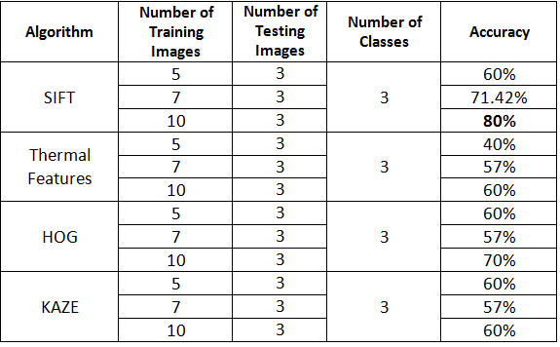
Evaluation: Experiment 1/3
Accuracy Testing using SVM

Slide 19
Evaluation: Experiment 1/3
Classifier:
Multi Layer Perceptron Neural Network
Features Extraction:
HOG
KAZE
Dataset:
Training: (100 per person X 17)
1700 images (Front, Right and Left profile images)
Testing: (30 per person X 17)
510 images (Glasses, Hat, Both, front , left , Right)

Slide 20
Evaluation: Experiment 1/3

Slide 21
Evaluation: Experiment 1/3

Slide 22
Evaluation: Experiment 2/3
On testing the application;
- Total number of images: 360.
- Image cases:
1)Glasses
2)Hat
3)Both
- Number of classes: 9 classes.
- Images per class: 40.
- Accuracy : 81%

Slide 23
Evaluation: Experiment 2/3

Slide 24
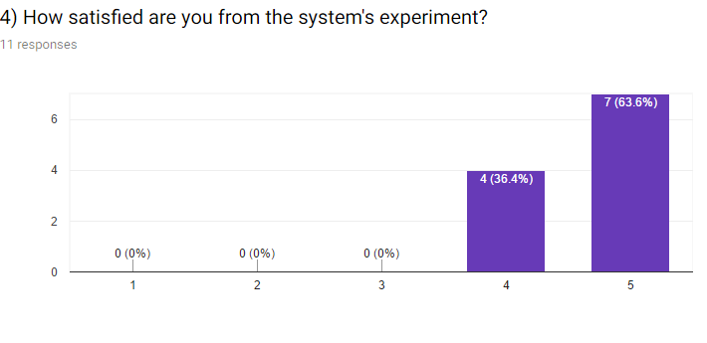
Evaluation: Experiment 3/3
The system was tested by 10 persons; - 3 domain experts. - 7 of our friends.
Survey results based on their impressions were as follows:

Slide 25
Evaluation: Experiment 3/3

Slide 26
Evaluation: Experiment 3/3

Slide 27
Evaluation: Experiment 3/3
Domain experts were: - Eng Amr Salem (Communication Systems Consultant) - Ali Abd El-Halim Mahmoud (Engineering and Development of Communication System General Manager) - Nader Kamal Hafez (Communications and Security systems Consultant)

Slide 28
Demo

Slide 29
Dell EMC
Had been shortlisted for moving to the next phase in Dell EMC Envision the Future Competition.
We are expected to develop and submit the Final Project Report by July 2nd, 2017.

Slide 30
Thank you!
Any Questions?

