Slide 1
Thermal Face Recognition
Computer Science
18.10.16
Presented By : Basil Essam Mohammed Amer Ahmed Essam
Supervisor: Dr. Tarek Gaber Assistant: Eng. Taraggy Mohy

Slide 2
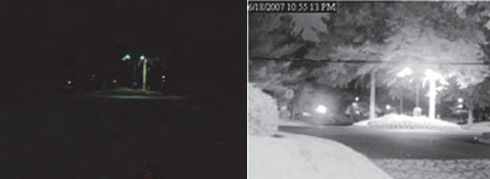
Introduction
Face recognition is identifying a person from a digital image or a video frame.
Thermal Face recognition is identifying a person based on his thermal image.
Advantages of thermal face recognition over visible face recognition.

Slide 3
Market Motivation
Who will be our end user?
How can the market benefit from our product?
Sponsor

Slide 4
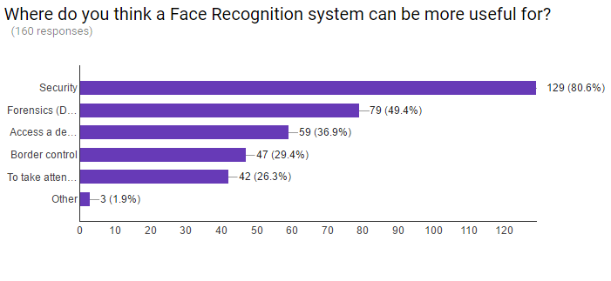
Market Motivation

Slide 5
Academic Motivation
Implementation on different Benchmark databases and Algorithm methods and Improving processing rate. [1].
Removing environmental distractions[2].
Hybrid Systems[3]
Combining different algorithms
Notes:
[1] F. B. Zaeri, Naser and R. Dib, Thermal face recognition using moments invariants, International Journal of Signal Processing Systems, vol. 3, no. 4, 2015 [2] A. D. Socolinsky and A. Selinger, “A comparative analysis of face recognition performance with visible and thermal infrared imagery,” Equinox Corp Baltomore MD, 2002. [3] Ali, Usman, et al. ”Real-time eﬃcient parallel thermal and visual face recognition fusion.” 2006 IEEE International Conference on Electro/Information Technology. IEEE, 2006.

Slide 6
Problem Statement
The main problems that faced thermal face recognition systems were improving recognition rate accuracy, enhancing processing rate and implementing various algorithms on different databases on thermal images.

Slide 7
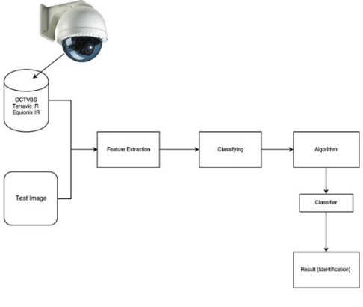
System overview

Slide 8
Related Work

Slide 9
Human Thermal Face Recognition Based on Random Linear Oracle (RLO) [1]
Challenges:
Image variation
Change of Facial expressions
Contribution:
Improving Recognition rate based on: Terravic Facial IR Database & RLO Algorithm
Features extraction using Segmentation-Based Texture Fractal Analysis (STFA).
Dimensionality reduction using Principal Component Analysis (PCA) and Linear Discriminant Analysis (LDA).
Experimental Results:
Using Terravic Facial IR Database. They reached 94.12% recognition rate which is better than the previous work.
Notes:
[1] Gaber, Tarek, et al. ”Human Thermal Face Recognition Based on Random Linear Oracle (RLO) Ensembles.” Intelligent Networking and Collaborative Systems (INCOS), 2015 International Conference on. IEEE, 2015.

Slide 10
Fusion Based Approach for Thermal and Visible Face Recognition under Pose and Expressivity Variation [1]
Contribution:
Investigating the combined thermal and visible face recognition on PCA
Classification using K-nearest
Experimental results:
Based on OTCBVS Database, Average recognition rate with K-NN Classifier reached: 1) 1-NN: 90.84% 2) 3-NN: 87.18% 3) 5-NN: 81.76% 4) 7-NN: 78.86%
Notes:
[1] Pop, Florin Marius, et al. ”Fusion based approach for thermal and visible face recognition under pose and expressivity variation.” 9th RoEduNet IEEE international conference. IEEE, 2010.

Slide 11
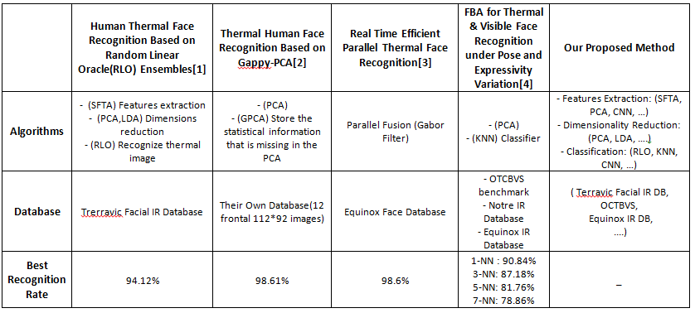
Comparison

Slide 12
Any Questions ?

