Slide 1
Thermal Face Recognition
Computer Science
03.04.17
Presented By : Basil Essam Mohammed Amer Ahmed Essam
Supervisor: Dr. Tarek Gaber Assistant: Eng. Taraggy Mohy

Slide 2
Quick Introduction
Face recognition is identifying a person from a digital image or a video frame.
Thermal Face recognition is identifying a person based on his thermal image.
Advantages of thermal face recognition over visible face recognition.

Slide 3
Document Objective
The main objective of this is to make a clear Software Requirements Specification Document for the designers to be implemented properly.

Slide 4
Academic Objective
Reach a comparative study between the best related algorithms and techniques to come up with the best one or combined one to be used later on in many real world applications.

Slide 5
Market Objective
Develop an application that can be specialized in making universities’ control rooms more secured by having a thermal face recognition system that allows desired people to enter the rooms based on their authorities.

Slide 6
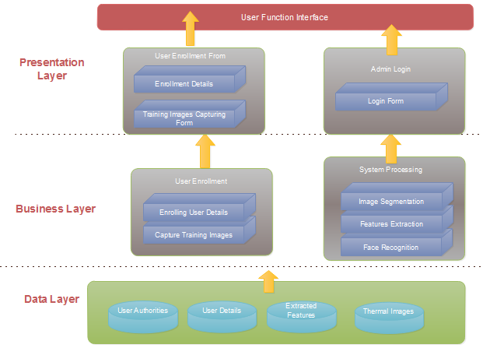
Architecture Diagram

Slide 7
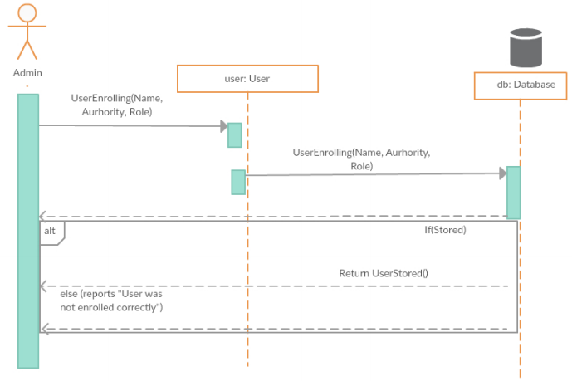
Main Sequence Diagrams
Enrolling users’ data

Slide 8
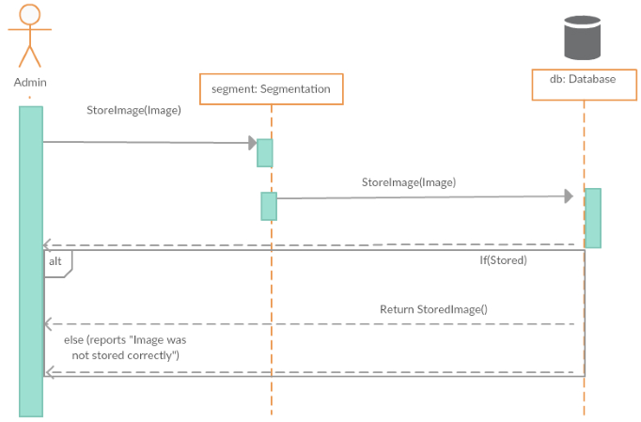
Cont. Main Sequence Diagrams
Segmentation of testing images

Slide 9
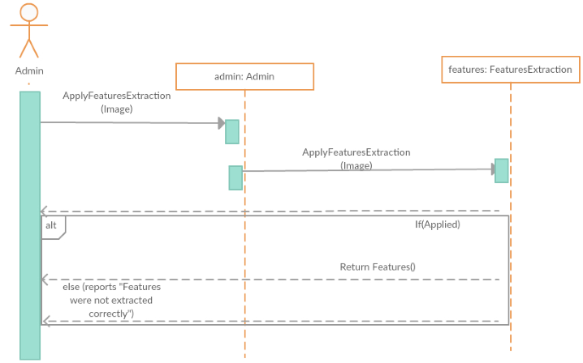
Cont. Main Sequence Diagrams
Features Extraction to testing images

Slide 10
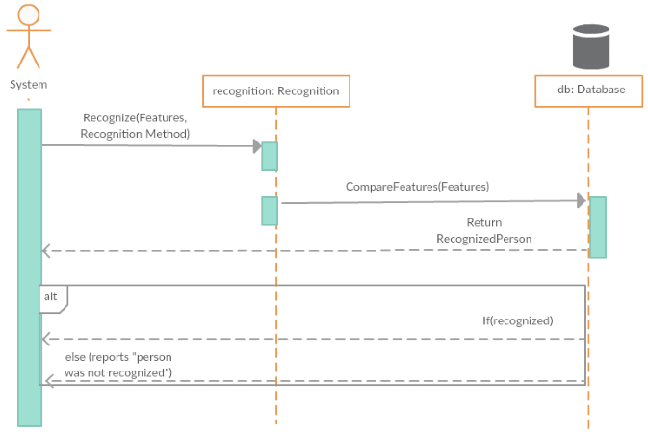
Cont. Main Sequence Diagrams
Recognition of testing images

Slide 11
Main Algorithms
Segmentation
- Adaptive Threshold:
- If g(x, y) is a thresholded version of f(x, y) at some global threshold T

Slide 12
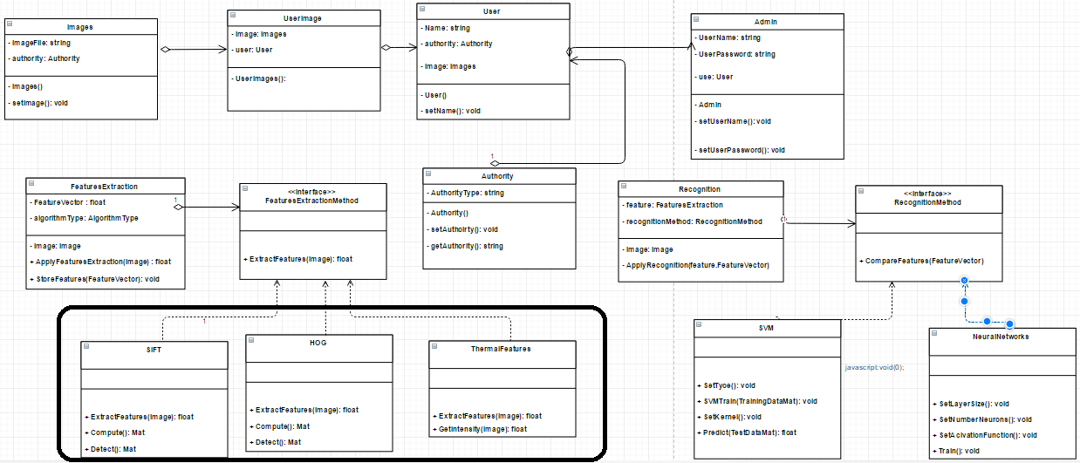
Class Diagram

Slide 13
Database

Slide 14
Dell EMC
Had been shortlisted for moving to the next phase in Dell EMC Envision the Future Competition.
We are expected to develop and submit the Design Document by April 6th, 2017 and the Final Project Report by July 2nd, 2017.

Slide 15
Dataset
Terravic Facial Infrared Database[1].
Contains 20 classes of 20 persons, each person has thermal face images that ranges between 210-270 Images.
Images dimensions are 320*240
All faces include full frontal, left and right profile images.
Notes:
[1] http://vcipl-okstate.org/pbvs/bench/Data/04/download.html

Slide 16
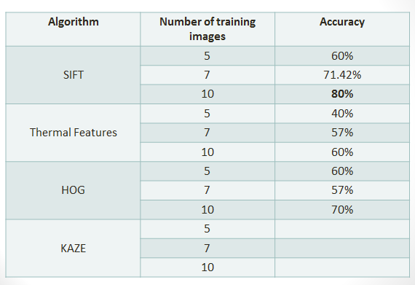
Primitive Results (SVM)

