Slide 1
Vigil SDD presentation
BY: MAHMOUD ELSHENNAWY, KHALED SALEM AND HUSSIEN YASSIeN.
SUPERVISED BY: PROF. AYMAN EZZAT.

Slide 2
Presentation Overview
1- Purpose
2- Problem statement
3- Architecture Diagram
4- Sequence Diagrams
5- Main Algorithms
6- Class Diagram
7- Database
8- Dataset information

Slide 3
Purpose
To describe the architecture and system design of our graduation project, which is an abnormal behavior detection system aimed at the detection of abnormal behaviors related to car theft.

Slide 4
Problem Statement
We aim to create a real-time abnormal behavior detection system by processing over GPU.

Slide 5
Architecture Diagram
We use, layered MVC architecture.
We separate UI from Logic and data Transactions.

Slide 6
Logic Layer Pipeline
Some features in the logic layer run sequentially, hence we show the pipeline

Slide 7
Action Detection Sequence Diagram(1)
This sequence
diagram describes the
Detect Actions
Functionality.

Slide 8
Loitering Sequence Diagram(2)
This sequence
diagram describes the
Detect Loitering
Functionality.

Slide 9
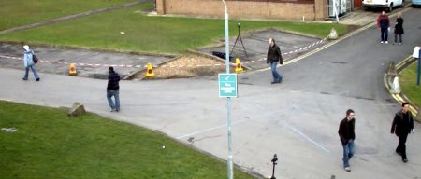
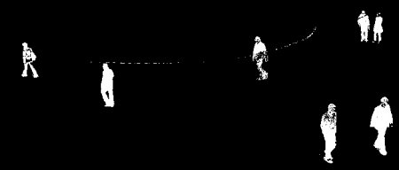
Main Algorithms (Background Subtraction)
it’s a Gaussian Mixture-based Background/Foreground Segmentation Algorithm.
It uses a method to model each background pixel by a mixture of K Gaussian distributions

Slide 10
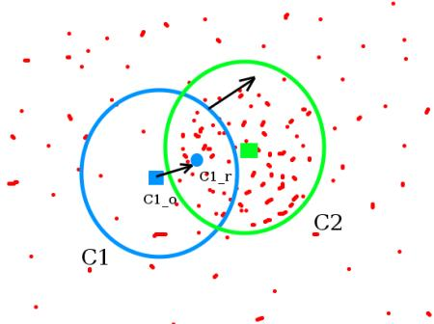
Main Algorithms (Mean/Cam Shift)
  MeanShift:
Continuously move a rectangle drawn over an object to match the rectangle’s centroid with the centroid of most dense area.
  CamShift:
We use Continuously Adaptive Mean Shift to update the size of the window

Slide 11
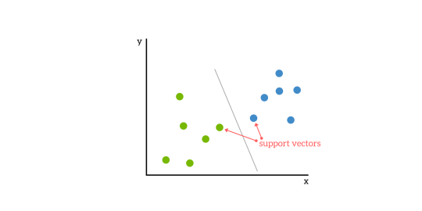
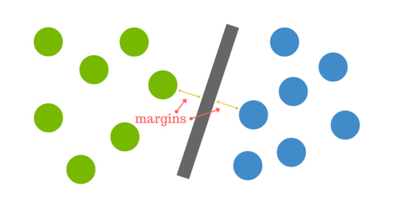
Main Algorithms (SVM)
Support Vector Machines:
-It’s a machine learning algorithm.
-It separates data vectors by hyperplanes.
-Used mostly for training and classification.

Slide 12
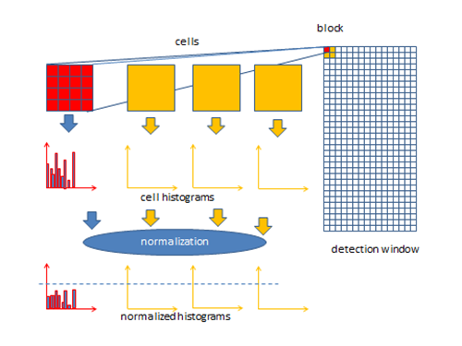
Main Algorithms (HOG)
Histogram of oriented gradients:
-It is used for features detection and feature
Extraction.
-Groups pixels into 8x8 cells.
-Similar cells grouped into 16x16 blocks.

Slide 13
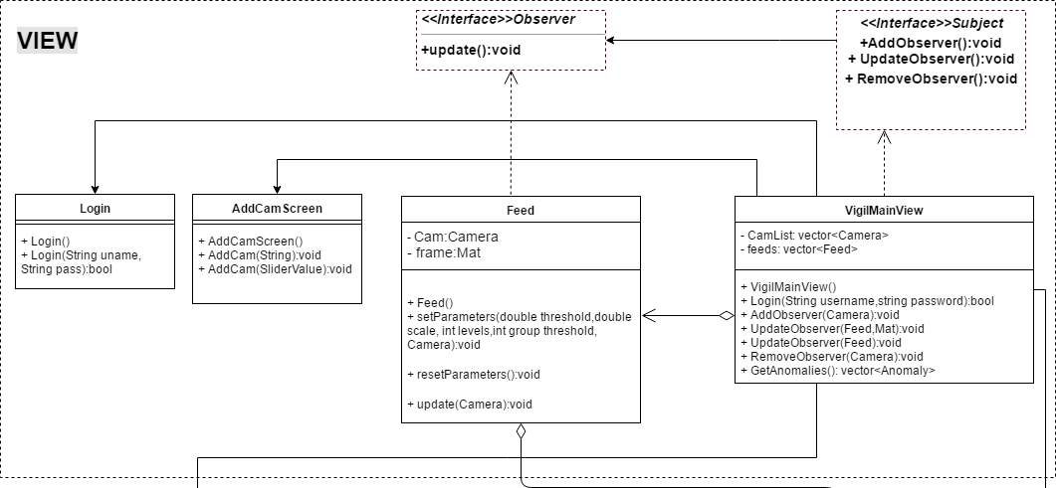
Class Diagram (View)

Slide 14
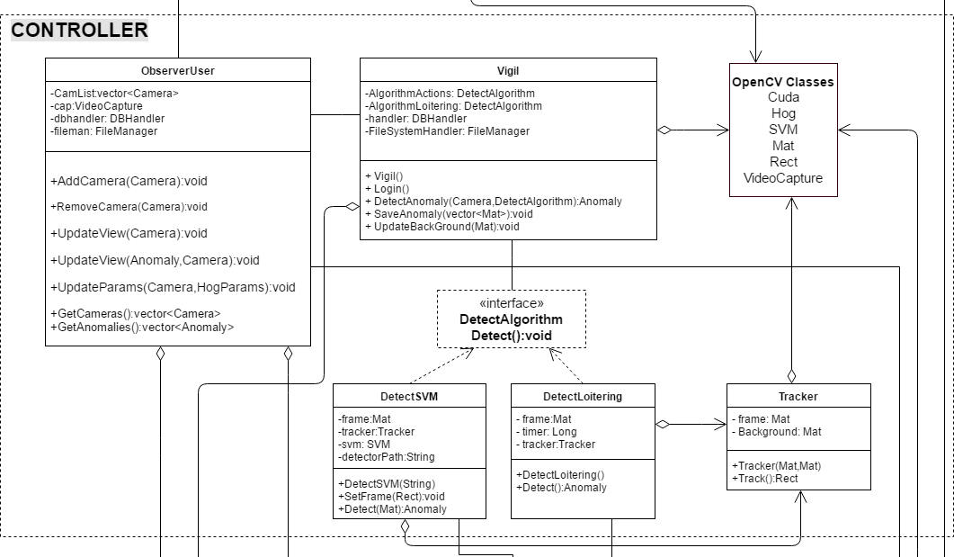
Class Diagram (Controller)

Slide 15
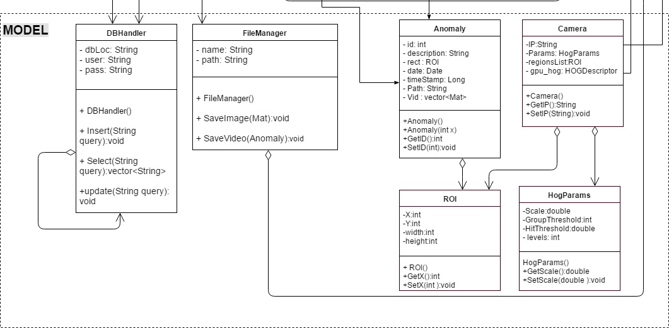
Class Diagram (Model)

Slide 16
Database

Slide 17
Dataset Details
5007 Images extracted from our own recorded sequence.
Divided into 5 classes. {0,1,2,3,4}
1098 negatives. (Class 4)
1570 positive image for “Jumping into Car” action. (Class 0)
673 positive image for “Object swinging” action. (Class 1)
663 positives image for “Punching” action. (Class 2)
1004 positive image for “Pushing” action. (Class 3)

Slide 18
Demo

Slide 19
Thank you!

