Slide 1
Cancer Detection
By Bassma El-Sherbiny, Nardeen Nabil, Youssef Emad & Seif Hassab El-Naby.
(Computer Science Senior Students)
Supervised by Dr. Ashraf Abdelraouf , Eng. Taraggy Mohiy & Eng. Nada Ayman

Slide 2
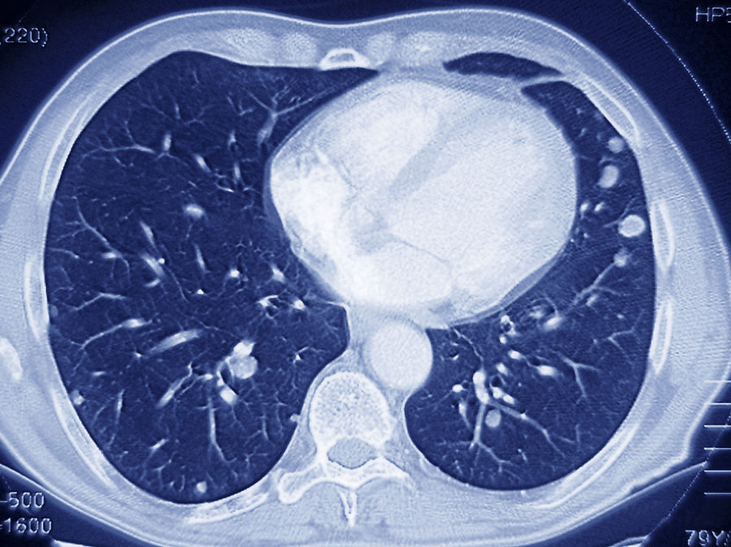
Introduction 1/2
Cells divide without control and can invade nearby tissues [1].
Early diagnosis, treatment improves the chances of survival[2].
Tumor

Slide 3
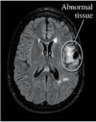
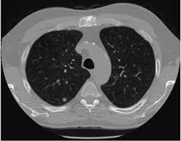
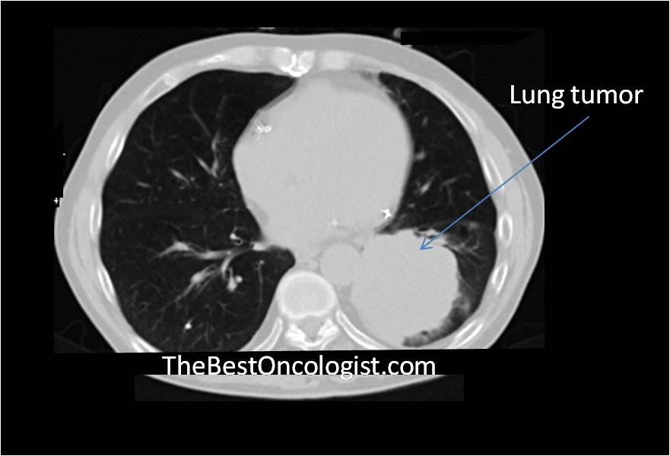
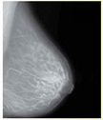
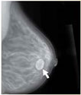
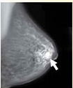
Introduction 2/2
Several Cancerous cells can occur in different organs:
1St Brain
2nd Lungs
3rd Breast
Normal Tissue
Not Cancer & Not Normal
Cancer
Normal Tissue
Abnormal Tissue
Normal Tissue
Abnormal Tissue

Slide 4
Problem Statement
Detect cancerous cells & tumors in Brain & Lungs with high accuracy.
Prediction of breast cancer through breast dense percentage calculation with high accuracy.

Slide 5
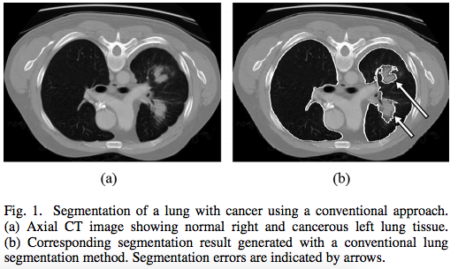
Related Work 1: Automated 3-D Segmentation of Lungs With Lung Cancer in CT Data Using a Novel Robust Active Shape Model Approach
It lakes learning data [3].
They used RASM Algorithm.
Dice coefficient of 0.975+ 0.006.
Tumor

Slide 6
Related Work 2: Brain Tumor Segmentation Using Convolutional Neural Networks in MRI Images
Proposed and used the Algorithm BCN,FCN and Expectation Maximization.
Used Dataset BRATS[4].
Since we note a significant drop in performance in PPV in the same regions.
DSC metric of 0.78, 0.65, and 0.75 for the complete, core, and enhancing regions.

Slide 7
Related Work 3: Breast Segmentation and Density Estimation in Breast MRI: A Fully Automatic Framework
High time consuming.
They used fuzzy C-means (FCM), expectation–maximization and STAPLE algorithms.
Average DSC value of 0.80 ± 0.13 (mean ± sd).

Slide 8
Related Work 4: Computer-aided detection/diagnosis of breast cancer in mammography and ultrasound.
Two types of CAD:
CADe : Identify and mark suspicious areas in an image. The goal of CADe in mammography is to help radiologists avoid missing cancers.
CADx: which assist the radiologist to determine the grade of abnormalities as benign or malignant.

Slide 9
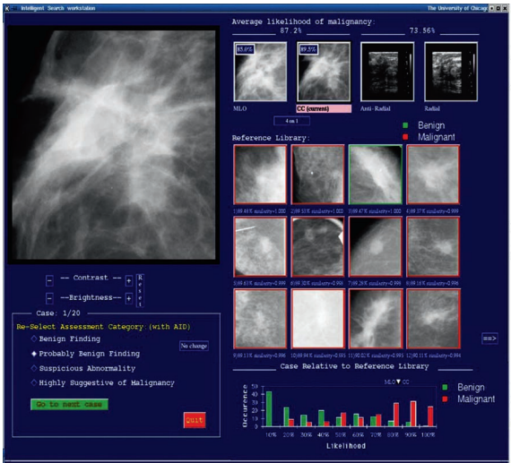
Related Work 5-1/2: U. Bick · F. Diekmann (Eds.) Digital Mammography
User Interface of CADx:
Numerical Output
Pictorial Output
Assessment Category
Graphical Output

Slide 10
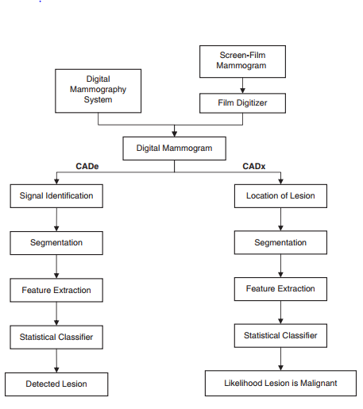
Related Work 5-2/2: U. Bick · F. Diekmann (Eds.) Digital Mammography

Slide 11
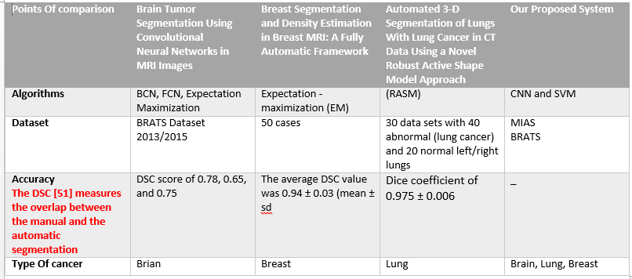
Table of Comparisons

Slide 12
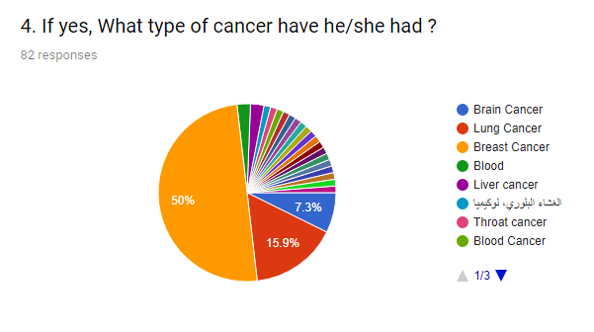
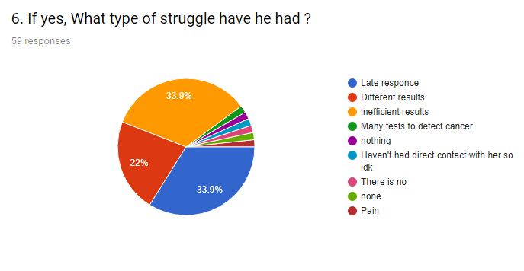
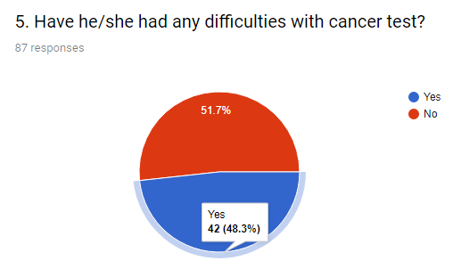
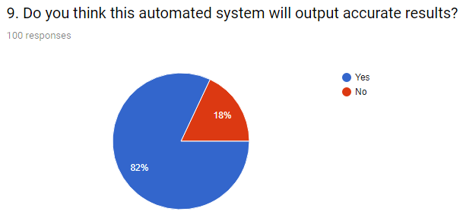
Motivation 1/3

Slide 13
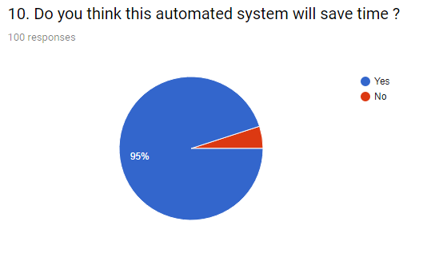
Motivation 2/3

Slide 14
Motivation 3/3- According to Question 10 , explain your answer ?

Slide 15
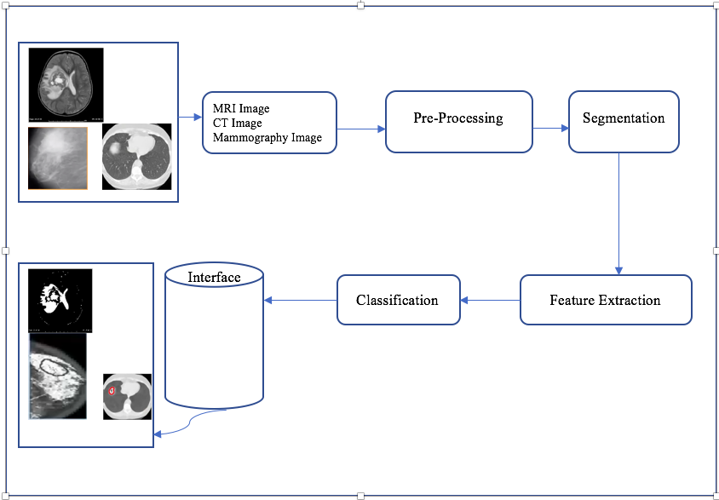
System Overview

Slide 16
System Overview- Preprocessing
Starts using bias filed distortion and Normalization step.
Use filters such as Grayscale & Gaussian.

Slide 17
System Overview- Segmentation
Every patch should be indicating some feature.
Several features then extracted from previous work.

Slide 18
System Overview- Feature extraction
Gabor Wavelets represent an accuracy 0.86 DSC[9].
intensity, intensity differences , local neighborhood and wavelet texture[10].
Notes:
1-88% Dice overlap for the complete tumor region, 75% for the core tumor region and 95% for enhancing tumor region [10]
2- Texture features: Co-occurrence Matrices, Laws Features.• Geometric features: Volume, Rectangular Fit, Compactness, Relative distance measure from pleural wall.• Intensity based features: mean brightness measure in terms of Hounsfield units (HU)

Slide 19
System Overview- Classification
Use CNN & SVM classifiers
Try combinations between classifiers to get higher accuracy.

Slide 20
Supportive Document

Slide 21
Expected Results
Output images with detected cancerous & tumor parts.
Output breast dense level or type (A->D).
High accuracy.

Slide 22
Any Questions?

Slide 23
Thank You

