Slide 1
Escort visual analytics for large scale sensor trajectories for detecting anomalous behaviors
LOAI HAMDY – AHMED WAEL – AMR ALI FARAG – MINA KAMAL
Supervised by : DR.MAI SHEHALY
October 3, 2016

Slide 2
PROBLEM DEFINETION
Nowadays there are many places might be crowded by traffic problems, which is a very difficult for the security personal to handle alone by human capabilities.
Identifying regular patterns is crucial to help urban planners.
Identifying anomalous behavior helps security analysts.
Collecting data is very important to make an accurate analyses to detect what ever you want.

Slide 3
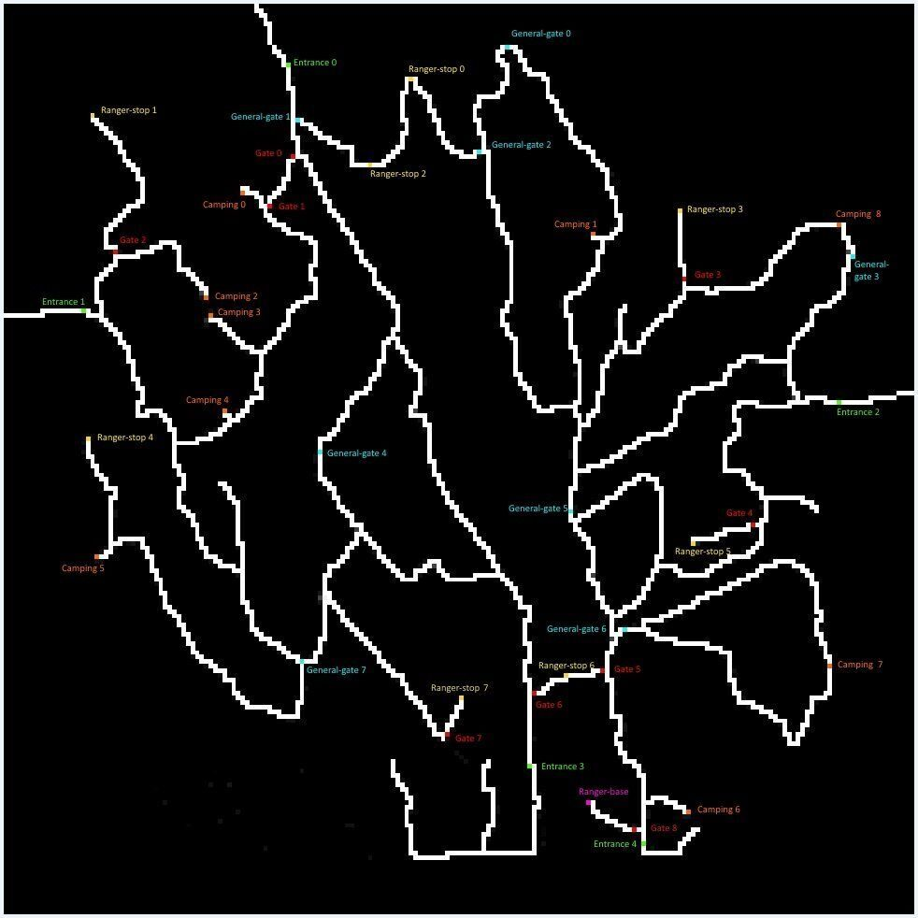
Background
There are several systems that used visual analytics for large scale trajectories for several purposes such as (Marketing-security).
Large amounts of tracking data is available nowadays in different types (e.g.: GPS Data trajectory, RF-id Data trajectory, Sensor Data trajectory,… etc.) which poses a lot of challenges on the analysis process.
Trajectory analysis focuses on searching for trajectories that have similar features within a given trajectory set (classification or clustering).
Using sensor trajectories in Lekagul Nature Preserve to protect endangered animals[2].
http://vacommunity.org/VAST+Challenge+2017+MC1

Slide 4
Similar systems
SmartAdP system for selecting billboard locations based on GPS trajectories of taxi[1].
[1] Liu, Dongyu, et al. "SmartAdP: visual analytics of large-scale taxi trajectories for selecting billboard locations." IEEE transactions on visualization and computer graphics 23.1 (2017): 1-10.

Slide 5
Our aim
In this project we aim to solve the traffic problem by decreasing the human error and increasing the precision of detecting anomalous behaviors.
Combining the power of machine learning and human expertise, this system learns the normal patterns or behaviors of cars and get out the time, location of any anomalous behavior
Supporting the detection of anomalous behavior through comparison to the studied normal patterns .
By putting an electronic system to detect the anomalous behavior it will help Politically in the country.

Slide 6
System Overview
Raw Data
Data pre- processing
Trajectory Analyses
Visual Analyses
Possible Scenarios
Alerting security
Algorithms
Patterns

Slide 7
Raw Data
Raw Data
Alerting security
Possible Scenarios
Data pre- processing
Visual Analyses
Trajectory Analyses
Algorithms

Slide 8
Data
Source: IEEE VAST Challenge 2017 (Sensor data trajectory) http://www.vacommunity.org/VAST+Challenge+2017+MC1
Source: GPS Data trajectory
There are a lot of cars passes daily in a specific road, so we should disguise vehicles target from each other.
its must to be connected with the GPS to detect the location of cars number in the specific place.
excel raw data.()

Slide 9
Data pre-processing
Raw Data
Alerting security
Conclusion
Possible Scenarios
Data pre- processing
Visual Analyses
Trajectory Analyses
Algorithms

Slide 10
Project Demo

Slide 11
Trajectory Clustering
Raw Data
Alerting security
Possible Scenarios
Data pre- processing
Visual Analyses
Trajectory Clustering
Algorithms

Slide 12
Trajectory Clustering
We will use the K-nn algorithm.
KNN can be used for both classification and regression predictive problems. However, it is more widely used in classification problems in the industry.
K-nn Algorithm depends on 3 important aspects:
1. Ease to interpret output.
2. Calculation time.
3. Predictive Power.

Slide 13
Possible Scenarios
Raw Data
Alerting security
Possible Scenarios
Data pre- processing
Visual Analyses
Trajectory Clustering
Algorithms

Slide 14
Scenarios Comparison
User start investigating and analyzing different scenarios and start putting a conclusion for what happened.

Slide 15
Alerting security
Raw Data
Alerting security
Possible Scenarios
Data pre- processing
Visual Analyses
Trajectory Clustering
Algorithms

Slide 16
Project plan
Project Phase | State | Deadline | Note
Collecting raw Data | Done
Meeting Stockholders | Done |  | Marketing-Security
Testing Different algorithms | Done
Clustering the Data | In Progress | 26/9/2017 | To find similar trajectories
SRS | - | Beginning of November
SDD | - | End of January
Testing different scenarios | -
Detecting anomalous behaviors | - | Beginning of March | Comparing with normal patterns
Final Discussion | - | Beginning of June

Slide 17
ANY QUESTIONS

