Slide 1
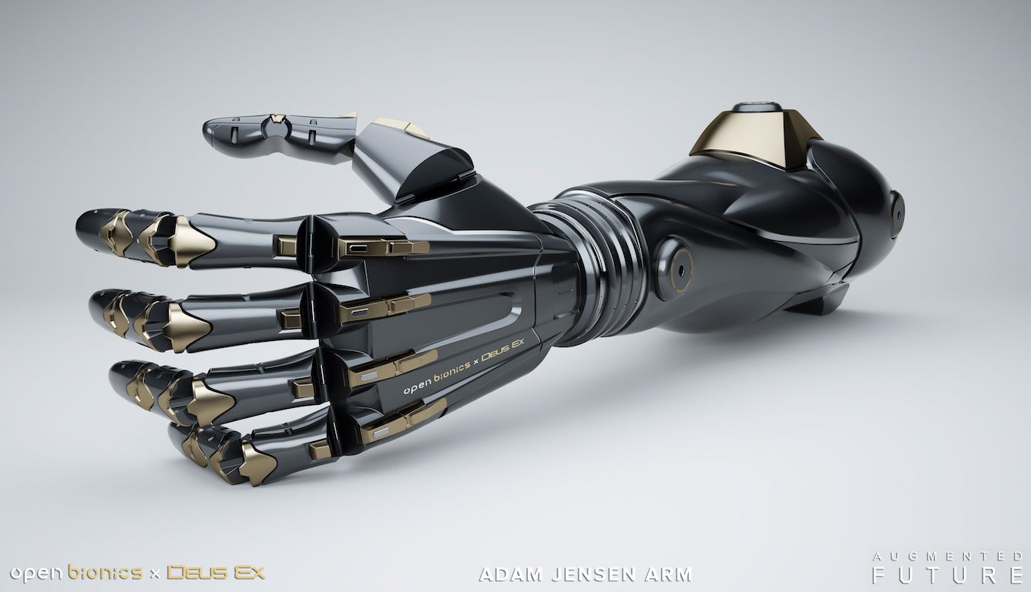
September, 26 2017
MIU X-PROSTHETIC Real-time arm controlling
By: Hassan Hamdy, Philip Naguib, Amr Hamdi, Hossam Badr
Supervised by dr.sara nabil and Eng: radwa samy
1

Slide 2
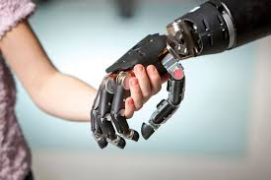
Introduction
How do we control our bodies?
Approximately 185,000 amputations occur in the United States each year[1]
In 2009, hospital costs associated with amputation totaled more than $8.3 billion[2]
[1]Owings M, Kozak LJ, National Center for Health S. Ambulatory and Inpatient Procedures in the United States, 1996. Hyattsville, Md.: U.S. Dept. of Health and Human Services, Centers for Disease Control and Prevention, National Center for Health Statistics; 1998.
[2]HCUP Nationwide Inpatient Sample (NIS). Healthcare Cost and Utilization Project (HCUP). Rockville, MD: Agency for Healthcare Research and Quality; 2009.
2

Slide 3
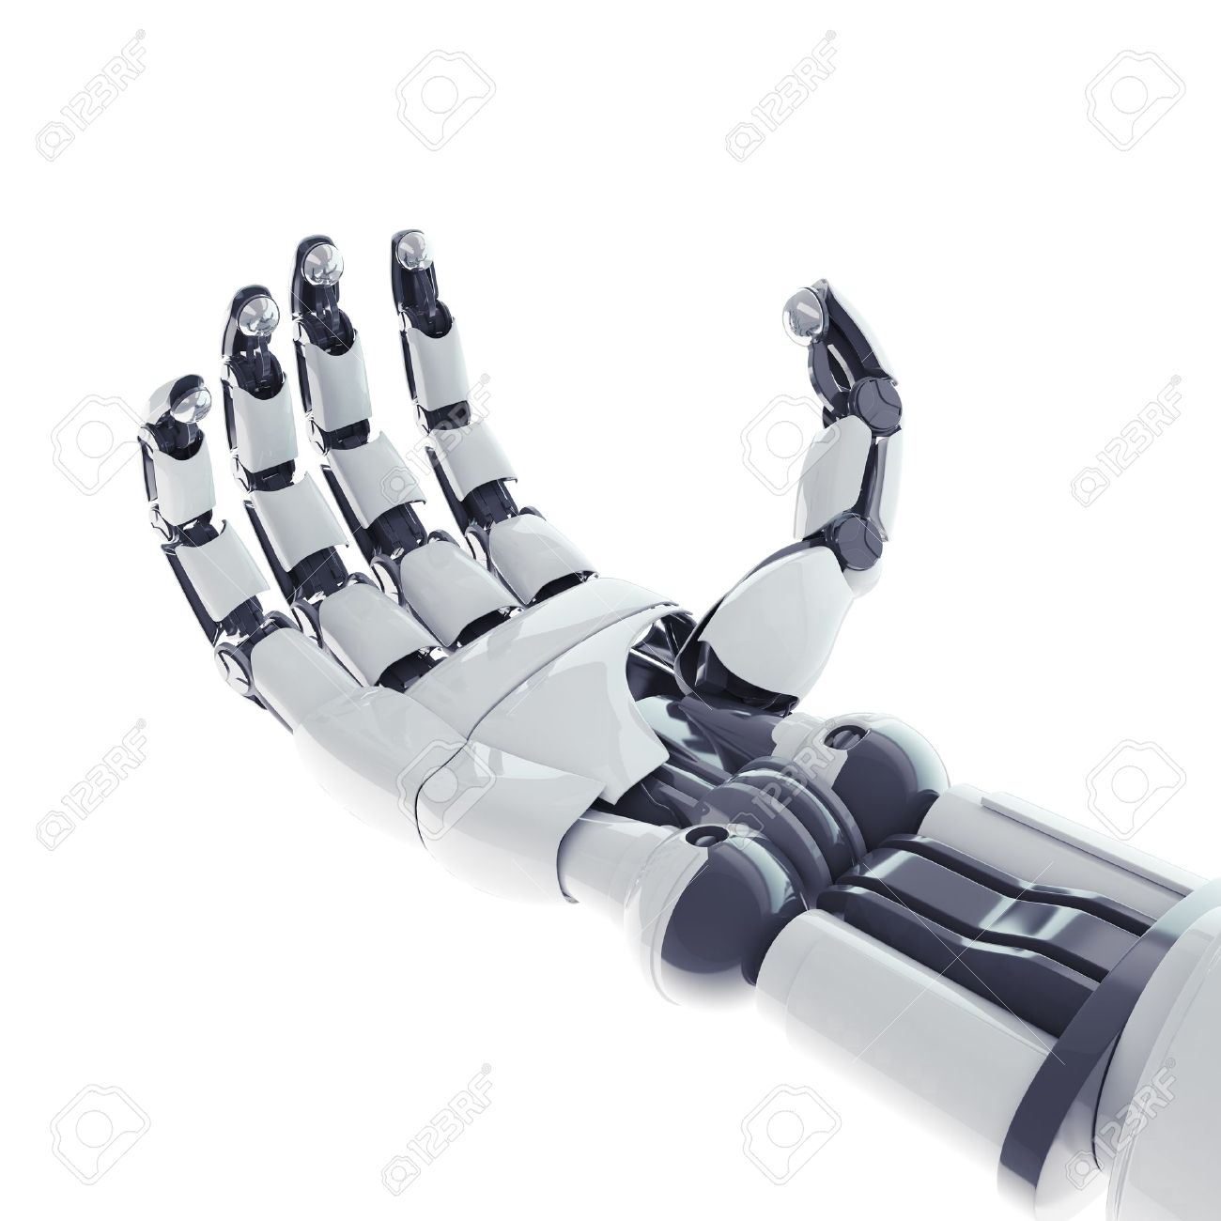
Solution
We are trying to detect signals and control robotic arm.
Classify signals to control remotely arm with MYO armband
3

Slide 4
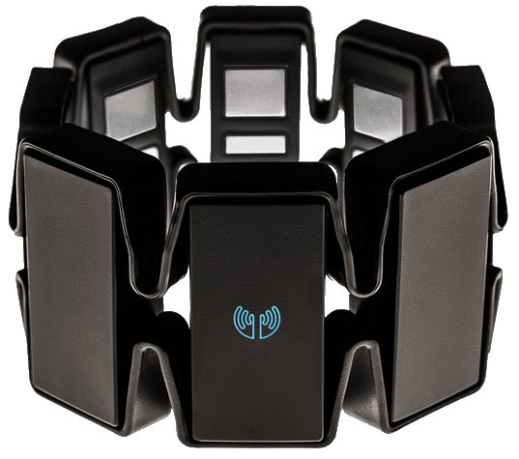
Solution
EMG and inertial signals
MYO have 8 sensor take signals from 8
different muscles

Slide 5
Project Description
Detecting and classification signals
Training system
Testing.
5

Slide 6
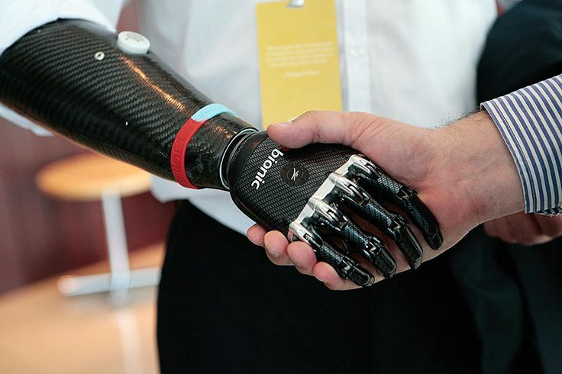
Related work-1: bebionic arm
This is first and only certified commercial programable arm NOT learnable machine
detect only 14 movements
6

Slide 7
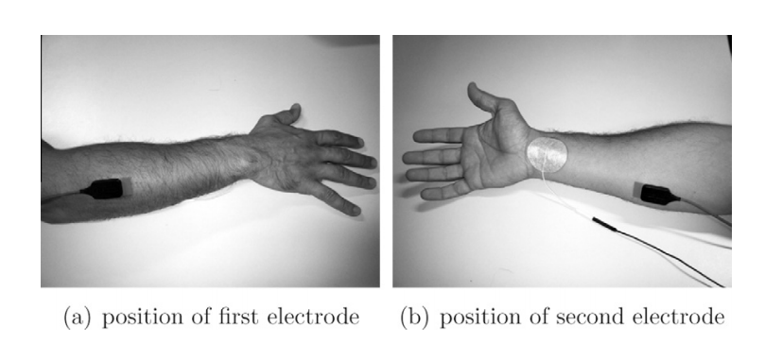
Related work -2:
Recording data with electrodes
And it feature 10 movements
7

Slide 8
Table of comparisons
Points of comparisons | Algorithm Used | Accuracy Achievement % | Movements | Cost
bebionic arm | Programmable | Up to 85% | 14 Movements | 11,000$
Toward improved control of prosthetic fingers using surface electromyogram (EMG) signals | KNN and SVM | Classification accuracy 90% | 10 Movements | -
Our proposed system | KNN and RMS on mobile device. SVM on server | - | - | 200$ + Arm price
8

Slide 9
Problem Statement
IMPROVEMENT OF CLASSIFICATION, ACCURACY of EMG signals then detect it from myo armband device and control other device remotely In REAL-TIME, cost REDUCTION
DETECT EMG signals from a MYO armband device then CLASSIFY and IMPROVE ACCURECY and control remotely by MOBILE in REAL-TIME
COST REDUCTION
9

Slide 10
System overview

Slide 11
SERVER side
STORING DATA IN OUR DATABASE
SENDING RESULTS TO MOBILE
APPLYING SVM

Slide 12
System Overview
MOBILE SIDE.
Preprocessing
HIGH-PASS FILTER
Feature-Extraction
RMS
UNITY CONTROLING-ARM
Classification
KNN

Slide 13
System overview
MYO device will send signals to the Mobile Device and study it then the Mobile device will control some device
We will use KNN (Offline) and CNN (online)
Signals generated and stored for the learning system in advance.
13

Slide 14
System overview preprocessing
Takes place on mobile (offline) or a server side (online)
14

Slide 15
Future Work
We will Try to Learn From any new signals by deep learning to increase the number of movements so we will implement CNN for deep learning.

Slide 16
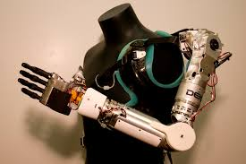
OUR Movements

Slide 17
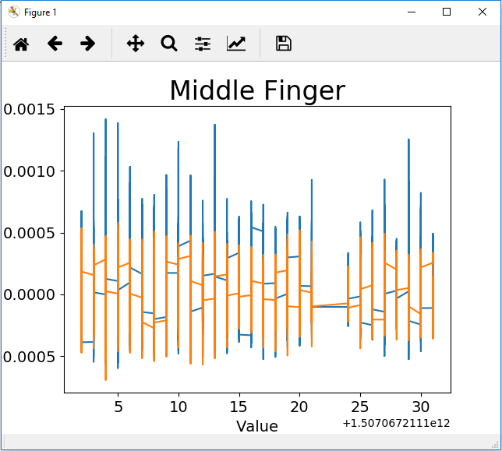
DEMO

Slide 18
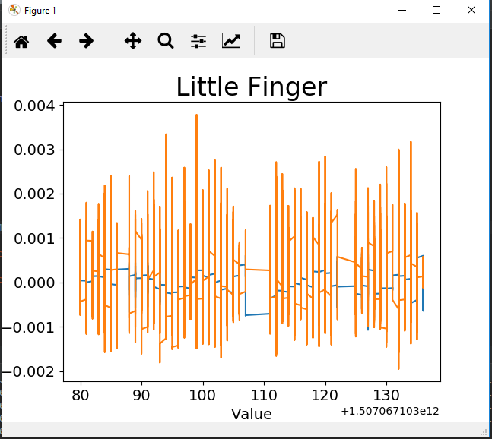
DEMO

Slide 19
DEMO

Slide 20
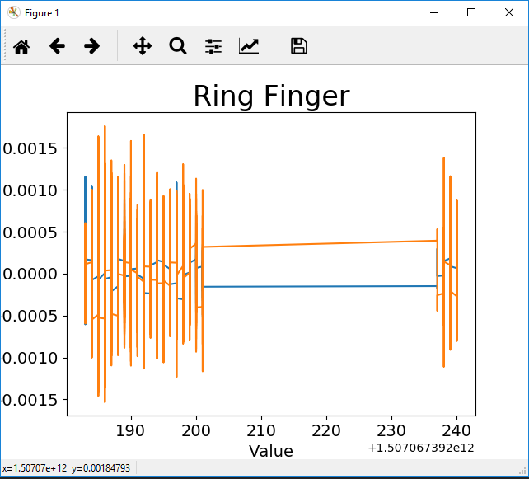
DEMO

Slide 21
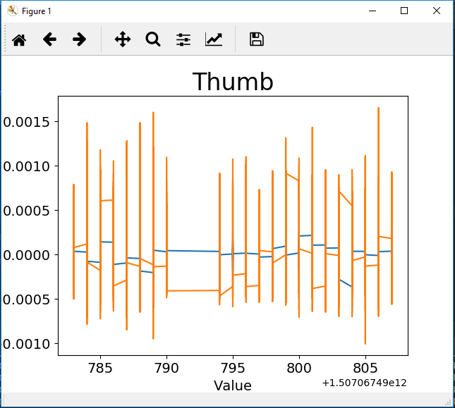
DEMO

Slide 22
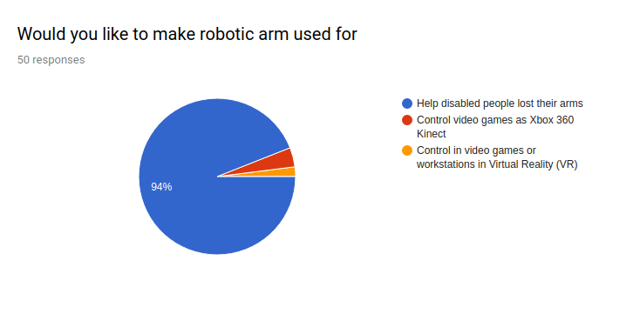
22

Slide 23
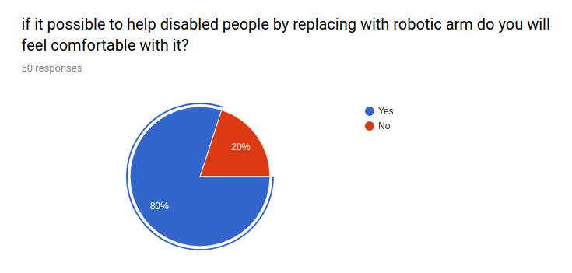
23

Slide 24
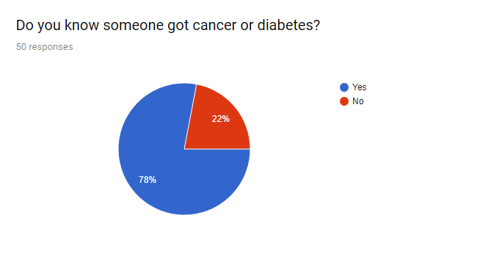
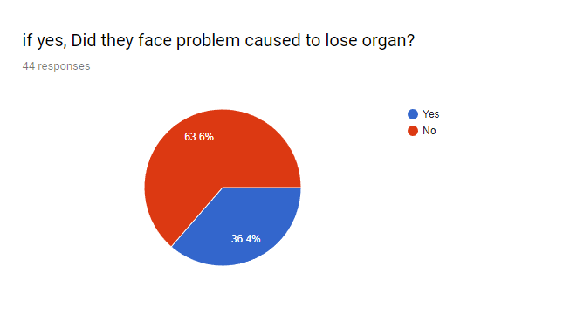
24

Slide 25
Any questions?!
25

Slide 26
KNN Algorithm
K-Nearest Neighbors (KNN) classier is a non-parametric classier, which classifies a given item into one of the categories by finding its k nearest neighbouring items.
26

Slide 27
SVM ALGORITHM
SUPPORT VECTOR MACHINE (SVM) is a class of machine learning that has successfully been applied to analyzing vectors.

