Slide 1
BREACTOR SOFTWARE DESIGN DOCUMENT
Team Members : Abdelrahaman Shahata , Ahmed Hany , Doaa Hamed , Nader El- Sheikh
Supervised By : Dr Sarah Nabil Teaching Assistant : Eng Menna Gamil

Slide 2
Table of content
Introduction
System overview
Architecture Diagram
Sequence Diagram
Class Diagram
Main Algorithms()
User Interface
Requirement Matrix
DataSet Details
Demo

Slide 3
Introduction
Purpose:To illustrate the system architecture and sequence and to detect the drowsiness for the drivers
Scope:Is to detect the drowsiness of the driver or abnormal behavior and save drivers life’s as to avoid accident happening.
Overview:Their will be some questions for user to take a survey about what user prefer the way to pay attention to traffic and road, if he fall asleep the system will alert him.

Slide 4
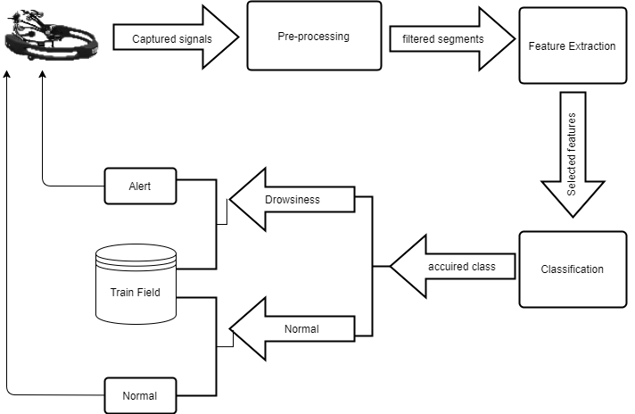

System overview

Slide 5
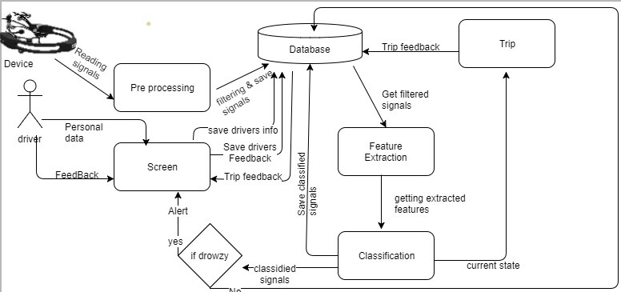

Architecture Diagram

Slide 6
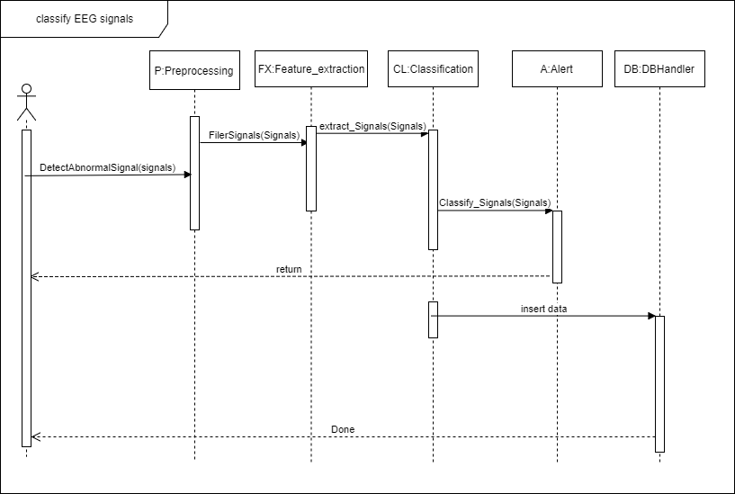

Sequence digram

Slide 7
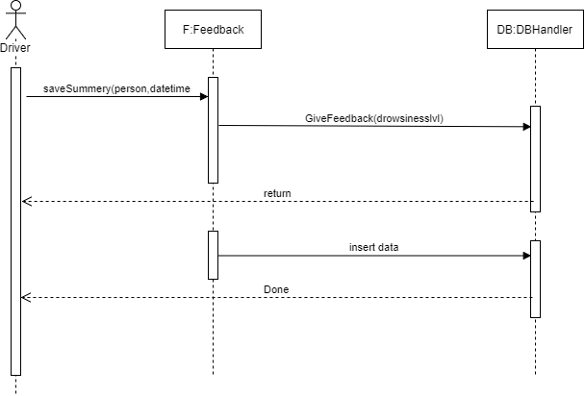

Sequence digram(2)

Slide 8
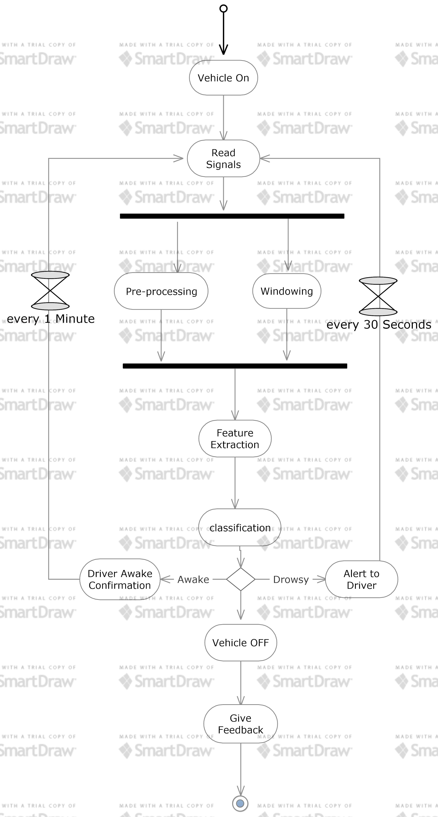

Activity Digram

Slide 9
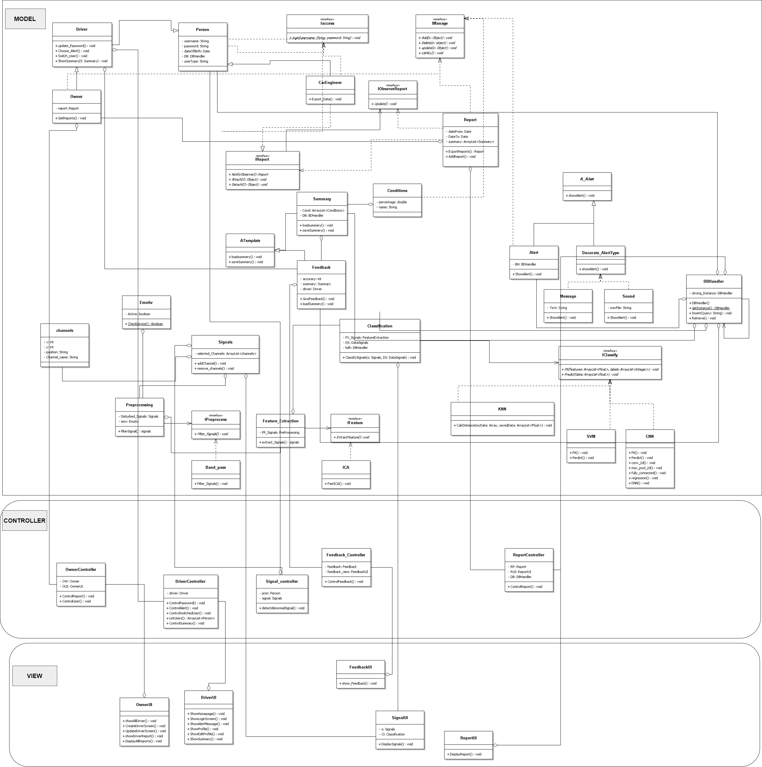

Class Diagram

Slide 10
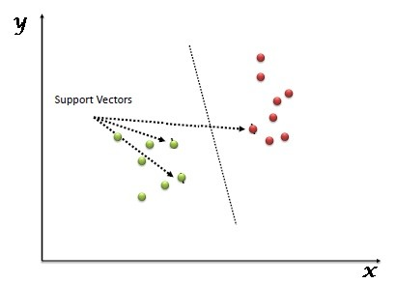

Component design
Main Algorithm (1)
Support Vector Machine ( SVM )
it is mostly used in classification problems.
In this algorithm, we plot each data item as a point in n-dimensional space (where n is number of features you have) with the value of each feature being the value of a particular coordinate.

Slide 11
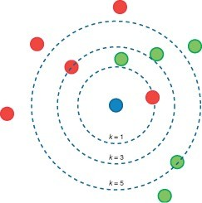

Main Algorithms (2)
K Nearest Neighbor (KNN)
Algorithm sort scenarios
Predict class based on distance functions
K value make normal distribution with accuracy

Slide 12
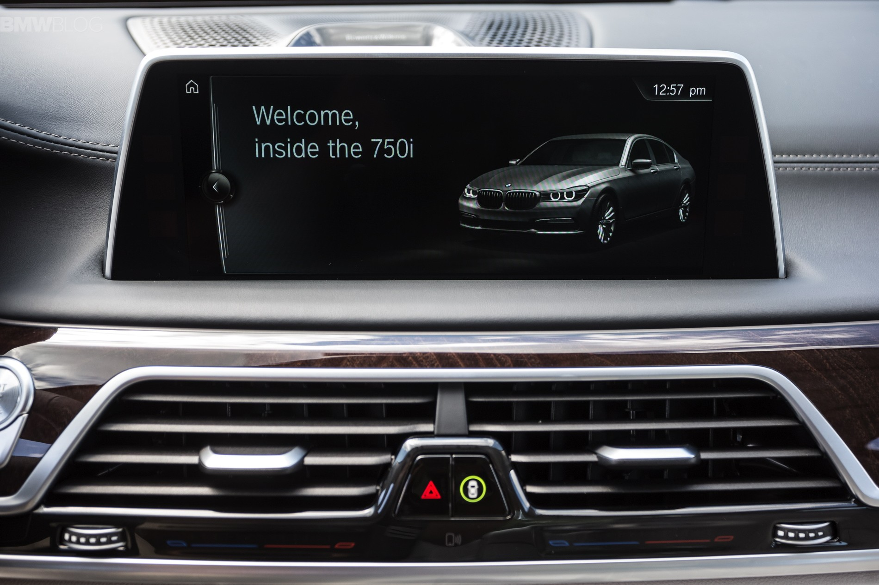

User Interface

Slide 13
Requirement matrix
Rec. Id | Rec. Type | Rec. Name | Req. Des. | Status
BREACTOR06 | Required | Reading the signals | This function is responsible for reading the signal | Completed
BREACTOR05 | Required | filter signals | the used signals will be filtered according to a certain | not- Completed
BREACTOR09 | Required | Classifying Training | Classifying of the signal | Completed
BREACTOR04 | Required | Save Driver Signal | user data will be saved in the memory card | not- Completed

Slide 14
DataSet Details
It’s called DROZY, is a database containing various types of drowsiness-related data (signal, images, etc.)
Data are recorded at a frame rate of 512 Hz
It contains 5 EEG signals: ‘FZ’ , ‘CZ’ , ‘C3’ , ‘C4’ , ‘PZ’
It Contains 36 Subject-test
We choose theta and alfa law

Slide 15
Demo

Slide 16
Thank you

Slide 17
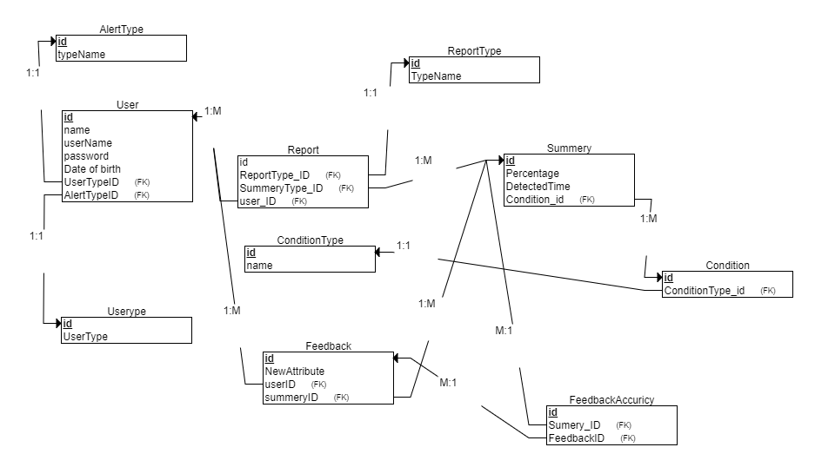

DataBase Schema

Slide 18
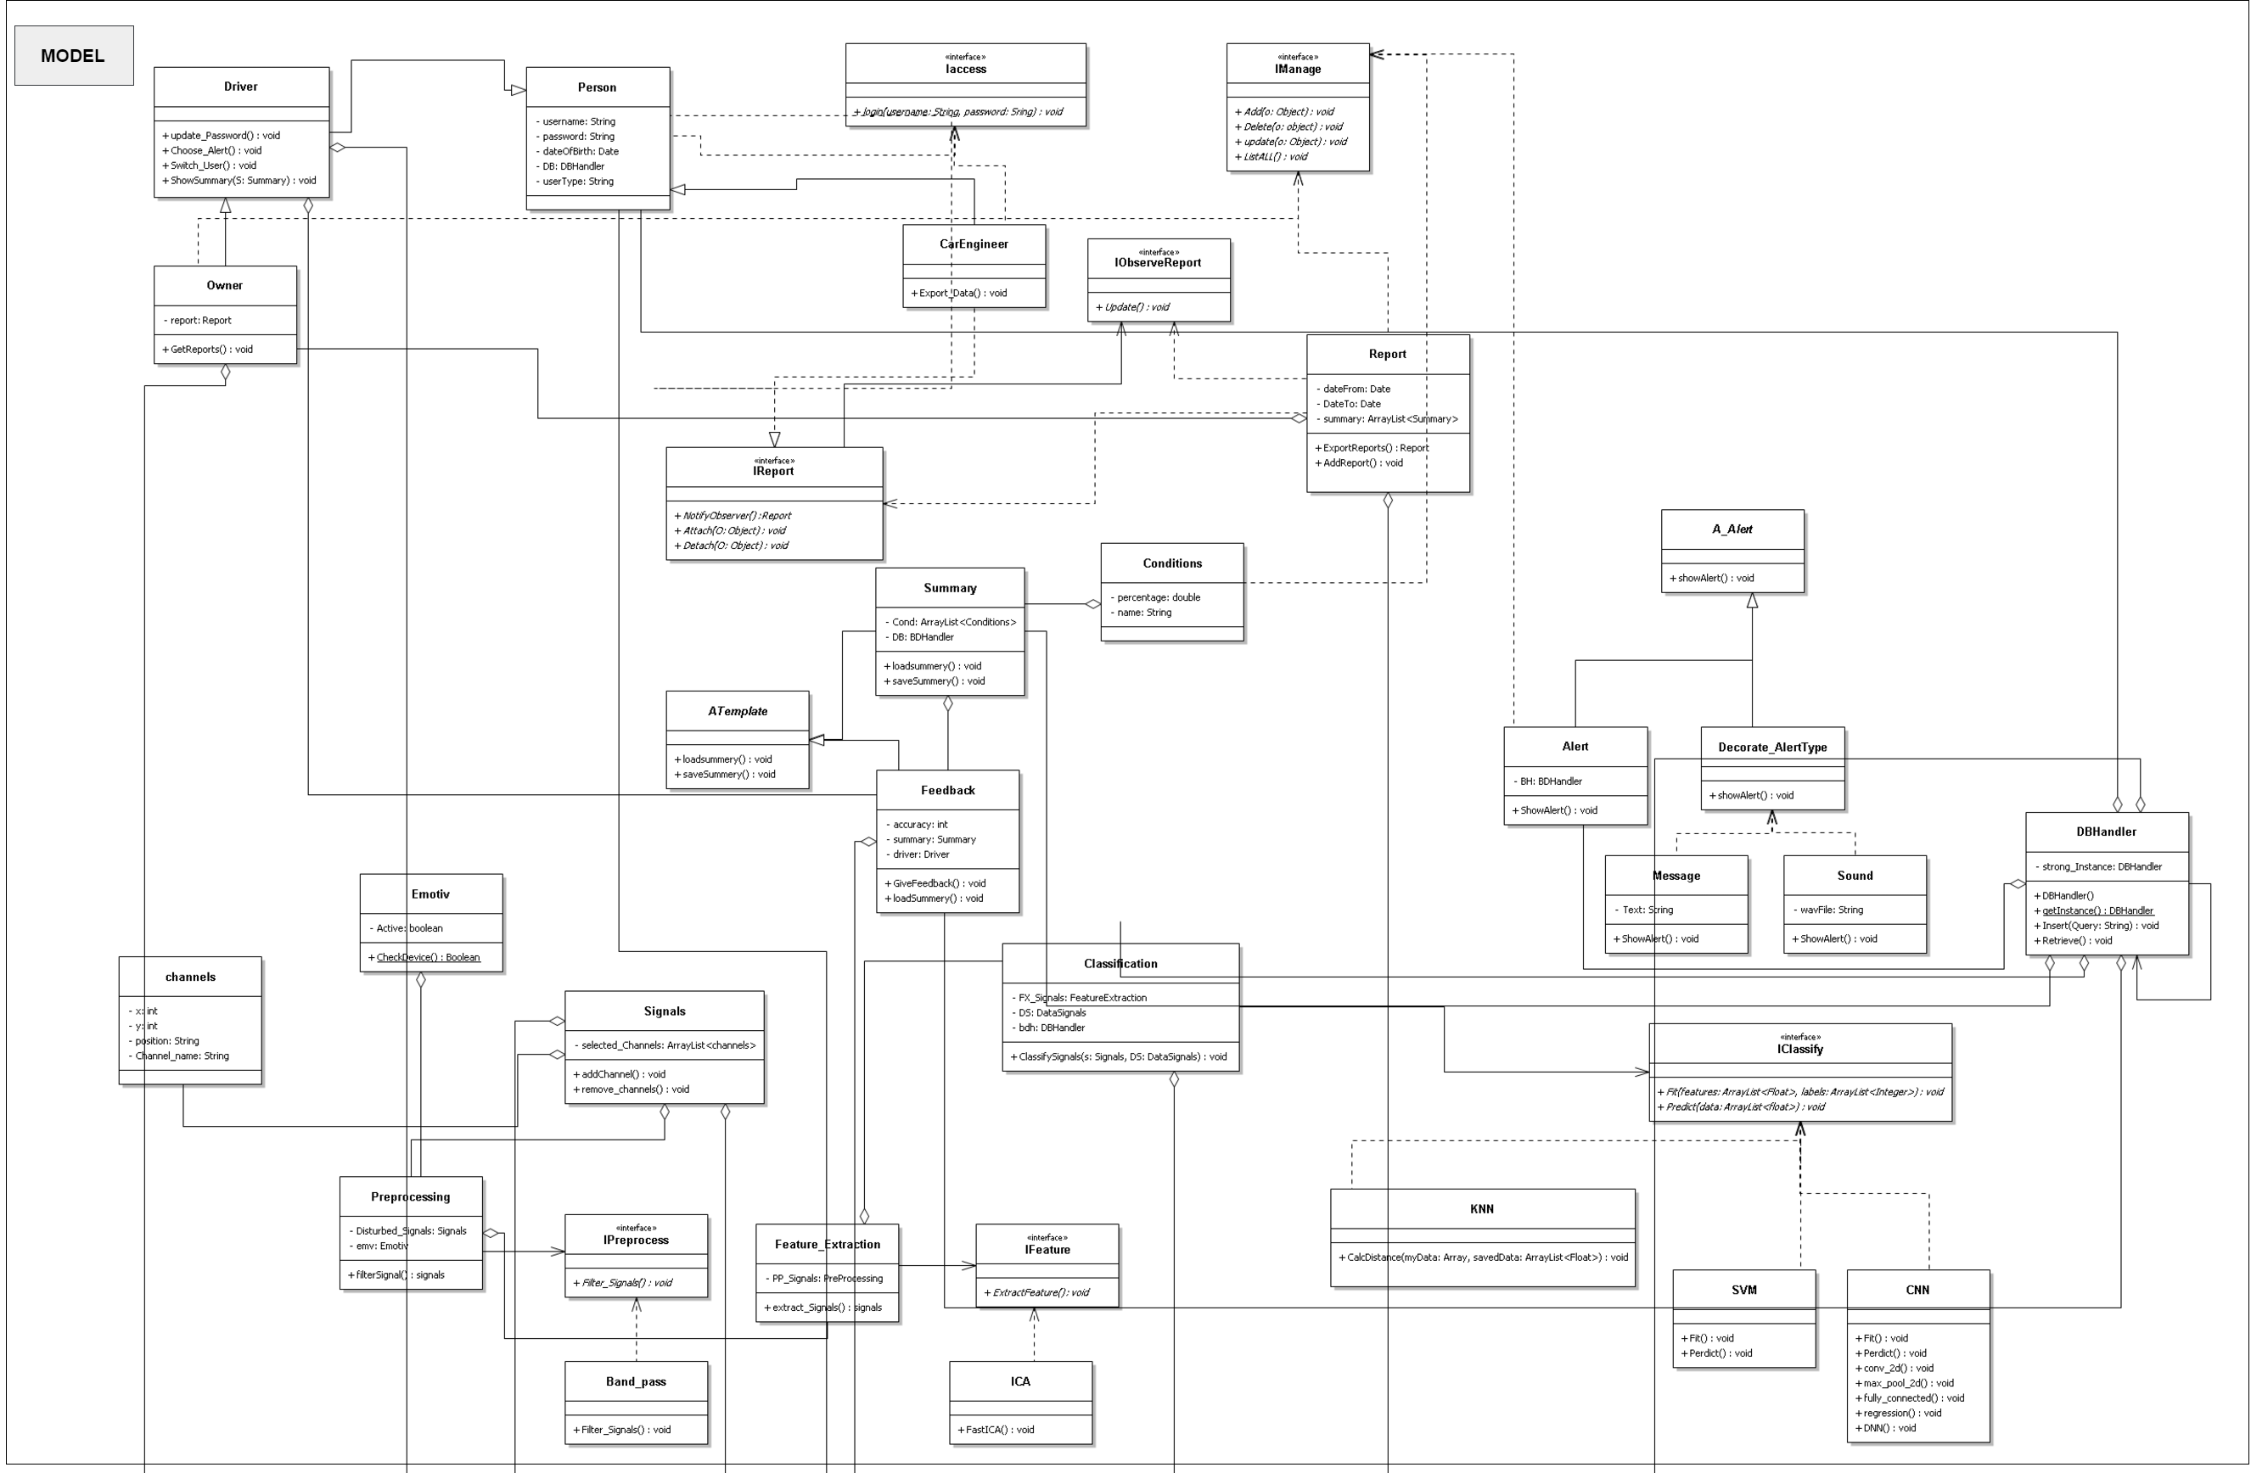

Class Diagram(Model)

Slide 19
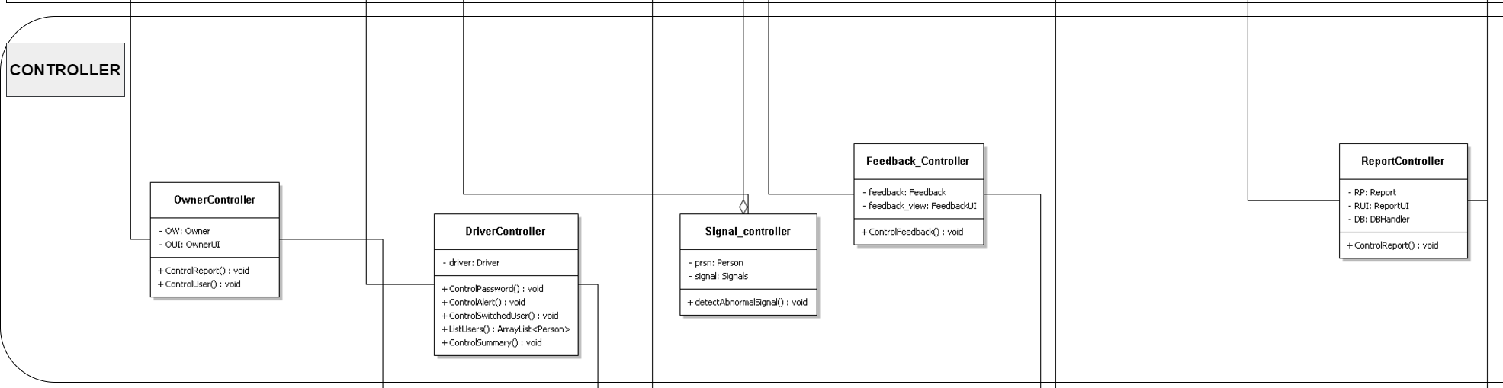

Class Diagram(Controller)

Slide 20
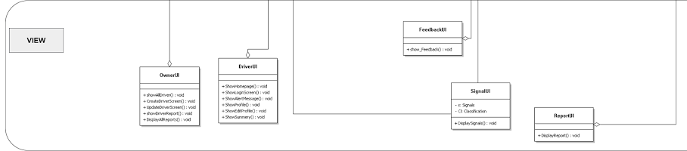

Class Diagram-(view)

Slide 21
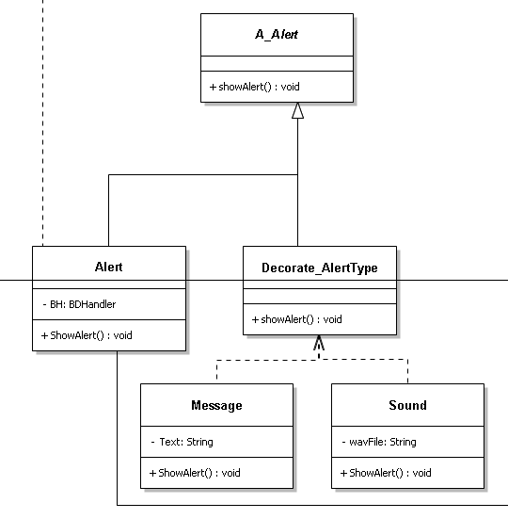

Class diagram- Decorative

Slide 22
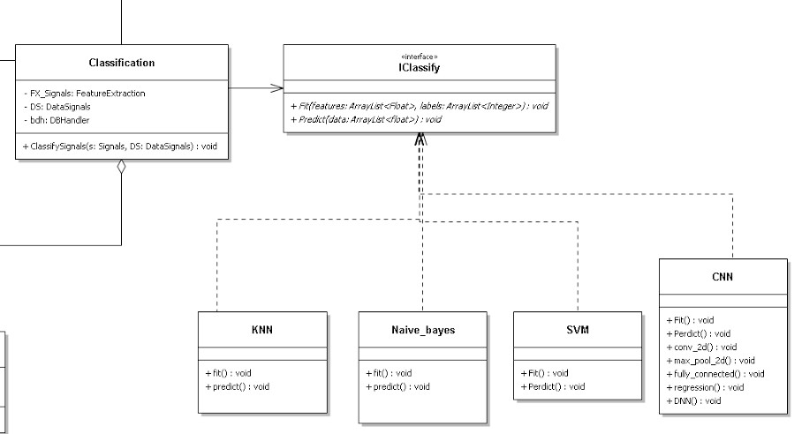

Class diagram- Strategy

Slide 23
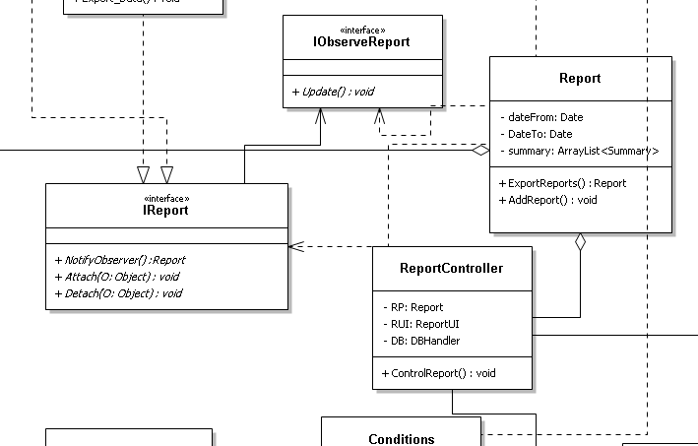

Class diagram – Observer

Slide 24
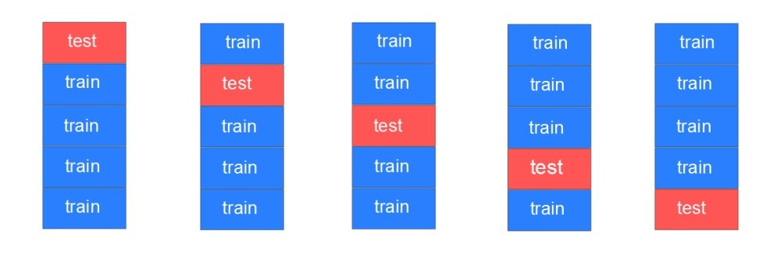

Cross Validation
For each behavior:
37 training samples.
Cross validation was recommended to be 10.
It is applied on SVM, KNN, CNN and naïve Bayes.

Slide 25
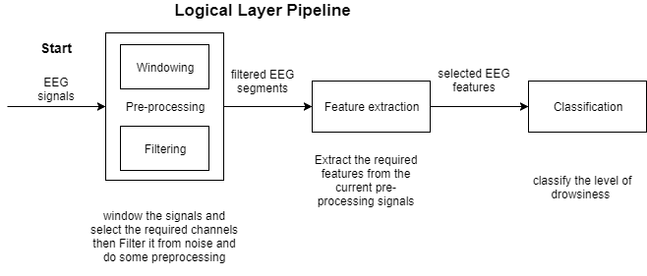

Logic Layer Pipeline

