Slide 1
“BRECTOR”
Driving behavior BCI
21nd September 2017
BY:
Ahmed Hany –Nader El-sheikh – Doaa Hamed – Abdelrahman Shahata
Under Supervision :
Doctor : Sarah Nabil- TA : Menna el-masry

Slide 2

Introduction: Analysis
1.3 million people die in road crashes each year. [1]
Road traffic crashes rank as the 9th leading cause of death. [1]
90% of all road fatalities occur in low and middle-income countries. [1]
Jump from 9th to 5th in 2030. [1]

Slide 3

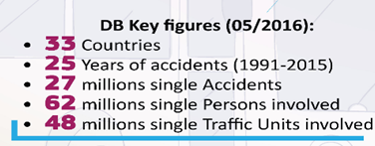

Slide 4
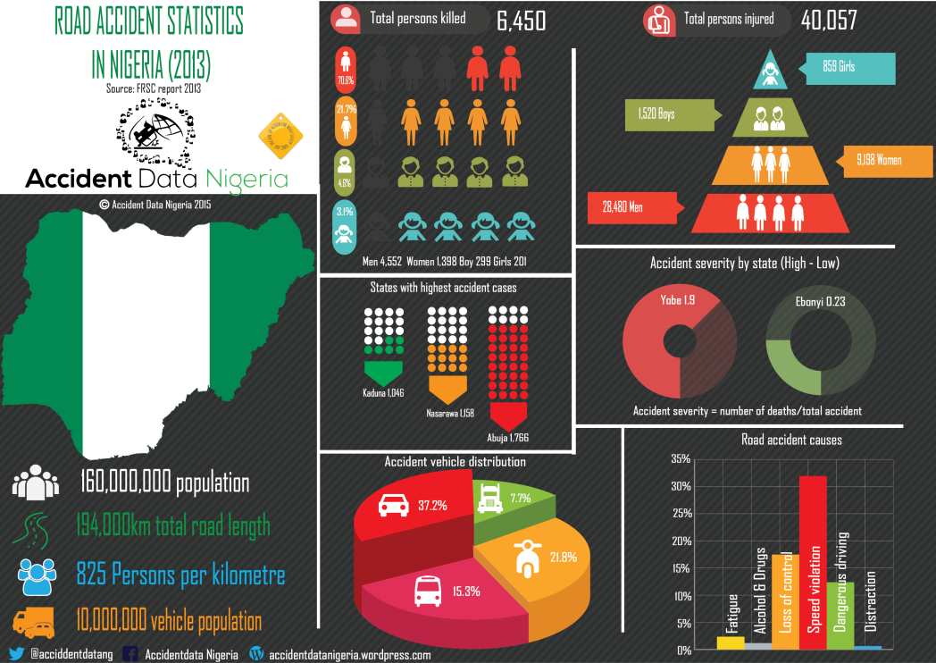
Federal Road Safety Corp[1]

Slide 5
Introduction-Signals
Human electrical signals.
Brain interactive structures.
Brain computer Interaction(BCI).

Slide 6
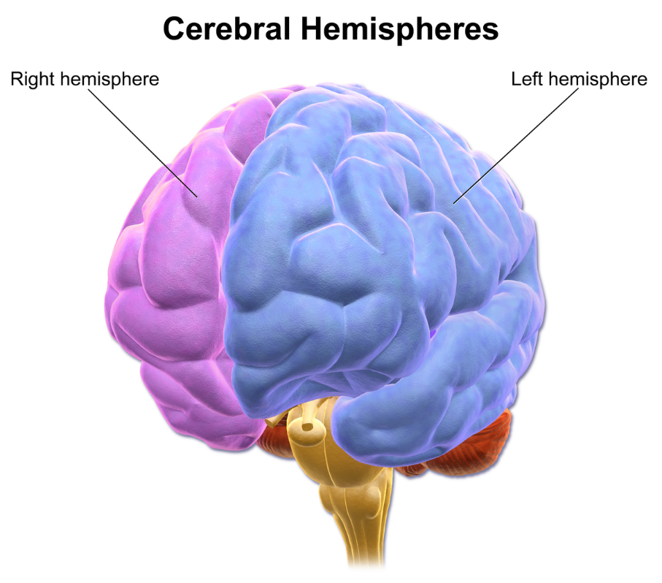
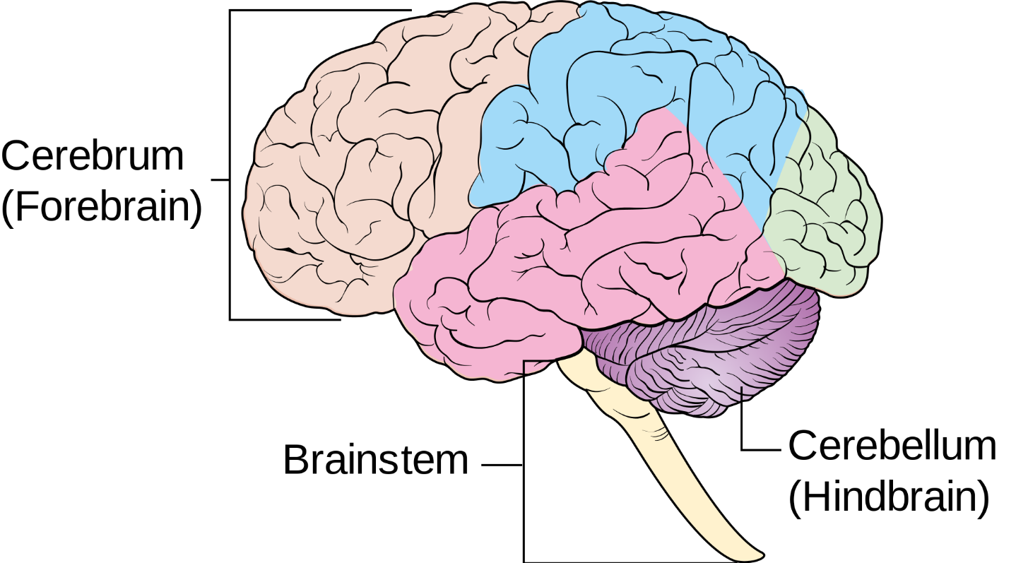
Brain
Complex organ
Scientist divide it into parts
The largest Part is cerebrum

Slide 7
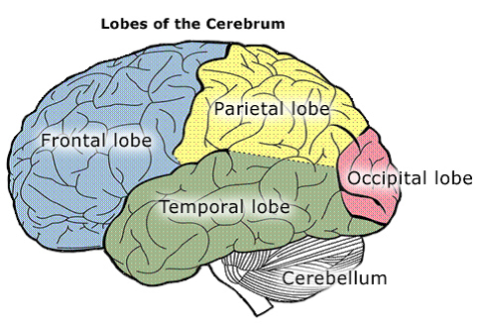
Introduction: Brain interactive structures.
The frontal lobe Personality
Emotions,
Higher thinking skills
The parietal lobe Attention,
Language.
The occipital lobe see,
recognition of shapes and colors.
The temporal lobe Hearing,
Language,
Reading.
https://www.youtube.com/watch?time_continue=6&v=EeE7Fpg061I

Slide 8
Brain Waves
Brainwave are produced by synchronized electrical pulses from masses of neurons communicating with each other

Slide 9
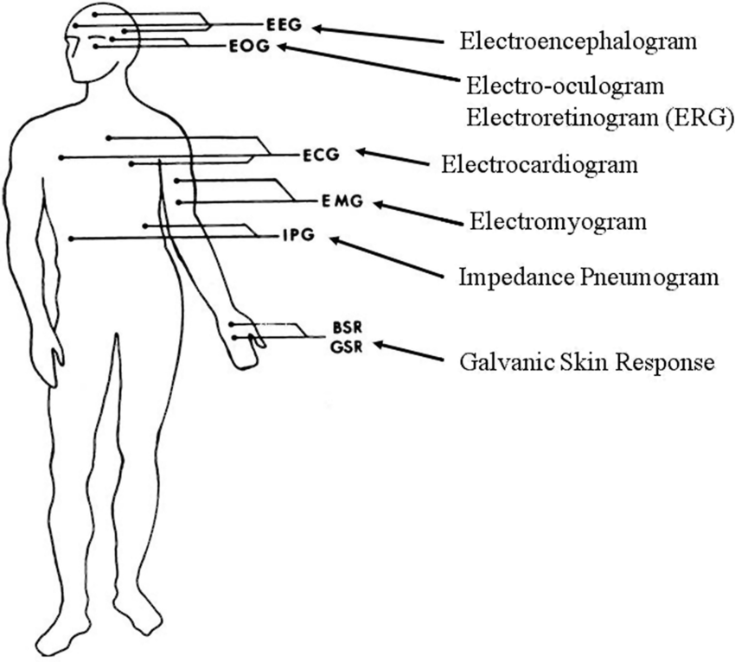
Types of Bio-Signals

Slide 10
Introduction: Bio Signals VS Camera
\ | Camera | Bio Signals (EMG&EEG)
Decide & take action | Detect outside behavior | Detect Decision before taking action
Subconscious | ~ | Detect behavior
Wearing sun Glass while eye close | ~ | Detect low brain signals
Looking calm but feeling angry or stressed | ~ | Detect his feeling

Slide 11
Driving Abnormal behaviors
(Drowsy driving)
Negative Emotions:
  Getting into an argument with your significant other.
  A stressful day at work.
  Another driver on the road cuts you off.
  Receiving sad/distressing news.
  Running late to an important appointment.

Slide 12
Driving Abnormal behaviors
(Drowsy driving) 2
Positive emotion:
  Receiving a raise at work.
  Getting good/exciting news.
  Heading to or from a celebration.
  Winning a prize.
  Listening/singing along to a song you really like.

Slide 13
Driving Abnormal behaviors
Handling Emotional Distractions
Pull over (if you're already driving).
Take deep breaths, perhaps while counting backwards in odd intervals.
Turn some calming/enjoyable music on.
Remember that you have full control over your own actions and intentions, not the person, idea, or event affecting you.
Envision the consequences of your actions if you began driving recklessly.
Notes:
https://www.dmv.org/how-to-guides/driving-and-emotions.php

Slide 14
First Related Work
Identifying Stable Patterns over Time for
Emotion Recognition from EEG
Algorithms and Techniques :
Pre-processing: Band-pass Filter ,Linear Dynamic System ,Down Sampling to 128 Hz
Feature Extraction: Power Spectral Density(PSD), Differential Entropy(DE), Differential Asymmetry(DASM), Rational Asymmetry(RASM) , Differential Caudality (DCAU), Asymmetry (ASM)
Classification: K Nearest Neighbors (KNN) , Logistic Regression (LR) , Support Vector Machine ( SVM )
Results : Average classification accuracy of 79.28%.
Challenges : Focus on identifying EEG stability in emotion recognition

Slide 15
Second Related Work
Detecting Emergency Situations by Monitoring
Drivers' States from EEG
Algorithms and Techniques :
Pre-processing : Band-pass filter between 0.53 and 60 Hz to remove other high-frequency noise for further analysis
Feature Extraction : LDA (Linear Discriminant Analysis)
Classification : Threshold
Results : can recognize the emergency situation within one second (which is shorter than the response time of drivers) with an accuracy of about 70%

Slide 16
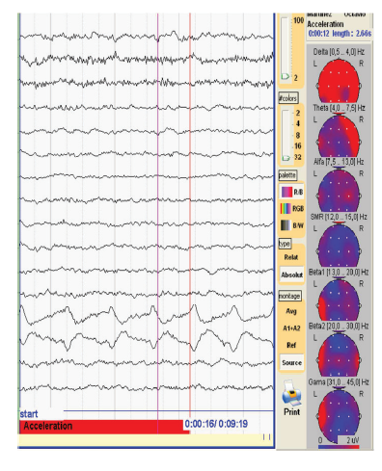
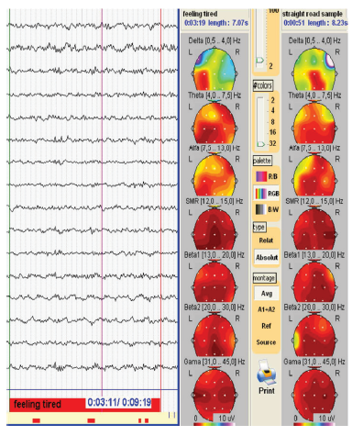
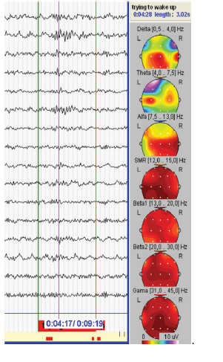

Slide 17
Related Work Comparison ( EEG )
Name | Pre-processing | Feature Extraction | Classification | Results
BREACTOR | Band-pass Filter, ICA | FFT | Support Vector Machine, KNN | No Results Yet
Detecting Emergency Situations by Monitoring Drivers' States from EEG | Band-pass Filter | Linear Discriminant Analysis | Threshold | 70%
Identifying Stable Patterns over Time for Emotion Recognition from EEG | Band-pass Filter ,Linear Dynamic System ,Down Sampling to 128 Hz | PSD , DE , DASM, RASM , DCAU , ASM | K Nearest Neighbors (KNN) , Logistic Regression (LR) , Support Vector Machine ( SVM ) | classification accuracy of 79.28% , Differential Entropy Feature accuracy is 91.07 %
Notes:
Power Spectral Density(PSD), Differential Entropy(DE), Differential Asymmetry(DASM), Rational Asymmetry(RASM) , Differential Caudality (DCAU), Asymmetry (ASM)

Slide 18
Third Related Work
Evaluation of the Myo Armband for the Classification of hand motions
Algorithms and Techniques :
Single Pre-processing : high pass filter
Feature Extraction pattern recognition
Classification : Support Vector Machine (SVM), K-Nearest Neighbor (KNN), Artificial Neural Networks (ANN), Linear Discriminant Analysis (LDA).
Results :
Accuracy Detection : f 5.82 ± 3.63% for CONV and 9.86 ± 8.05% for MYB with no significantly difference

Slide 19
Fourth Related Work
Arm Motion Estimation Algorithm using MYO Armband
Algorithms and Techniques :
Single Pre-processing : high pass filter
Feature Extraction Levenberg-Marquardt
Classification principal component analysis (PCA) and artificial neural network (ANN)
Results :
Accuracy Detection : they achieved a training accuracy of 85.7% and a testing accuracy of 81.2%.

Slide 20
Related Work Comparison(EMG)
Name | Pre-processing | Feature Extraction | Classification | Results
Evaluation of the Myo Armband for the Classification of hand motions | high pass filter | pattern recognition | (SVM), (KNN), (ANN), (LDA). | f 5.82 ± 3.63% for CONV and 9.86 ± 8.05% for MYB
Arm Motion Estimation Algorithm using MYO Armband | high pass filter | Levenberg-Marquardt | (PCA) ,(ANN) | It was found from experiments that the proposed method achieves a training accuracy of 85.7% and a testing accuracy of 81.2%.

Slide 21
Problem statement
Trying to increase the accuracy of detecting the abnormal behavior of the driver by reading Bio signals.

Slide 22
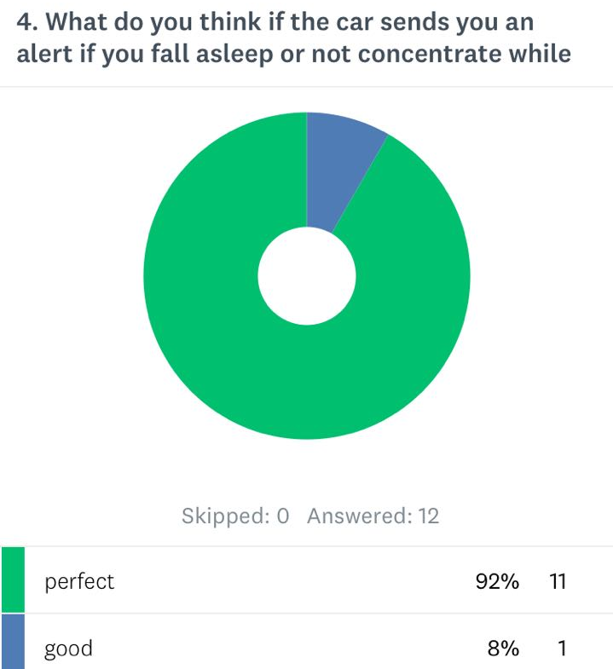
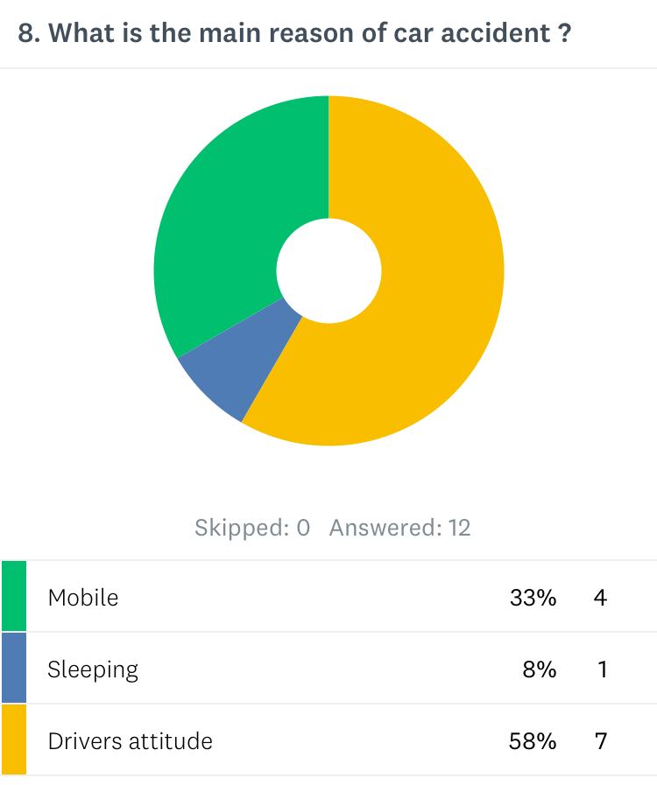
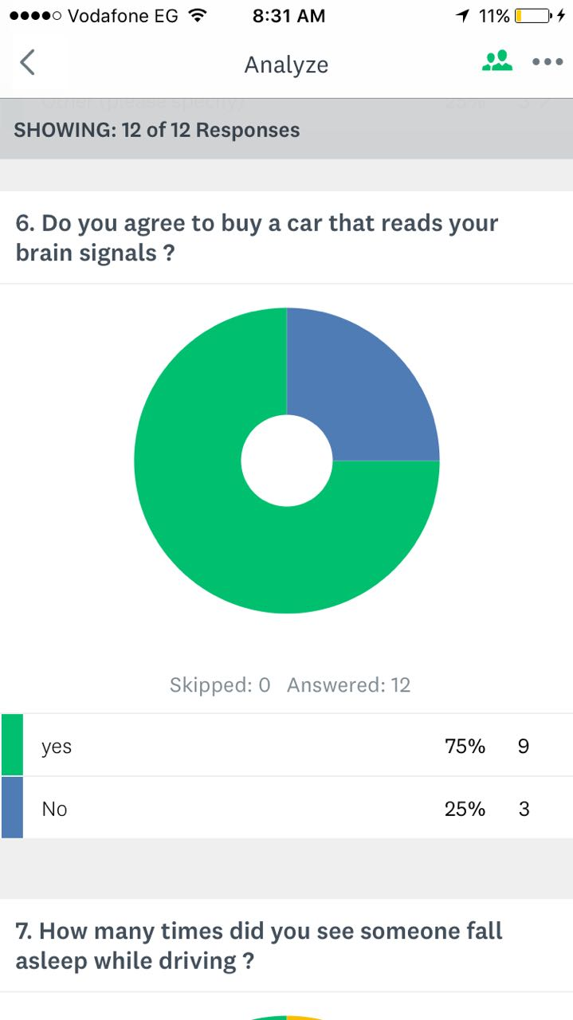
Market motivation

Slide 23
Academic motivation
BCI is still growing
System still facing problems in accuracy and detection.
BCI still not well-known technology.

Slide 24
System Overview
Reading signals
Preprocessing (filter wise)
Feature extraction
classification
Algorithms:
Independent Component Analysis(ICA)
linear quadratic estimation (LQE)(Kalman filter)
Autoregressive coefficients(AR)
Selected Algorithm:
ICA for identification +
FFT bandpass filter
Algorithms:
Common spatial pattern(CSP)
Asymmetric spatial pattern(ASP)
Asymmetric Features (AF)
Power spectrum density (DSP)
Selected Algorithm:
CSP
Bio signals
Selected Signal type:
EEG , EMG
Algorithms:
Support Vector machine (SVM)
K nearest neighbor (KNN)
Linear Discriminant Analysis (LDA)
Selected Algorithm:
SVM

Slide 25
Output
A Survey for Driver in Setup
Output Solution depending on Survey answers

Slide 26
Expected contributions
BREACTOR will detect and classify Bio-signals
BREACTOR will work in real time interaction with detecting signals and sending alerts for User

Slide 27
Demo

Slide 28
Limitation
The software required specific type of brain signal detectors.
The device should be stick to the head without removing.
The gap between the skull and the device could effect the efficiency of the detection.

Slide 29
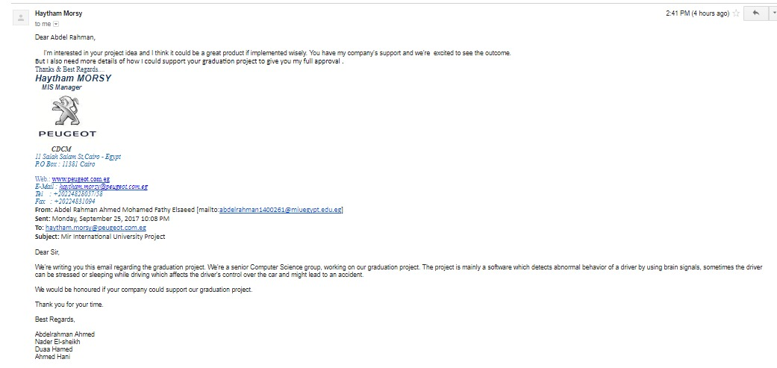
Supported motivation

Slide 30
Any Question?

Slide 31
Comparison with Feature Extraction Algorithms (1)
Method Name | Advantages | Disadvantages | Analysis Method | Suitability
Fast fourier Transform | (i) Good tool for stationary signal processing (ii) It is more appropriate for narrowband signal, such as sine wave (iii) It has an enhanced speed over virtually all other available methods in real-time applications | (i)Weakness in analyzing nonstationary signals such as EEG (ii) It does not have good spectral estimation and cannot be employed for analysis of short EEG signals (iii) FFT cannot reveal the localized spikes and complexes that are typical among epileptic seizures in EEG signals (iv) FFT suffers from large noise sensitivity, and it does not have shorter duration data record | Frequency domain | Narrowband, stationary signals
Wavelet Transform | (i) It has a varying window size, being broad at low frequencies and narrow at high frequencies (ii) It is better suited for analysis of sudden and transient signal changes (iii) Better poised to analyze irregular data patterns, that is, impulses existing at different time instances | Needs selecting a proper mother wavelet | Both time and freq. domain, and linear | Transient and stationary signal

Slide 32
Comparison with Feature Extraction Algorithms (2)
Method Name | Advantages | Disadvantages | Analysis Method | Suitability
Eigenvector | Provides suitable resolution to evaluate the sinusoid from the data | Lowest eigenvalue may generate false zeros when Pisarenko’s method is employed | Frequency domain | Signal buried with noise
Time frequency Distribution | (i) It gives the feasibility of examining great continuous segments of EEG signal (ii) TFD only analyses clean signal for good results | (i)The time-frequency methods are oriented to deal with the concept of stationary; as a result, windowing process is needed in the preprocessing module (ii) It is quite slow (because of the gradient ascent computation) (iii) Extracted features can be dependent on each other | Both time and frequency domains | Stationary Signal

Slide 33
Comparison with Feature Extraction Algorithms (3)
Method Name | Advantages | Disadvantages | Analysis Method | Suitability
Autoregressive | (i) AR limits the loss of spectral problems and yields improved frequency resolution (ii) Gives good frequency resolution (iii) Spectral analysis based on AR model is particularly advantageous when short data segments are analyzed, since the frequency resolution of an analytically derived AR spectrum is infinite and does not depend on the length of analyzed data | (i)The model order in AR spectral estimation is difficult to select (ii) AR method will give poor spectral estimation once the estimated model is not appropriate, and model’s orders are incorrectly selected (iii) It is readily susceptible to heavy biases and even large variability | Frequency domain | Signal with sharp spectral features

Slide 34
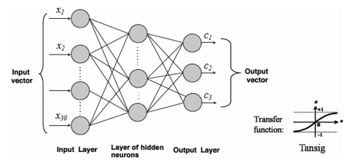
KNN(K-Nearest Neighbor)
Is a non-parametric method used for classification and regression.
In both cases, the input consists of the k closest training
The output depends on whether k-NN is used for classification or regression.

Slide 35
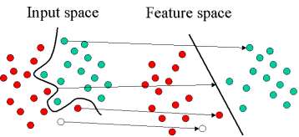
SVM (Support Vector Machine)
are supervised learning models with associated learning algorithms that analyze data used for classification and regression analysis Given a set of training examples, each marked as belonging to one or the other of two categories, an SVM training algorithm builds a model that assigns new examples to one category or the other

Slide 36
Points of comparison | KNN | SVM
Accuracy | 75.15% | 80%
Precision | 75.4% | 80.3%
F-Measure | 75.1% | 79.9%
Advantage | it is automatically non-linear, it can detect linear or non-linear distributed data It is also very sensitive to bad features (attributes) It is also sensitive to outliers and removing them before using KNN tends to improve results. | SVM can be used in linear or non-linear ways with the use of a Kernel if you have a lot of points in a low dimensional space then KNN is probably a good choice. if you have a few points in a high dimensional space then a linear SVM is probably better
Disadvantage | it is a lazy learner, it does not learn anything from the training data and simply uses the training data itself for classification | the big size may become a disadvantage

Slide 37
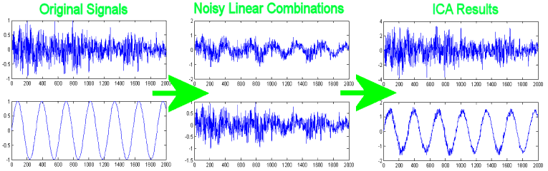
ICA( Independent component analysis)
ICA is a computational method for separating a multivariate signal into additive subcomponents. This is done by assuming that the subcomponents are non-Gaussian signals and that they are statistically independent from each other

Slide 38
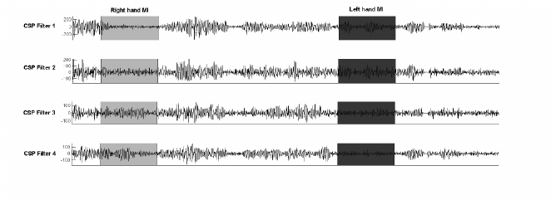
CSP (Constraint satisfaction problems)
Is a mathematical procedure used in signal processing for separating a multivariate signal into additive subcomponents which have maximum differences in variance between two windows.
Notes:
https://www.researchgate.net/figure/281076368_fig5_Fig-75-EEG-signals-spatially-filtered-using-the-CSP-Common-Spatial-Patterns

Slide 39
Points of comparison | ICA | CSP
Accuracy | High | low
Advantage | • Fast convergence (the precision with the number of iterations performed increases usually cubically, in worst case at least quadratically • Easy, convenient parallelization • No step parameter needs to be chosen
Disadvantage | The order of ICA is difficult to be determined The Fast ICA algorithm often leads to local minimum solution The suitable source signals are not isolated
Notes:
https://www.mff.cuni.cz/veda/konference/wds/proc/pdf10/WDS10_113_i2_Petricek.pdf
http://www.ijmlc.org/papers/279-LC021.pdf

Slide 40
Dataset and Analysis
Output Data (0 – 1) (awake – drowsy)
5-fold cross validation
RMSE
Power Spectral Density ( PSD ) => Feature extraction algorithm
Differential Entropy ( DE ) => Feature extraction algorithm
Channel(17) * Sample Number(885) * Frequency Band(25) (5)
Temporal Brain Areas and Posterior Brain Areas

