Slide 1
BLB (Brain/Lung/Breast) Cancer Detection
Automated detection and segmentation of tumors in three different organs - Brain, Lung & Breast.
Presented By: Bassma El-Sherbiny, Nardeen Nabil, Seif Yasser and Youssef Emad
Supervised By: Dr. Ashraf Abdelraouf, Eng. Taraggy Mohiy and Eng. Nada Ayman

Slide 2
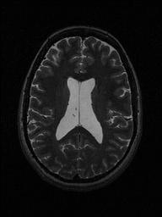
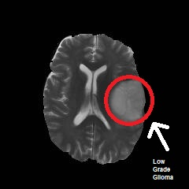
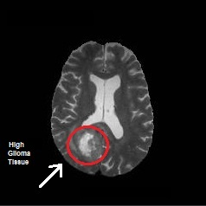
Introduction 1/3
- Gliomas are tumors that arise from the gluey or supportive tissue of the brain [1]
- Gliomas represent 24.7% of all primary brain tumors and 74.6% of all malignant tumors [1].
- Two types of Gliomas: Low Grade Glioma (LGG) and High Grade Glioma (HGG). [1]
Normal Brain
Low Grade Glioma Tumor
High Grade Glioma Tumor

Slide 3
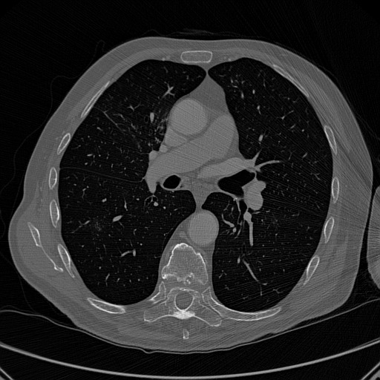
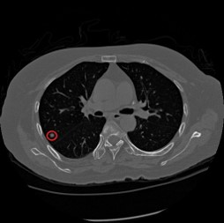
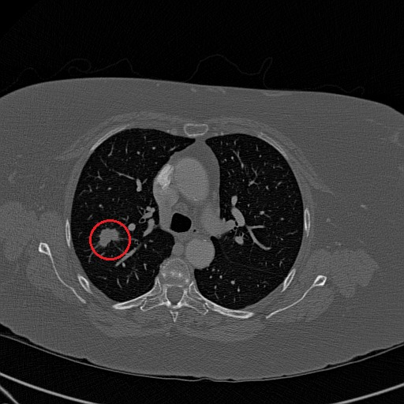
Introduction 2/3
- Lung cancer is the second most common cancer in both men and women [2].
- A nodule is a rounded opacity shape found in lung [3].
- There are two main types of nodules: malignant (cancerous) and benign (noncancerous) [3].
Normal Lung
Benign Lung Nodule
Malignant Lung Nodule

Slide 4
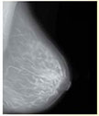
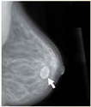
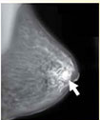
Introduction 3/3
- Breast Dense indicates the amount of dense (white) tissue on a breast mammogram [4].
- Dense tissues might hide breast cancer beneath them.
- Breast density is categorized into four different classes [4].
- Breast Cancer is one of the most dangerous cancer types that mainly affects women [5].
- There are two types of breast cancer: malignant (cancerous) and benign (noncancerous) [5].
Normal Breast Tissue
High dense tissues with no cancer
Breast Cancer tissues

Slide 5
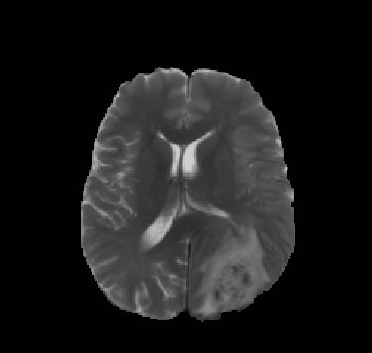
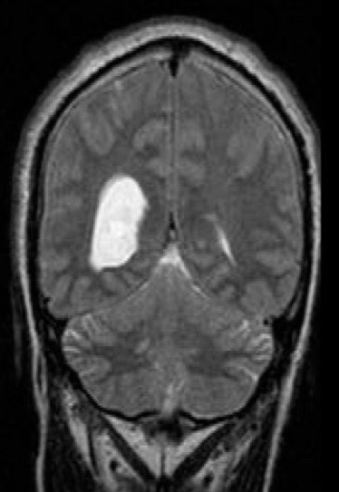
Related Work I - Brain
Tumor/Non-tumor Classification [6]
Approach
Brain tumor detection in MRI images.
Algorithms
Kmeans Segmentation, Normalized Histogram & SVM classifier.
Results
91.49% on 110 images taken from Yatharth Hospital.
Focused only on white tumor detection and didn't consider graylevel tumors
Drawbacks
Graylevel Tumor
White Tumor

Slide 6
Related Work II - Brain
Low/High Grade Glioma Classification [7]
Approach
Algorithms
Results
Drawbacks
Classification of Low-grade and High-grade Glioma usingMulti-modal Image Radiomics Features.
Three types of radiomics features, 10-foldcross validation.
89.8% on 108 cases from BRATS 2015 dataset.
16-34 Features calculated for each image which takes a lot of time in calculation.

Slide 7
Related Work III - Lung
Nodule Detection [8]
Automatic Lung Nodule Segmentation and Classification in CT Images Based on SVM.
Low system accuracy -High FP (False positives)
Approach
Algorithms
Drawbacks
Results
Preprocessing techniques, Hounsfield Units (HU) ROI calculation, Feature extraction & SVM classifier.
78.08% on SPIE-AAPM Lung CT dataset

Slide 8
Related Work IV - Lung
Nodule Classification [9]
Approach
Results
Algorithms
Drawbacks
Malignancy Level Classification of Lung Nodules.
Preprocessing techniques, SCM Features extracted, Housefield unit (HU), SVM classifier.
74.5% on LIDC dataset.
Low Accuracy.

Slide 9
Related Work V - Breast
Dense Classification [10]
Approach
Detecting masses in dense breast using independent component analysis
Algorithms
Multiple filters and K-Means segmentation
Results
92.71% in detecting masses in nondense and 79.17% in dense breasts on Mini-Mias and DDSM
Drawbacks
Low accuracy in dense breasts

Slide 10
Related Work VI - Breast
Cancer Classification [11]
Approach
Algorithms
Results
Drawbacks
Marker-controlled WatershedSegmentation and Morphological Analysis.
Detection of Breast Tumor Candidates.
90% on MIAS dataset.
Low accuracy.

Slide 11
Problem Definition
- Reduce conflicts between doctors' diagnosis.
- Reduce time taken by manual diagnosis.
- Increasse accuracy of CAD systems.

Slide 12
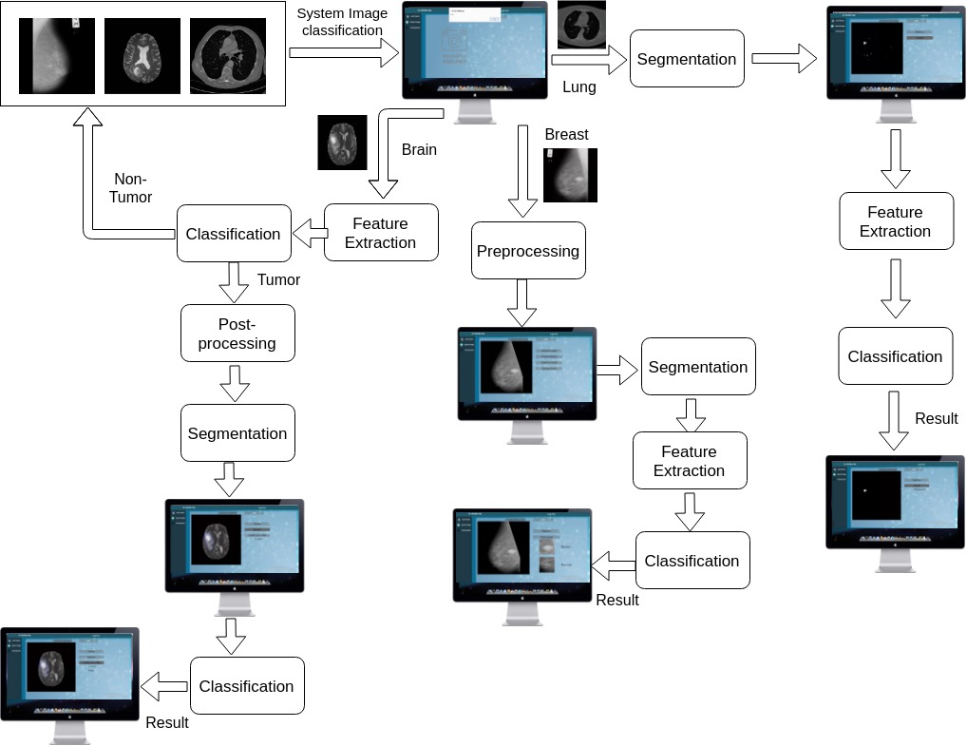
System Overview

Slide 13
Problem Definition
Methodology
Lung
Breast Dense
Features Extracted: Area, Correlation Homogeneity & Eccentricity
Segmentation: Clear Boarder, Threshold, Erosion & Closure.
Classification: Extra-Trees
Features Extracted: Modified Skewness, Smoothness, Modified Kurtosis.
Segmentation: Threshold,Connected Components.
Classification: Extra-Trees
Brain
Breast Cancer
Features Extracted: Beta, Gamma, Homogeneity & Minimum.
Segmentation: Median, K-means Dilation & Canny Edge.
Classification: SVM & Extra-Trees
Feature Extraction: None
Segmentation: Median, Most shiny.
Classification: ExtraTrees.

Slide 14
Extra-Trees [12]
- Randomized Decision Tree Based
- Best threshold Candidate Splitted To Another Trees
- Number of estimators
- Minimum impurity split

Slide 15
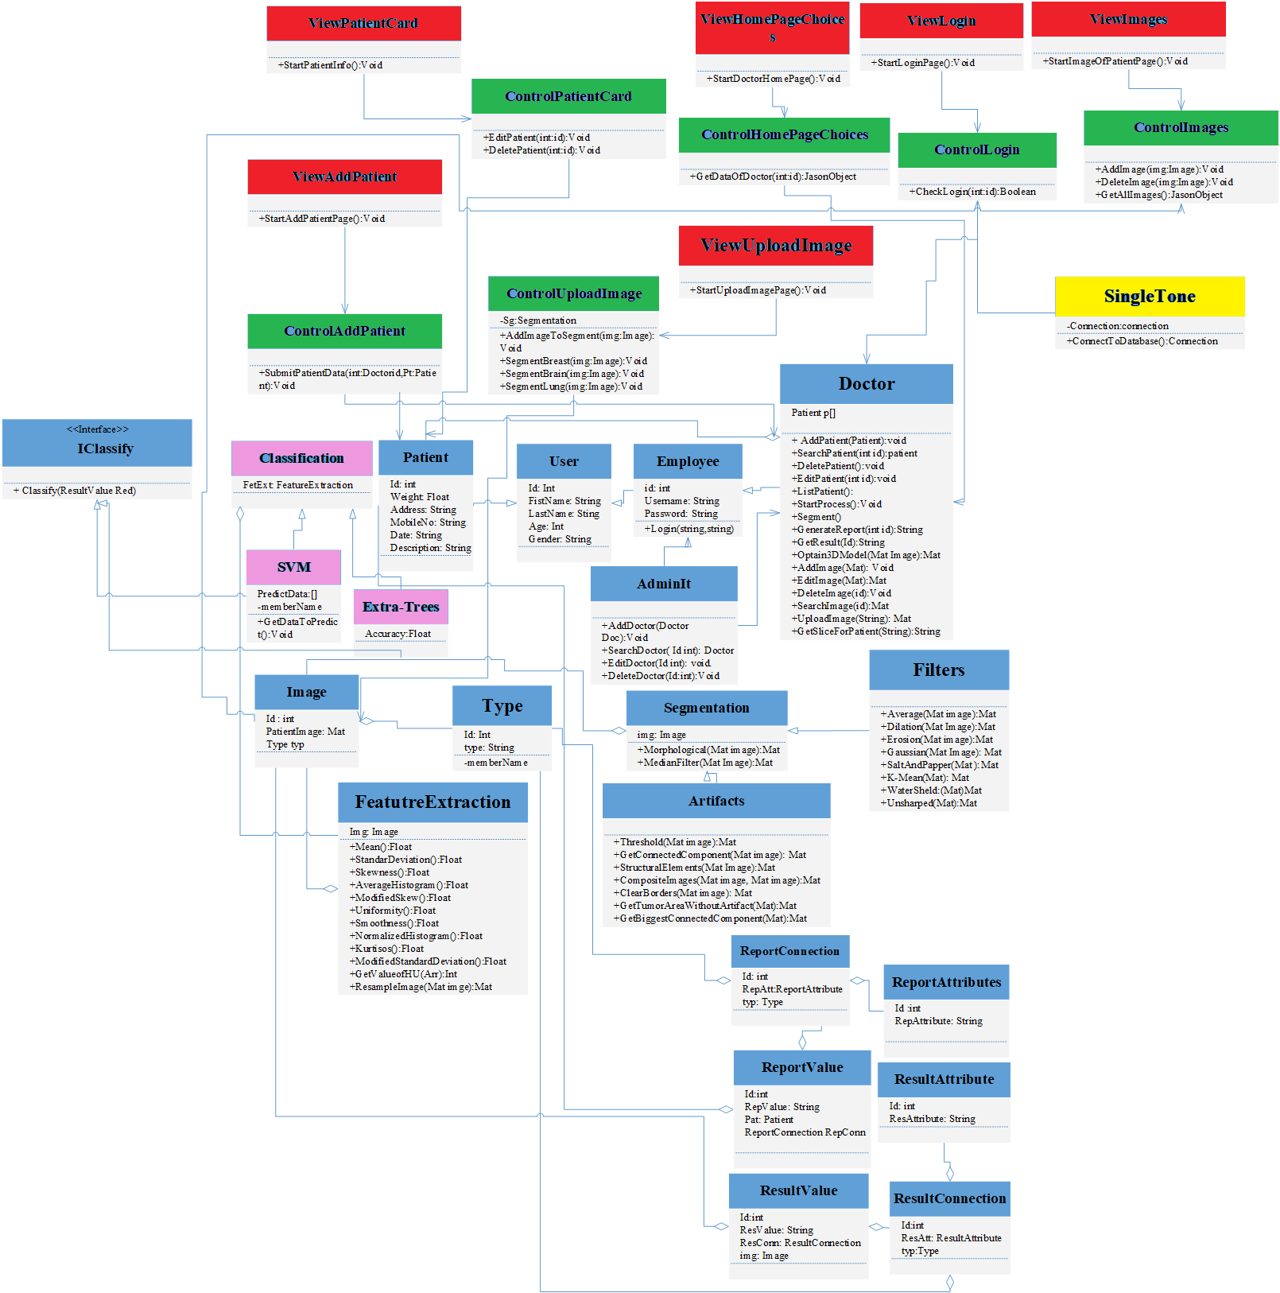
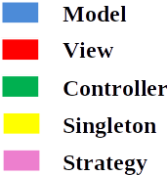
System Overview

Slide 16
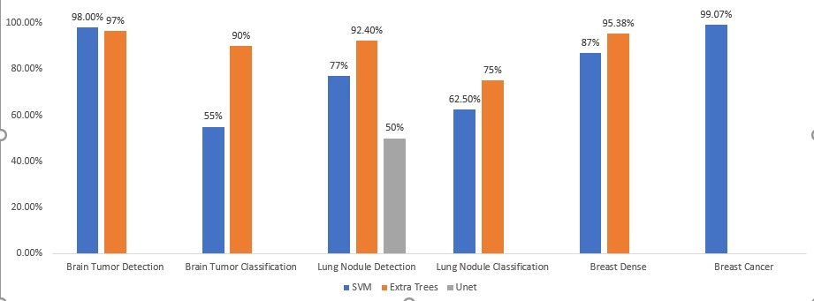
Experiment I
Setup:
- MRI Images obtained BRATS 2015 & 2017 datasets
- CTscan Images obtained from Luna & SPIE-AAPM datasets.
- Mammography Images obtained from MIAS dataset.
Goal: Choosing the best algorithm in each approach.

Slide 17
Experiment II 2/3
Feature Extraction
Brain
Lung
Breast
Dense
Beta, Gamma, Minimum, Homogeneity, Skewness, Kurtosis, Mean, Standard deviation, Entropy
Area, Perimeter, Homogeneity, Eccentricity Correlation, Circularity, Entropy,
Mean, Standard deviation, Skewness, Kurtosis, Uniformity, High Average , Average histogram, smoothness , modified standard deviation, Modified Skewness

Slide 18
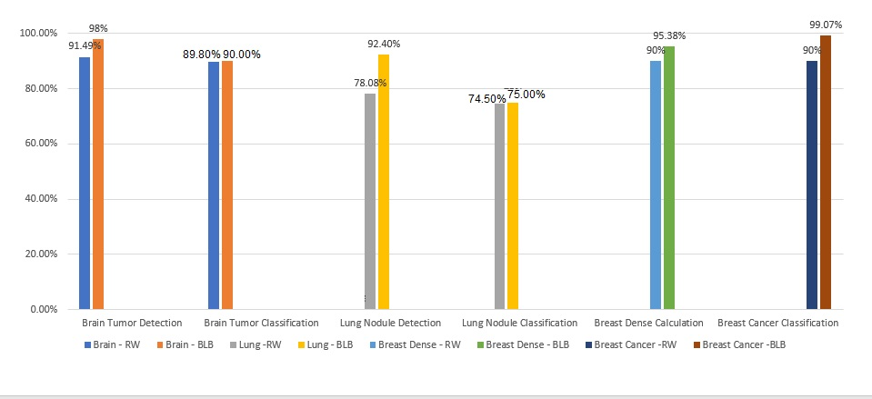
Experiment II 3/3

Slide 19
Experiment II 1/3
Goal
Choosing the best features which fits the best classifier.
Setup
Calculating features from given images for each dataset

Slide 20
User Study - Video
Experiment III 1/2

Slide 21
User Study
Experiment III 2/2

Slide 22
DEMO

Slide 23
Achievements
IEEE BLB (Brain/Lung cancer detection and segmentation and Breast Dense calculation)
Journal Title : 2018 First International Workshop on Deep and Representation Learning (IWDRL)
Publication Year : 2018
Publication Month : 03
Authors : Bassma El-Sherbiny, Nardeen Nabil, Seif Yasser,
Youssef Emad, Ashraf Abdelraouf, Taraggy Mohiy and Nada Ayman
El Sevier Journal
Waiting for submission

Slide 24
Any Questions ?

Slide 25
Thank You

Slide 26
Appendix

Slide 27
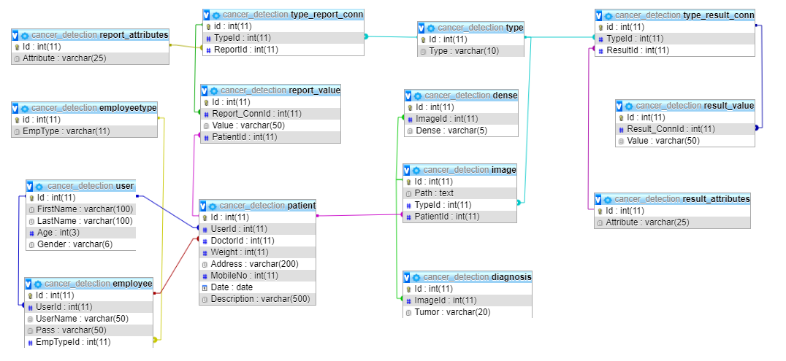
ERD

Slide 28
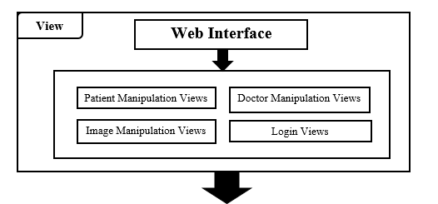
System Architecture View

Slide 29
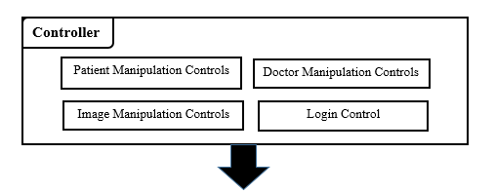
System Architecture Controller

Slide 30
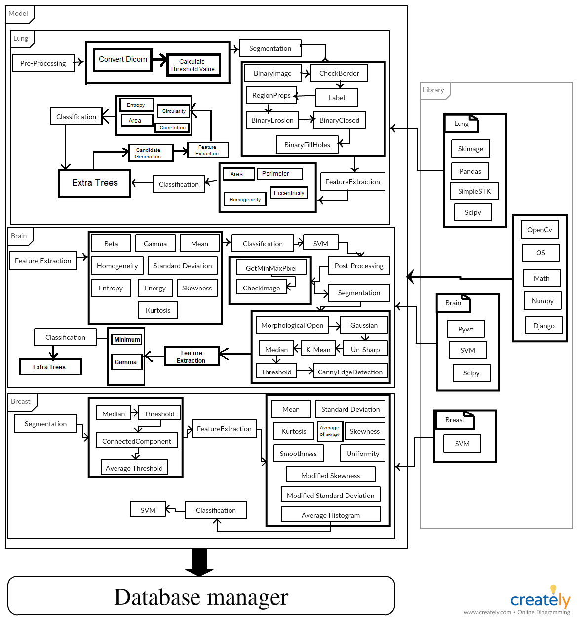
System Architecture Model

Slide 31
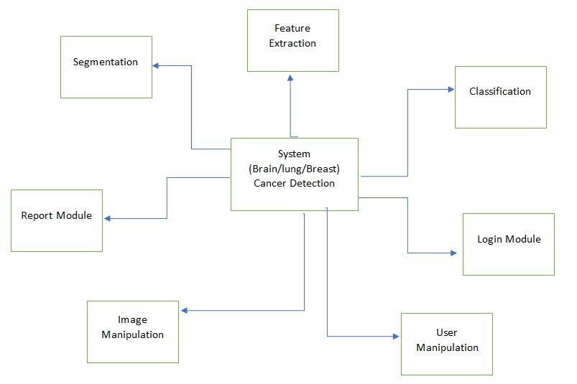
Block Diagram

Slide 32
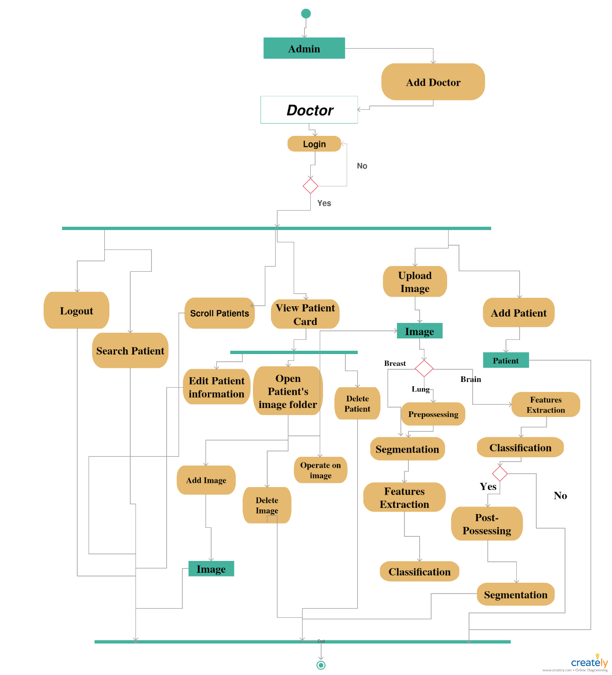
Sequence Diagram

Slide 33
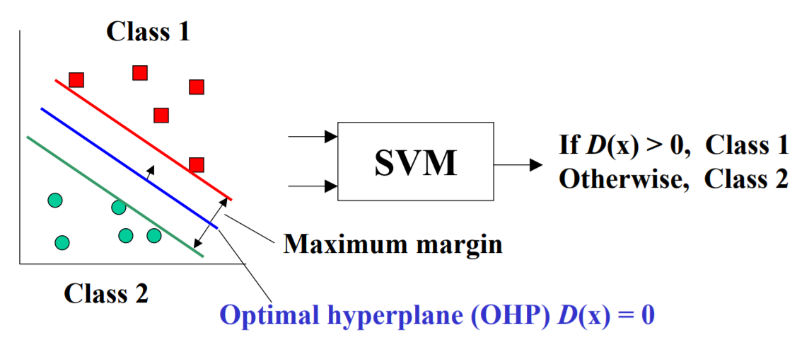
SVM

Slide 34
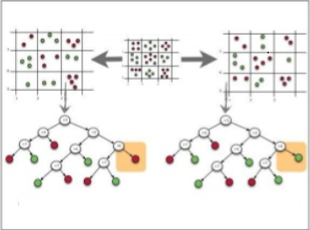
Extra-Trees

Slide 35
Bibliography
[1] | "Brain Tumor Facts," [Online]. Available: http://www.sdbtf.org/resources/brain-tumor-facts/.
[2] | "Key Statistics for Lung Cancer," [Online]. Available: https://www.cancer.org/cancer/non-small-cell-lung-cancer/about/key-statistics.html.
[3] | "Mayo Clinic Dense breast tissue may increase the risk of breast cancer," 23 March 2018. [Online]. Available: https://www.mayoclinic.org/diseases-conditions/lung-cancer/expert-answers/lung-nodules/faq-20058445.
[4] | "Mayo Clinic , Dense breast tissue may increase the risk of breast cancer," 23 March 2018. [Online]. Available: https://www.mayoclinic.org/tests-procedures/mammogram/in-depth/dense-breast-tissue/art-20123968.
[5] | "national breast cancer, Breast Tumors :: The National Breast Cancer Foundation," [Online]. Available: http://www.nationalbreastcancer.org/breast-tumors.
[6] | D. M. A. Garima Singh, "Efficient Detection of Brain Tumor from MRIs Using K-Means Segmentation and Normalized Histogram," IEEE, 2016.
[7] | H. P. {Hwan-ho Cho, "Classification of Low-grade and High-grade Glioma using Multi-modal Image Radiomics Features," IEEE, 2017.
[8] | E. R.-G. a. V. Ponomaryov, "Automatic Lung Nodule Segmentation and Classification in CT Images Based on SVM," IEEE, 2016.
[9] | R. V. M. D. N. S. S. A. A. P. P. R. F. J. B. F. D. A. K. S. a. V. H. C. D. A. MURILLO B. RODRIGUES, "Health of Things Algorithms for Malignancy Level Classification of Lung Nodules," IEEE, 2018.
[10] | A. K. B. M. V. L. Luis Claudio de Oliveira Silva, "Detecting masses in dense breast using independent component analysis," Artificial Intelligence in Medicine, Elsevier, 2017.
[11] | S. H. L. a. A. Dong, "Detection of Breast Tumor Candidates Using Marker-controlled Watershed Segmentation and Morphological Analysis," IEEE, 2018.
[12] | D. E. a. L. W. Pierre Geurts, "Extremely randomized trees," 2006.

