Slide 1
BLB Cancer Detector
Presented By: Seif Yasser, Bassma Elsherbiny , Nardeen Nabil and Youssef Emad.
Supervised By: Dr.Ashraf Abdelraouf, Eng.Taraggy Mohiy and Eng Nada Ayman

Slide 2
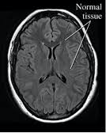
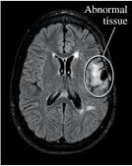
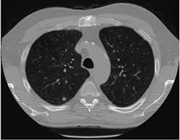
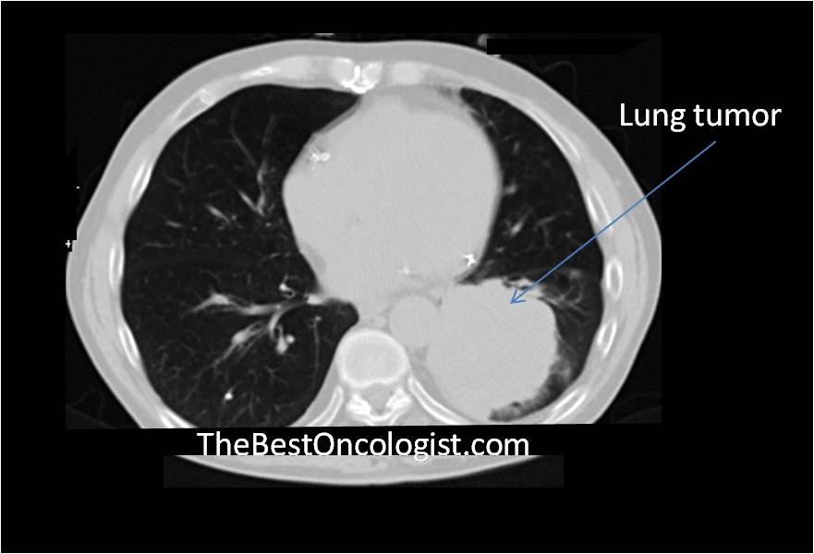
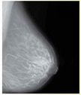
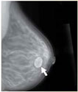
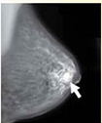
Introduction 1/2
Cells divide without control and can invade nearby tissues.
Problems Statement:
Conflicts between Doctors
Accurate Results(size, location).
1St Brain
2nd Lungs
3rd Breast
No Tumor
Tumor
No Tumor
Tumor
No Cancer
High Dense No Cancer
Cancer

Slide 3
Introduction 2/2 (Proposed Solution)
Minimizing the mentioned gap.
Providing one accurate result.
Notes:
Decrease The Gap

Slide 4
Related Work 1/3 (Lung) [1]
Advantages:
Two Datasets.
Using Classification with 2 methods(CNN , Unet)
Disadvantages
Less Labeled data
[1] Peter Lu Albert Chon, Niranjan Balachandar. Deep Convolutional Neural Networks for Lung Cancer Detection. Stanford, 2017.

Slide 5
Related Work 2/3 (Brain) [3]
Advantages:
Successful classification of MRI and segmentation of tumor parts.
High accuracy 91.49% with SVM classifier.
Disadvantages:
Processed on one dataset only.
Dataset used contained only clear white tumors.
Failed on BRATS dataset.
[3] Garima Singh, Dr. M.A. Ansari, 2016 IEEE , Efficient Detection of Brain Tumor from MRIs Using K-Means Segmentation and Normalized Histogram.

Slide 6
Related Work 3/3 (Breast)[4]
Advantages:
Using SVM Classification with Accuracy of 95.44%
Disadvantages
MIAS database mentioned 3 types
[4] U. Bick and F. Diekmann. Digital Mammography. Heidelberg. Springer, 2010.

Slide 7
Motivation 1/2
Less Time
Saving Lives
More Accuracy

Slide 8
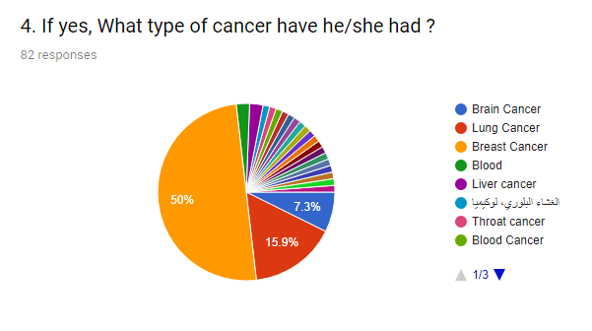
Motivation 2/2-1

Slide 9
Motivation 2/2-2

Slide 10
Motivation 2/2-3

Slide 11
Motivation 2/2-4

Slide 12
System Overview

Slide 13
System Overview – Input Interface
MRI Image
Ct Scan Image
Mammography Image
Interface

Slide 14
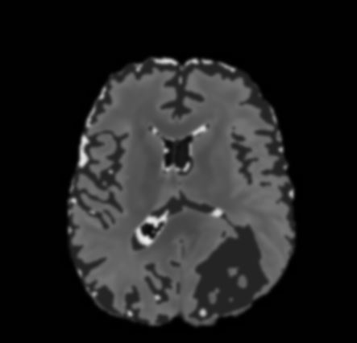
System Overview – Brain[5][6]
Max Min Normalization (0,255)
Pre Process
Median Average Gaussian
Feature Extraction Beta/Gamma Normalized Histogram
Classification SVM or CNN
Segmentation K-means Threshold Canny Edge detection
According to Brats 2017
ground truth [4][5]
Original Image
After Pre-processing
Beta/Gamma results
Kmeans Segmentation
Edge Detection
[5] https://www.ncbi.nlm.nih.gov/pubmed/25494501 [6] https://www.ncbi.nlm.nih.gov/pubmed/28872634

Slide 15
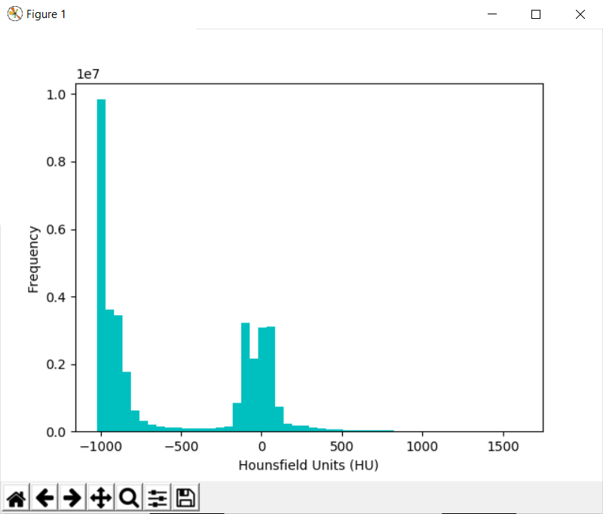
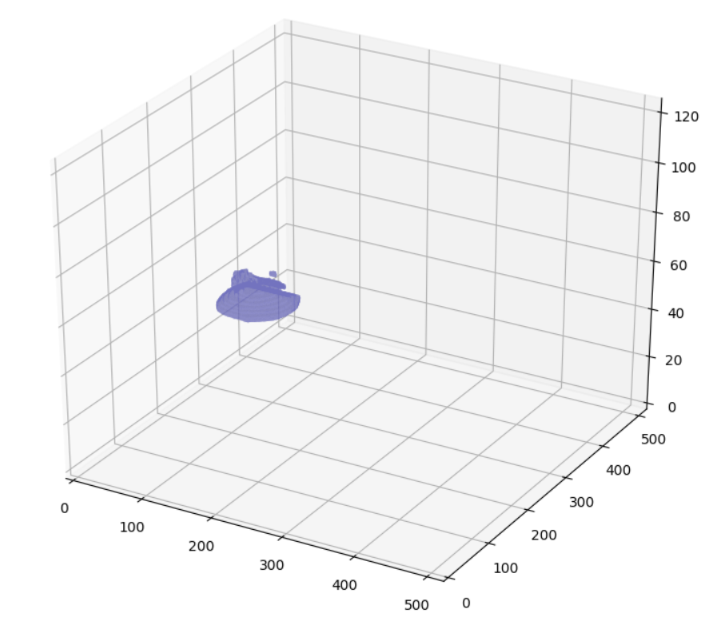
System Overview – Lung[7][8]
Pre Process
Threshold(Binary)
Feature Extraction Nodule Pixel 1 (Cross Entropy)
Segmentation
Clear border Label Erosion
Classification CNN , U-Net
- Resample <512 *512 - Get HU pixels
-500 HU
3d Tumor
[7] https://luna16.grand-challenge.org/ [8] https://www.kaggle.com/c/data-science-bowl-2017/data

Slide 16
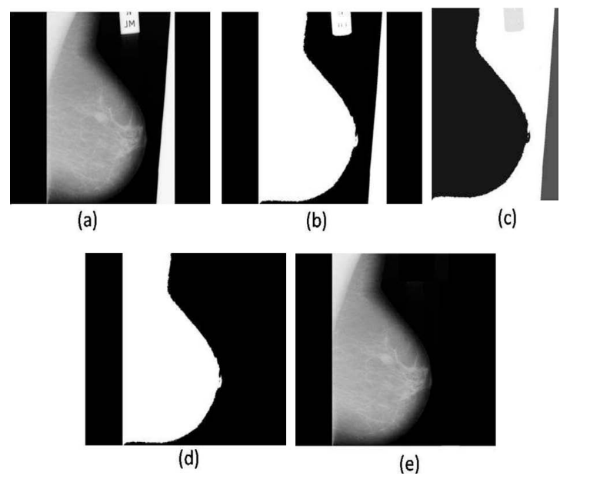
System Overview – Breast [9]
Pre Process
histogram based thresholding
Feature Extraction Standard Deviation Skewness Mean
Segmentation
Remove - artifacts
Pectoral Remove
Classification SVM
[9] http://peipa.essex.ac.uk/info/mias.html

Slide 17
Challenges
Classification (Neural Network)
Huge Datasets to process
Non labeled Datasets
Different approaches contradict with different datasets

Slide 18
Wireframe

Slide 19
Demo

Slide 20
Expected Contribution
Detection of cancerous/not cancerous patients.
Final report generated.
Size and location of tumor (volume if necessary to doctor)
Classification for more accuracy in the future.

Slide 21
Any Questions ??

Slide 22
Thank You

Slide 23
References
[1] Peter Lu Albert Chon, Niranjan Balachandar. Deep Convolutional Neural Networks for Lung Cancer Detection. Stanford, 2017.
[2] Akbari H1 2 Sotiras A1 2 Bilello M1 2 Rozycki M1 2 Kirby JS3 Freymann JB3 Farahani K4 Davatzikos C1 2 Bakas S1, 2. Advancing The Cancer Genome Atlas glioma MRI collections with expert segmentation labels and radiomic features. US National Library of Medicine National Institutes of Health, Sep 2017.
[3] U. Bick and F. Diekmann. Digital Mammography. Heidelberg. Springer, 2010.
[4] Dr. M.A. Ansari Garima Singh. Efficient Detection of Brain Tumor from MRIs Using K-Means Segmentation and Normalized Histogram. IEEE, 2016.

Slide 24
References
[5] Bauer S Kalpathy-Cramer J Farahani K Kirby J Burren Y Porz N Slotboom J Wiest R Lanczi L Gerstner E Weber MA Arbel T Avants BB Ayache N Buendia P Collins DL Cordier N Corso JJ Criminisi A Das T Delingette H Demiralp C¸ Durst CR Dojat M Doyle S Festa J Forbes F Geremia E Glocker B Golland P Guo X Hamamci A Iftekharuddin KM Jena R John NM Konukoglu E Lashkari D Mariz JA Meier R Pereira S Precup D Price SJ Raviv TR Reza SM Ryan M Sarikaya D Schwartz L Shin HC Shotton J Silva CA Sousa N Subbanna NK Szekely G Taylor TJ Thomas OM Tustison NJ Unal G Vasseur F Wintermark M Ye DH Zhao L Zhao B Zikic D Prastawa M Reyes M Van Leemput K. Menze BH, Jakab A. The Multimodal Brain Tumor Image Segmentation Benchmark (BRATS). Dec 2014.
[6] Daniel Kopans Richard Moore Michael Heath, Kevin Bowyer and W. Philip Kegelmeyer. Proceedings of the Fifth International Workshop on Digital Mammography, M.J. Yaffe, ed., 212-218. Medical Physics Publishing, ISBN 1-930524-00-5., 2001.
[7] Daniel Kopans W. Philip Kegelmeyer Richard Moore Kyong Chang Michael Heath, Kevin Bowyer and S. MunishKumaran. Digital Mammography, 457-460, Proceedings of the Fourth International Workshop on Digital Mammography. Kluwer Academic Publishers., 1998.
[8] K. Vogt et al N.F. Boyd, J.M. Rommens. Mammographic breast density as an intermediate phenotype for breast cancer. Lancet Oncology 6, 2005.
[9] Ramalingam V. Palanivel S. Subashini, T. Automated assessment of breast tissue density in digital mammograms. Computer Vision and Image Understanding, 114(1), 33-43. doi:10.1016/j.cviu.2009.09.009, 2010.
[10] I. dos Santos Silva V.A. McCormack. Breast density and parenchymal patterns as markers of breast cancer risk: a meta-analysis, Cancer Epidemiology Biomarkers and Prevention. 2006.

Slide 25
Class Diagram 1/2

Slide 26
Class Diagram 2/2

Slide 27
ERD

Slide 28
Use Case

Slide 29
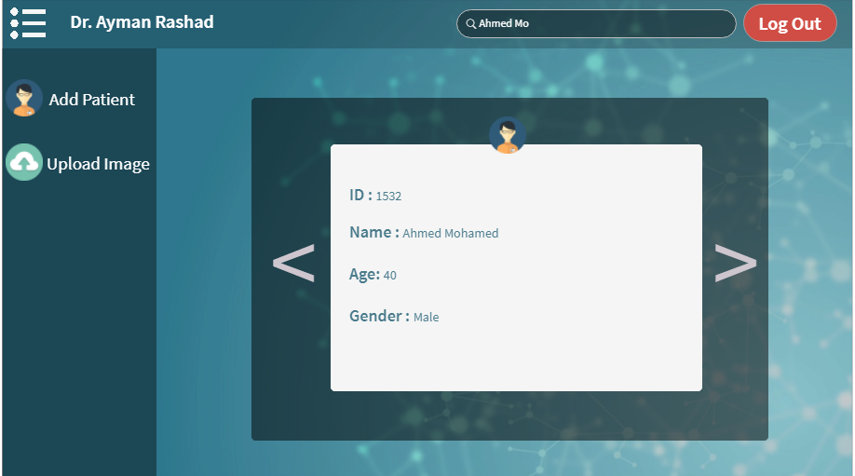
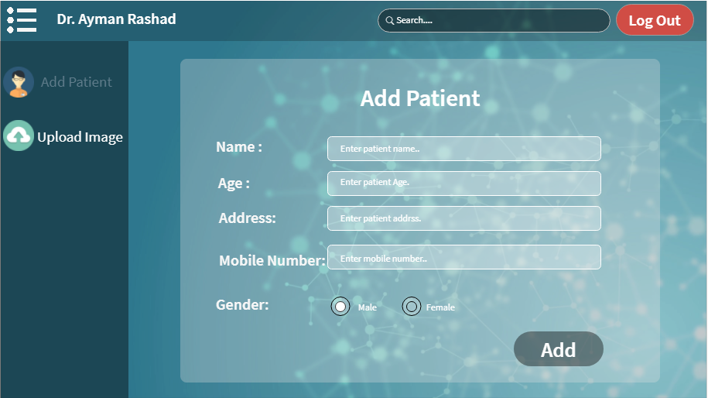
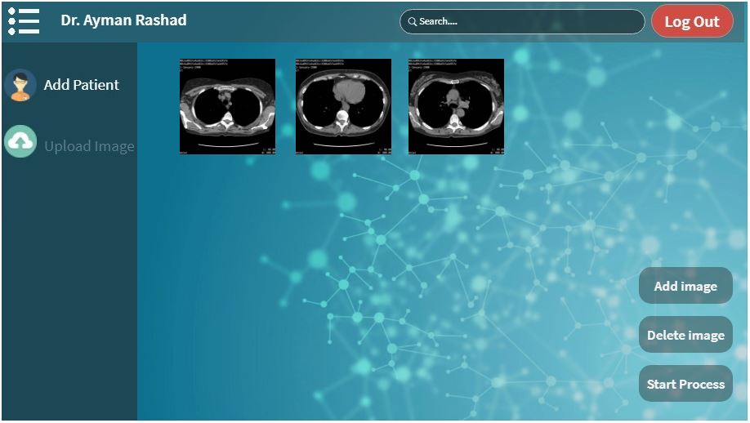
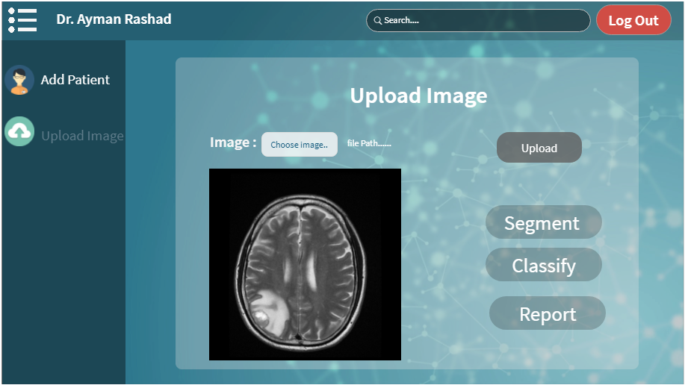
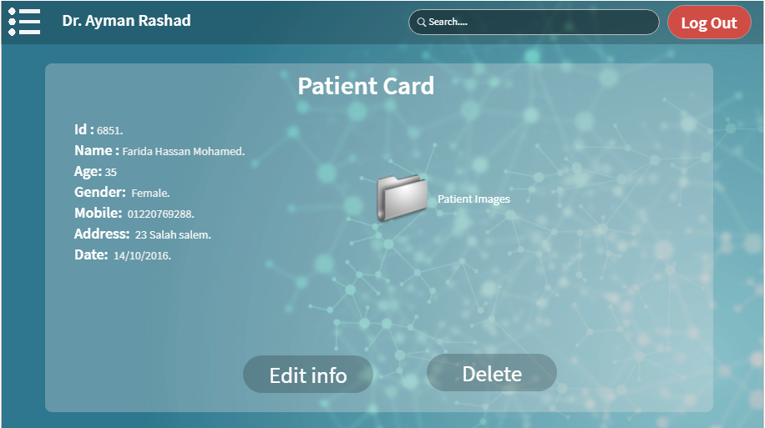
Wireframes

Slide 30
Functional Requirements
Upload Image
Obtain3DModel
Generate Report
Segment Image
Get Results
Doctor
Feature Extraction
-Normalized Histogram
-Mean
Classification System
-Classify
Segmentation System
-ApplyKMeans

Slide 31
Non Functional Requirements
Security
Maintainability
Reliability
Reflects On :(login,AddPatient,AddDoctor) encryption of passwords.
Reflects on MVC design pattern
Reflects on handling exceptions which prevents system failure.
Keeping the data secured.
System has to be easly maintained in future.
Delivering a reliable and trusworthy system.

Slide 32
Design Patterns:
MVC
Separates Model, View,Control
Singletone
Allow single conncetionto database
Strategy
Choosing the strategy of removing artifacts.

