Slide 1
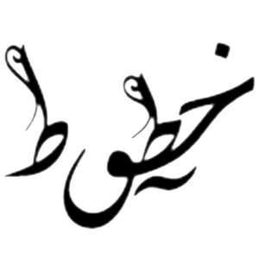
Pixtective: Arabic Handwriting Forgery Detection
By: Sylvia Hani
Caroline Kamal
Diana Abdelnaser
Hatem El Herzawy
Supervised by: Dr. Sherin Moussa, Eng. Youssef Mohamed
10, December, 2017

Slide 2
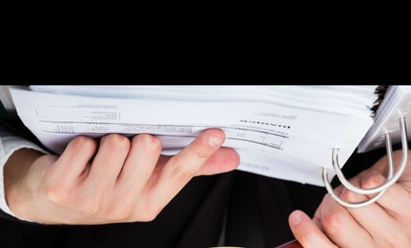
Introduction
Forgery definition: the action of forging (fabricating) a copy or imitation of a document, signature, banknote, or work of art.
2

Slide 3
Introduction - Types of Document Forgery
The penalty of forgery in Egypt is imprisonment for not less than two
years and may lead to prison 25 years. [1]
Forged handwriting(different styles, different inks).
Forged money.
Forged stamps, prints.
Forged finger prints
[1] In accordance with the book of law Articles 207 and 206
3

Slide 4
Problem Statement
Building a system that detects forged Arabic handwriting with an accepted accuracy level and processing time, taking into consideration the features of the Arabic handwriting style of writers.
4

Slide 5
Related Work 1- GMM-based Handwriting Style Identification System for Historical Documents.
Gaussian Mixture Model GMM.
Iterative EM Algorithm to refine the GMM parameters (weights, means, variances).
Implemented using HTK (HMM Tool Kit) tool .
Disadvantage: The computational complexity increases linearly with the number of handwriting styles to be identified.
DATASET: scanned page images from books written between the 8th and the 17th centuries with different writers and different handwriting styles.
Future work NN like MLP, SVM.
Fouad Slimane1,3, Torsten Schaßan2, Volker M¨argner1 GMM-based Handwriting Style Identification System for Historical Documents, International Conference of Soft Computing and Pattern Recognition

Slide 6
Related Work 2- Writer Verification of Arabic Handwriting
Neural Network
13 Macro features like:
Stroke width
Average word gap
Entropy of gray values
Binarization threshold
10 different writers, each 10 different full page documents (150–200 words), scanned at a resolution of 300 dots per inch.
Disadvantage: The system can correctly verify the writer around 86% of the time only.
Sargur N. Srihari and Gregory R. Ball, Writer Verification of Arabic Handwriting, The Eighth IAPR Workshop on Document Analysis SystemsAZz

Slide 7
Related Work 3-A FEATURE EXTRACTION TECHNIQUE BASED ON CHARACTER GEOMETRY FOR CHARACTER RECOGNITION
STARTERS
INTERSECTIONS
MINOR STARTERS.
Intersections
Non-intersections
DISTINGUISHING LINE SEGMENTS
Horizontal line.
Vertical line.
Right diagonal line.
Left diagonal line.
FEATURE EXTRACTION
Number of horizontal, vertical, Right diagonal and Left diagonal lines.
Normalized Length of all horizontal , vertical, right diagonal and left diagonal lines.
DATASET: English handwritten documents.
Dinesh Dileep, A FEATURE EXTRACTION TECHNIQUE BASED ON CHARACTER GEOMETRY FOR CHARACTER RECOGNITION

Slide 8
Marketing Motivation
1- The market motivation has confirmed that detecting a forged
handwriting is difficult, takes times, not accurate and needs skilled professionals.
2- No system exists in Egypt to detect Arabic handwritten forgery
-Head of teller in HSBC El Hussain Abdoun

Slide 9
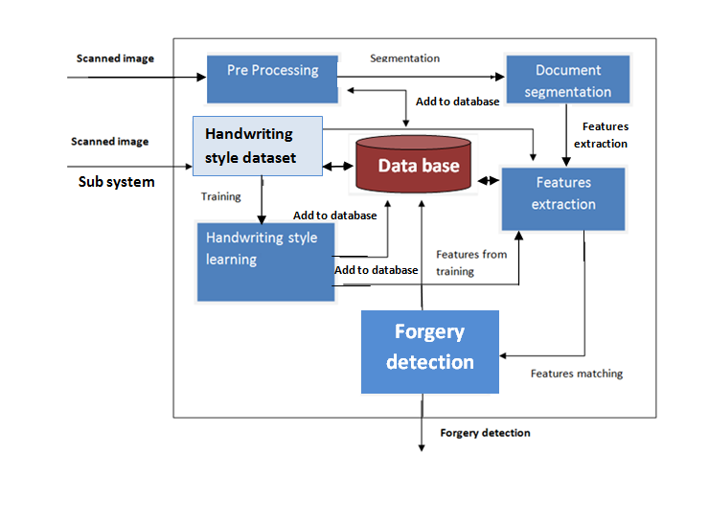
System overview

Slide 10
System overview 1/3
Preprocessing: Binarization, thinning.
Segmentation: using Thresholding , Histogram (white spaces)

Slide 11
System overview 2/3
Feature Extraction:
Number of horizontal lines
Number of Vertical lines
Finding neighbors
Slant distribution
Starter intersection
Direction
Entropy
Edge hinge distribution
In progress
9. Stroke width
10. Number of black lines

Slide 12
System overview 3/3
Training dataset: +250 images
Training &Matching Algorithms:
Probability distribution function (PDF)
In progress
Support Vector Machine (SVM)
Neural Network MLP

Slide 13
Expected Contribution
Detecting Arabic handwriting forgery based on the handwriting style with high accuracy rates and reasonable processing time by integrating:
3 different matching algorithms,
8 + of features extracted,
Training over 50 people styles, each of 5 images.

Slide 14
Conclusion
Our System investigates Forgery detection in Arabic handwritten documents. Arabic handwriting styles are considered, where matching/ training algorithms are used to detect whether the document is best matched with the claimed writer or not, otherwise is forged.

Slide 15
ありがとうございました Thank you.

