Slide 1
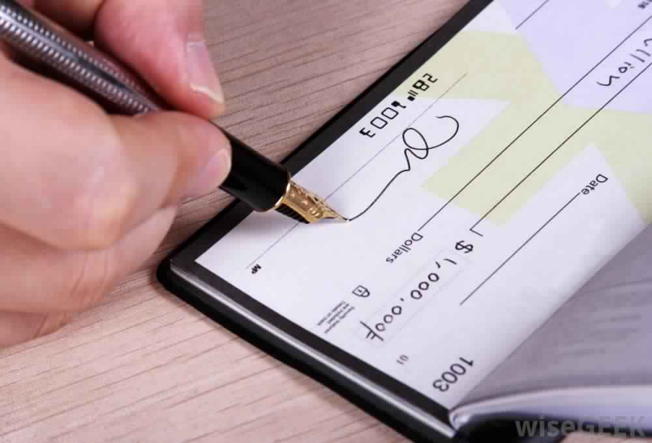
Tazwiry
Team Name: Pixtective
Team Members:
Hatem Herzawy
Caroline Kamal
Diana Salama
Sylvia El maraghy

Slide 2
Have you ever thought of the amount of fraud that happens from signature verification ?
60%

Slide 3
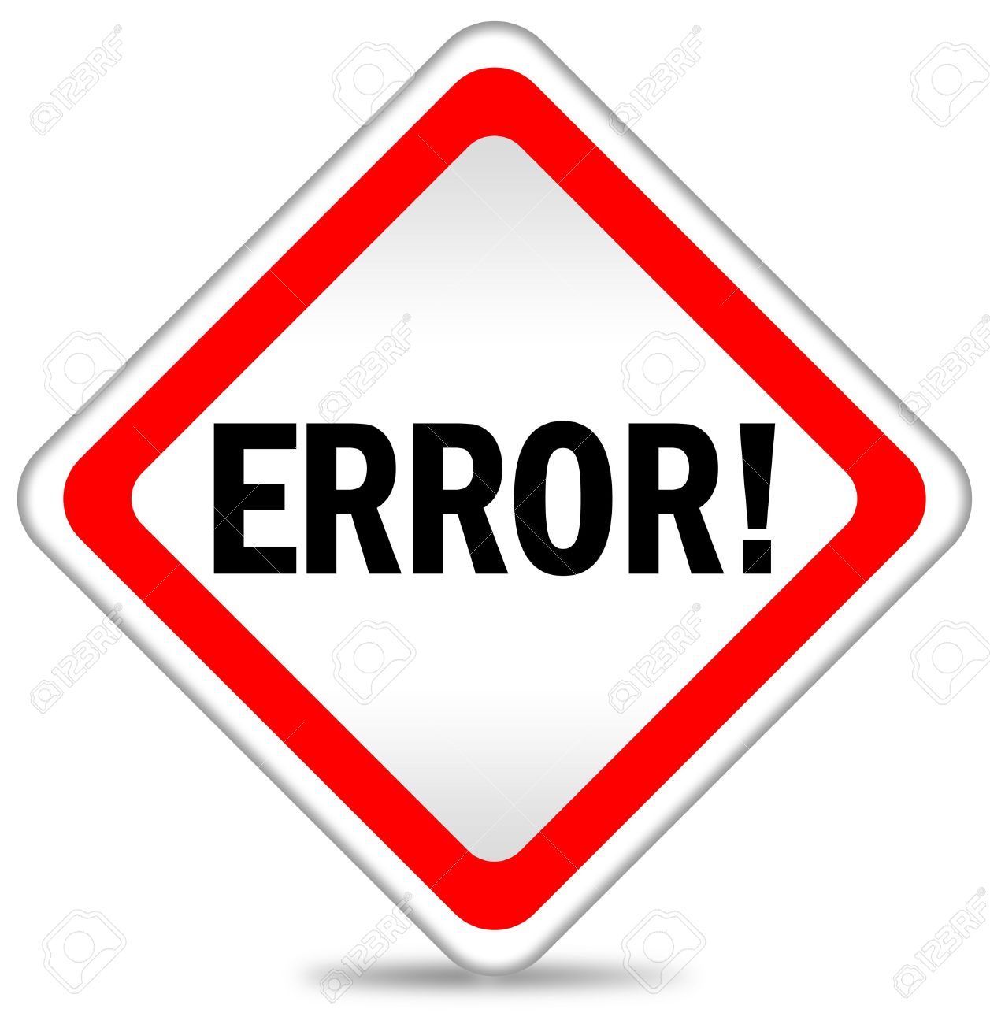
Business case
Cost of time consumed to verify the signature
Cost of Fraud ( Cost of Human Error )
Turn around time for signature verification
Inefficient allocation of front liners time.

Slide 4
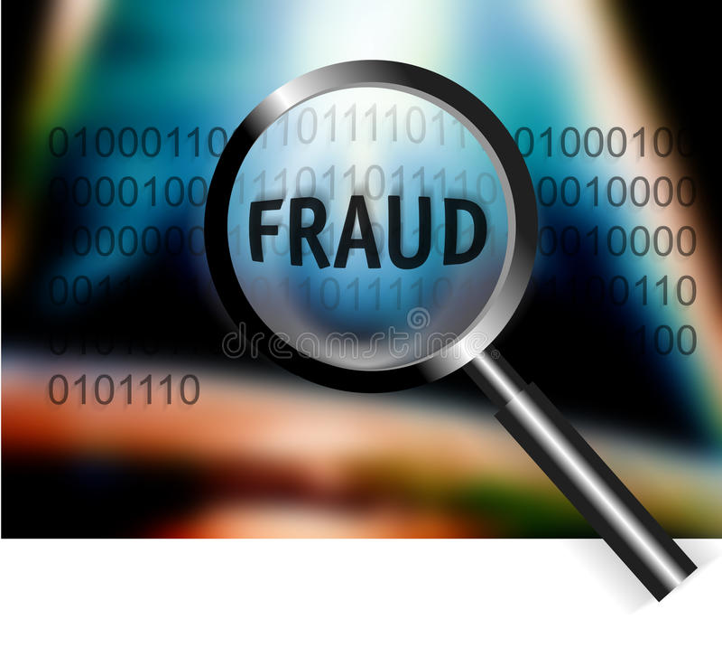
Solution
Tazwiry’s role is identifying the signature authenticity by identifying the writer’s signature.
How it works:
Feature extraction of each writer’s signature style an match each writer’s style to detect the accuracy, if accuracy is high enough then the signature is correct, otherwise it’s fraud.

Slide 5
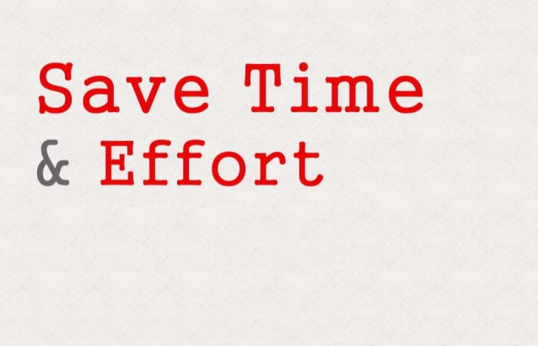
Benefits
Tazwiry is more accurate than manually checking for fraud.
Tazwiry is more secure.
Tazwiry saves time, effort and cost
Tazwiry can detect the type of forgery if found.
Tazwiry ensuring Customer satisfaction.

Slide 6
Thank You.

