Slide 1
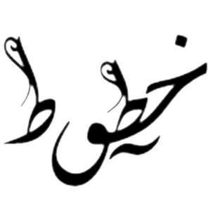
Arabic Handwriting Forgery Detection
By: Sylvia Hani
Caroline Kamal
Diana Abdelnaser
Hatem El Herzawy
Supervised by: Dr. Sherin Moussa, Eng. Youssef Mohamed
4, October, 2017

Slide 2
Introduction
Forgery definition: the action of forging(fabricating) a copy or imitation of a document, signature, banknote, or work of art.

Slide 3
Introduction - Types of Document Forgery
The penalty of forgery in Egypt is imprisonment for not less than two
years and may lead to prison 25 years. [1]
Forged handwriting(different styles, different inks)
Forged money
Forged stamps, prints
Forged finger prints
[1] In accordance with the book of law Articles 207 and 206

Slide 4
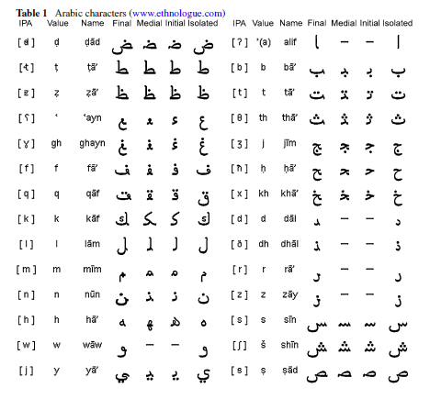
Arabic Handwriting
Cursive Language
Every character has 4 different shapes based on it’s position.
Focused Features:
1- Strokes (مسافات)
2- Baseline (upper, lower, middle)
3- Skew, Slant (الانحناء, الميل)
4- Concavity (التجويف)
5- Dots placement
6- Start, end, branch points.
OUR WORK: 1- Fixed Font (Naskh)
2- Fixed resolution

Slide 5
Problem Statement
Building a system that improves
the accuracy detection of forged
Arabic handwriting in less
time consumed, taking into
consideration the Feature Extraction
of handwriting forgery documents.

Slide 6
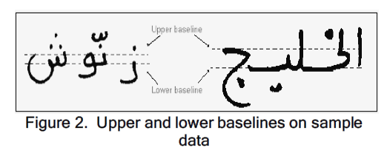
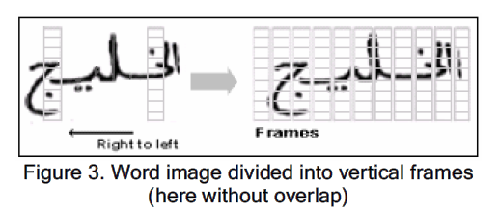
Work Related 1- Arabic Handwriting Recognition Using Baseline Dependent Features and Hidden Markov Modeling.
Hidden Markov Model (HMM).
Baseline detection by vertical overlapping window (sliding window Technique).
Veterbi Algorithm modeling
Ramy El-Hajj, Laurence Likforman-Sulem, Chafic Mokbel, Arabic Handwriting Recognition Using Baseline Dependant Features and Hidden Markov Modeling
, 2005 Eight International Conference on Document Analysis and Recognition (ICDAR’05)

Slide 7
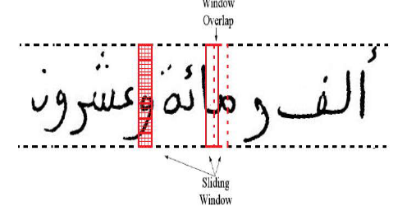
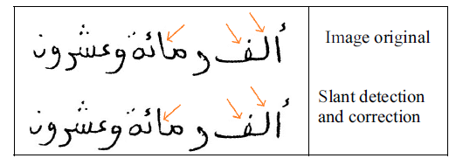
Work Related 2- Recognition of Off-line Arabic Handwriting words Using HMM Toolkit (HTK)
Hidden Markov model.
Sliding window Algorithm
SFSA modeling
Hicham El Moubtahij, Khalid Satori, Akram Halli in Recognition of Off-line Arabic Handwriting words Using HMM Toolkit (HTK), 2016 13th International Conference Computer Graphics, Imaging and Visualization.

Slide 8
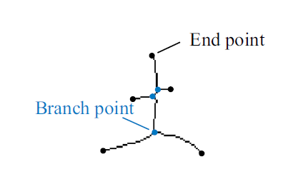
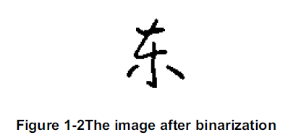
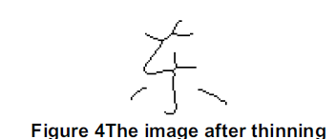
Work Related 3- Offline Chinese Handwriting Character Recognition through Feature Extraction
Ostu Algorithm
Smoothing, Thinning filters
Open, close loops Algorithm
Position, Adjecency Matrix
Yuchen Luo, Rui Xia, M. Abdulghafour, Offline Chinese Handwriting Character Recognition through Feature Extraction,
2016 13th International Conference Computer Graphics, Imaging and Visualization

Slide 9
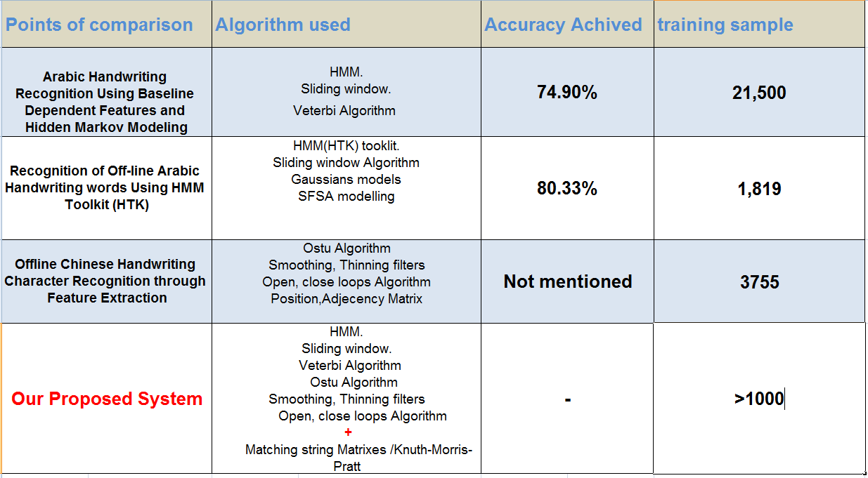
Table of comparison

Slide 10
Market Motivation 1/2
The market motivation has arised according to the conducted
results from the survey we have done.
162 persons filled the survey
72 Males & 90 Females.
71.7% has reported that they encountered handwritten forgery
Before.

Slide 11
Marketing Motivation 2/2
1- The market motivation has confirmed that detecting a forged
handwriting is difficult, takes times, not accurate nor precise,
needs skilled professionals.
2- No systems exists in Egypt to detect Arabic handwritten forgery
-Head of teller in HSBC
El Hussain Abdoun

Slide 12
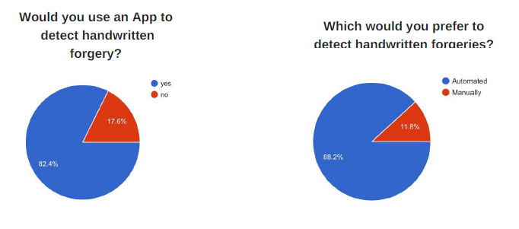
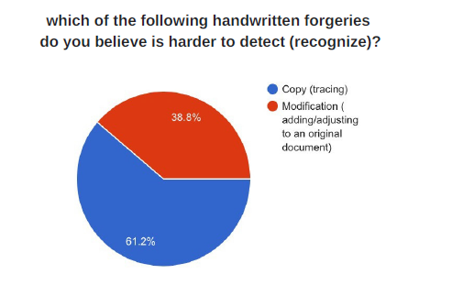
Survey Questions

Slide 13
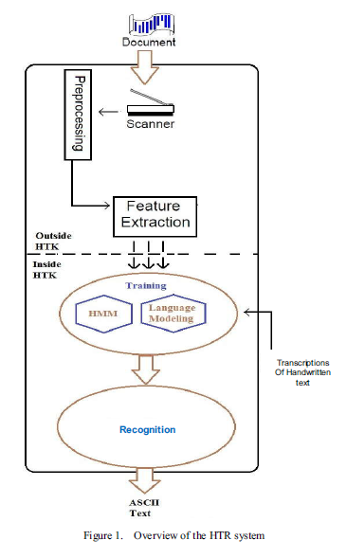
System overview
Binarization
Smoothing & noise reduction
Feature Extraction
HMM Recognition
Matching Algorithm

Slide 14
Expected Results
Improving Arabic Handwritten Forgery detection and
classification accuracy
Optimizing time consumed

Slide 15
Thank you!

Slide 16
1- Ramy El-Hajj, Laurence Likforman-Sulem, Chafic Mokbel, Arabic Handwriting Recognition Using Baseline Dependant Features and Hidden Markov Modeling, 2005 Eight International Conference on Document Analysis and Recognition (ICDAR’05) 2- Yuchen Luo, Rui Xia, M. Abdulghafour, Offline Chinese Handwriting Character Recognition through Feature Extraction, 2016 13th International Conference Computer Graphics, Imaging and Visualization. 3- Hicham El Moubtahij, Khalid Satori, Akram Halli in Recognition of Off-line Arabic Handwriting words Using HMM Toolkit (HTK), 2016 13th International Conference Computer Graphics, Imaging and Visualization. 4- Shirin Saleem, Huaigu Cao, Krishna Subramanian, Matin Kamali, Rohit Prasad, Prem Natarajan, Improvements in BBN's HMM-based Offline Arabic Handwriting Recognition System, 2009 10th International Conference on Document Analysis and Rec. 5- M. Pechwitz, V. M¨argner, Baseline Estimation For Arabic Handwritten Words, Eighth International Workshop on Frontiers in Handwriting Recognition (IWFHR’02). 6- Volker Märgner, Haikal El Abed, Guide to OCR for Arabic Scripts , Springer London Heidelberg New York Dordrecht. 7- Jianying Hu, Michael K. Brown, Senior, and William Turin, HMM Based On-LineHandwriting Recognition, TRANSACTIONS ON PATTERN ANALYSIS AND MACHINE INTELLIGENCE, VOL. 18, NO. 10, OCTOBER 1996, IEEE. 8- Jianying Hu, William Turin and Michael K. Brown, Language modeling using stochastic automata with variable length contexts, Lucent Technologies, Bell Laboratories, 700 Mountain Avenue, Murray Hill, NJ 07974, USA and AT&T Research Laboratories, 600 Mountain Avenue, Murray Hill, NJ 07974, USA. 9- Alaa M. Gouda’ and M. A. Rashwan, Segmentation of Connected Arabic Characters Using Hidden Markov Models, CIMSA 2004 ~ L E E Elm emvtional Conference on Computalional Intelligence for Measurement Systems and Applications Baston, YD, USA, 14-16 July 2004. 10- Shutao Li a,, Qinghua Shen a, Jun Sun, Skew detection using wavelet decomposition and projection profile analysis, College of Electrical and Information Engineering, Hunan University, Changsha 410082, China b Fujitsu R&D Center Co., Ltd., Eagle Run Plaza B1003, Xiaoyun Road No. 26, Chaoyang District, Beijing 100084, China. 11- Homayoon S.M. Beigi, Krishna Nathan, Gregory J. Clary and Jayashree Subrahmonia, Challenges of handwriting in arabic, farsi with the same handwriting style, J.T Watson research center, IBM.
References

