Slide 1
Pixtective: Arabic Handwriting Forgery Detection
By:
Sylvia Hani
Diana AbdelNasser
Hatem Herzawy
Caroline Kamal
Supervised by: Dr. Sherin Moussa, Eng. Youssef Mohamed

Slide 2
Objective
Detection and classification accuracy of Arabic handwritten forged documents.
With Accuracy percentages with the closest match of writers at real-time

Slide 3
Functional Requirement
User file manager(add, delete, modify, list, view) Document, Writer file manager(add, delete, list, view, modify) | Admin User
Train dataset, Segment document, Feature extract, Match features, encrypt authentication, encrypt document path. | Forgery System

Slide 4
Non Functional Requirement
Performance
Security
Maintainability
Reliability

Slide 5
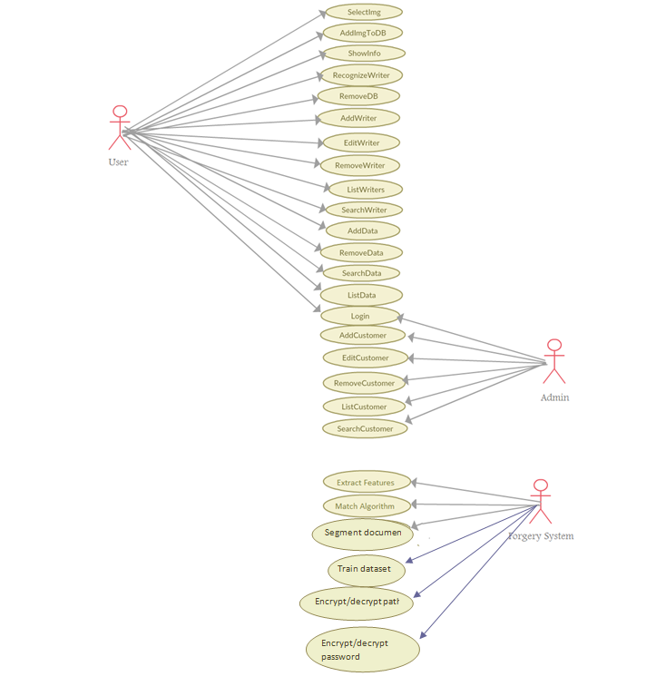
Use Case 1/3

Slide 6
Use Case 2/3

Slide 7
Use Case 3/3

Slide 8
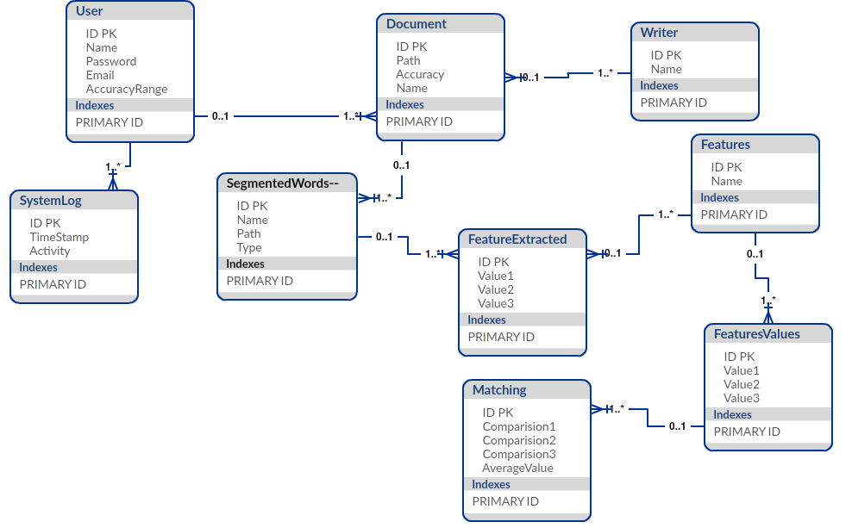
Data base

Slide 9
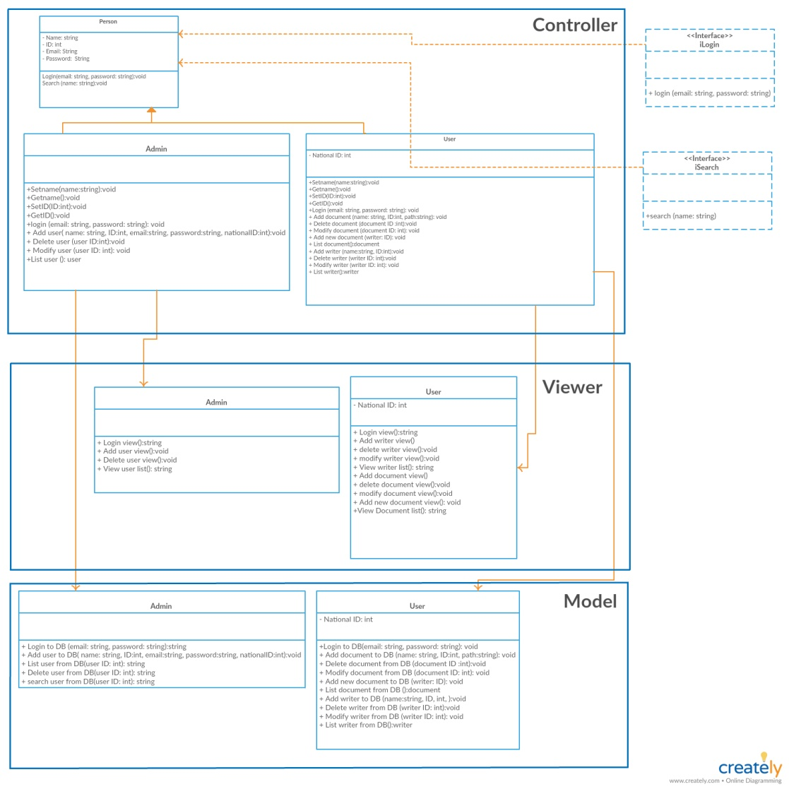
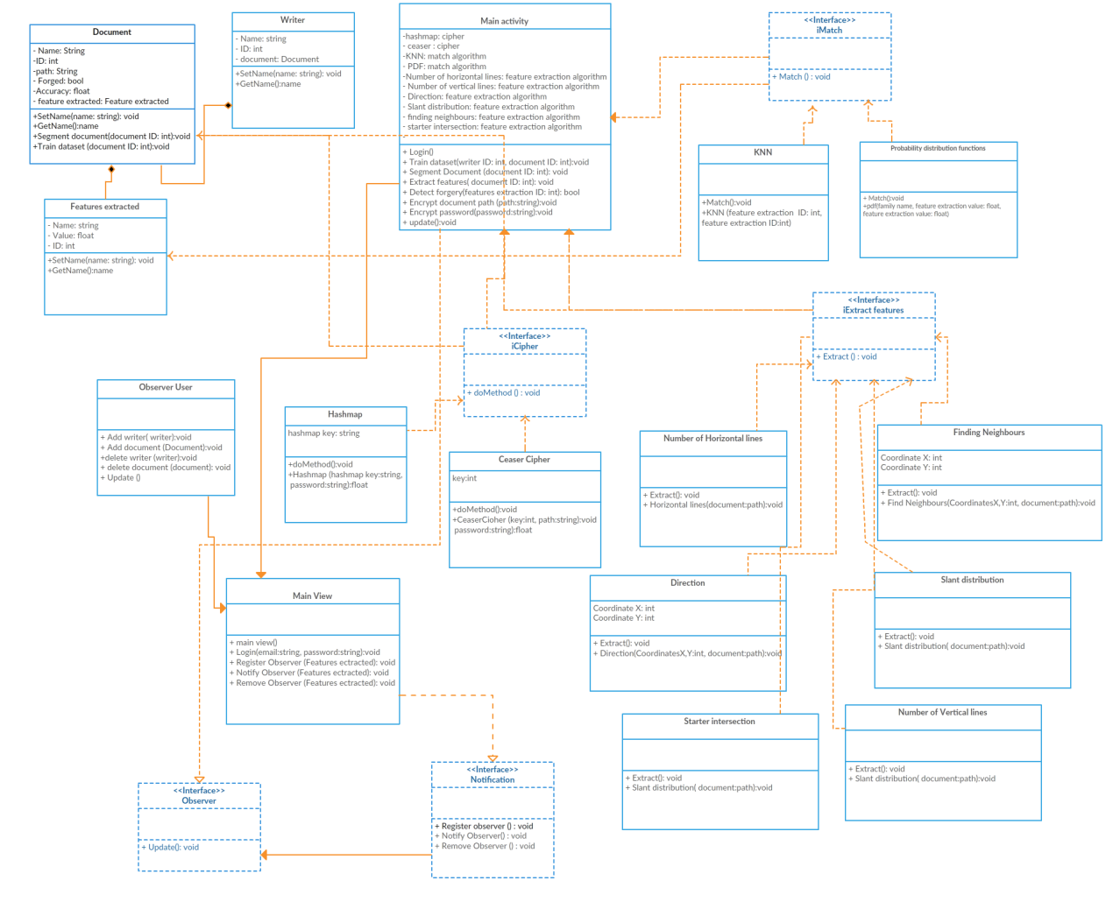
Class Diagram

Slide 10
Class Diagram

Slide 11
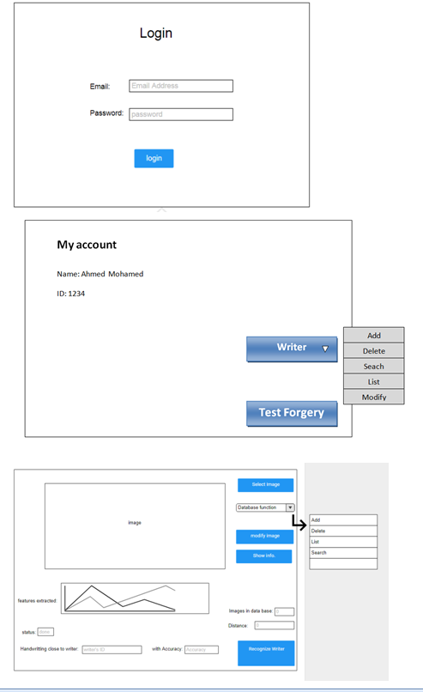
Main Interface 1/3

Slide 12
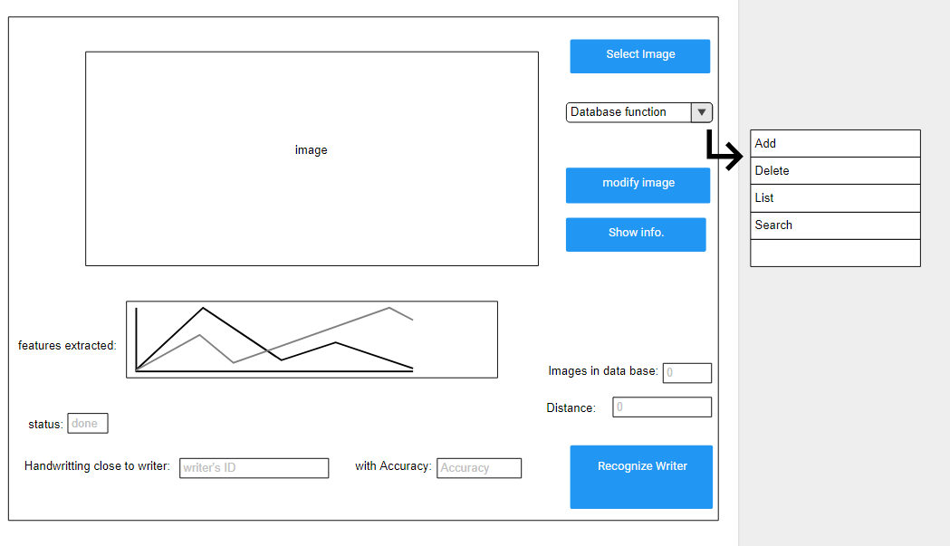
Main Interface 1/2

Slide 13
Thank you

