Slide 1
X-MYO Assistive Limb
Project By:
Amr Hamdi
Hassan Hamdy
Hossam Badr
Philip Naguib
Supervised By:
Dr. Sarah Nabil
Eng: Youssef Mubarak
Eng: Radwa Samy

Slide 2
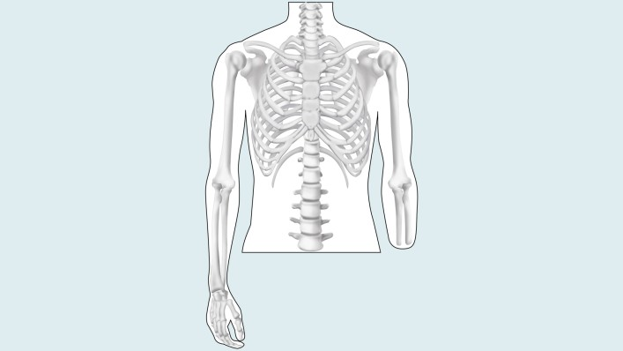
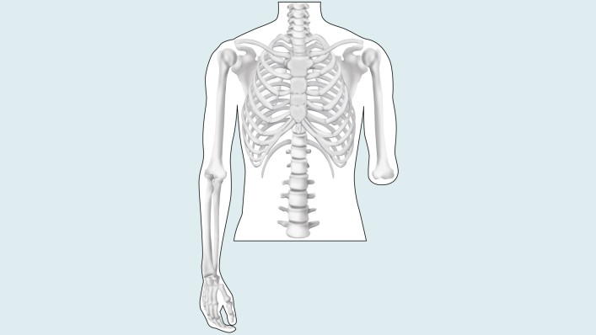
Introduction
Every year occur more than 50k people lose their forearm.
Only two solutions plastic hand or assistive limb.
What is EMG Signals?

Slide 3
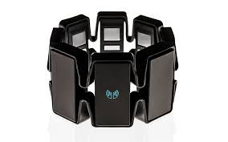
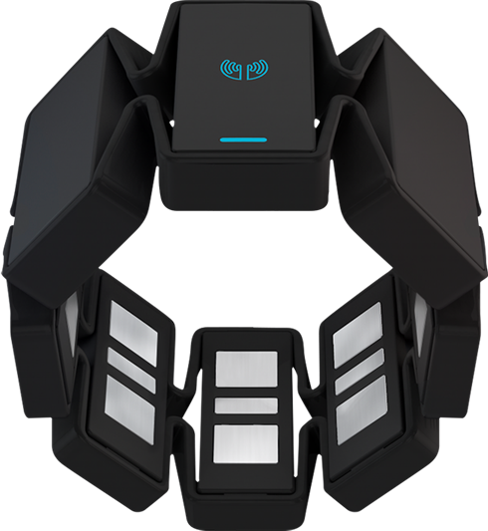
Introduction-MYO
What is Myo-armband?
What is the 8 sensors?
Myo sends data through bluetooth.
Myo armband cost about 300 USD

Slide 4
Motivation
Low cost
Portability
User friendly

Slide 5
Our main problem
Is trying to increase detection accuracy of the gesture using the myo armband

Slide 6
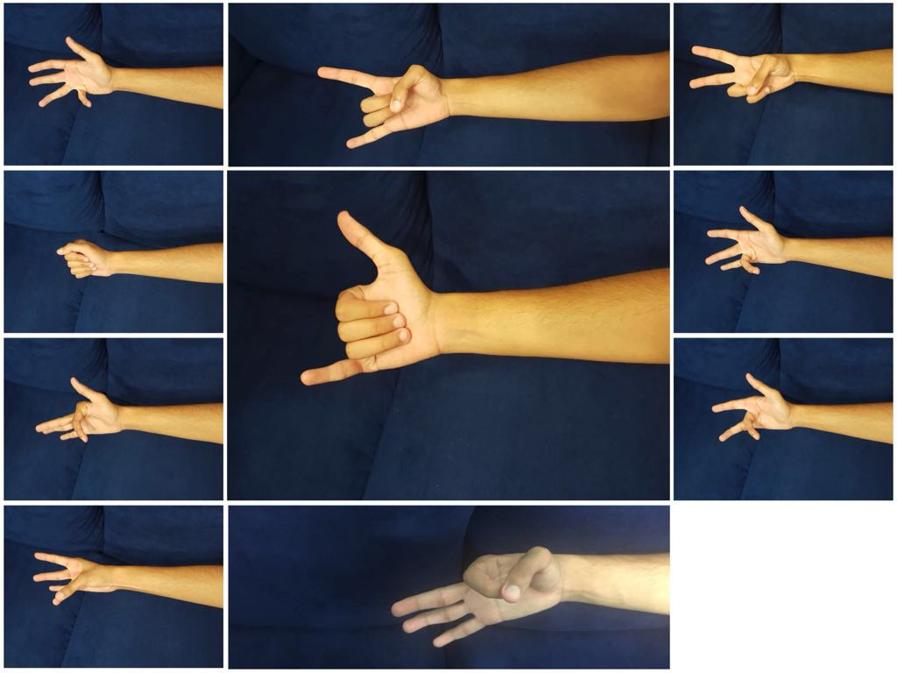
Achievements
The system can now detect 10 movements of user
The user can add new movement
The user can send his feedback

Slide 7
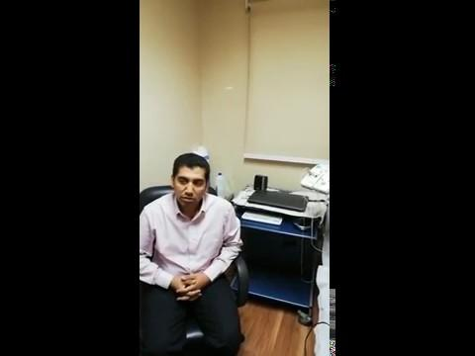
User Experience
Prof. Mohamed Hammed
Prof in Neuro Med
Prof in Neurology.

Slide 8
System Overview
The system can detect the 10 defined gestures of the user using his row EMG data.
User can add new gesture of his own.
The system will render the cube and rotate or move it according to the gesture sent from the device

Slide 9
Technologies.

Slide 10
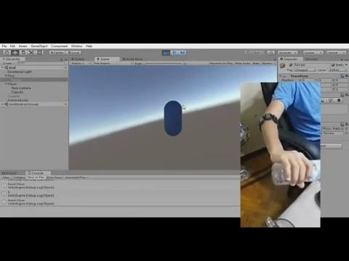
Demo 1

Slide 11
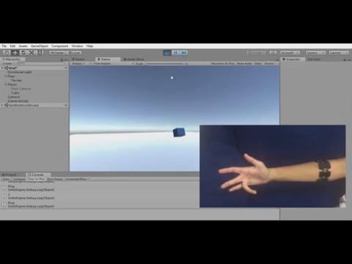
Demo 2

Slide 12
Any Questions?

Slide 13
Thanks

