Slide 1

Swimming Self-Coaching
Mohamed ehab – Hossam Mohamed – Muhamed ahmed – Mostafa hamad
Supervisor: Dr. Ayman Ezzat
Teacher Assistant: Eng. Noha Elmasry
Date: 25/9/2018

Slide 2
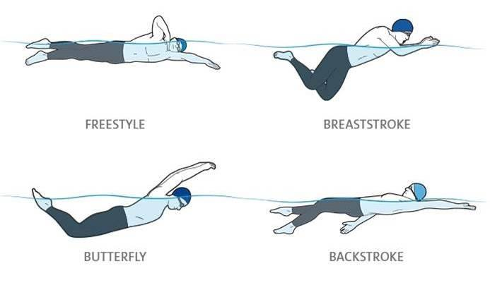
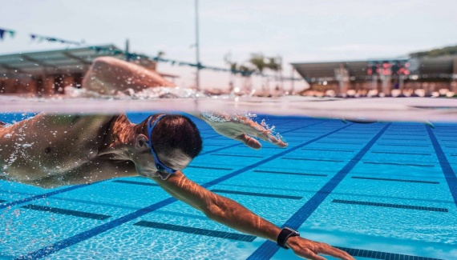
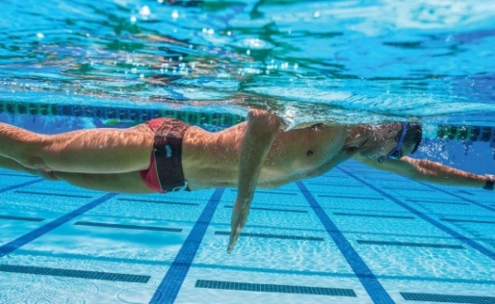
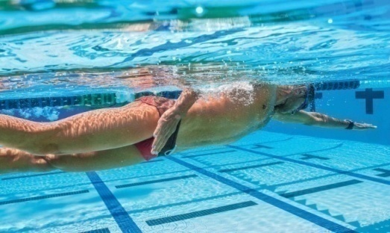
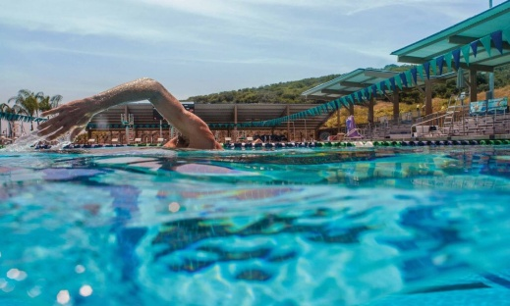
Introduction (1/2)
80% of Americans they can swim; while only 56% can perform all the basic styles. [1]
Phases of the freestyle stroke.
Stroke Count.
Stroke Duration.
Stroke Rate.
1- Catch
2- Pull
3- Exit
4- Recovery
[1] https://www.quora.com/What-percentage-of-the-worlds-population-can-swim
[2] https://www.theendurancestore.com/blogs/the-endurance-store/54878339-swim-club-blog-stroke-rate-v-stroke-count-and-why-its-critical-for-swim-performance
Notes:
2

Slide 3
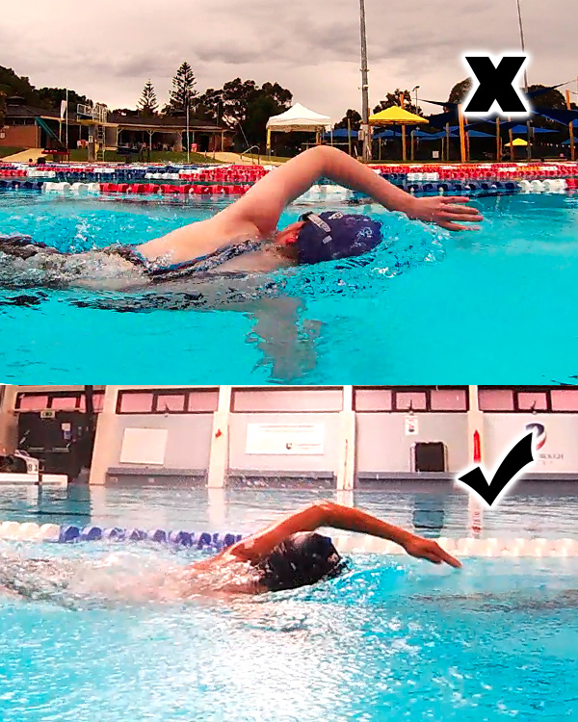
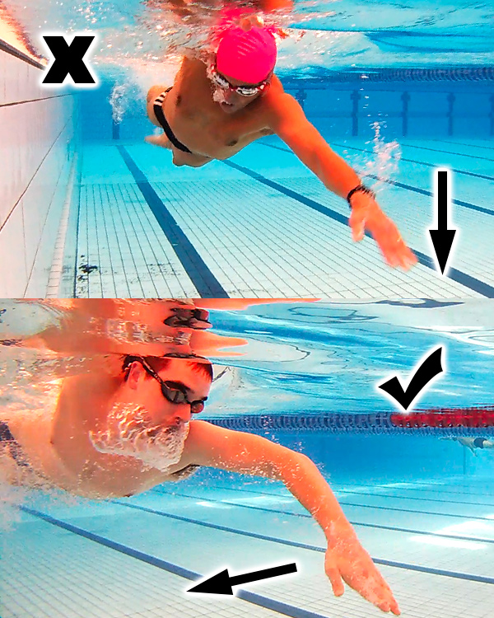
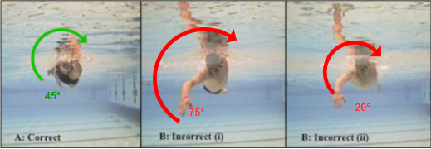
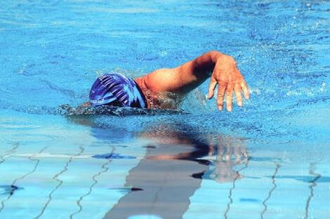
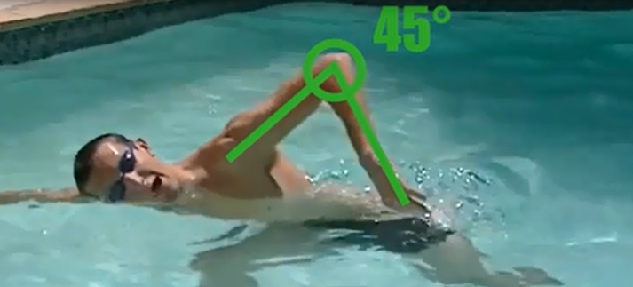
Introduction Common Mistakes In freestyle (2/2)
Dynamic behaviors patterns
Static behaviors
Hand (Elbow) entry angle.
Pull-through pattern
Body roll angle.
Elbow position during recovery

Slide 4
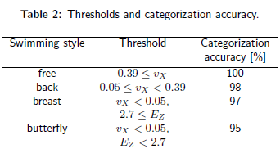
Related Work (1/4):
Aim to optimize training efficiency and thus improve results that the swimmer can obtain
Handmade collected data-set
Sensor position:
  Lower back.
auto detection for swimming style and whether the subject swims or turns
[4] Kon, Yoshihisa et al. “Toward classification of swimming style by using underwater wireless accelerometer data.” UbiComp/ISWC Adjunct (2015)..

Slide 5
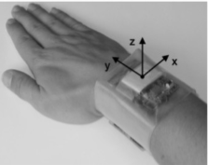
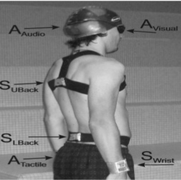
Related Work (2/4):
optimum body position .
Sensor positions:
  Upper back.
  Lower back.
  Right wrist.
Time per lane, the swimming velocity and the number of strokes per lane
Data analysis is based on off-line algorithms.
[4] Bächlin, Marc & Förster, Kilian & Tröster, Gerhard. (2009). SwimMaster: A Wearable Assistant for Swimmer. ACM International Conference Proceeding Series. 215-224. 10.1145/1620545.1620578.
Notes:
5

Slide 6
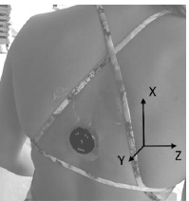
Related Work (3/4):
In swimming, coaches often simultaneously monitor 10 swimmers or more within short intervals from each other.
Comparison of human and sensor-based studies of swimming performance.
Tri-Axial Accelerometers the placed on upper back.
Reported accuracy for stroke detection 95%
[5]Ganzevles, Sander, et al. "Using tri-axial accelerometry in daily elite swim training practice." Sensors 17.5 (2017): 990.

Slide 7
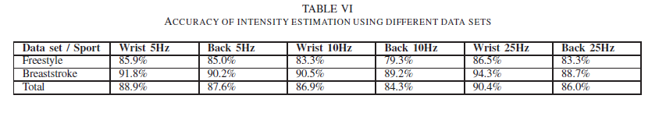
Related Work (4/4):
Comparison of two different sensor placements (wrist and upper back) and different sampling frequencies.
Two datasets:
  1- consists of freestyle and breaststroke with 3 different velocities.
  2- consists of freestyle, breaststroke and backstroke but by any velocities.
Reported accuracy:
[6] Siirtola, Pekka, et al. "Efficient accelerometer-based swimming exercise tracking." Computational Intelligence and Data Mining (CIDM), 2011 IEEE Symposium on. IEEE, 2011.

Slide 8
Problem Statement
Enhance the classification accuracy of swimming style exercises through sensor readings and providing
real-time feedback with AR mobile application

Slide 9
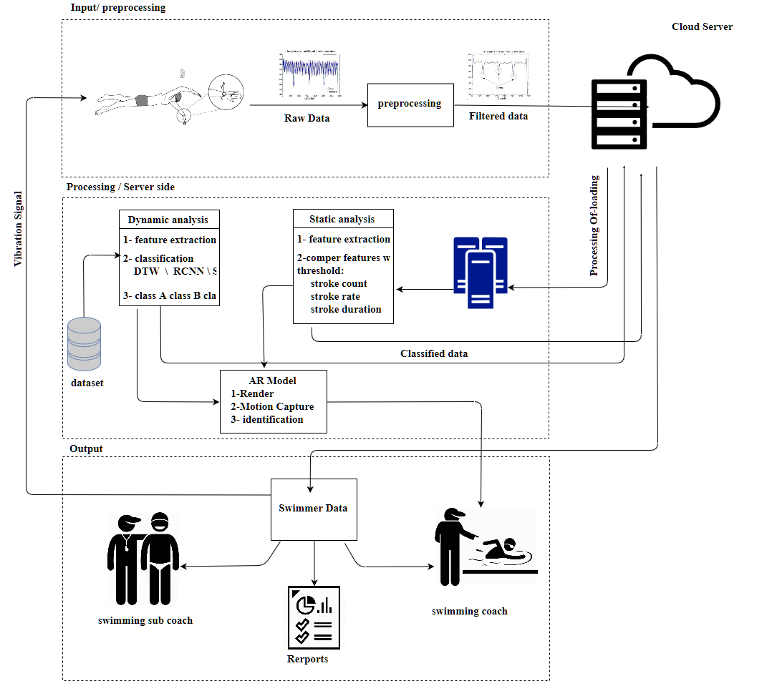
System Overview

Slide 10
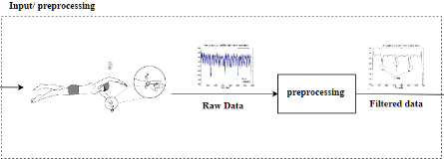
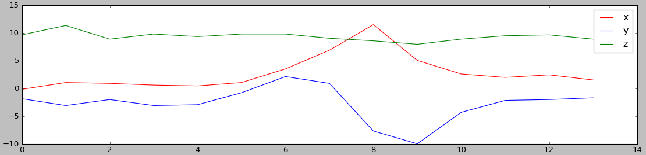
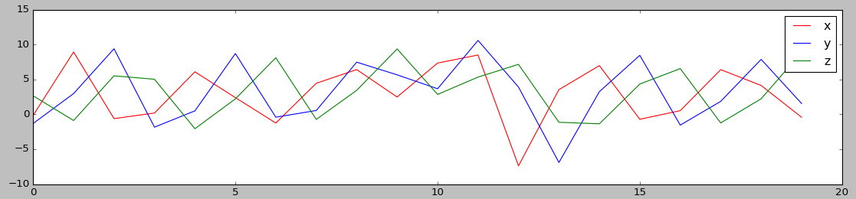
Preprocessing
Get sensor readings.
Proposed techniques:
  Low-pass.
  Hamming.
  Kalman.
Segmentation(Windowing).
Signal interpolation / extrapolation.
Before
After

Slide 11
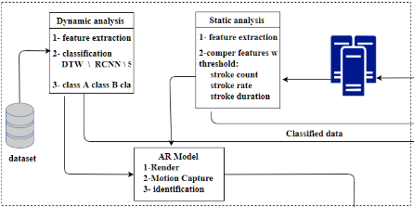
Detection and Classification
Use DTW and R-CNN Algorithm.
Automatic stroke detection.
  Stroke count,
  Stroke rate and
  Stroke duration.
Swimmer behavior analyzed and stored.

Slide 12
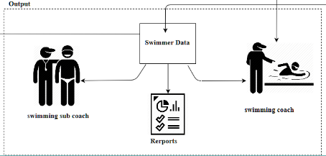
Output
Coach module:
  Automatic stroke scoring.
  Real-time swimmer rating.
Sub coach module:
  Stroke count, rate, duration.
Swimmer module:
    Vibration.
Reports module.

Slide 13

Expected Results
Output of stroke count, stroke rate and stroke duration.
Real-time feedback and analysis about swimmer behavior.
Enhancing accuracy.

Slide 14
Any Questions?

Slide 15
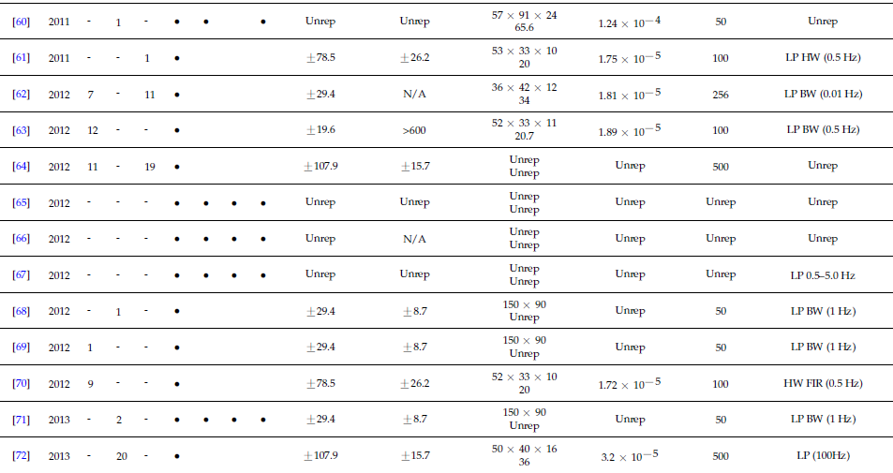

Slide 16
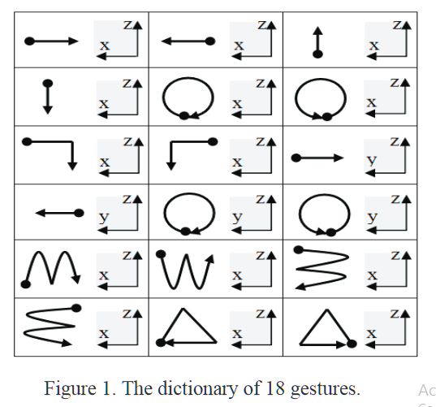
Appendix - DTW Algorithm
ACCELEROMETER-BASED GESTURE RECOGNITION VIA DYNAMIC–TIME WARPING, AFFINITY PROPAGATION, & COMPRESSIVE SENSING
They propose a gesture recognition system based primarily on a
single 3-axis accelerometer using dynamic time warping
Reported accuracy : 94.79%.
[8] Akl, Ahmad & Valaee, Shahrokh. (2010). Accelerometer-based gesture recognition via dynamic-time warping, affinity propagation, & compressive sensing. 2270 - 2273. 10.1109/ICASSP.2010.5495895.

Slide 17
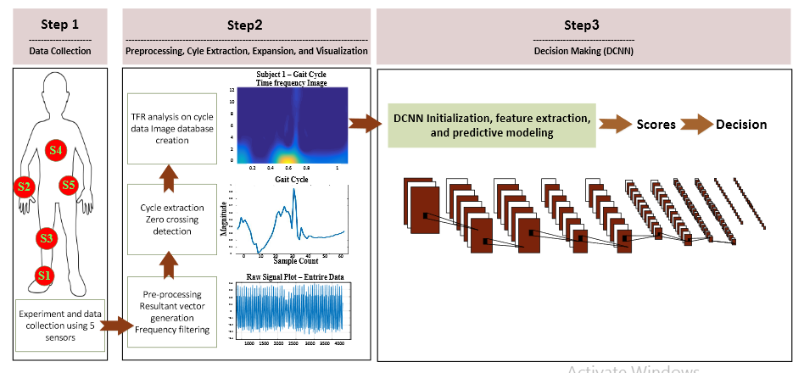
R-CNN Algorithm
The wide spread usage of wearable sensors such as in smart watches has provided
continuous access to valuable user generated data such as human motion to identify an individual based on his motion patterns such as, gait.
Reported accuracy : 97.06%
Dehzangi, Omid, Mojtaba Taherisadr, and Raghvendar ChangalVala. "IMU-Based Gait Recognition Using Convolutional Neural Networks and Multi-Sensor Fusion." Sensors 17.12 (2017): 2735.

Slide 18

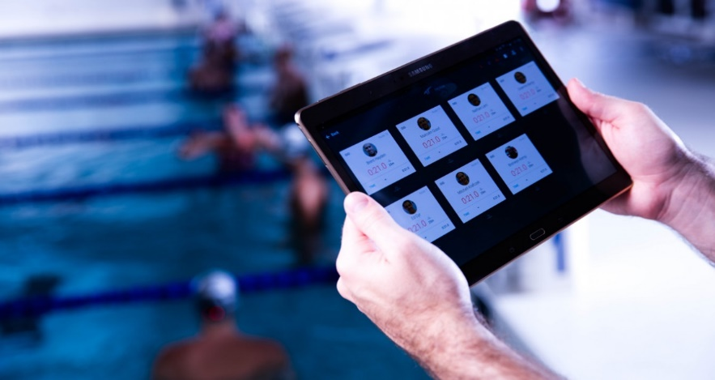
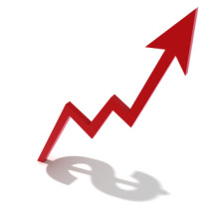
Challenges
Provide real-time
analysis for each stroke.
AR mobile application.
Enhancing accuracy.
Notes:
18

Slide 19
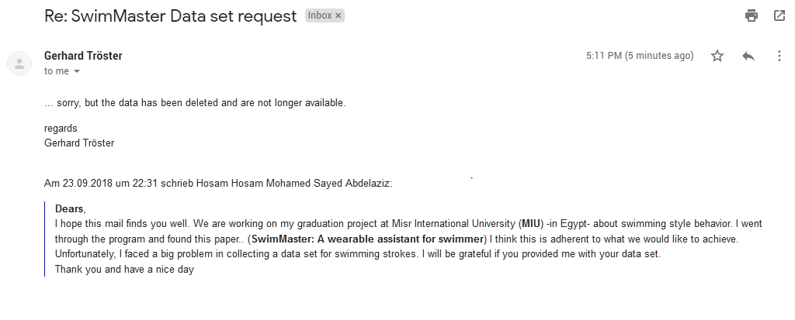
Dataset (1/2)

Slide 20
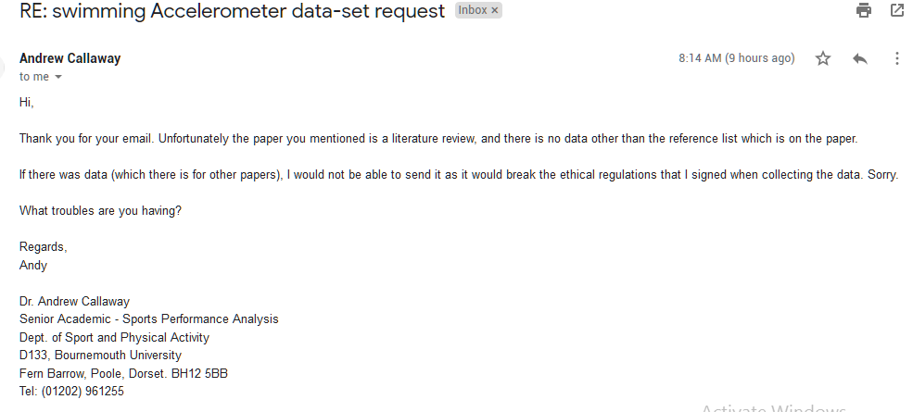
Dataset (2/2)

Slide 21
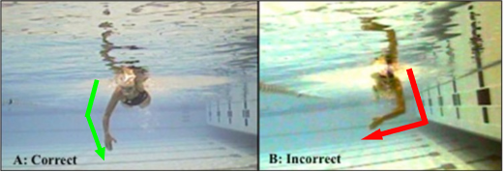
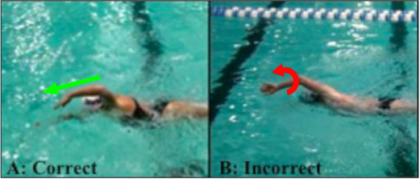
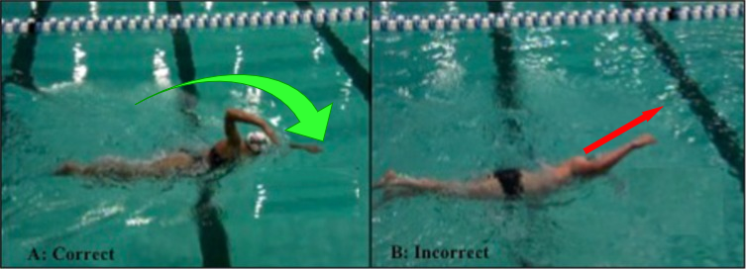
Introduction Common Mistakes In Front Crawl Stroke (2/2)
Dynamic behaviors patterns
Static behaviors
Pull-through pattern
Hand (Elbow) entry angle.
Elbow position during recovery
Body roll angle.
[3] Virag, Bonnie et al. “Prevalence of Freestyle Biomechanical Errors in Elite Competitive Swimmers.” Sports health (2014).
Notes:
21

