Slide 1
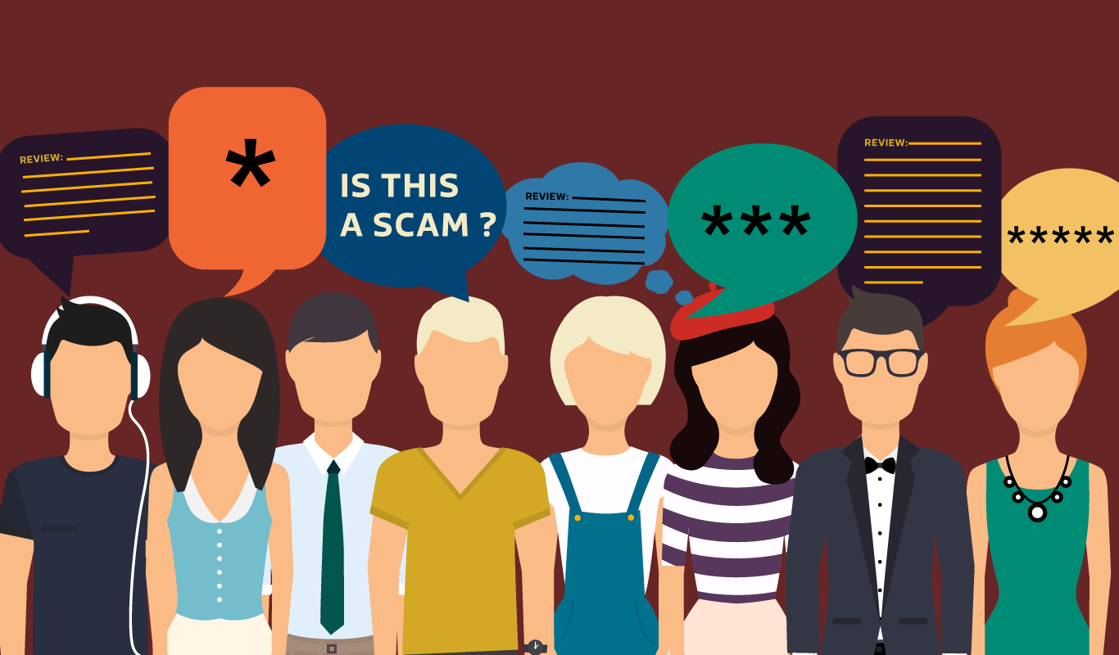
Fake Reviews Detection
SPAM
By Amira Ashraf, Marim Mohamed, Yara Ahmed Nader & Yasmine Maged
Supervised by: Dr. Ammar Mohamed & Eng. Huda Mohamed

Slide 2
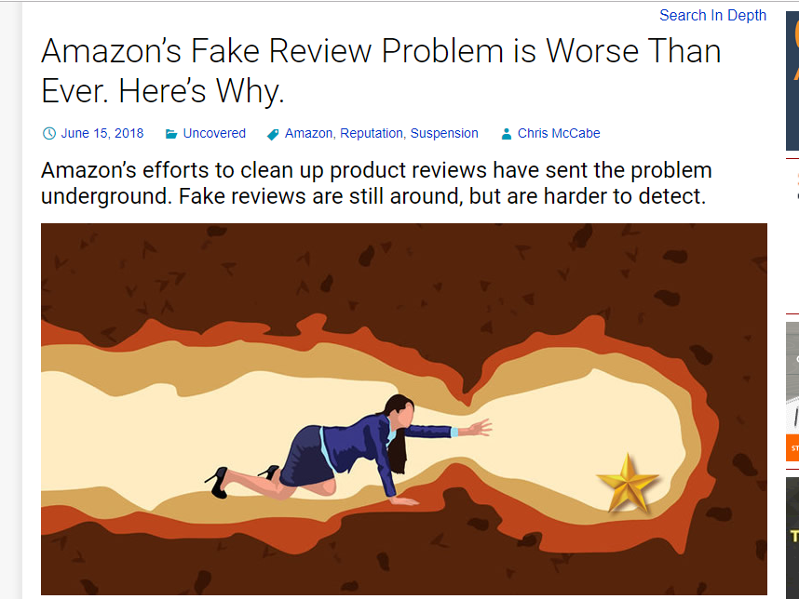
Introduction 1/2

Slide 3
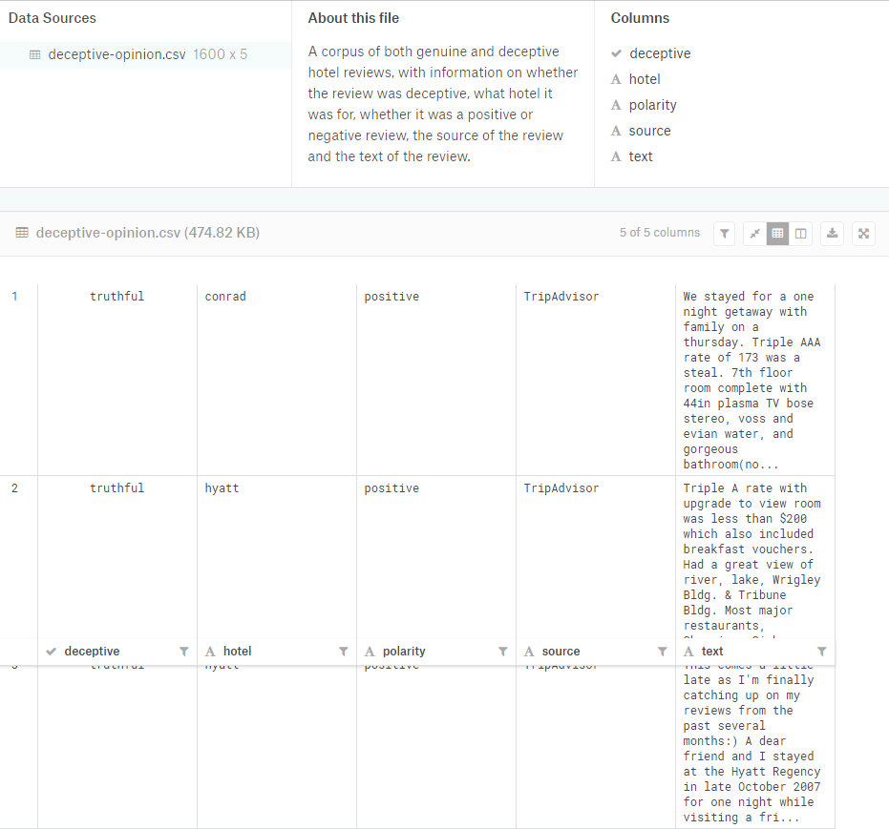
Introduction 2/2

Slide 4
Dataset schema 1/2

Slide 5
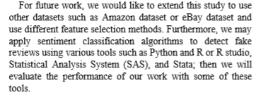
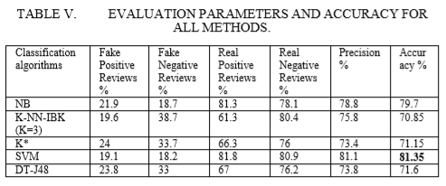
Related Work 1/2
Detecting Fake Reviews through Sentiment Analysis
Using Machine Learning Techniques:
Analyzing data to detect fake reviews.
Used algorithms: Naïve Bayes , SVM, KNN, (K*) and Decision Tree.
C. The dataset they used is movie review dataset V2.0 and V1.0.
D. They reach 81.5% accuracy by using SVM.
Elmurngi, Elshrif, and Abdelouahed Gherbi. "Detecting Fake Reviews through Sentiment Analysis Using Machine Learning Techniques." IARIA/DATA ANALYTICS (2017): 65-72.

Slide 6
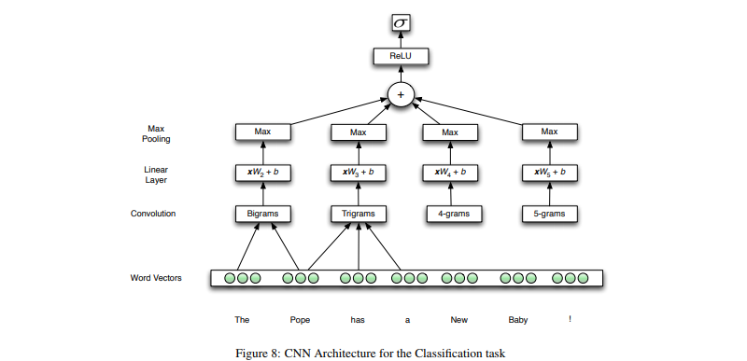
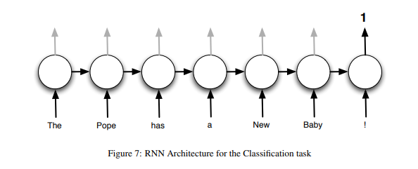
Related Work 2/2
Fake News Detection Using Deep Learning:
They build a classifier that predict if the news is fake or not, based on its content.
B. They used RNN and CNN with GRU & LSTMs.
C. They used Kaggle dataset that contains Fake news articles. And Signal Media News dataset which contains Authentic news articles .
Lee, Dong-Ho, et al. "Fake news detection using deep learning."

Slide 7
Similar system comparison
reviews

Slide 8
Problem Statement
Detecting fake reviews by using efficient deep learning techniques.

Slide 9
System Overview 1/3

Slide 10
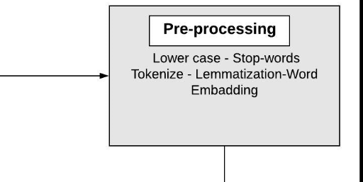
System Overview 2/3 Input
Lower case : 'Analytics’ ‘analytics’
Removal of Stop Words : as , this , the.
Tokenization : {“I love dogs”} {“I”, “love” , “dogs”}
Lemmatization: ‘Dresses’ ‘Dress’
Word Embedding: TF-IDF , Word2vec, bag of words.

Slide 11
System Overview 3/3 Process & Output
Fake Reviews Detection: Deep Learning, SVM, Naïve Bayes.
Output:
Fake, Real Reviews.

Slide 12
Expected Result and Contribution
Obtaining fake detection model with high accuracy.

Slide 13
Challenges
Getting a large scale of labeled dataset which include the user information.
Features need to detect fake reviews:
What is the personal reviews score distribution?
What is the lifetime of an reviewer account?
How frequent the reviewer is writing reviews?

Slide 14
Pre-processing Demo

Slide 15
Thank You

