Slide 1
Swimming Self-Coaching
Mohamed ehab – Mohamed ahmed – Hossam Mohamed – Mostafa hamad
Supervisor: Dr. Ayman Ezzat
Teacher Assistant: Eng. Noha Elmasry

Slide 2
Objective
Enhance the classification accuracy of swimming style exercises through sensor readings and providing real-time feedback with AR mobile application.

Slide 3
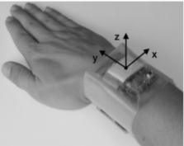
Similar System
Optimum body position . Sensor positions:
Upper back.
Lower back.
Right wrist.
Time per lane, the swimming velocity and the number of strokes per lane.
Data analysis is based on off-line algorithms.
[1] Bächlin, Marc & Förster, Kilian & Tröster, Gerhard. (2009). SwimMaster: A Wearable Assistant for Swimmer. ACM International Conference Proceeding Series. 215-224. 10.1145/1620545.1620578.
Notes:
3

Slide 4
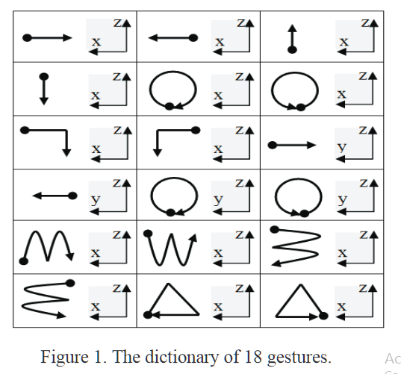
DTW Algorithm
ACCELEROMETER-BASED GESTURE RECOGNITION VIA DYNAMIC–TIME WARPING, AFFINITY PROPAGATION, & COMPRESSIVE SENSING
They propose a gesture recognition system based primarily on a
Single 3-axis accelerometer using dynamic time warping
Reported accuracy : 94.79%.
[2] Akl, Ahmad & Valaee, Shahrokh. (2010). Accelerometer-based gesture recognition via dynamic-time warping, affinity propagation, & compressive sensing. 2270 - 2273. 10.1109/ICASSP.2010.5495895.

Slide 5
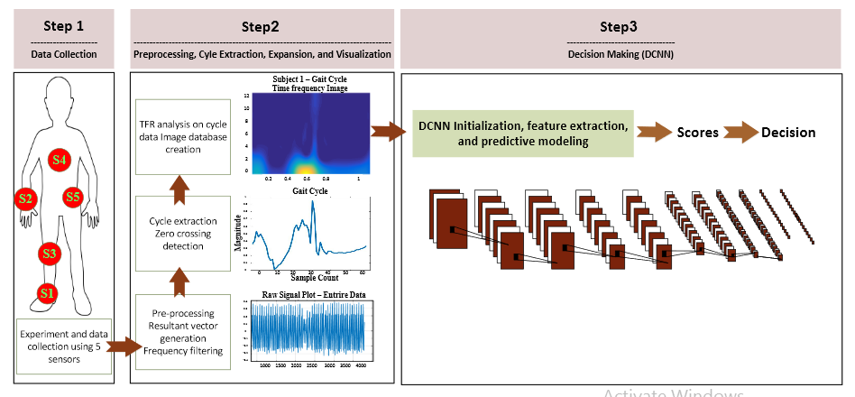
RNN Algorithm
The wide spread usage of wearable sensors such as in smart watches has provided
continuous access to valuable user generated data such as human motion to identify an individual based on his motion patterns such as, gait.
Reported accuracy : 97.06%
[3]Dehzangi, Omid, Mojtaba Taherisadr, and Raghvendar ChangalVala. "IMU-Based Gait Recognition Using Convolutional Neural Networks and Multi-Sensor Fusion." Sensors 17.12 (2017): 2735.

Slide 6
KNN Algorithm
Recognizing Human Activities User independently on Smartphones Based on Accelerometer Data
Human activity recognition of five everyday activities using a mobile phone.
Models were implemented to the phone and the whole classification process (preprocessing, feature extraction and classification) was done.
[4]Siirtola, Pekka, and Juha Röning. "Recognizing human activities user-independently on smartphones based on accelerometer data." IJIMAI 1.5 (2012): 38-45.
Notes:
Preprocessing: Magnitude acceleration and the orientation of the phone has limitations.
Feature extraction: features extracted from a signal where two out of three acceleration channels were square summed.

Slide 7
System Overview

Slide 8
Block Diagram

Slide 9
Most Important Functional Requirement (1/7)- Collecting Signals

Slide 10
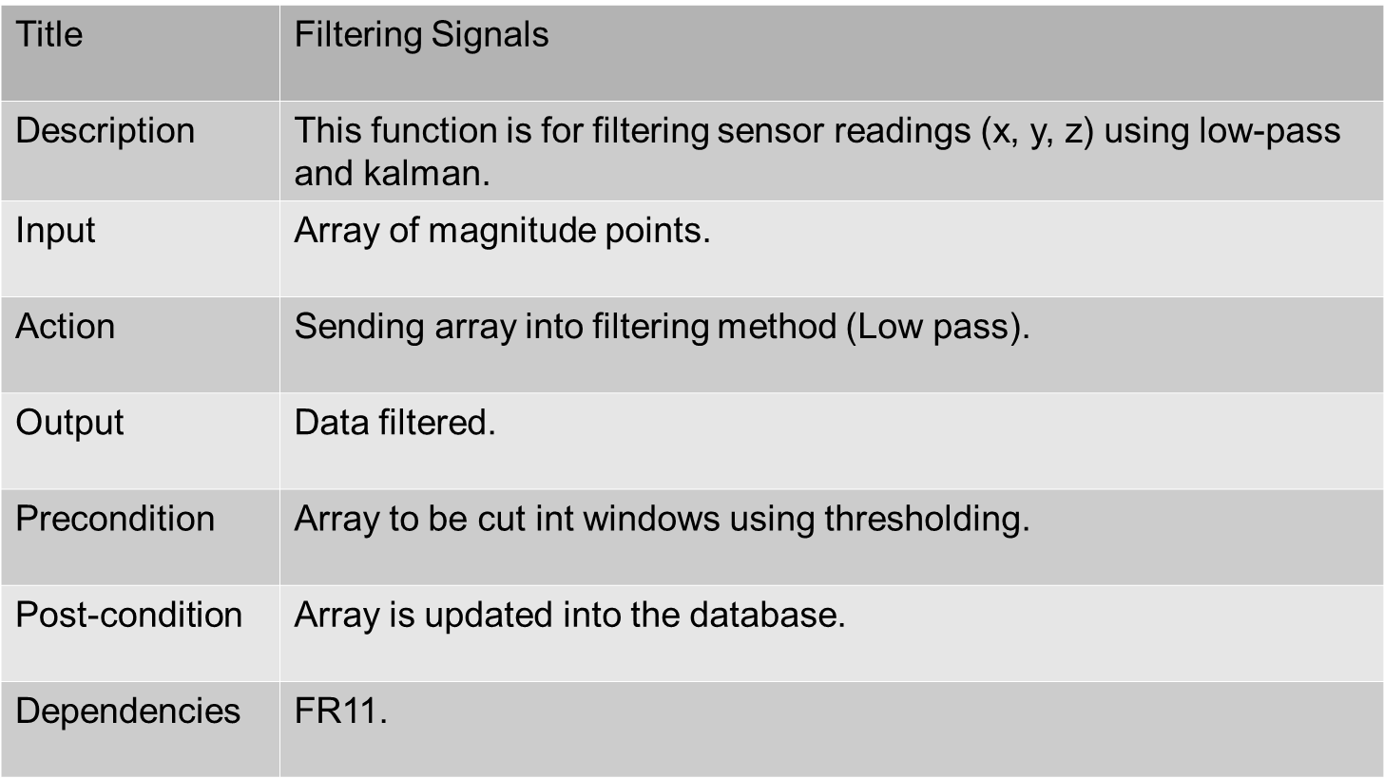
Most Important Functional Requirement (2/7)- Filtering Signals

Slide 11
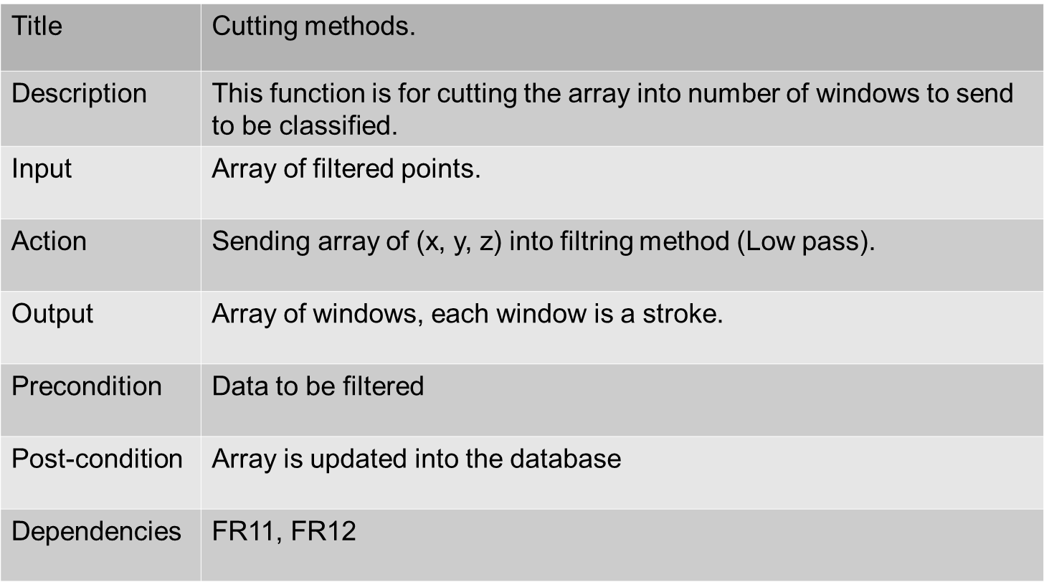
Most Important Functional Requirement (3/7)- Cutting Methods

Slide 12
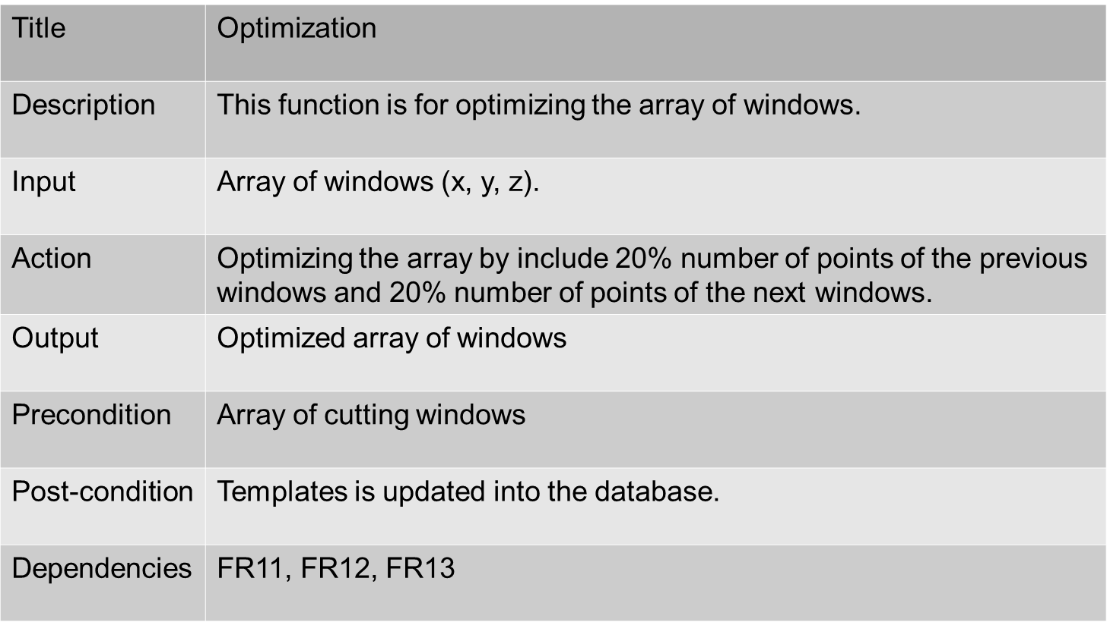
Most Important Functional Requirement (4/7)- Optimization

Slide 13
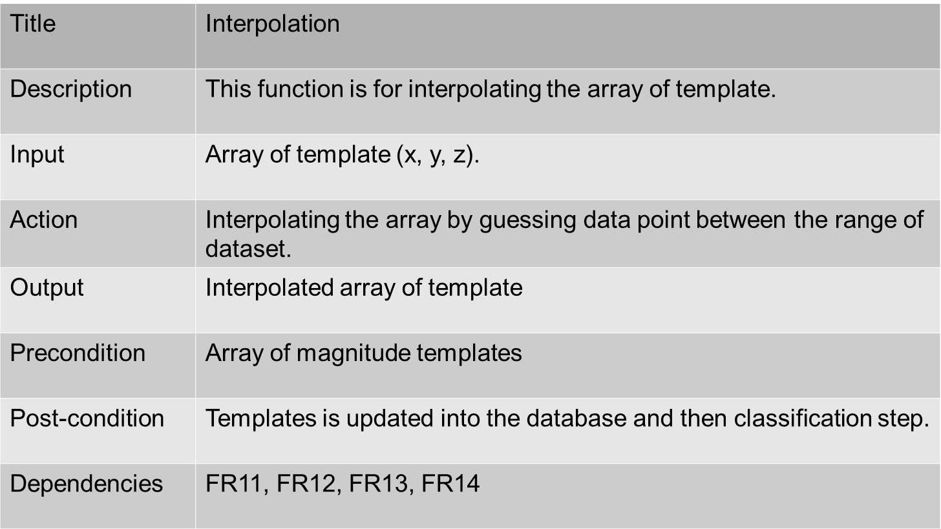
Most Important Functional Requirement (5/7)- Interpolation

Slide 14
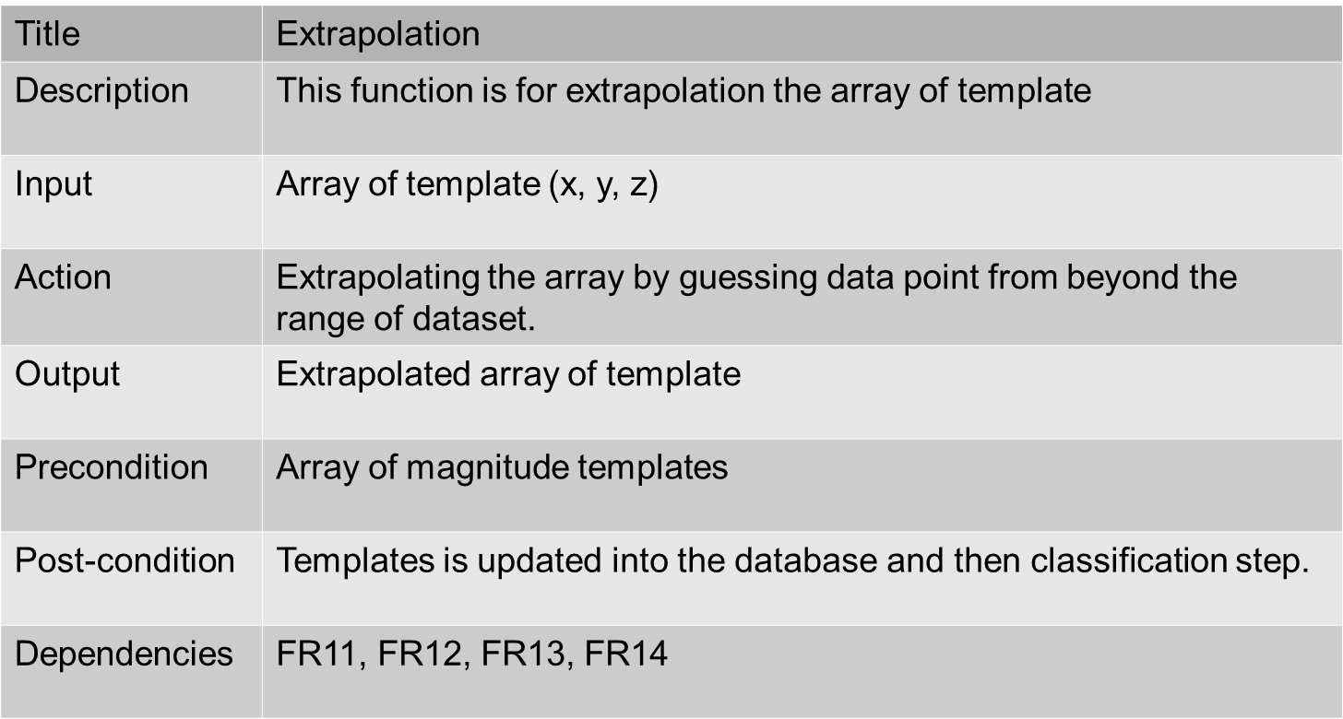
Most Important Functional Requirement (6/7)- Extrapolation

Slide 15
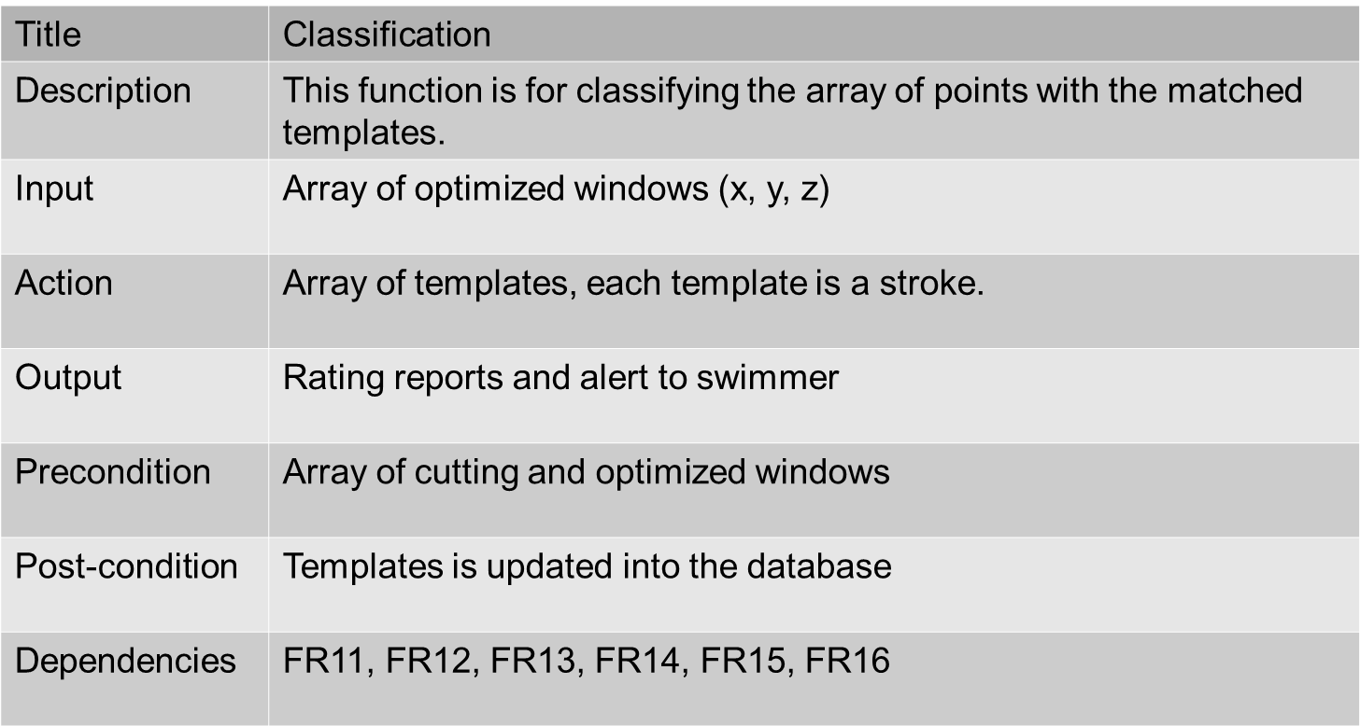
Most Important Functional Requirement (7/7)- Classification

Slide 16
Non Functional Requirements
Performance
and Speed
Reliability
Usability
Scalability
Notes:
Performance and speed: The Swimming Self-Coaching must be interactive and the delays involved must be reduced. So in every action response of the Swimming Self-Coaching. Detection and classification must have no delays.
Reliability: The Swimming Self-Coaching is reliable. It must be make sure that the system is reliable in its operations. This would be mainly focusing on the detection and classification. As sensors readings should be accurate and error free. When a detected wrong movement is being classified, it is very important to identify the type of the wrong movement correctly with no errors and the user should be able to trust the Swimming Self-Coaching fail rate is almost 0 percent.
Usability: Proportion of functionalities or tasks mastered doesn't need time to be learned. Also, this system is easy to be memorized due to the small number of tasks the user will do.
Scalability: The Swimming Self-Coaching is scalable. It should be easy to maintain to minimize the amount of changes that would be done to the code.

Slide 17
Database Diagram

Slide 18
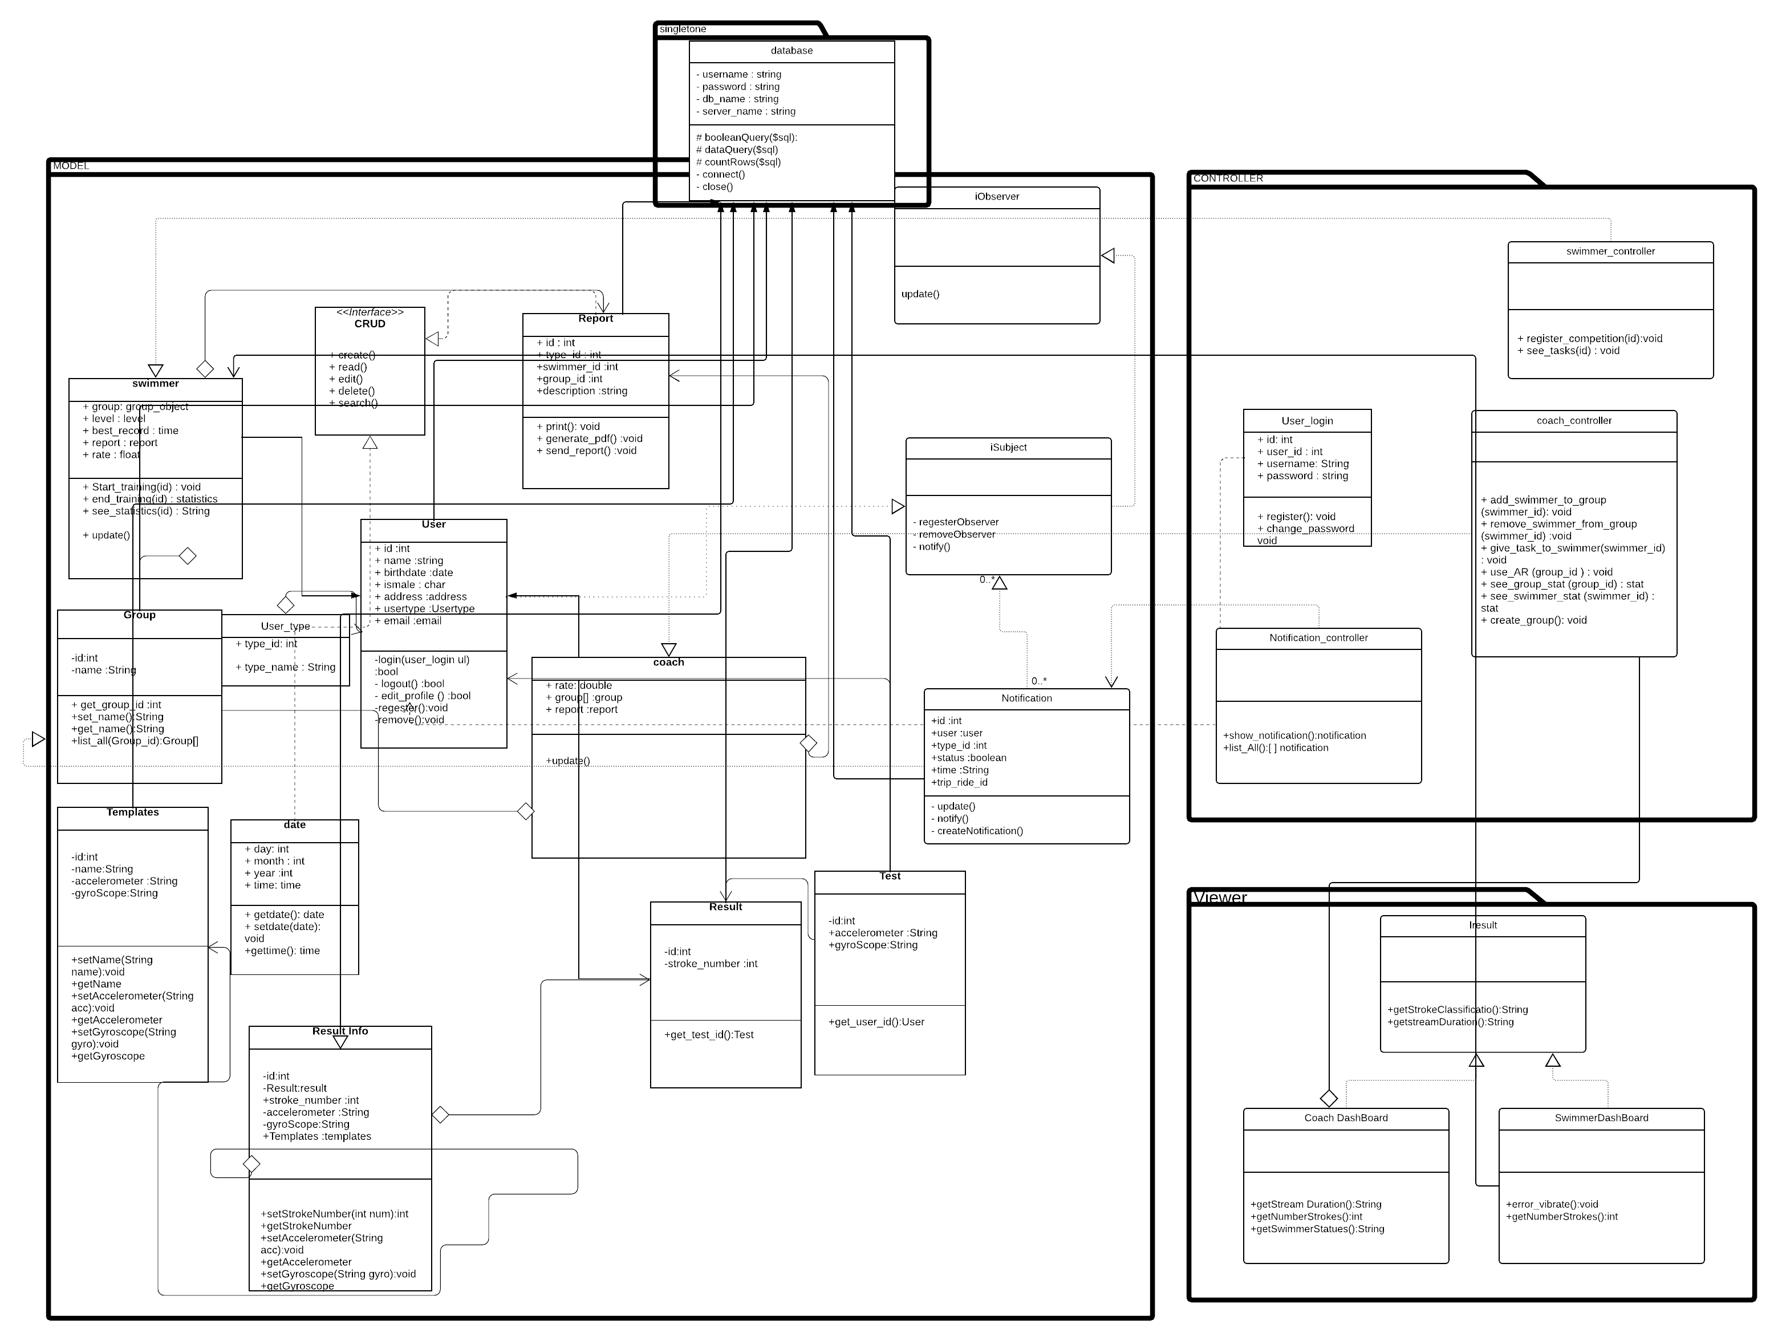
Class Diagram

Slide 19
Web Monitor Page

Slide 20
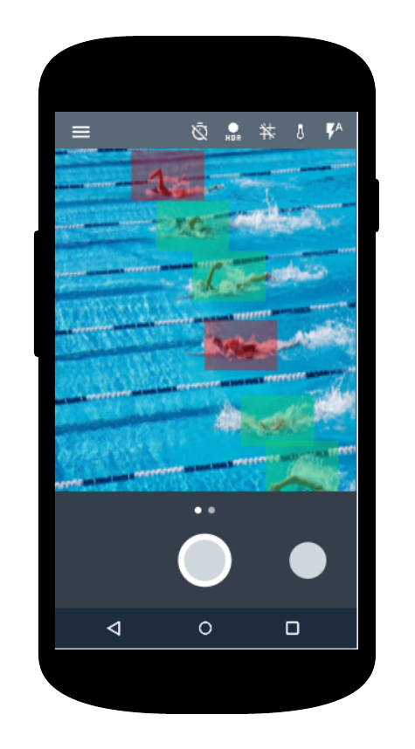
Coach AR Mobile Application

Slide 21
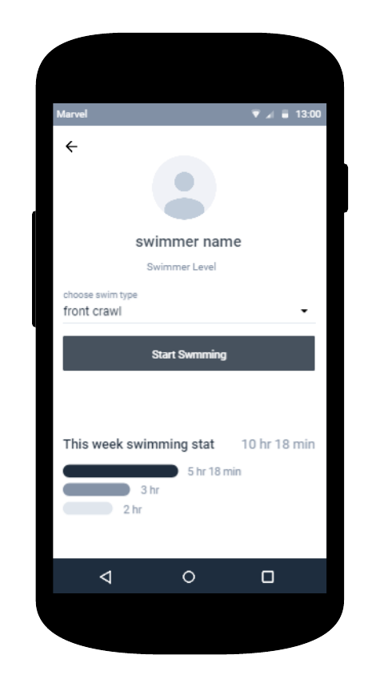
Swimmer Mobile Application

