Slide 1
Dermatologist Assistant
Presented by:
Alaa Muhammed
Ehab Mustafa
Hagar Maher
Supervised by:
Dr. Alaa Hamdy
TA. Nada Ayman
Wednesday, 26th September, 2018

Slide 2
Skin Diseases
Approximately 7% to 10% of hospitalized patients are influenced by skin infections.
Studies reveal that about 0.1% of the total population are affected by major burns.
One in every three cancers diagnosed is a skin cancer, according to Skin Cancer Foundation Statistics.
Dermatosis is spreading due to many reasons.

Slide 3
Motivation
On February 23, 2015 the FTC (Federal Trade Commission) fined app makers for false advertising.
The availability of inaccurate self-diagnosis’ apps may lead some patients to causes difficulty in absorption of the dose of treatment

Slide 4
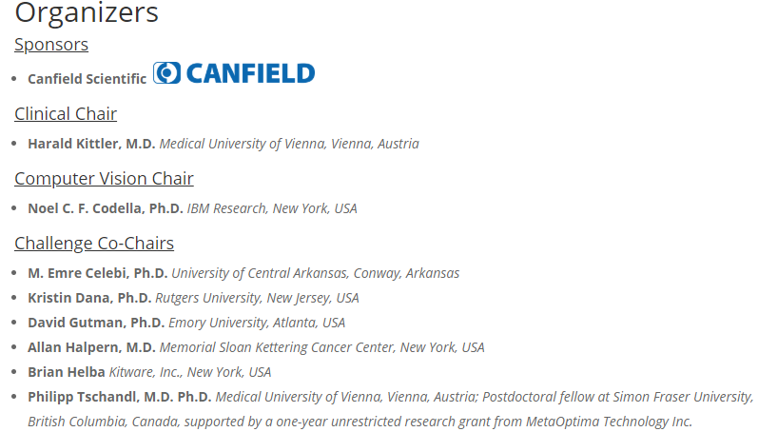
ISIC Challenge
This challenge is broken into three separate tasks:
Task 1: Lesion Segmentation
Task 2: Lesion Attribute Detection
Task 3: Disease Classification
Each competitor may participate in any or all of these tasks.
Cash prizes of $2500 USD will be awarded to winners of each of the tasks. The monetary prizes for the winners of the challenge will be awarded at the time of the MICCAI Workshop.

Slide 5
Problem Statement
Some dermatosis which are examined late causes difficulty in absorption of the dose of treatment thus, the patient doesn’t respond quickly to medication.
High similarity in skin lesion shapes and color.

Slide 6
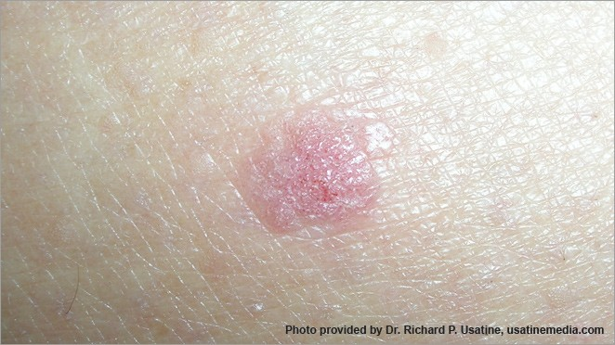
System Overview
Preprocessing
Segmentation
Feature Extraction
??????????
Is Detected
Treatment
Hospitals
Classification
Analysis

Slide 7
System Overview - Dataset
Our Dataset consists of images with it’s metadata and groundtruth.
A total 22191 images that is distributed as follow:
Basal cell carcinoma _ 586 Images
Actinic keratosis _ 329 Images
Melanoma _ 2169 Images
Nevus _ 18566 Images
Seborrheic keratosis _ 419 Images
Dermatofibroma _ 122 Images
Notes:
Our dataset contains 23906 Images that was collected from ISIC The International Skin Imaging Collaboration:

Slide 8
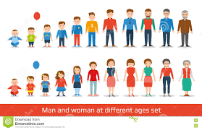
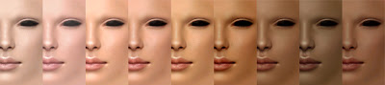
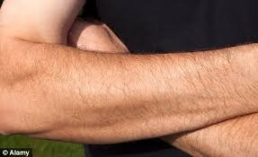
System Overview - Input

Slide 9
System Overview - Output
??????????
Is Detected
Treatment
Hospitals
Main Screen
Hospital \ Clinic Screen
Treatment Screen

Slide 10
System Overview - Segmentation
Color to monochrome image conversion
Image binarization using an adaptive threshold
Border identification
Notes:
Our dataset contains 23906 Images that was collected from ISIC The International Skin Imaging Collaboration:

Slide 11
System Overview - Feature Extraction
Color Features
Texture Features
RGB Histogram Features
Notes:
Our dataset contains 23906 Images that was collected from ISIC The International Skin Imaging Collaboration:

Slide 12
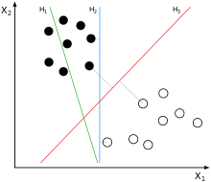
System Overview - Classification
Class | Diseases | Description
Class A | Melanoma | Melanoma Description
Class B | Nevus | Nevus Description
Class C | Basal Cell Carcinoma | Basal Cell Carcinoma Description
Class D | Actinic Keratosis | Actinic Keratosis Description
Class E | Seborrheic Keratosis | Seborrheic keratosis Description
Class F | Dermatofibroma | Dermatofibroma Description
Support Vector Machine (SVM)
Notes:
Our dataset contains 23906 Images that was collected from ISIC The International Skin Imaging Collaboration:

Slide 14
Related Work 1: SKIN LESION ANALYSIS TOWARD MELANOMA DETECTION
Task 1_Lesion Segmentation: They achieved a Jaccard Index of 0.765, accuracy of 93.4%, and Dice coefficient of 0.849, using a variation of a fully convolutional network ensemble (a deep learning approach).
Task 2_Dermoscopic Feature Classification: They detected clinical features by reformulating the problem as a segmentation task, and finetuning a CNN to detect pixels that contain the studied clinical features.
Task 3_Disease Classification: They added additional weakly labelled pattern annotations to their training data, and used AVG (Average between two classes).

Slide 15
Related Work 2: Automatic Diagnosis of Melanoma: a Software System based on the 7-Point Checklist
Boundary Detection: Extract the pigmented lesion from the surrounding healthy skin
a) RGB image b) Binary mask c) RGB image and Superimposed contour
Feature Extraction: Measure morphological and chromatic features related to the dermoscopic structures of interest
a) Color Segmentation b) Texture Extraction
Feature Classification: Detection of each criteria using Decision Tree & SVM
Accuracy: The whole diagnostic software provided a lesion sensitivity and specificity greater than 85%.

Slide 17
Expected Results
Automated detection application of Skin disease
Automatically determine the type of the skin diseases.
Output the detected disease with treatments and procedures to take.
Accurate diagnosis results.

Slide 18
Demo

