Slide 1

Safe & Fast
Sleepless Warriors
Team Member Names:
Andrew Usama
Habiba Elwany
Monica Medhat
Moustafa Waly
February 2019

Slide 2
Problem Statement
S
S
T
T
High Security & Time
Low Time, Low Security
Safe & Fast– Sleepless Warriors
Notes:
Mobile application option track the user and make sure the trucks are safer by telling them what roads and safer and the customers and tell them what roads are safest and the shortest and fastest and safest road and keep tracking them and keep informing them if the roads are still safe and keep them updated by getting live feeds from the street cameras. We keep them safe by telling them crowded areas and public places like shopping malls, banks and tap through those cameras to keep the customer updated.
Add : “Our idea also guarantees the security of the trucks that transport money from one branch to another” ?

Slide 3
Proposed Solution
Our idea guarantees the safety of our bank’s customers because we care about your safety.
Our idea also guarantees the security of the trucks that transport money.
S
T
High Security, Low Time
Safe & Fast– Sleepless Warriors
Notes:
Mobile application option track the user and make sure the trucks are safer by telling them what roads and safer and the customers and tell them what roads are safest and the shortest and fastest and safest road and keep tracking them and keep informing them if the roads are still safe and keep them updated by getting live feeds from the street cameras. We keep them safe by telling them crowded areas and public places like shopping malls, banks and tap through those cameras to keep the customer updated.
Add : “Our idea also guarantees the security of the trucks that transport money from one branch to another” ?
Our idea guarantees the safety of our bank’s customers to keep our customers loyal and because we care about your safety.

Slide 4
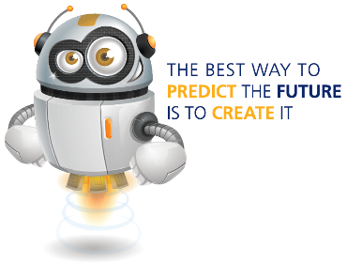
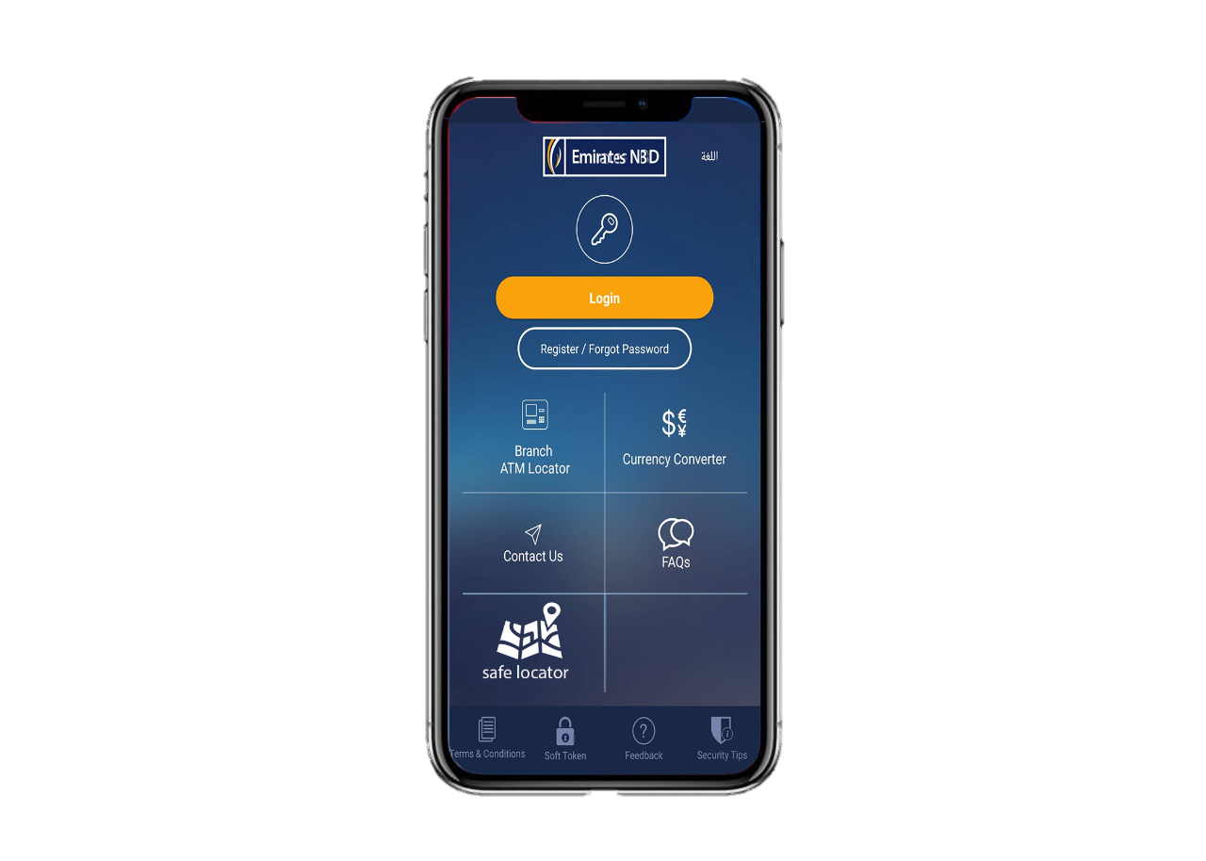

Prototype
Safe & Fast– Sleepless Warriors

Slide 5
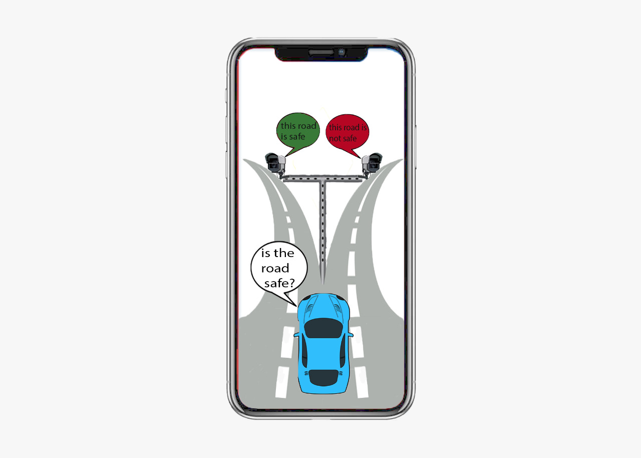
Prototype
Safe & Fast– Sleepless Warriors

Slide 6
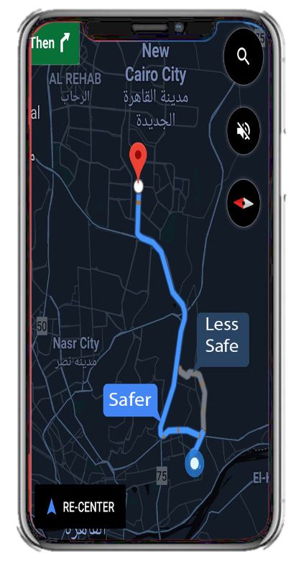
Prototype
Safe & Fast– Sleepless Warriors

Slide 7
Demo
Safe & Fast– Sleepless Warriors

Slide 8
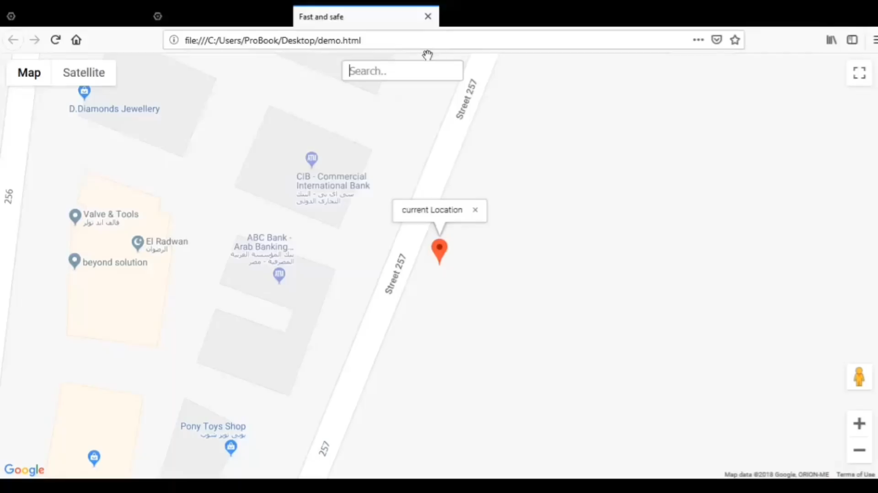

Slide 9
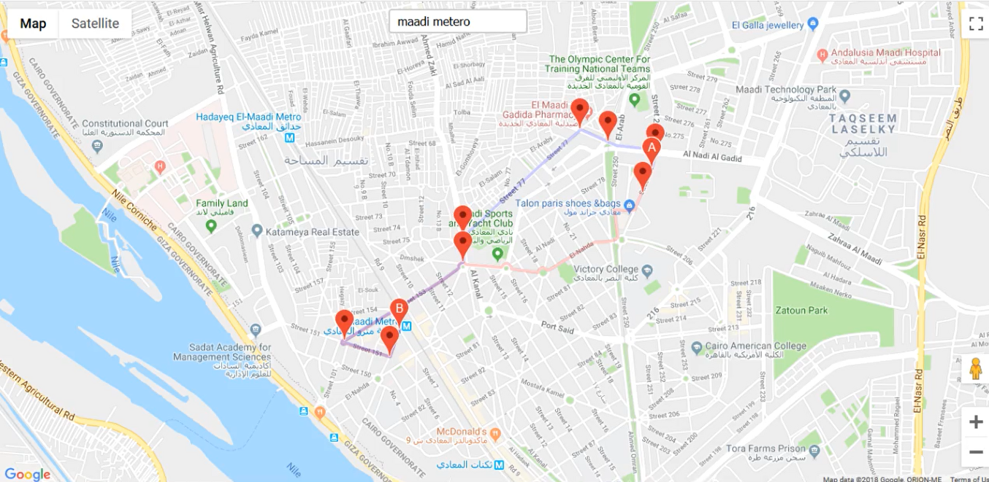
Results
Safe & Fast– Sleepless Warriors

Slide 10
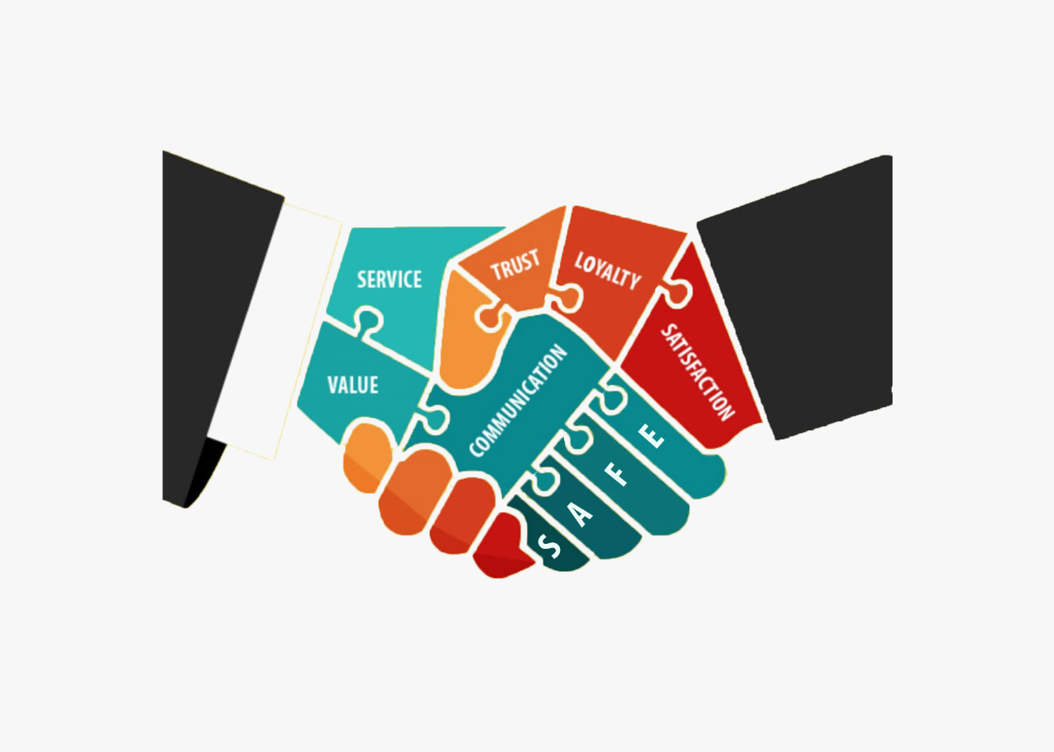
Benefits
Our idea is meant to make a person’s trip to the bank easier and safer and thus the benefits clearly stated are:
1- Improve the safety of the customer
2- Improve the safety for cash trucks while in transit
3- Increase and attract new customer base
4- Give the user the safest, fastest, and shortest road
Safe & Fast– Sleepless Warriors
Notes:
1- Our idea aims to improve the safety of the customer when making a trip to his bank
2- Our idea can also be used to plot cash truck trips which in turn guarantees the safety of the bank’s money while in transit
3- Because our idea aims to make the bank’s customers’ feel safe while making a trip to their bank; it will increase and attract new customers to the bank because they feel safe going to the bank
4- Because our idea relies on getting its information from google maps and then chooses the safest road; it gives the user both the safest and the fastest road to the bank chosen

Slide 11
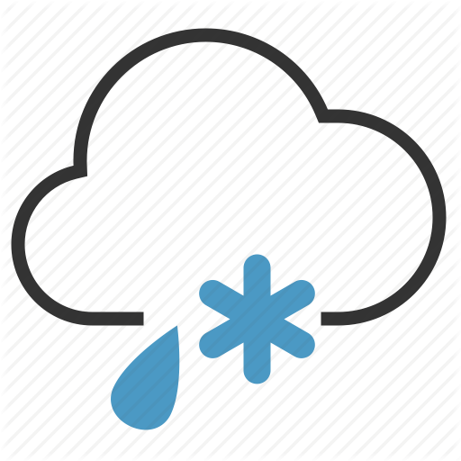

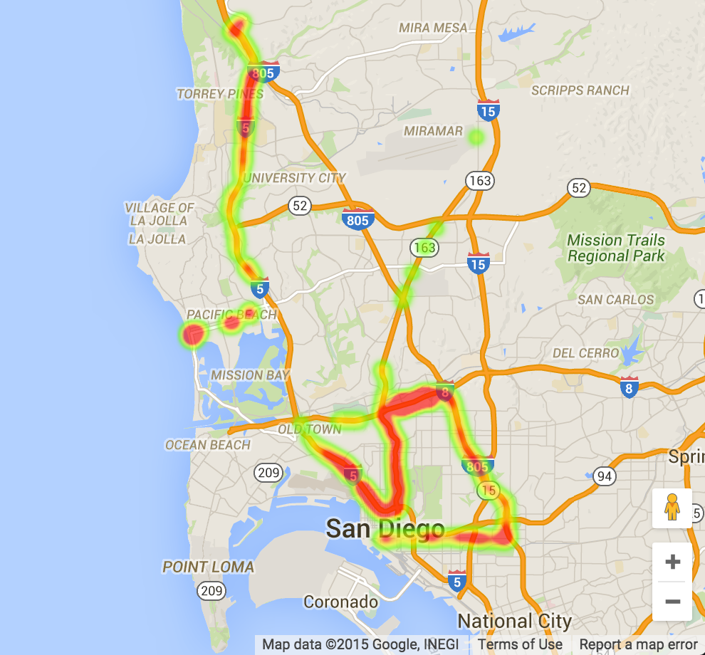
Our Vision
Accident Heatmaps
Weather conditions
News reports
Safe & Fast– Sleepless Warriors

Slide 12
Thank you
February 2019

