Slide 1
Omar Maysour
Mohamed Eleish
Full Stack Web Developer
omarmaysour@hotmail.com
Android Developer
mohamed.a.eleish@gmail.com
Mohamed Alaa
Nour El-din Tarek
Software Engineer
mohamedsedkey9113@gmail.com
Full Stack Web Developer
nour.tarek177@gmail.com
Supervised By
Dr. Soha.A.Ehssan & Eng. Youssef Mobarek

Slide 2
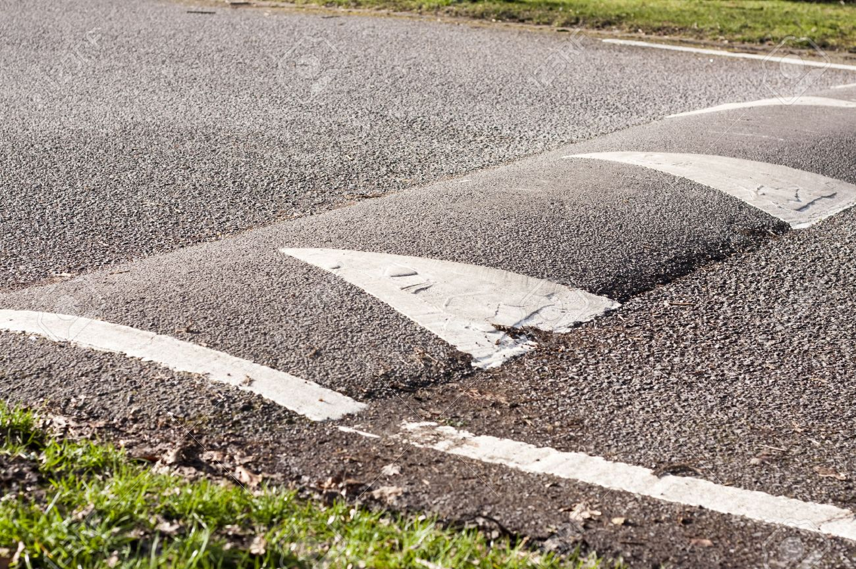
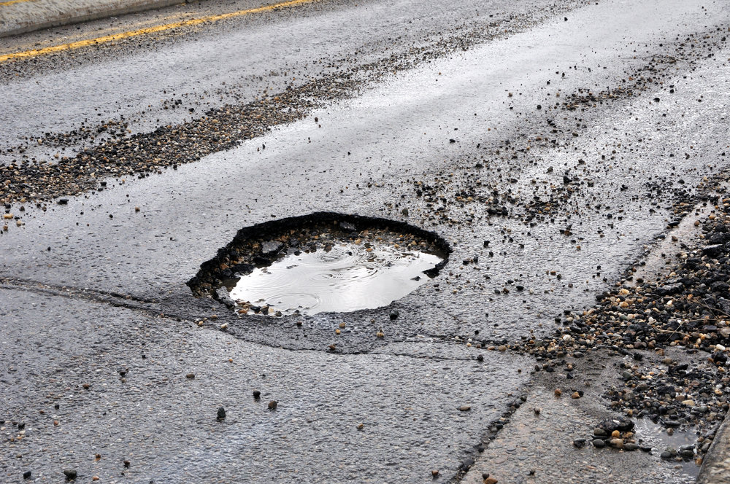
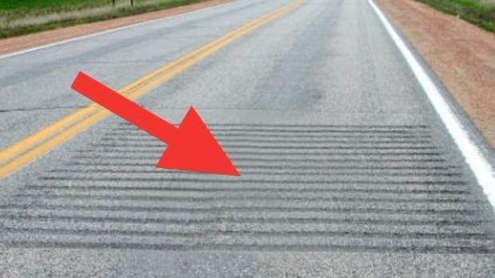
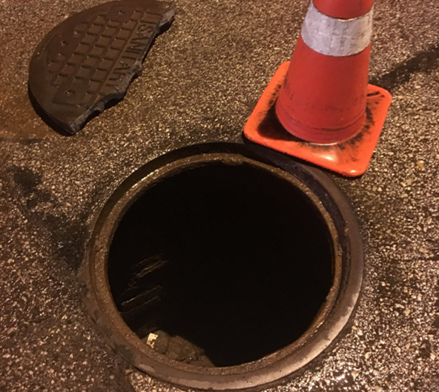
Introduction
Types of road anomalies
Bumps
Potholes
Manholes
Rumble Strips
Problem
Time and Man-power consuming process to localize
Compromise driver safety
Damage vehicles and increases maintenance cost
Increase trip time

Slide 3
Crowdsourcing
Solution
Step 1 : Data Collection
Step 2 : Data Analysis
Vehicles can be used to crowdsorce road data in a fast and efficient manner, will yield huge amount of data that is impossible to collect and analyze manually.

Slide 4
Problem Statment
Detection and localization of road anomalies using a deep learning approach and the enhancment of such approach by increasing the accuracy of the classification model.

Slide 5
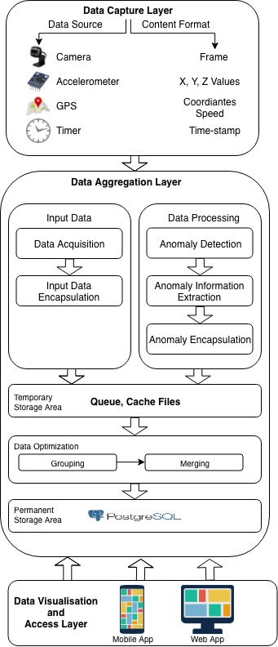
Block
Diagram

Slide 6
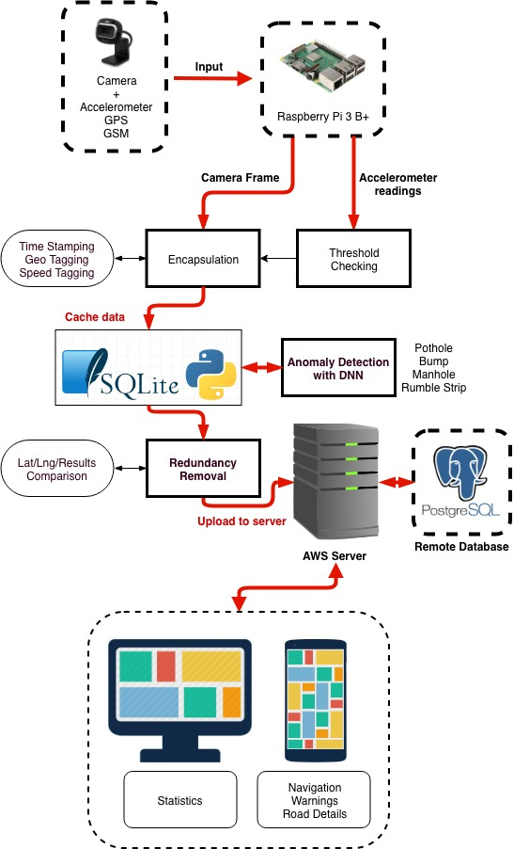
System Overview

Slide 7
Design
Patterns
Singleton
MVC
MVVM
EventBus

Slide 8
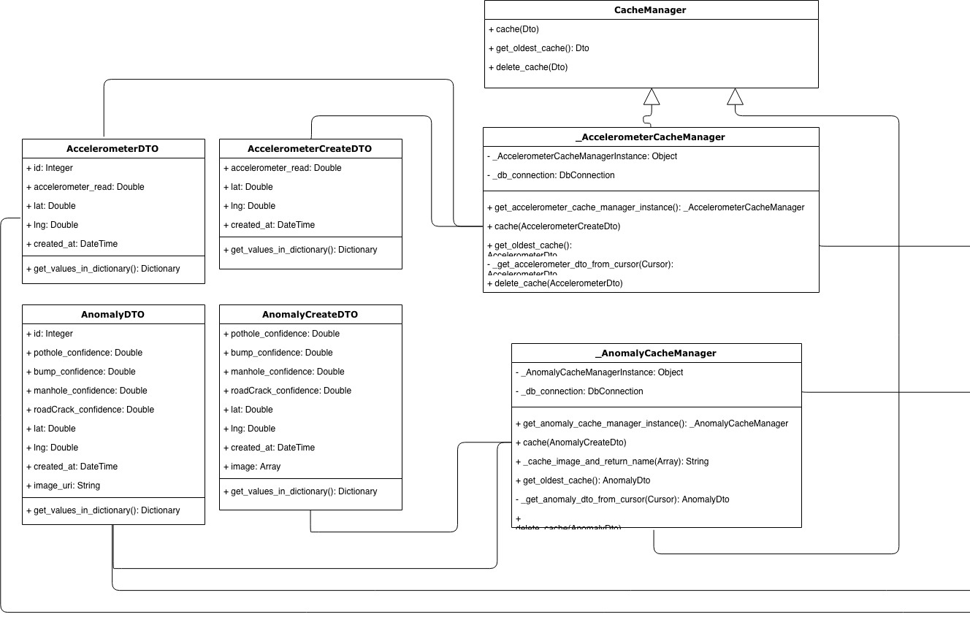
Class
Diagram
Vehicle Module
Part 1

Slide 9
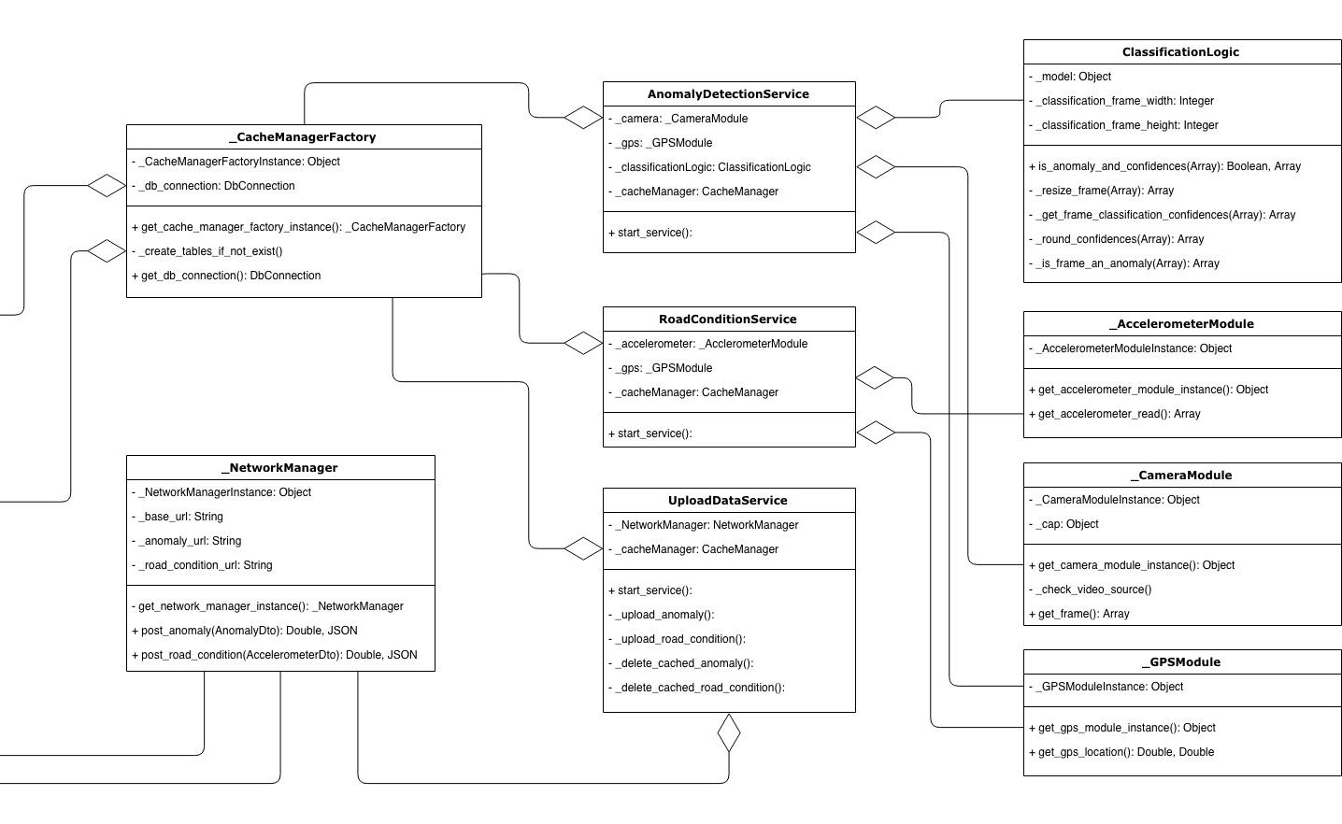
Class
Diagram
Vehicle Module
Part 2

Slide 10
Layered Architecture
Architecture
Design
Service Layer
Anomaly Detection
Service
Road Condition Service
Update Data Service
Data Access Layer
Business Layer
Cache Manager
Network Manager
Modules
Classification Logic

Slide 11
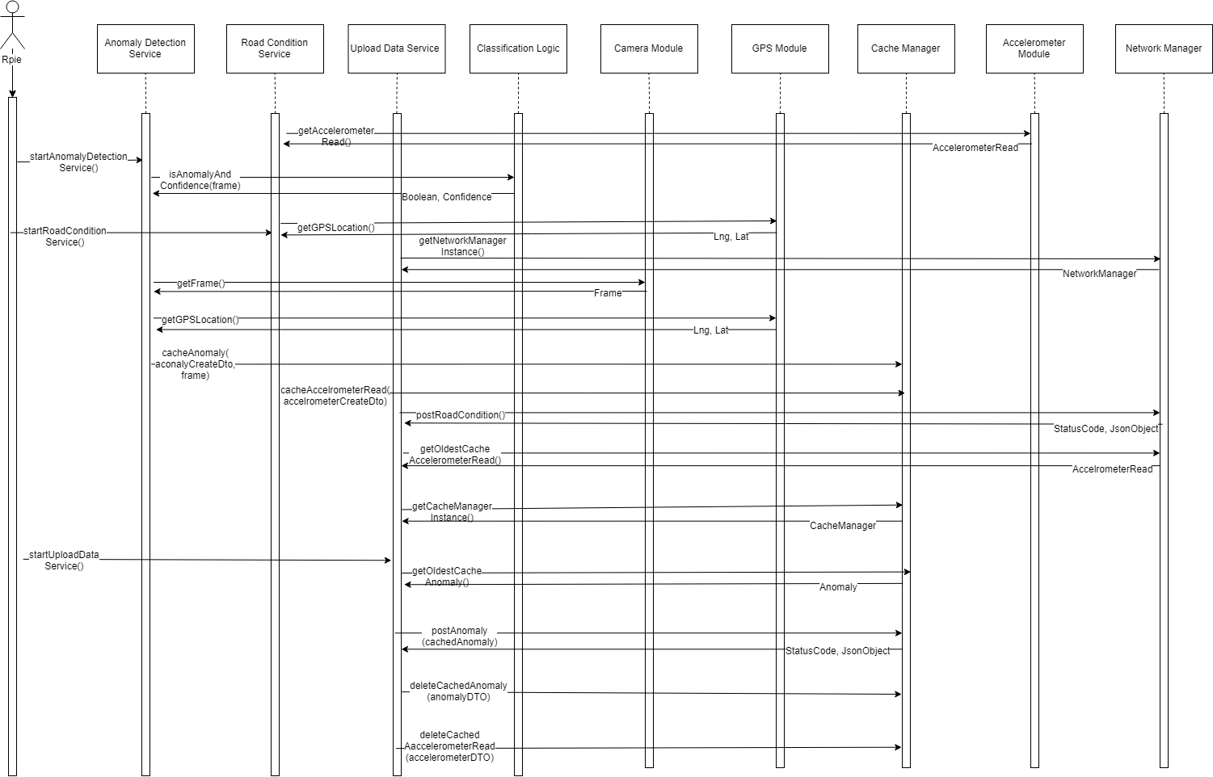
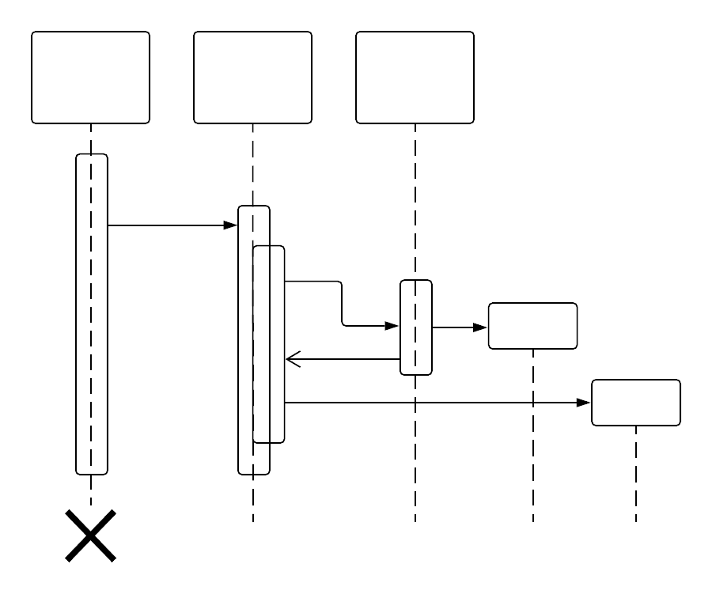
Sequence
Diagram

Slide 12
Similar System
Design
Rational
RoadDamage Detector
SSD using Inception V2 with defaullt parameters
SSD using MobileNet with defaullt parameters
78%-95%
77%-95%
Our work
Theoratical assumption:
Using a newer version of Inception used in the prevoius work and combining it with SeNet should be able to improve the previous accuracy.
Practical results
SeNet + Inception V4
80%-98%
Conclusion
SeNet + Inception V4 proved to yeild more accurate results

Slide 13
Frontend Stack

Slide 14
Backend Stack

Slide 15
Mobile Stack

Slide 16
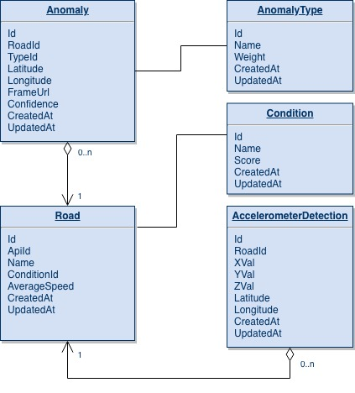
Database

Slide 17
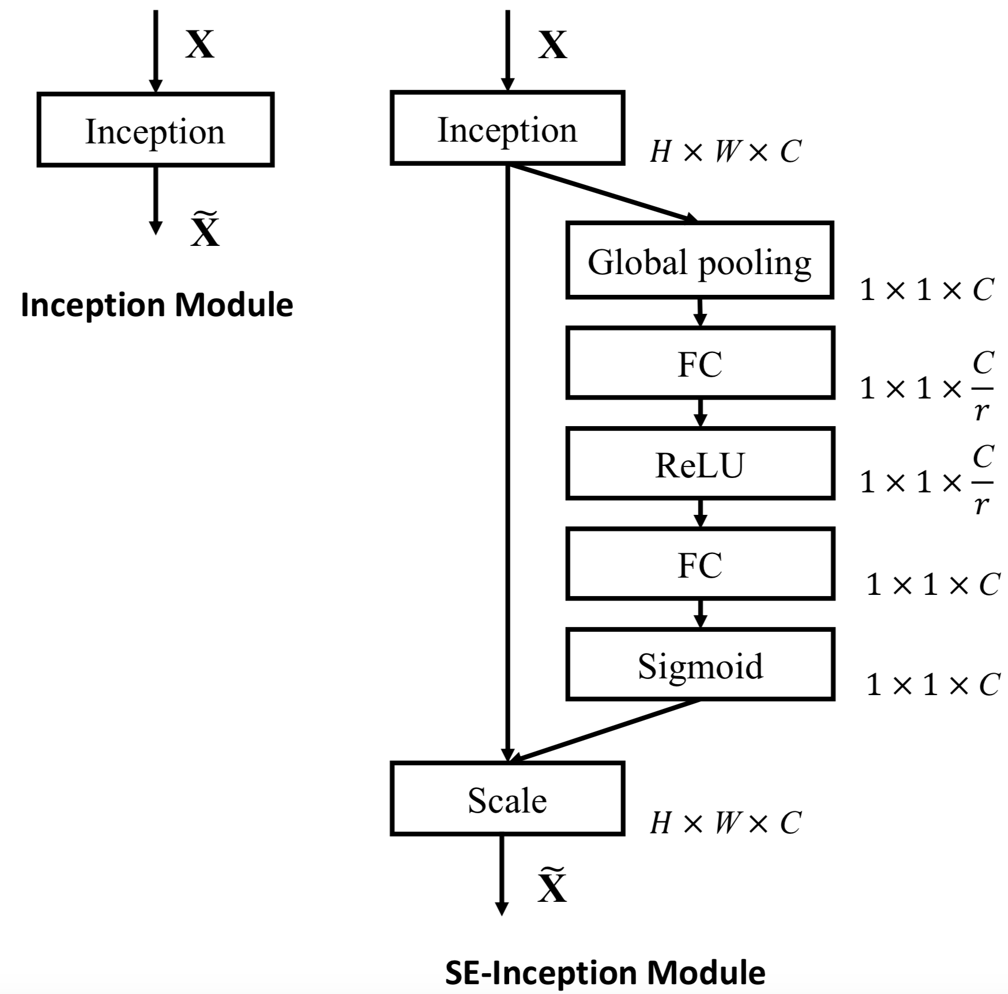
Component
Design
Christian Szegedy, Sergey Ioffe, and Vincent Vanhoucke. “Inception-v4,Inception-ResNet and the Impact of Residual Connections on Learning”.In:CoRRabs/1602.07261 (2016). arXiv:1602.07261.url:http://arxiv.org/abs/1602.07261.
Jie Hu, Li Shen, and Gang Sun. “Squeeze-and-Excitation Networks”. In:CoRRabs/1709.01507 (2017). arXiv:1709.01507.url:http://arxiv.org/abs/1709.01507.Jie Hu, Li Shen, and Gang Sun. “Squeeze-and-Excitation Networks”. In:2018.

Slide 18
Possible
Stakeholders

Slide 19
Demo

Slide 20
Thank You

