Slide 1

Software Design For Smart Movement Recognition
By: Maha Fayez, Nour Ehab, Sara Mohamed and Nourhan Ali
Supervised by: Dr. Mustafa Abdelsalam and Eng. Huda ElTouny
26/2/2019

Slide 2
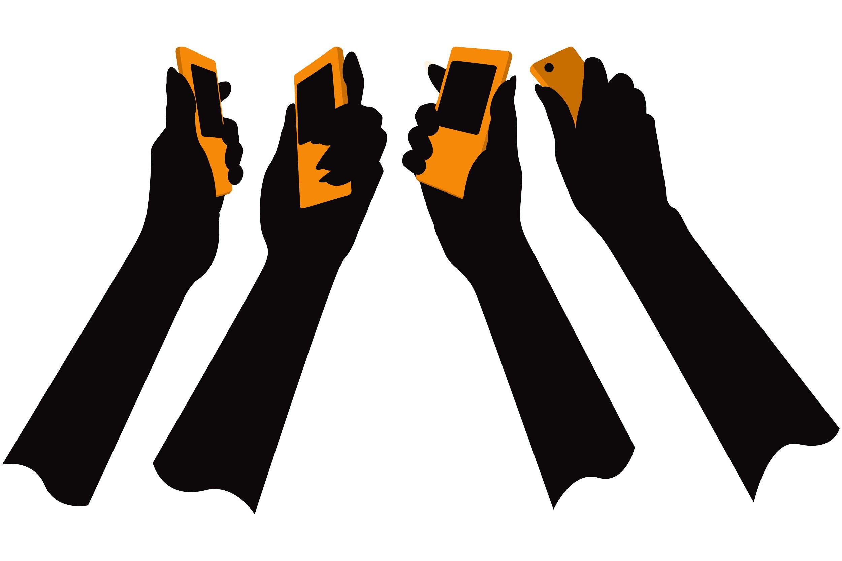
Introduction
Smart Movement Recognition has taken place in the last few years to detect and predict human behaviours.
In this project we detect the patient’s behaviour as falling and tremor by using accelerometer sensor.
Detection of the hand gesture for blind and elder people to reduce the effort needed for them to express their feelings and needs by doing certain patterns using smart phone.
We aim to propose a mobile application accessible with any android and ios phone to detect the gestures and the movements done by the patient.

Slide 3
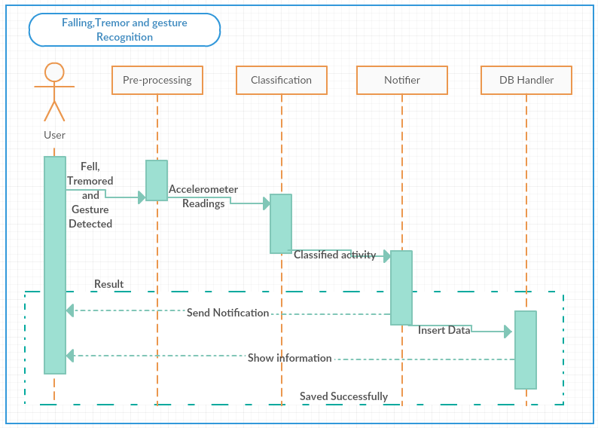
2. Sequence Diagram

Slide 4
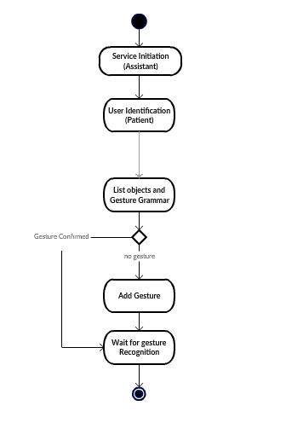
3. Gesture Activity Diagram

Slide 5
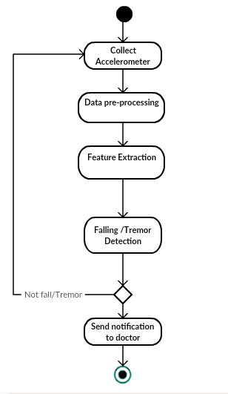
3.1 Fall/Tremor Activity Diagram

Slide 6
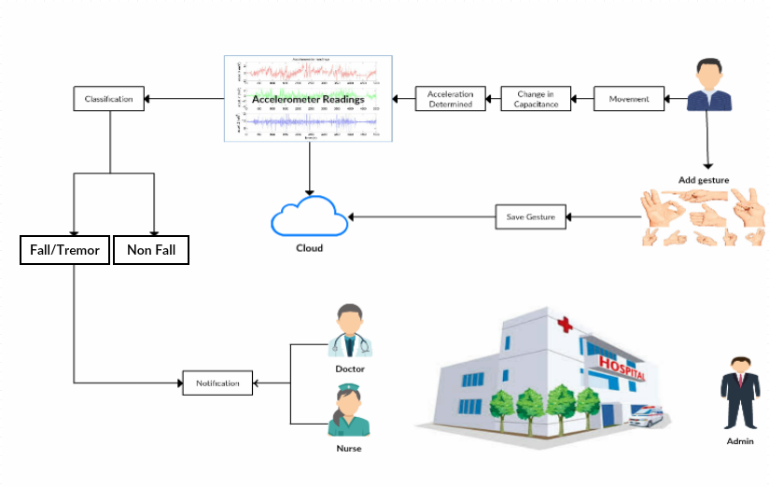
3. System overview
Notes:
Smart Movement Recognition is to detect patient's activity and helping him rapidly if something went wrong. Detecting the abnormal behavior of patient play a vital role in hospitals and will help doctors and nurses to be more careful to the patients. The project aims to enhance the accuracy of detecting patient abnormal behavior as falling and tremor, through a mobile application using the accelerometer sensor. This sensor will send classified readings to doctors and nurses if anything went wrong to help patient.

Slide 7
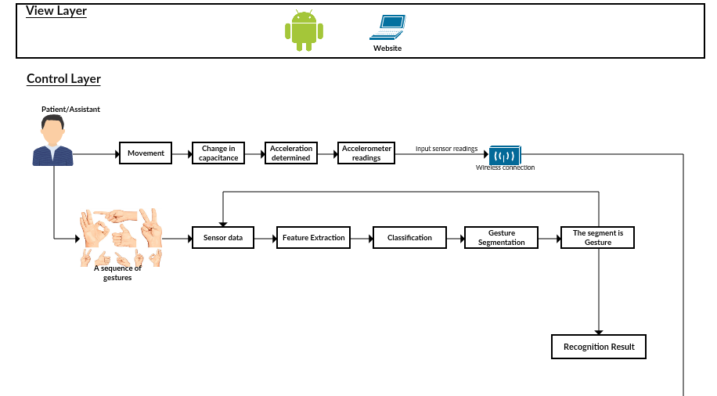
4. Block Diagram
Notes:
Detecting patient abnormal activity and hand gesture for blind are an important researches nowadays, as most of the hospitals need this application to help them to take care of patients by a mobile application instead of continuous monitoring the patient. Moreover, most of the housing for the blind need this application to facilitate their life and help them live in easier way.

Slide 8
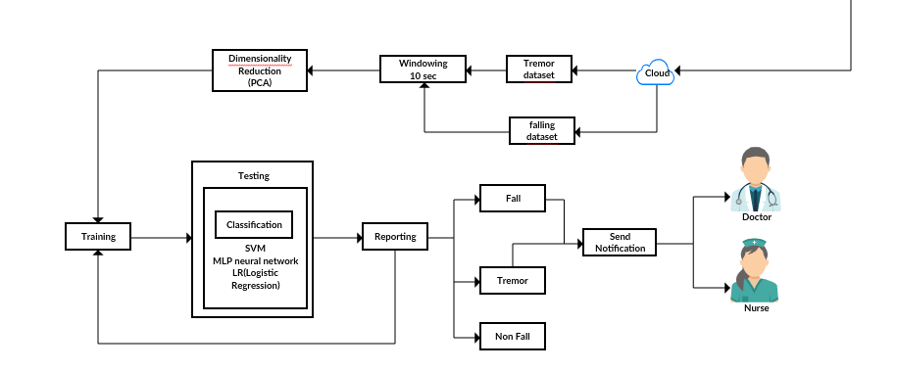
4.1 Block Diagram

Slide 9
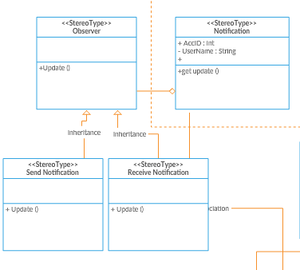
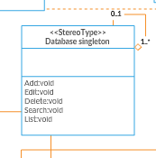
5.1 Decomposition Description
Class Diagram
Instance DatabaseConnection
Singleton
Observer

Slide 10
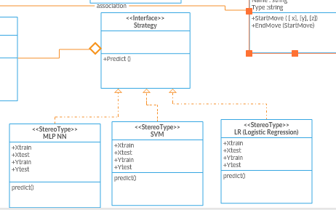
5.2 Class Diagram
Strategy

Slide 11
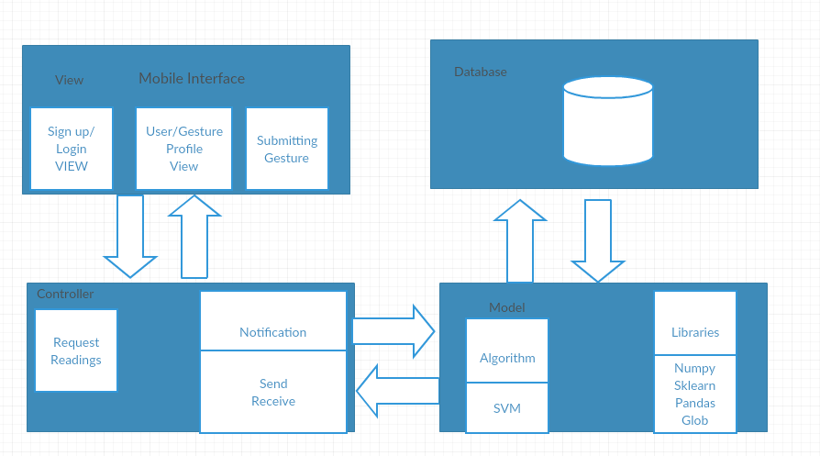
Architecture Diagram
MVC

Slide 12
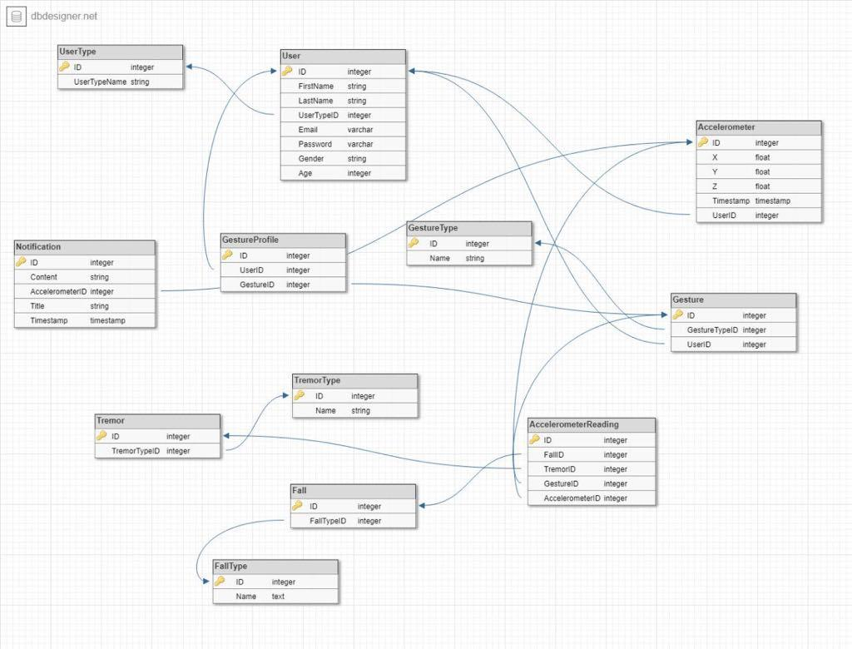
6. Data Design
Database

Slide 13
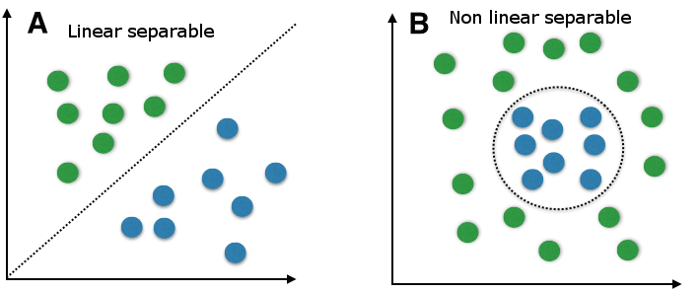
7 Component Design
Support Vector Machine (Linear SVM)
Supervised machine learning algorithm.
Used for classification and regression challenges.
It finds a hyperplane which could separate the data accurately .

Slide 14
8. Principal Component Analysis
Used to reduce the dimensionality of a dataset consisting of many variables correlated with each other..
Normalization of data.
Calculating covariance matrix.
Calculating eigenvalue for the matrix.
Choosing a component and forming a feature value.
Form Principal Component.

Slide 15
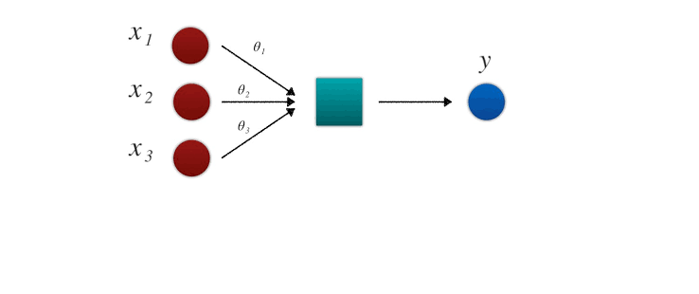
8.1 Logistic Regression
Used for classification tasks.
Models the probability of the default class.
Using Sigmoid function.
Logistic regression classified into 3 types here using binary logistic regression which gives 2 possible outcomes. either yes or not.

Slide 16
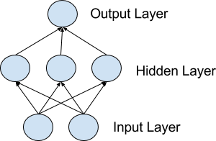
8.2 MLP Neural Network
Computer system modelled on the human brain and nervous system.
It consists of ; input layer, hidden layers and output layer.
Suitable for classification prediction problems where inputs are assigned to a class or label.

Slide 17
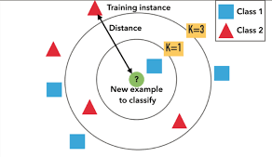
8.3 K-Nearest Neighbour
Nearest neighbor search is one of the most popular learning and classification techniques.
the most popular algorithm in pattern recognition.
predicting the nearest neighbour to the clusters.
calculating using euclidean distance function for the given values.

Slide 18
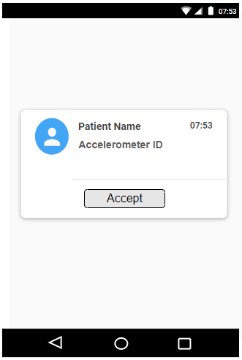
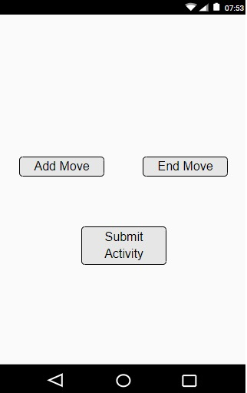
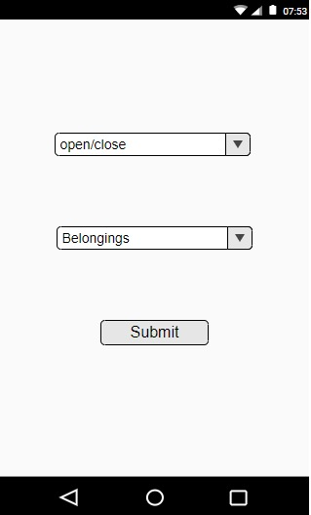
9. User Interface

Slide 19
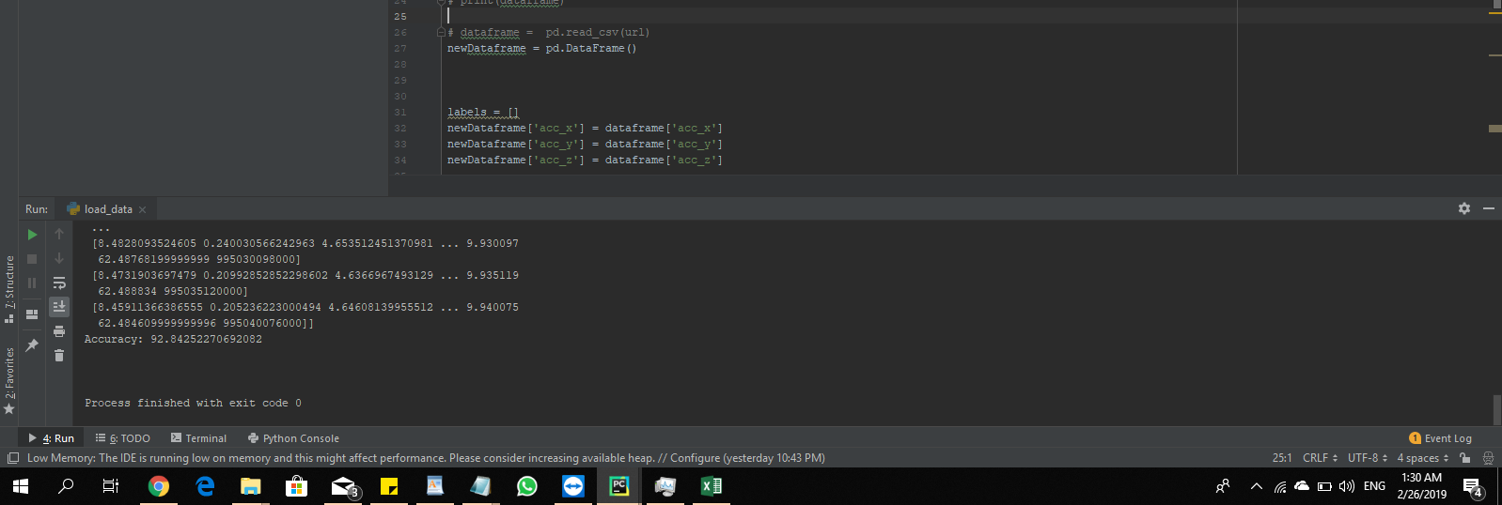
10. DEMO
Back-sitting-chair (BSC)

Slide 20
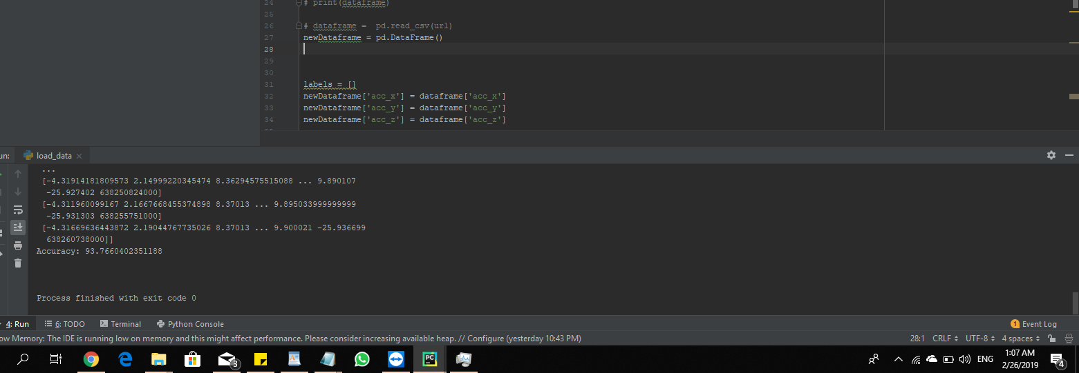
10.1 Front-knees-lying (FKL)

Slide 21
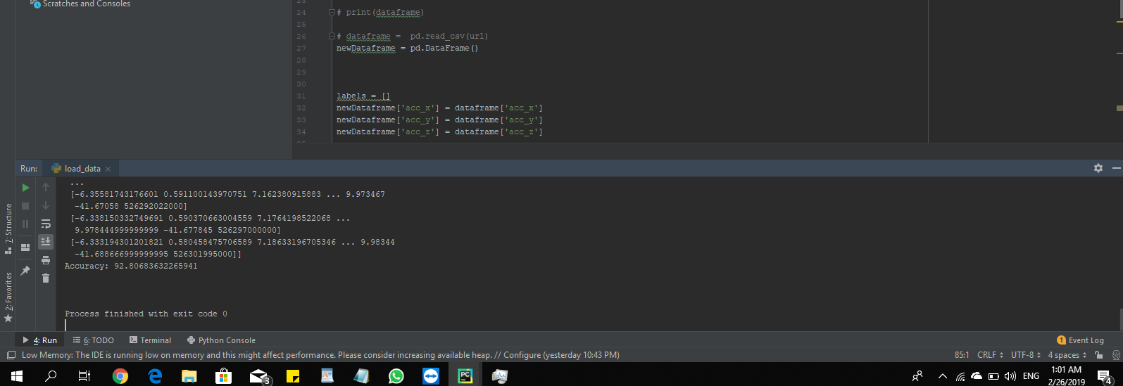
10.2 Forward-lying (FOL)

Slide 22
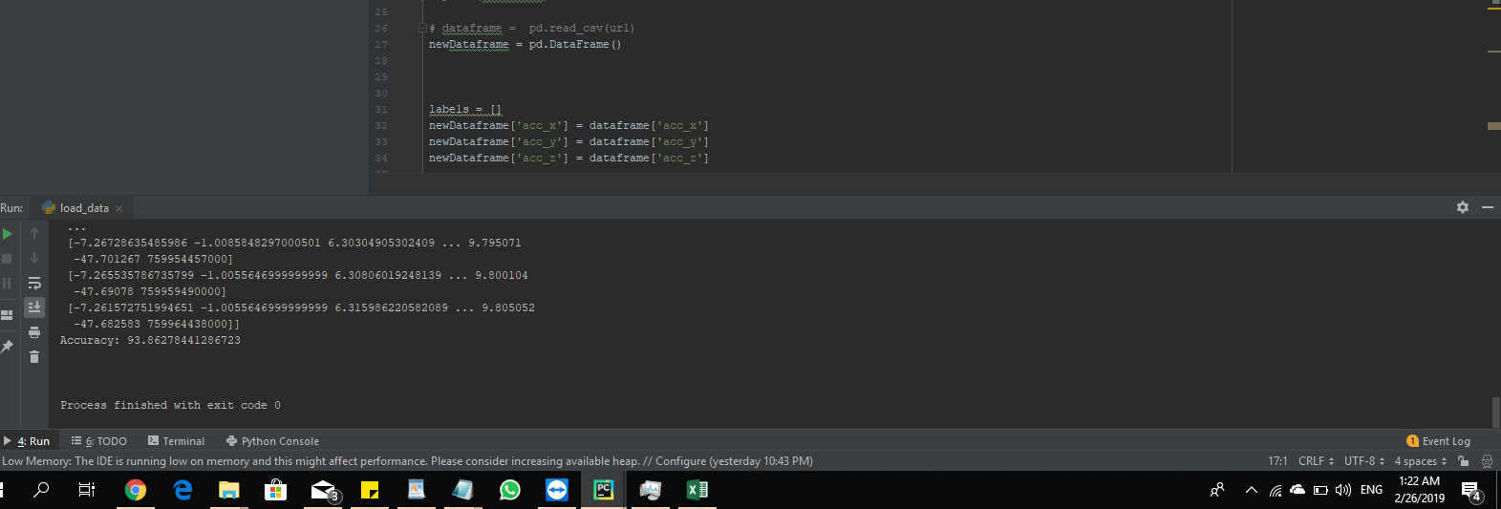
10.3 Sideward-lying (SDL)

