Slide 1
Navigation Application With Safety Features
By: Andrew Usama, Habiba Elwany, Monica Medhat, Moustafa waly
Supervised By: Dr. Mohamed Gazzar
Teacher Assistant: Eng. Youssef Mobarak
Date: 27/11/2018

Slide 2
Introduction
According to Egypt Independent, a news website, in 2017, the number of car accidents that occurred recorded 11,098 with 3,747 deaths, 13,998 injuries, and 17,201 damaged vehicles.
Current navigation applications do not consider road safety as a factor but rather, they simply give the driver the shortest path there is.
Which is why our project aims to add some, much needed, safety features to a user’s day-to-day navigation.

Slide 3
Problem Statement
Navigation systems always aim to give the user the shortest path, while neglecting the element of safety.
The main problem is how to extract junction, curve radius, and safe areas information from Google Maps API, then use machine learning to classify the safety of a street based on these factors.

Slide 4
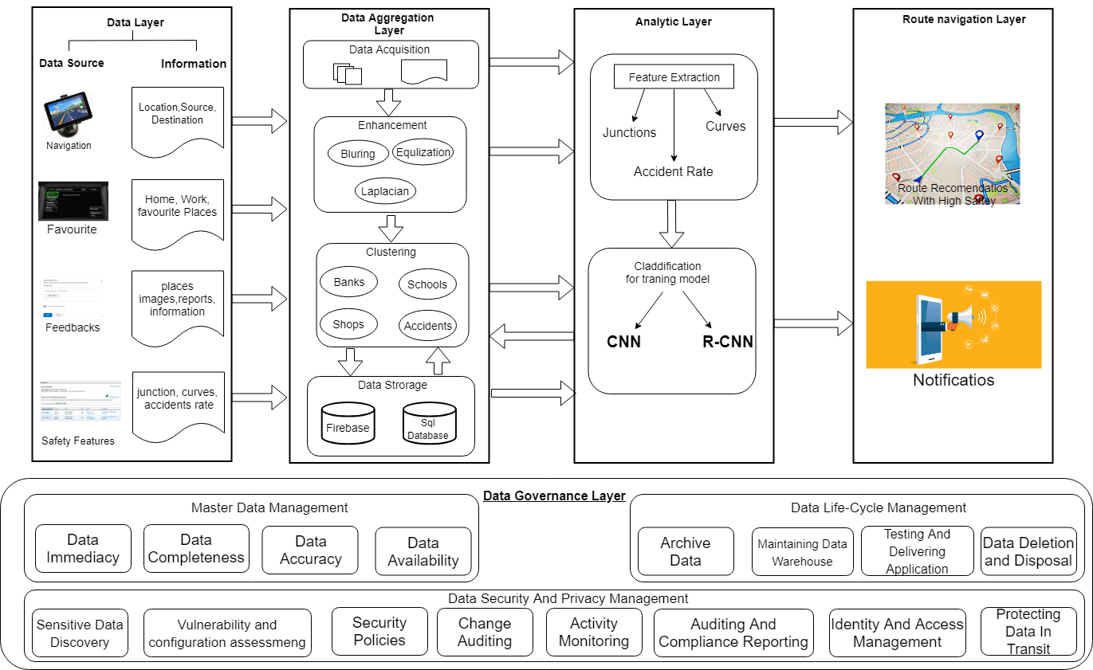
Block Diagram

Slide 5
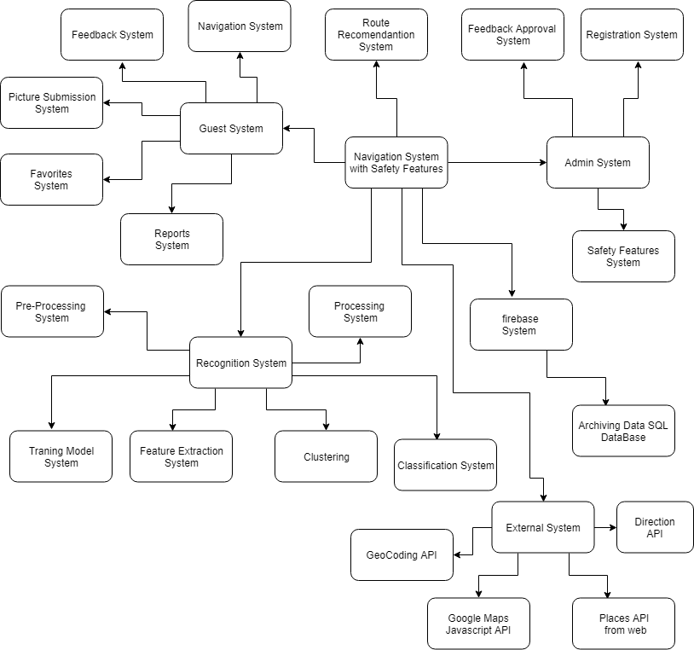
Context Diagram

Slide 6
Similar Systems
Google Maps
Waze
Pros:
Can help avoid some unwanted areas like highway
Provide the shortest route
Allows a user to add favorite places
Cons:
it doesn't provide any information with regards to newly closed roads
Doesn't provide all route at once for the user to choose from
Doesn't provide the safest path
Pros:
The application is organized
The application provides all the routes
The application provides the user important information like traffic data
Cons:
The Application is very slow
The Application is very childish
The Application is hard to navigate through
Doesn't provide the safest path

Slide 7
Important Algorithm
Our most important algorithm is the CNN
We are working on Detecting the junctions and Curve radius then using these to train the CNN
Our fully functional CNN shall be able to detect junctions on its own

Slide 8
Functional requirement
Set Start point :The user shall be able to enter the trip's start point
Set Destination : The user shall be able to enter the trip's Destination point
Give Feedback : The user shall be able to enter their Feedback with regard to a location and whether or not the location in question is considered safe or not
Submit a picture: The user shall be to submit pictures of a street as per our request
Set Favorites : The user shall be able to enter their favorite location and as many as they want in case they want to use those locations as a trips destination in the future

Slide 9



None-functional Requirements
Security
Reliability
Compatibility

Slide 10
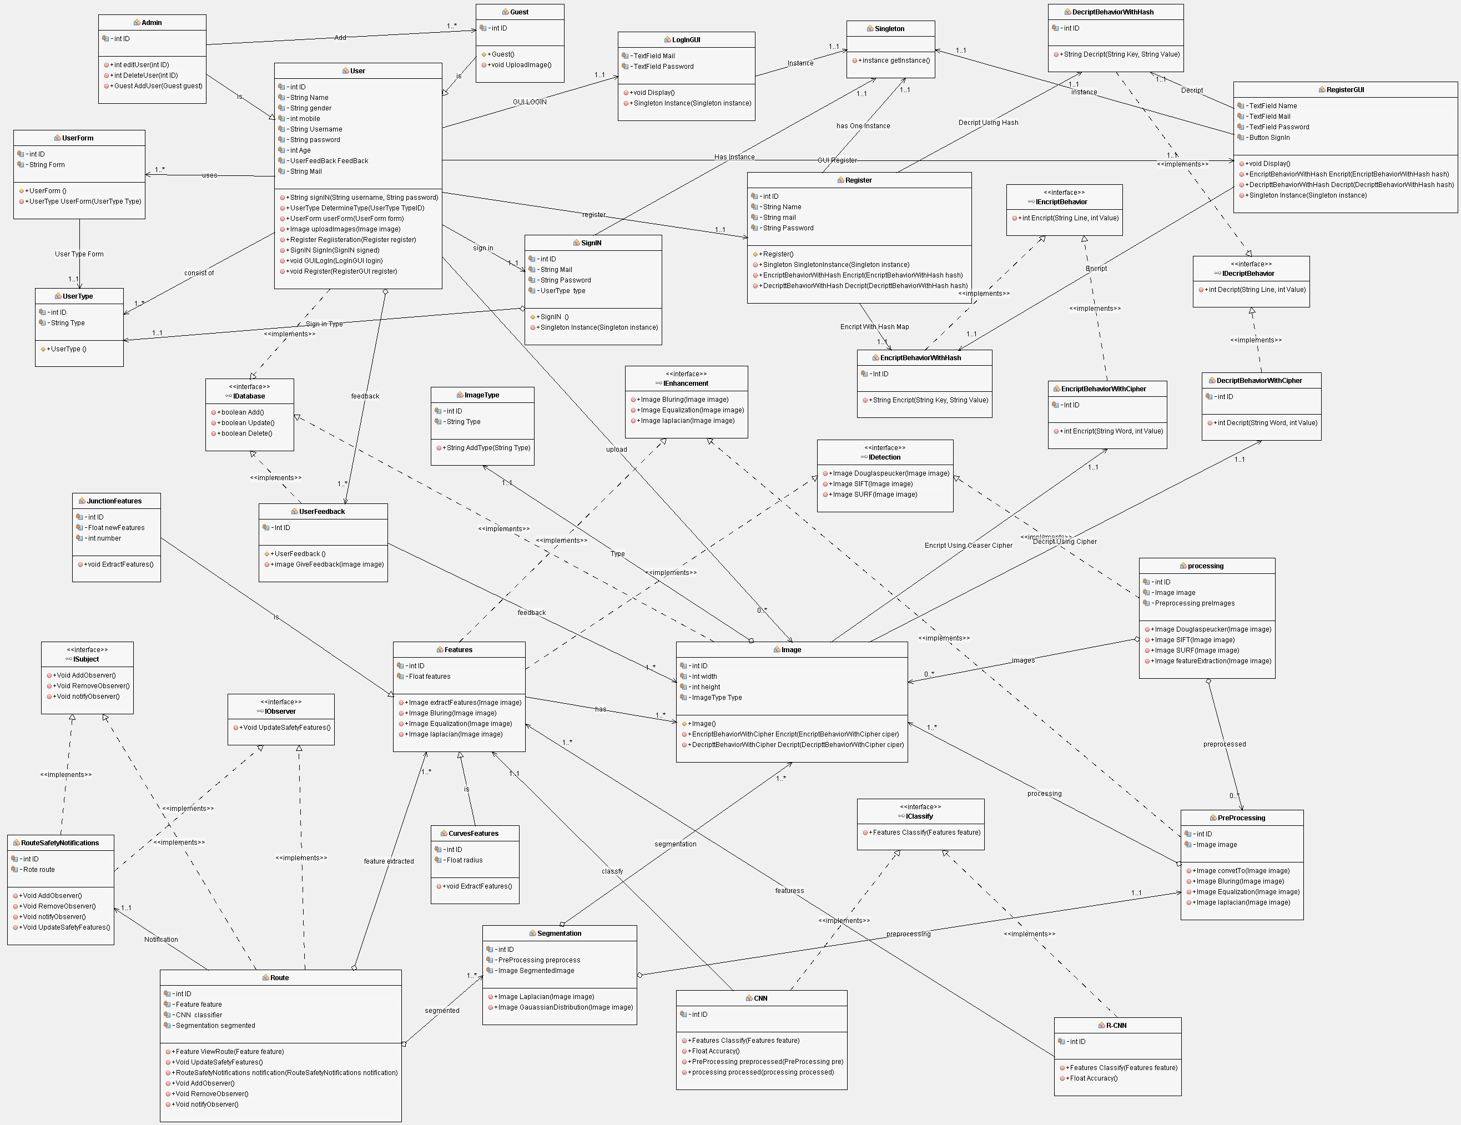
Class Diagram

Slide 11
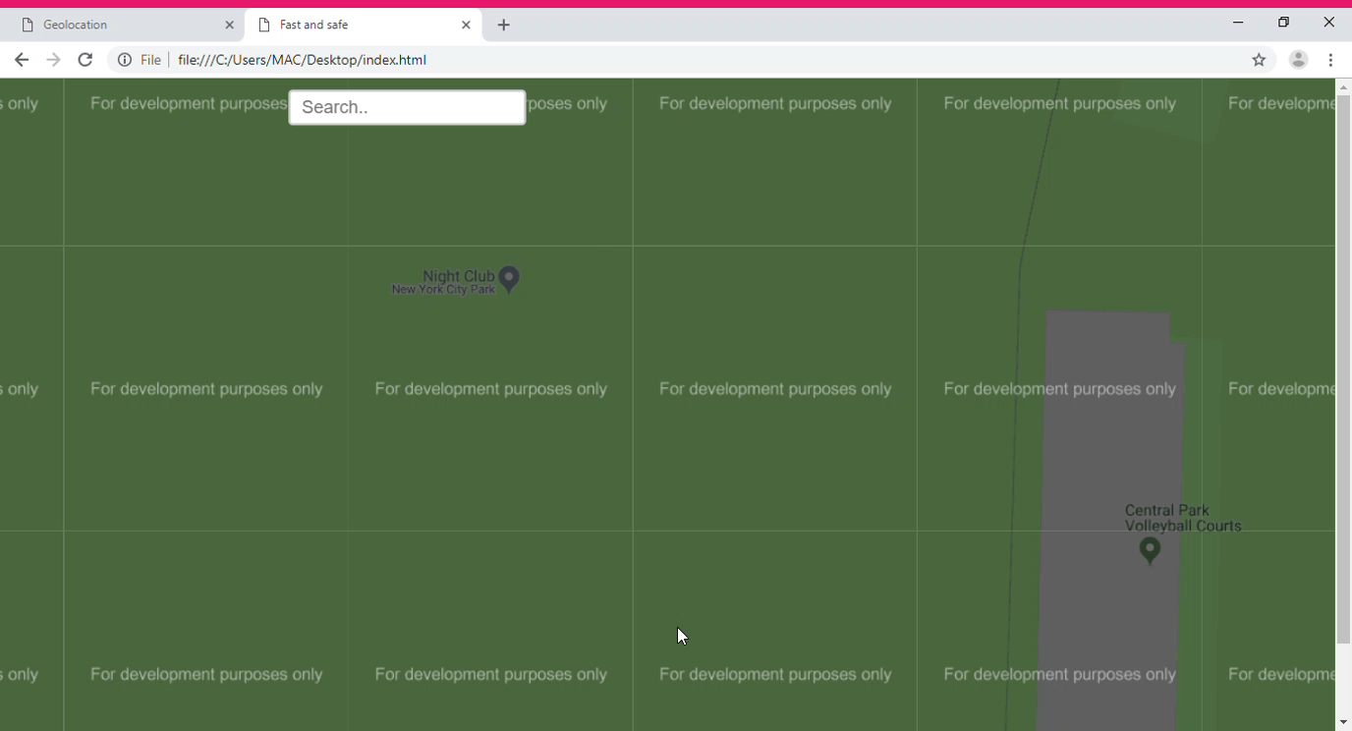
DEMO

Slide 12
THANK YOU
QUESTIONS?

