Slide 1


Smart Detection of Abnormal Behavior in Hospitals
Supervised by:
Dr. Mustafa Abdelsalam
Eng. Huda ElTony
Done by:
Maha Fayez 15/05513
Nour Ehab 15/00107
Nourhan Ali 15/04273
Sara Abdelfattah 15/04468
26-08-2018

Slide 2

1. Introduction
Field of abnormal psychology study people's emotional, cognitive, behavioral problems or specific mental disorder.
Abnormal behavior may be defined as unusual action that is disturbing (socially unacceptable), distressing, maladaptive, and often the result of distorted thoughts (cognitions).
Patient’s abnormal behavior needs instant observation to prevent any unconscious move made by the patient.

Slide 3
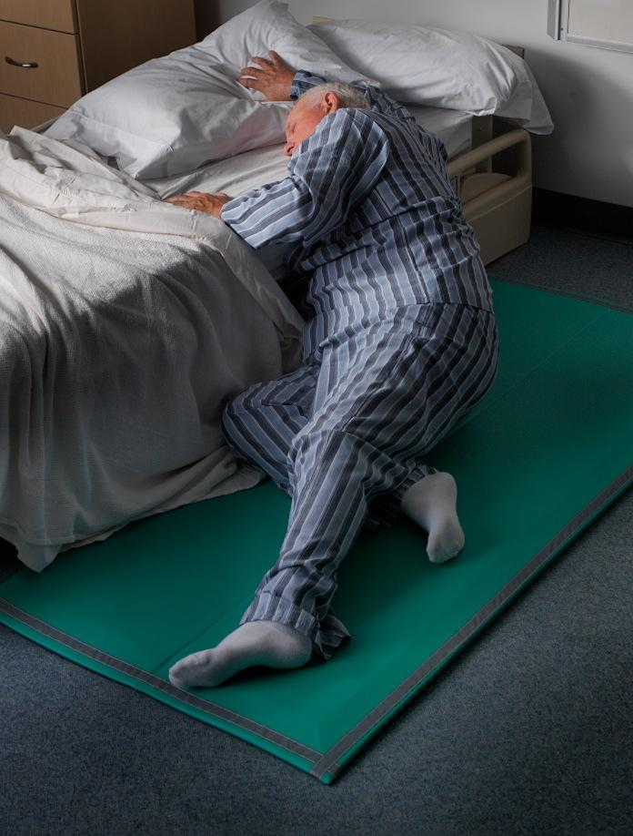

Cont’d to introduction
Detect & identifying the patient abnormal behavior.
Detect and observe the abnormal behaviors like choking, tremors, falling and dizziness in hospitals.
(1)
(2)

Slide 4

Motivation
According to the World Health Organization report, about 28-35% people aged over 65 and 32-42% people aged over 70 experience falls each year.
[3] World Health Organization. Ageing and Life Course Unit. 2008. WHO global report on falls prevention in older age. WorldHealthOrganization

Slide 5
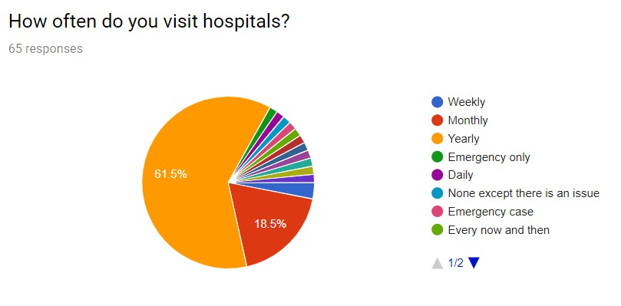
Cont’d to Motivation
Survey Result 1

Slide 6
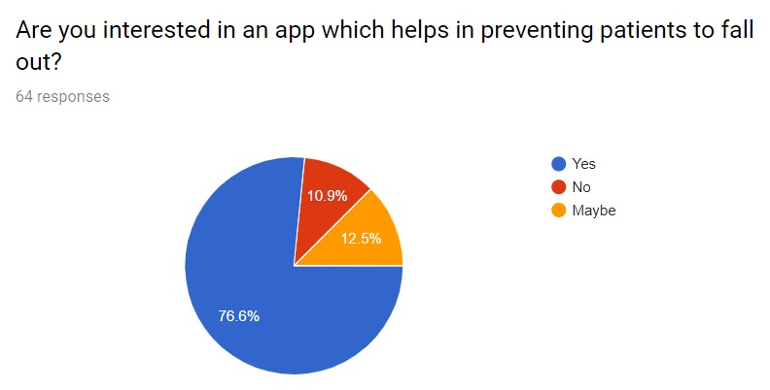
Cont’d to Motivation
Survey Result 2

Slide 7
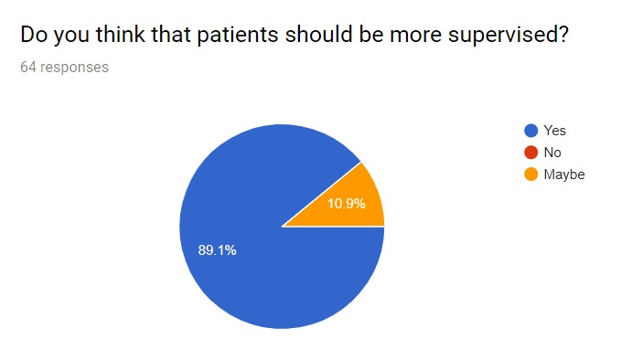
Cont’d to Motivation
Survey Result 3

Slide 8
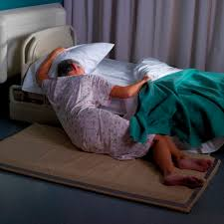
2. Problem statement
Differentiate between each abnormal activity characteristics.
Discriminate between falls and Activities of Daily Living.
Enhance the accuracy of identifying and detecting abnormal activities

Slide 9
Related Work 1
Sensor Placement for Activity Detection using Wearable Accelerometers
Investigates wearable sensor placement at different body positions to detect activity classification.[1]
Feature Extraction.
Feature Selections:
RELIEF, The Simba (Iterative Search Margin Based Algorithm), mRMR (minimum Redundancy Maximum Relevance).
Classification:
Knn, Bayesian Classifier.
[1] L. Atallah, B. Lo, R. King, and G.-Z. Yang, “Sensor placement for activity detection using wearable accelerometers,” in Proc. Int. Workshop Wearable Implantable Body Sens. Netw. , Los Alamitos, CA, 2010, pp.
24–29.

Slide 10
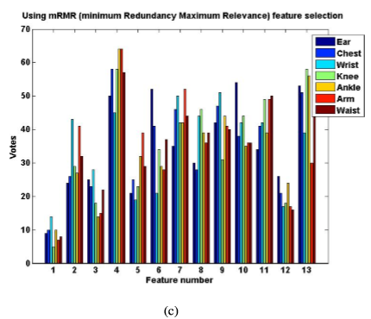
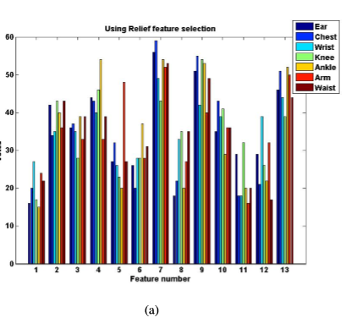
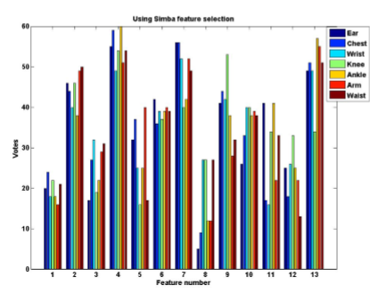
Cont’d to Related Work 1
Figure 1
Figure 2
Figure 3
mRMR Feature Selection: highest accuracy Ankle and Arms.
RELIEF Feature Selection: highest accuracy Chest.
SIMBA Feature Selection: highest accuracy: Ankle.
Figure 1:mRMR
Figure 2: Relief
Figure 3: Simba

Slide 11
Related Work 2
Detecting Falls Using a Wearable Accelerometer Motion Sensor
Detect falls based on the rapid acceleration changes using the threshold based approach,using a single accelerometer.[2]
Algorithm: Threshold method , SVM.
Accuracy: 96.35%
[2] Nguyen, H., Mirza, F., Naeem, M.A. and Baig, M.M., 2017, November. Detecting Falls Using a Wearable Accelerometer Motion Sensor. In Proceedings of the 14th EAI International Conference on Mobile and Ubiquitous Systems: Computing, Networking and Services (pp. 422-431)

Slide 12
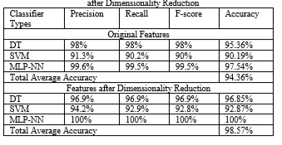
Related Work 3
Activity Recognition using Accelerometer Sensor and Machine Learning Classifiers
An approach for the activity recognition using an accelerometer sensor embedded in a smartphone. This approach uses a publicly available accelerometer dataset as the raw input signal.[3]
Algorithm Used: Principal Component Analysis (PCA).
Machine learning classifiers
Accuracy:
(1)
[3] Sukor, AS Abdull, A. Zakaria, and N. Abdul Rahim. "Activity recognition using accelerometer sensor and machine learning classifiers.", IEEE, 2018.
Figure 1: Comparison of Classifiers between Original Features and Features after Dimensionality Reduction

Slide 13
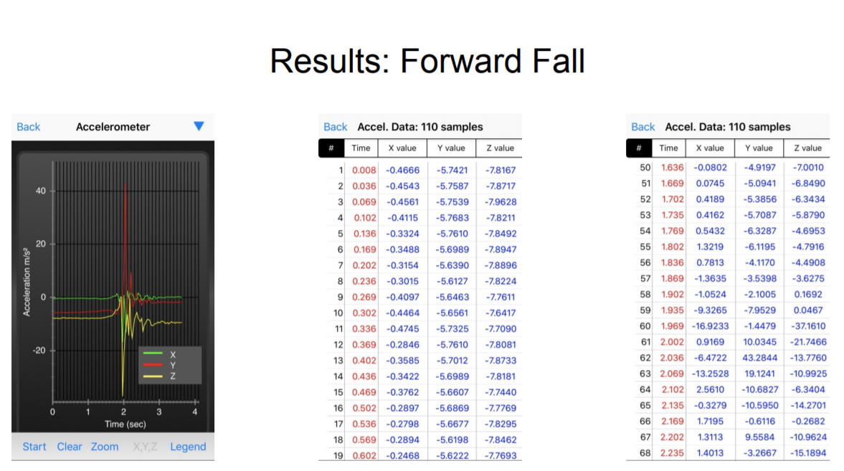
Accelerometer Reading: Forward fall

Slide 14
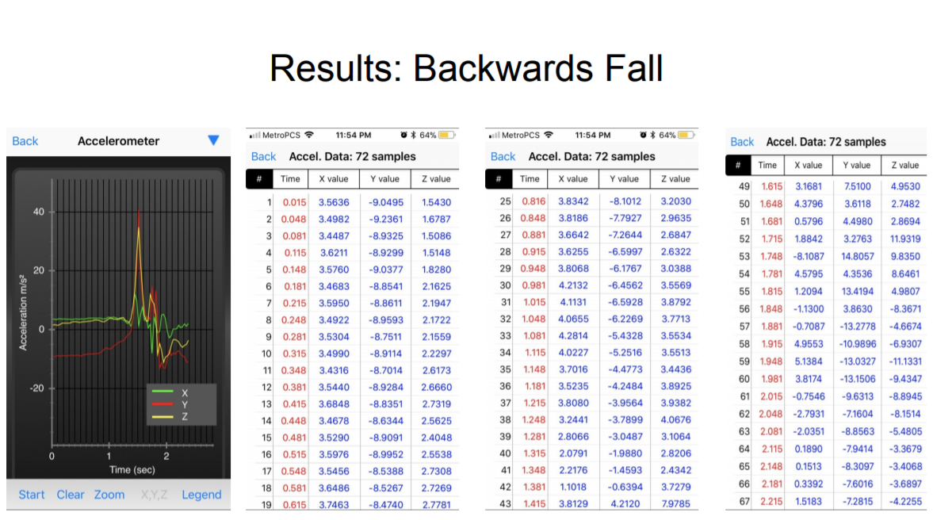
Accelerometer reading: Backwards fall

Slide 15
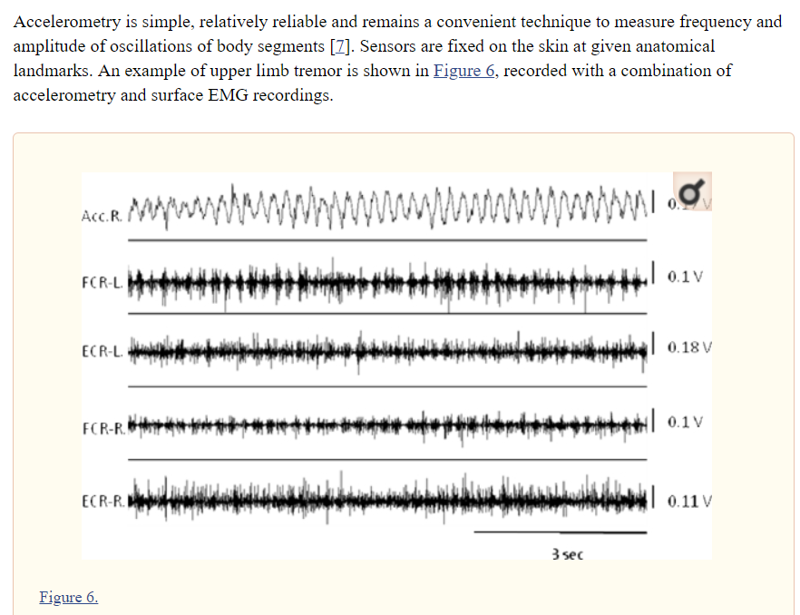
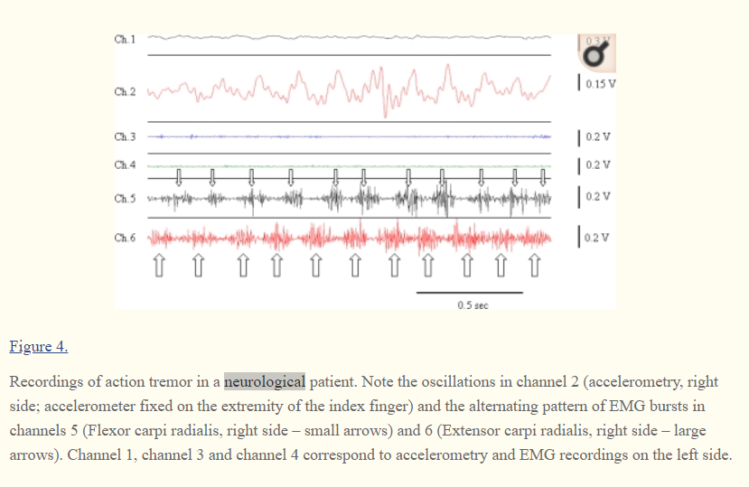
Accelerometer reading: Tremor

Slide 16
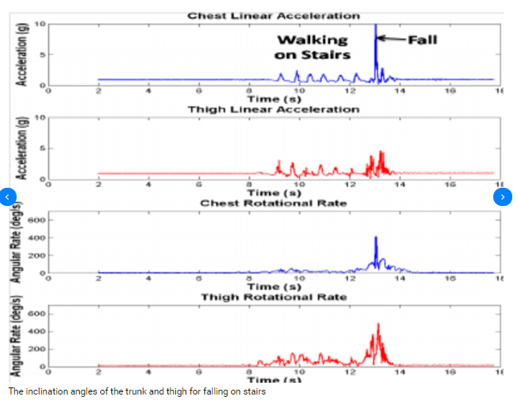
Accelerometer reading: walking stairs

Slide 17
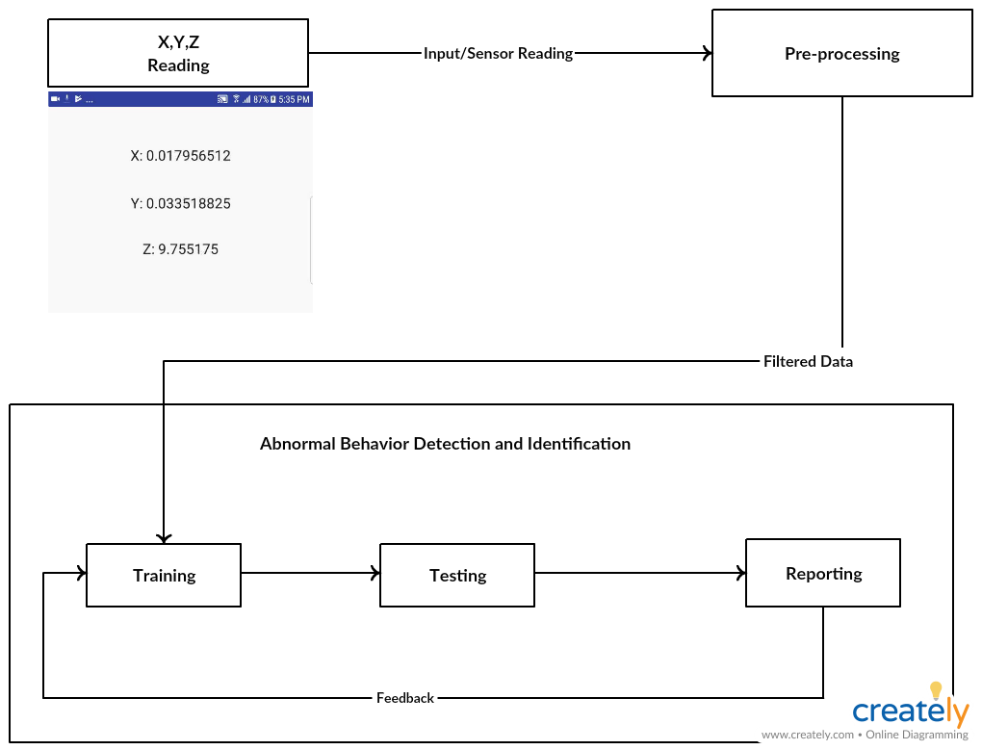
4. System Overview

Slide 18

5. Expected Result/ Contribution
Mobile Application:
To detect and identify patient’s abnormal activities using sensors.

Slide 19

Contribution
Detecting and identifying patients abnormal behavior.

Slide 20
THANK YOU
ANY QUESTIONS?

Slide 21
DEMO

