Slide 1

Smart Movement Recognition
By: Maha Fayez, Nour Ehab, Sara Mohamed and Nourhan Ali
Supervised by: Dr. Mustafa Abdessalam and Eng. Huda ElTouny

Slide 2
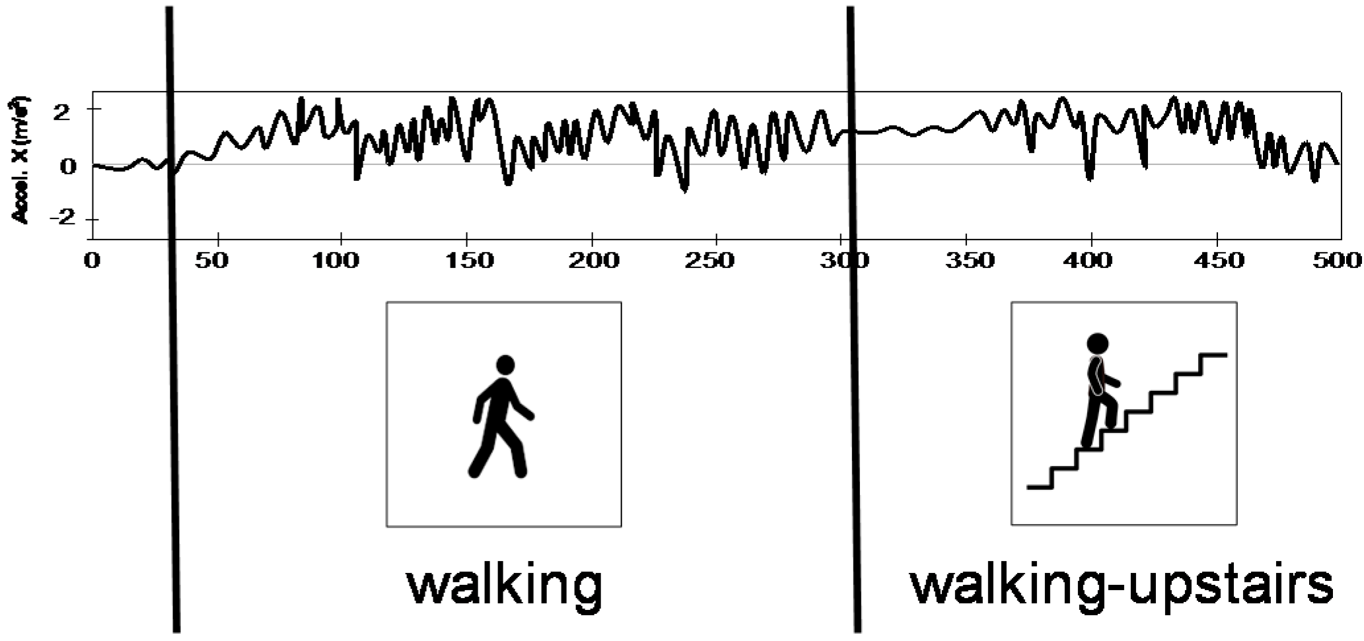
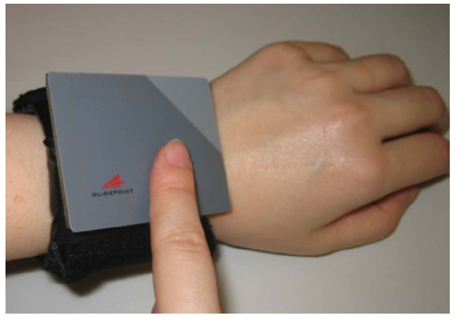
Introduction
Activity Recognition
Detecting the abnormal activities as (falling and tremor) using wearable Accelerometer sensor on different body parts of the patient to reduce the risks of patient’s injuries.
Hand Gesture
System to assist elder and blind people to express their needs through a Generic gesture using Accelerometer sensor.

Slide 3
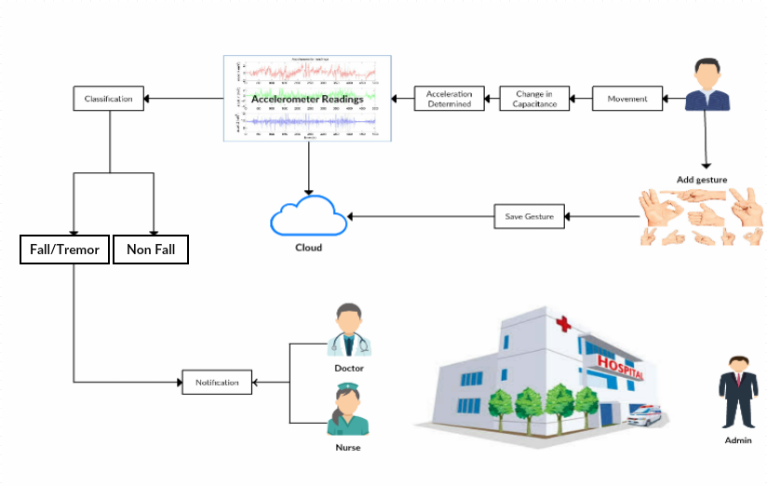
Business Model

Slide 4
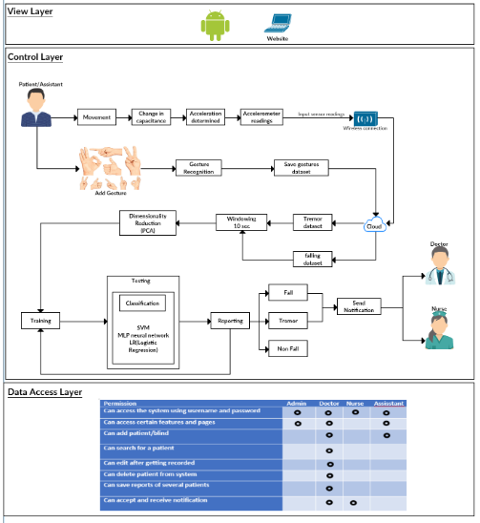
Block Diagram

Slide 5
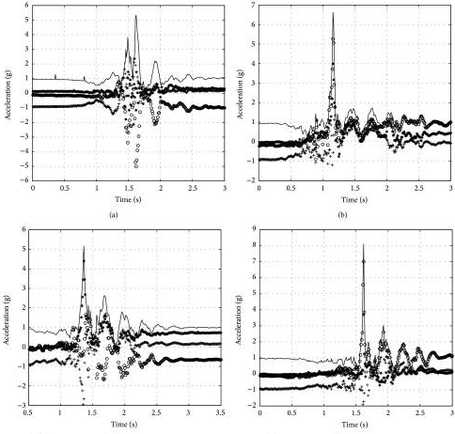
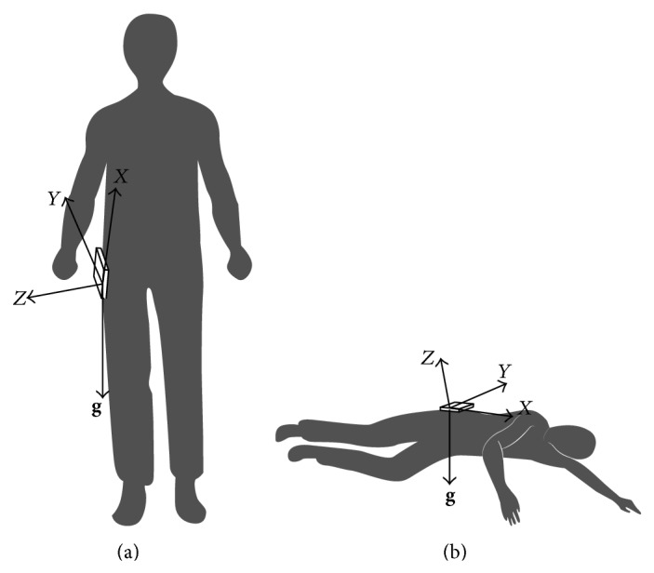
Similar System for Fall Detection using wearable sensor.
Accelerometer and gyroscope could provide information directly. Sensor measurements could be used to distinguish a real fall [3].
The wearable device will be mounted on human's waist at first to reflect the motion of human body closely.
As normal activity of resting also has similar rotation as falling, it may trigger fall alarm when the body hits ground heavily. So the choice of a threshold is quite important to distinguish falling from heavily lying activity.
Threshold based fall detection algorithm will be used in this system.
[3] Falin Wu , Hengyang Zhao , Yan Zhao , Haibo Zhong, Development of a Wearable-Sensor-Based fall detection system, International Journal of Telemedicine and Applications, 2015, p.2-2, January 2015.

Slide 6
Similar System for Activity Recognition
Activity Recognition Using Sensor And Machine Learning Classifiers.
takes the features of signals based on time and frequency and PCA used to help in ﬁltering features and extract the most signiﬁcant ones that detect human activities as falling, abnormality detection and prediction of human behaviour. [1]
From the overall results, Multi-layer Perceptron Neural Network shown to has the highest accuracy compared to other classifier.
[1] Sukor, AS Abdull, A. Zakaria, and N. Abdul Rahim. Activity recognition using accelerometer sensor and machine learning classiers., IEEE, 2018.

Slide 7
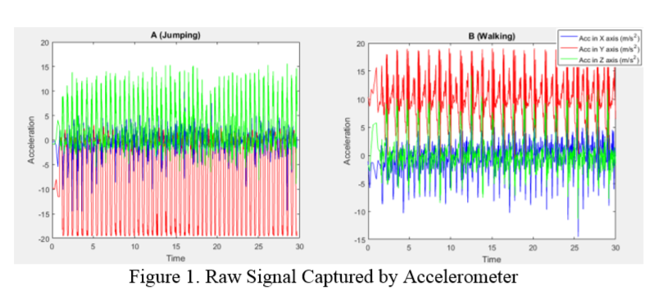
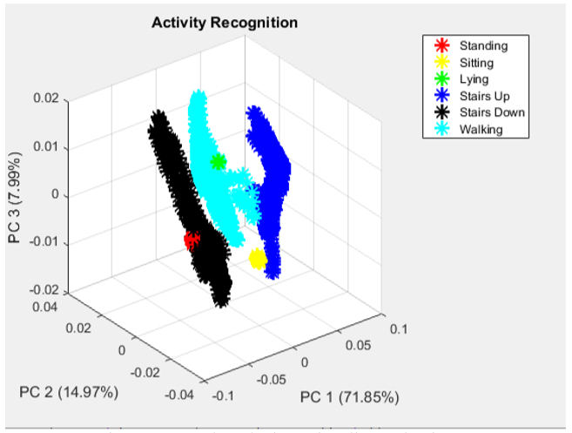

Slide 8
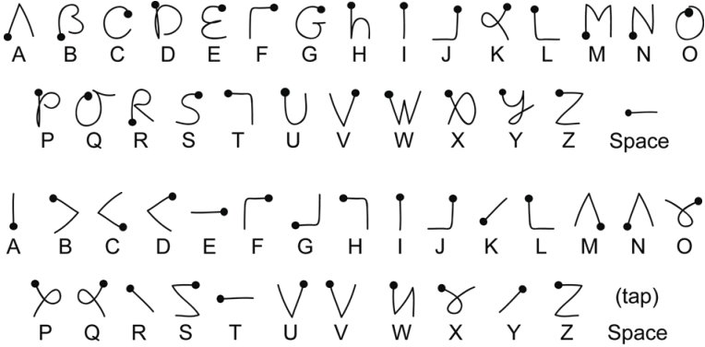
Similar System for Hand Gesture
Hand gesture recognition interface for visually impaired and blind people.
They used WEKA dataset that stores the structure of the sample. Algorithms used are Naive Bayes Algorithm, HMM, Neural Networks, Decision trees, Support-Vector Machines, k-nearest neighbor.
The best results based on a SVM with a polynomial kernel and RZR (94.29%).
[2] Markus Modelewski, Esteben Beyro Kaisar. Hand Gesture recognition interface for visually impaired and blind people,IEEE,2012

Slide 9
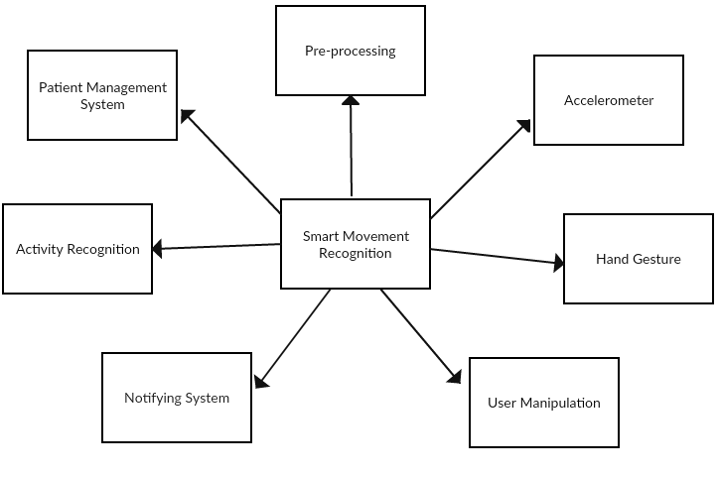
Context Diagram

Slide 10
Functional Requirments
User Manipulation
 | CRUD Doctors, nurses, Assistant and patients Login
 | Receive Notification Accept Notification
 | Start Move CRUD Gesture End Move Show Profile Submit Gesture Classify Encryption Decryption
Activity Recognition
Hand Gesture
System Requirements

Slide 11





Non-Functional Requirments
Reliability
Usability
Security
Maintainability
Portability

Slide 12
Class Diagram

Slide 13
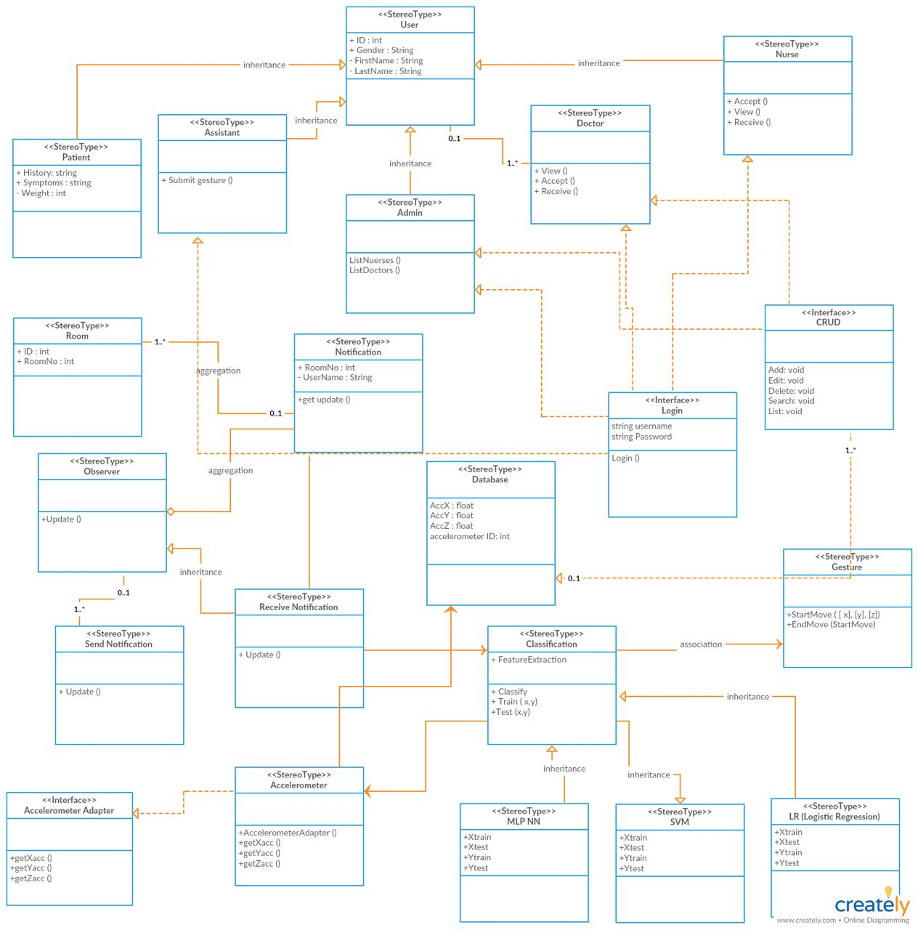

Slide 14
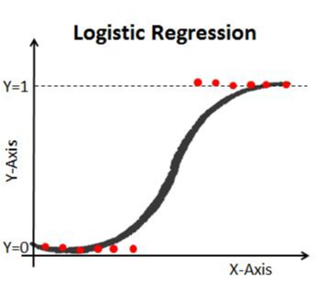
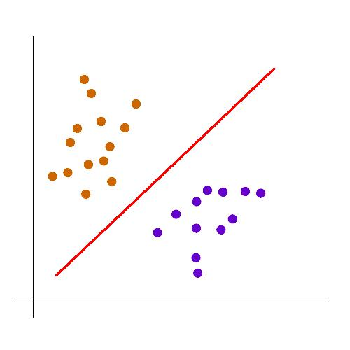
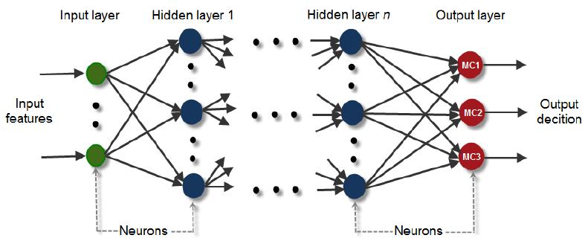
Algorithms
Logistic Regression
Used to predict the categorical dependent variable.
SVM
Descrimnative classifier defined by a separating hyperplan.
MlP NN
Consists of Multilayers “Input, Hidden and Output” layer.

Slide 15
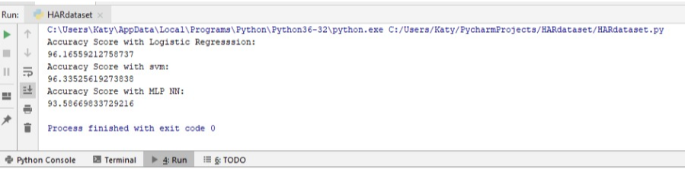
Activity Recognition Demo

Slide 16
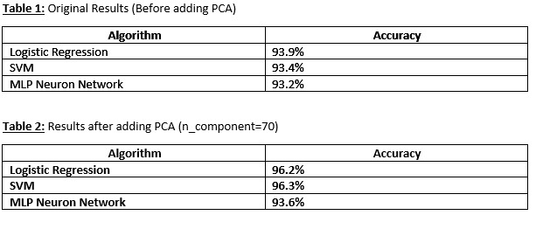
The Effect of PCA
Dimension Redution

Slide 17
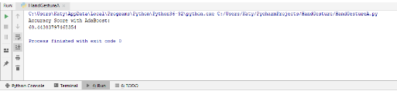
Hand Gesture Demo
Using AdaBoost algorithm and PCA (n component =70)
With accuracy 60.4%.

Slide 18
What is the Dimensionality Reduction (PCA)?
Dimensionality Reduction:
The higher the number of features, the harder it gets to visualize the training data.
Sometimes, most of the features are correlated.
It is the process of reducing the number of random variables under consideration, by obtaining a set of variables
PCA:
finding low-dimension set of axes that summarize data.
It should remove redundancy and describe the data with less properties

Slide 19
Stakeholders Refrences
Retirement home
Housing for the blind

Slide 20
Thanks!
Any questions?

