Slide 1
LOCO
By: Abdelrahman Samir, Fady Khaled, Rana Muhammed, Samar Saeid
Supervised by: Dr. Mohamed Elgazzar, Eng. Silvia Soliman

Slide 2
Introduction:
Electric power consumption (kWh per capita).

Slide 3
Scope
Recommending placement of IOT devices, based on the analysis of data of each device.
Saving power and increasing battery life.

Slide 4
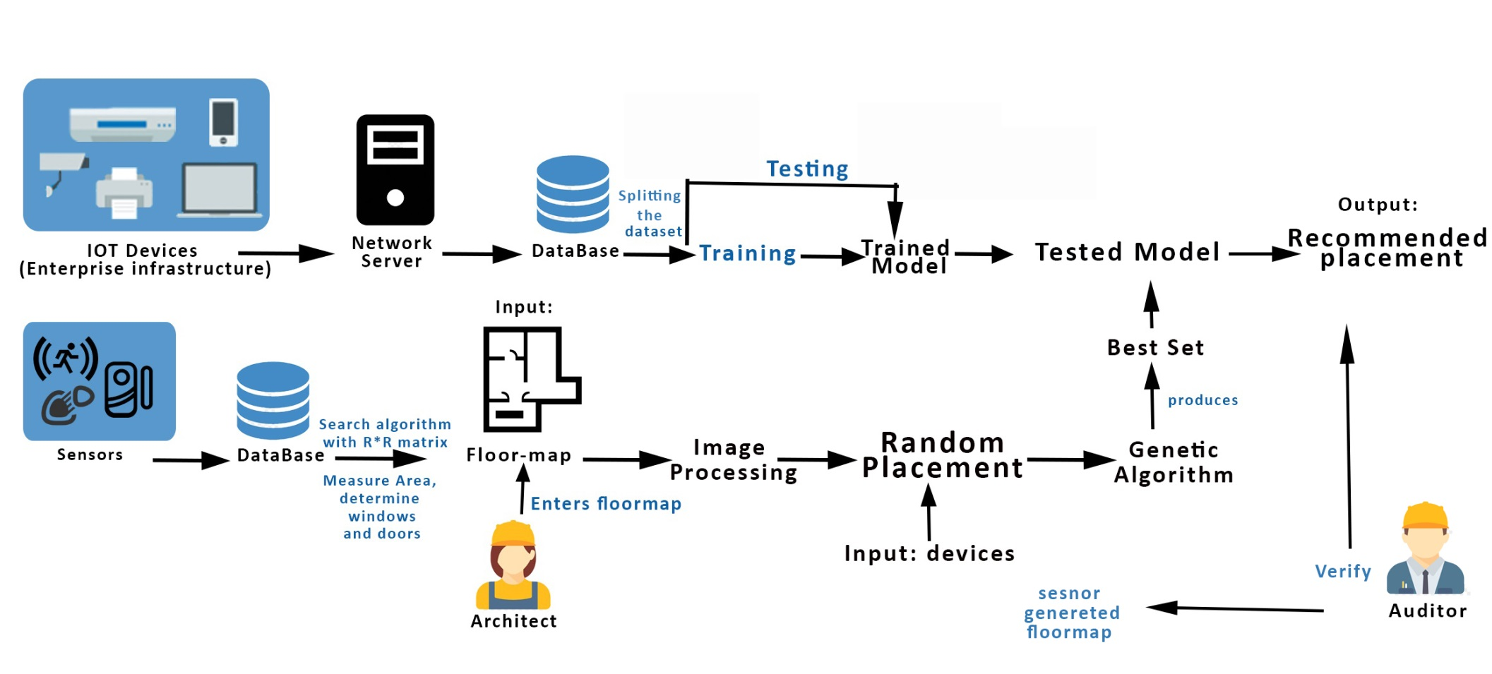
System Overview

Slide 5
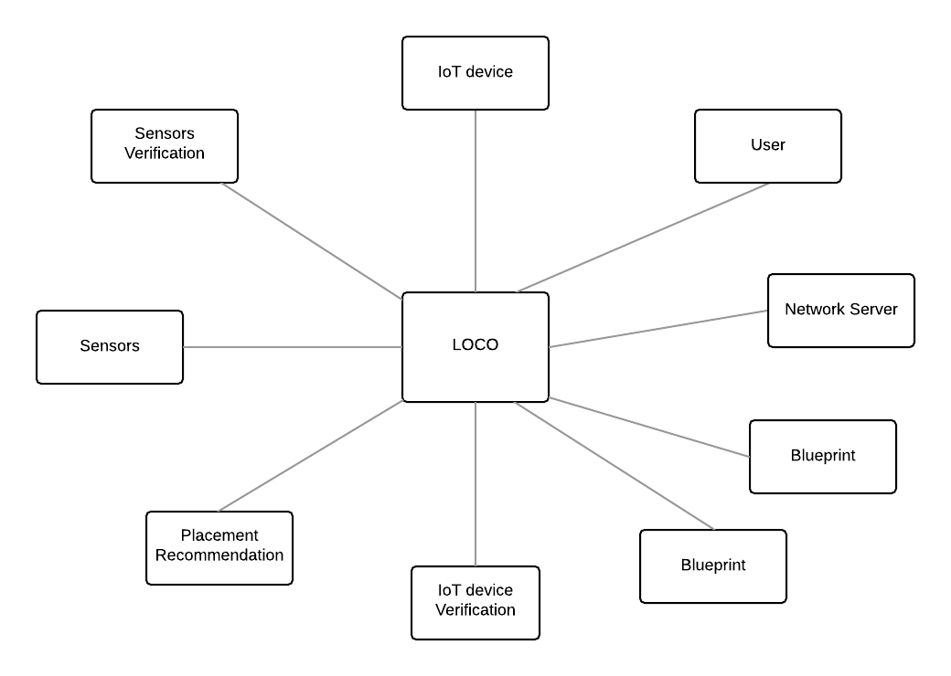
Context Diagram

Slide 6
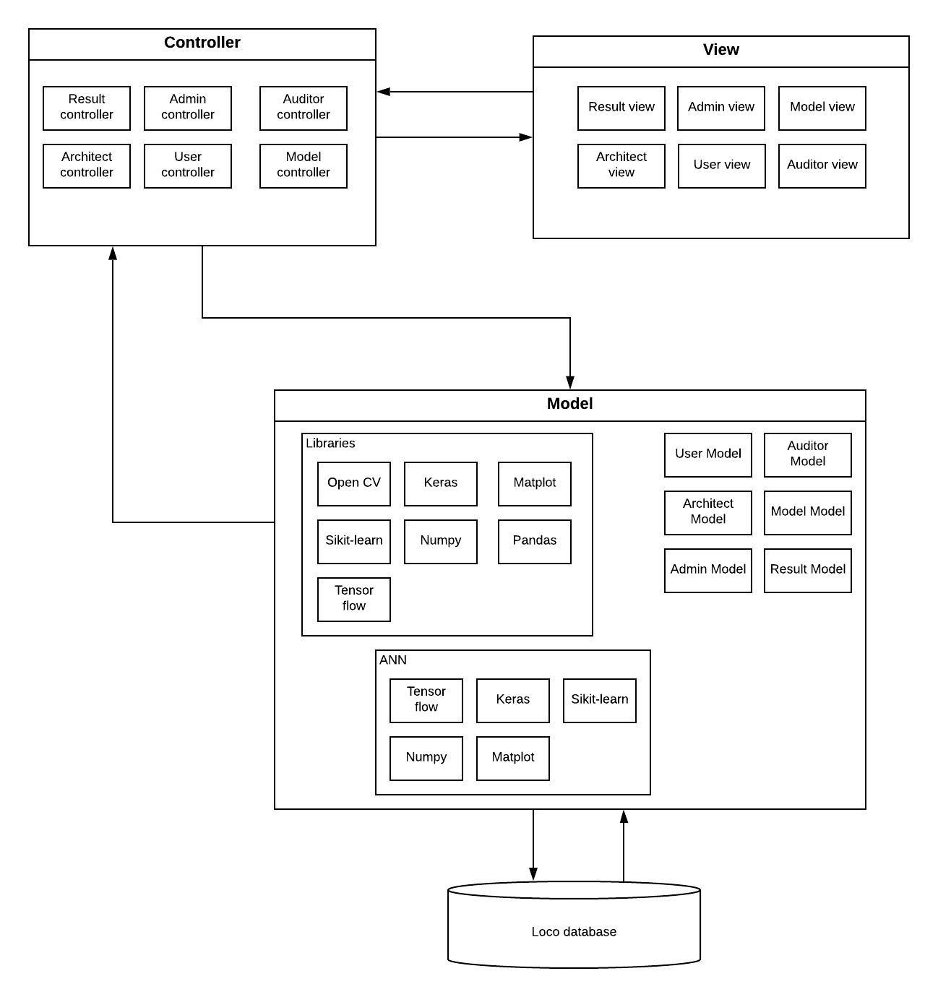
Architecture Diagrams

Slide 7
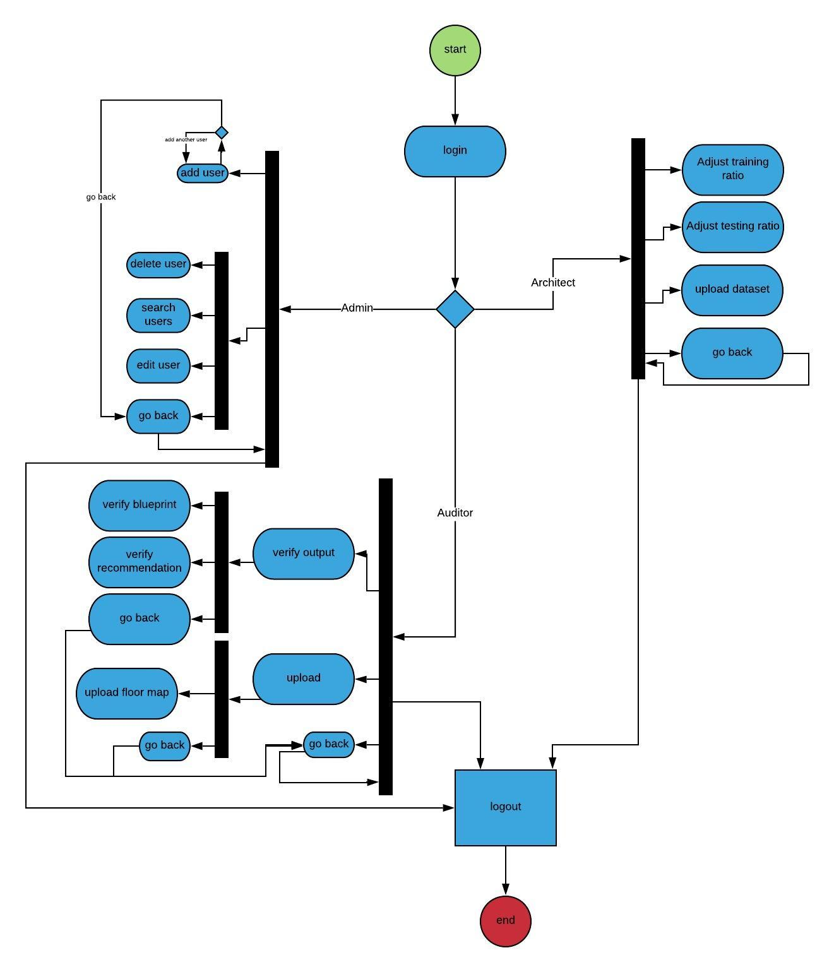
Architecture Diagrams

Slide 8
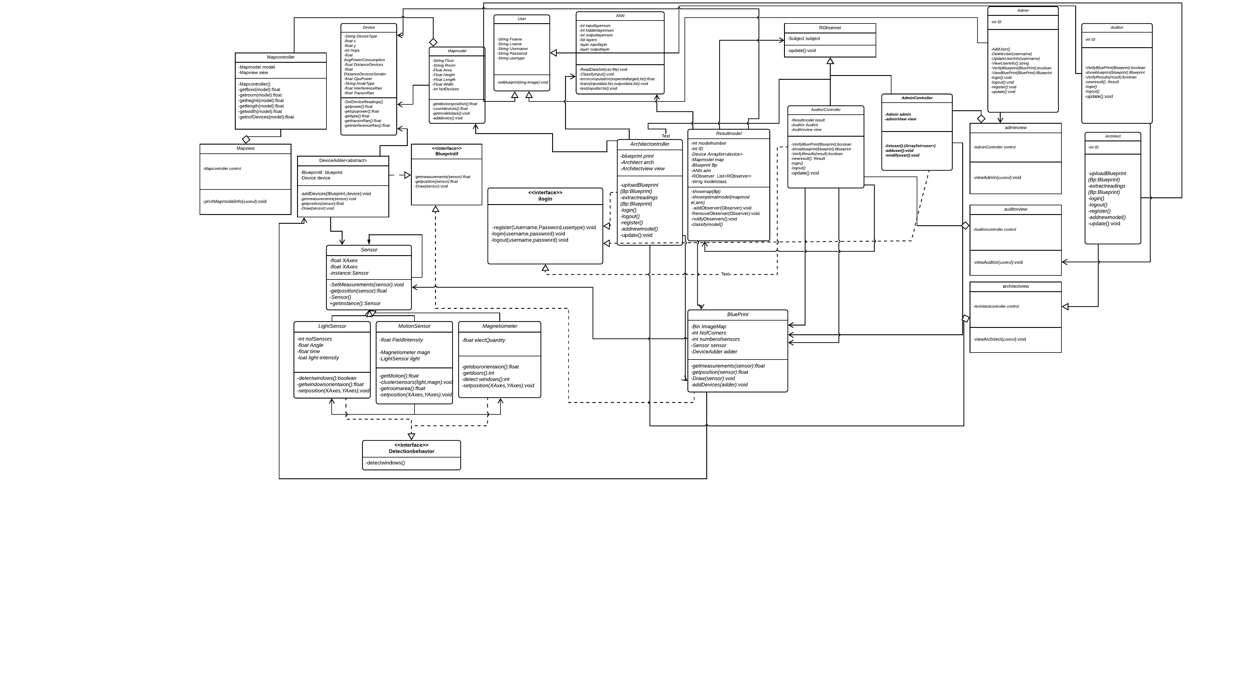
Decomposition description

Slide 9
SVM
classifier that is defined by a separating hyperplane into classes.
Disadvantages:
limitation is speed and size, both in training and testing.
It is less efficient when dealing with discrete data.

Slide 10
K-nn
is a non-parametric method used for classification and regression.
Disadvantages:
does not learn anything from the training data and simply uses the training data itself for classification.

Slide 11
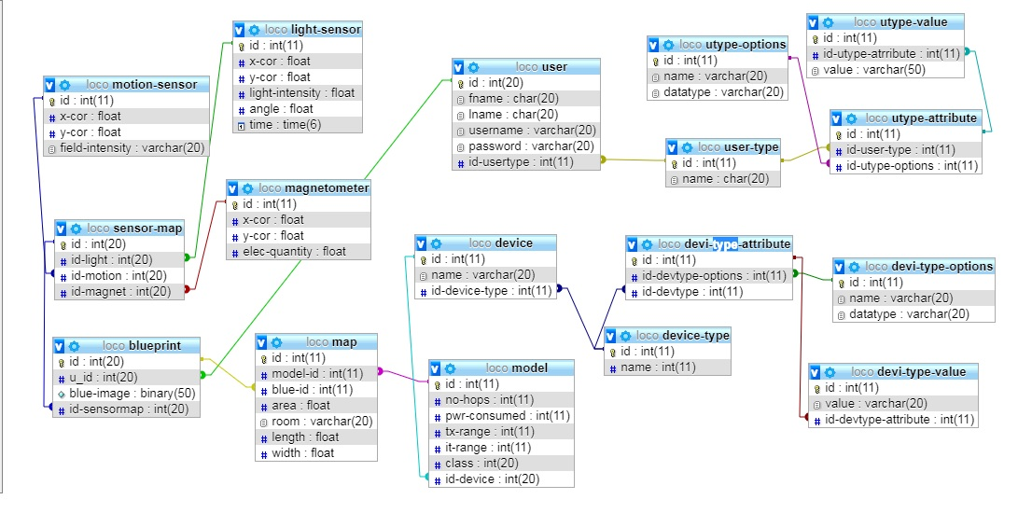
Data Design

Slide 12
Random forest
A supervised learning algorithm. It creates a forest and makes it somehow random. The „forest“ it builds, is an ensemble of Decision Trees, most of the time trained with the “bagging” method.
The general idea of the bagging method is that a combination of learning models increases the overall result.

Slide 13
Random Forest
Why Random Forest?
it can handle large amount of data sets.
it can be used for both regression and classification tasks .
Low chances of overfitting.

Slide 14
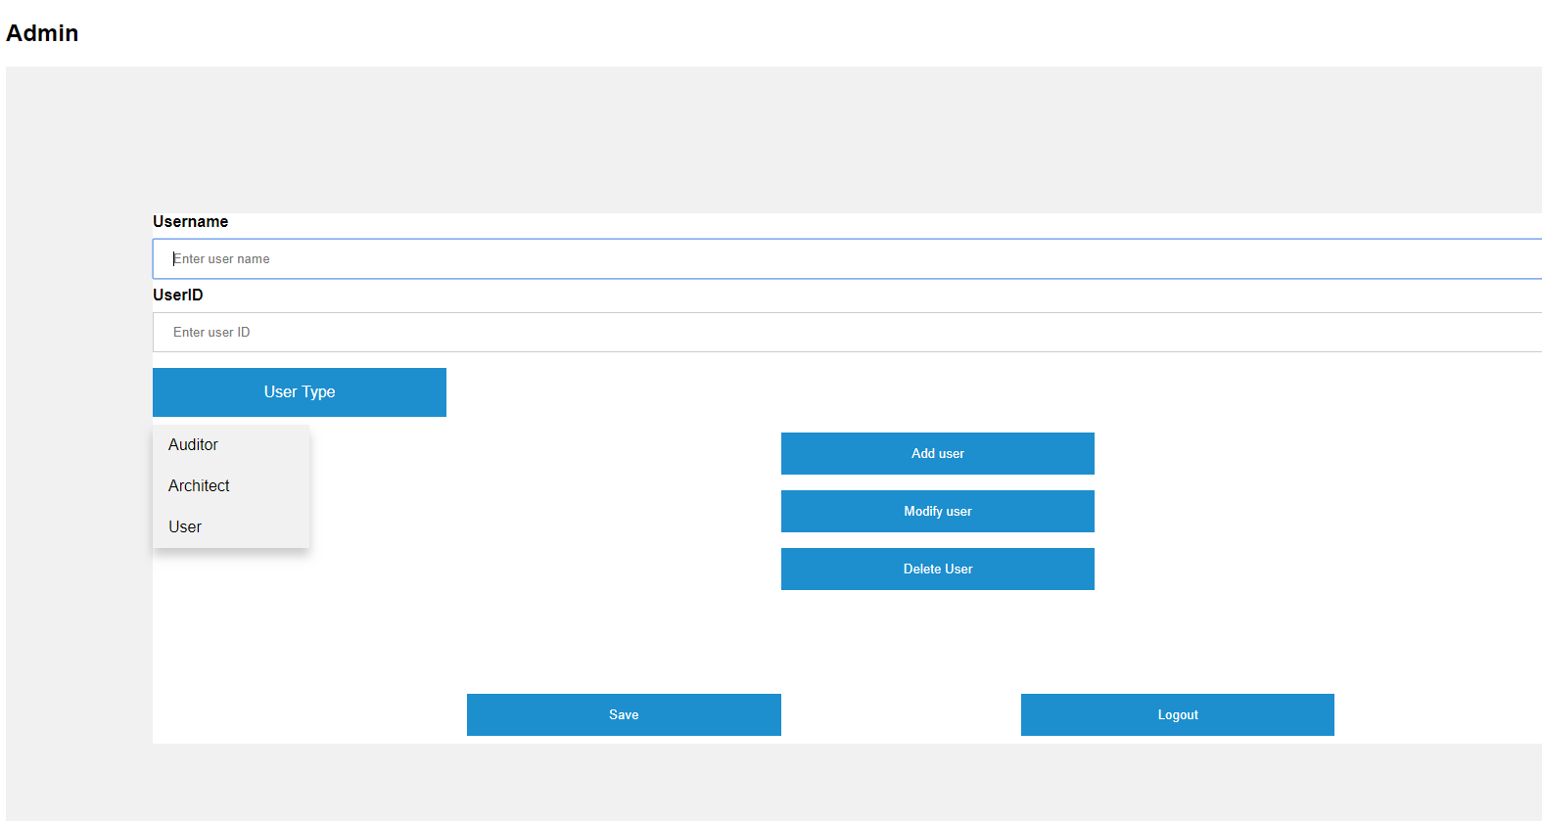
User Interface

Slide 15
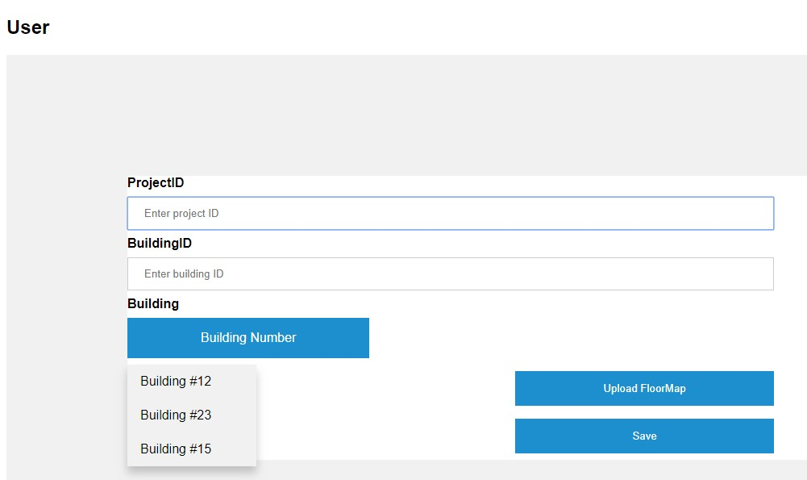
User Interface

Slide 16
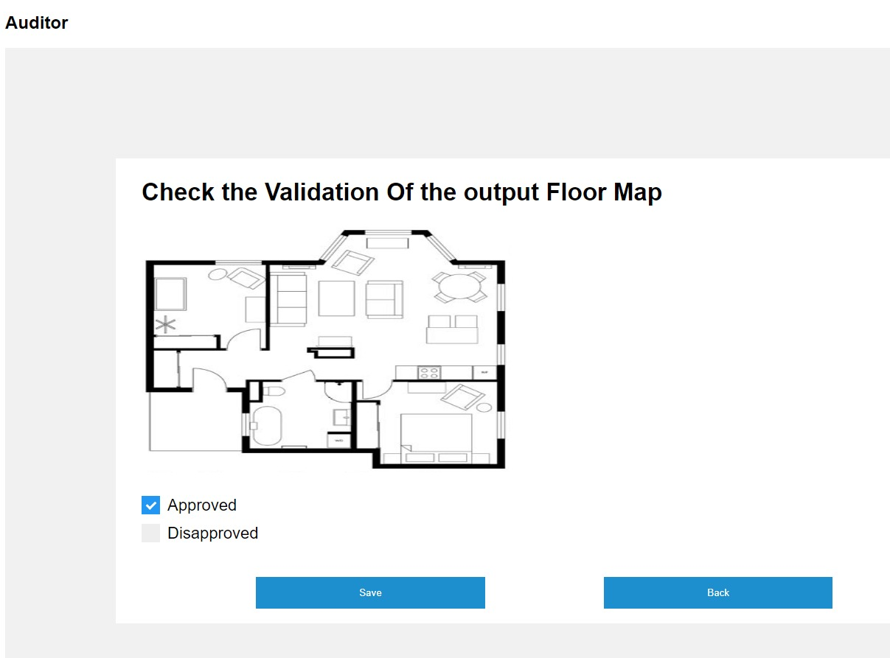
User Interface

Slide 17
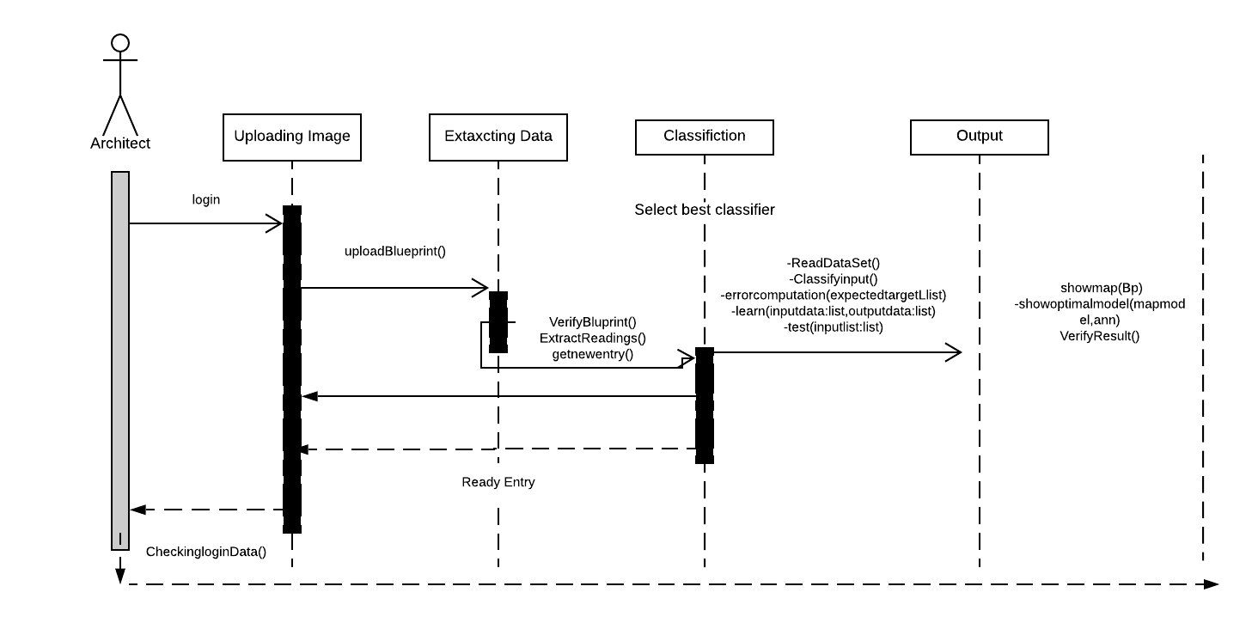
Sequence Diagram

Slide 18
Demo

Slide 19
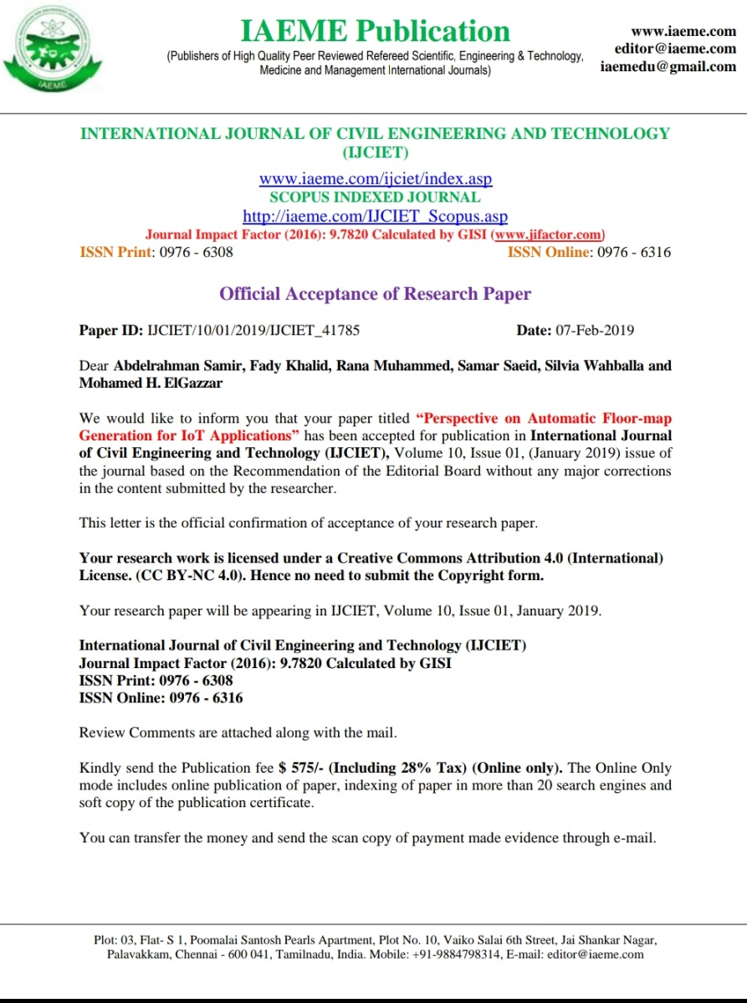
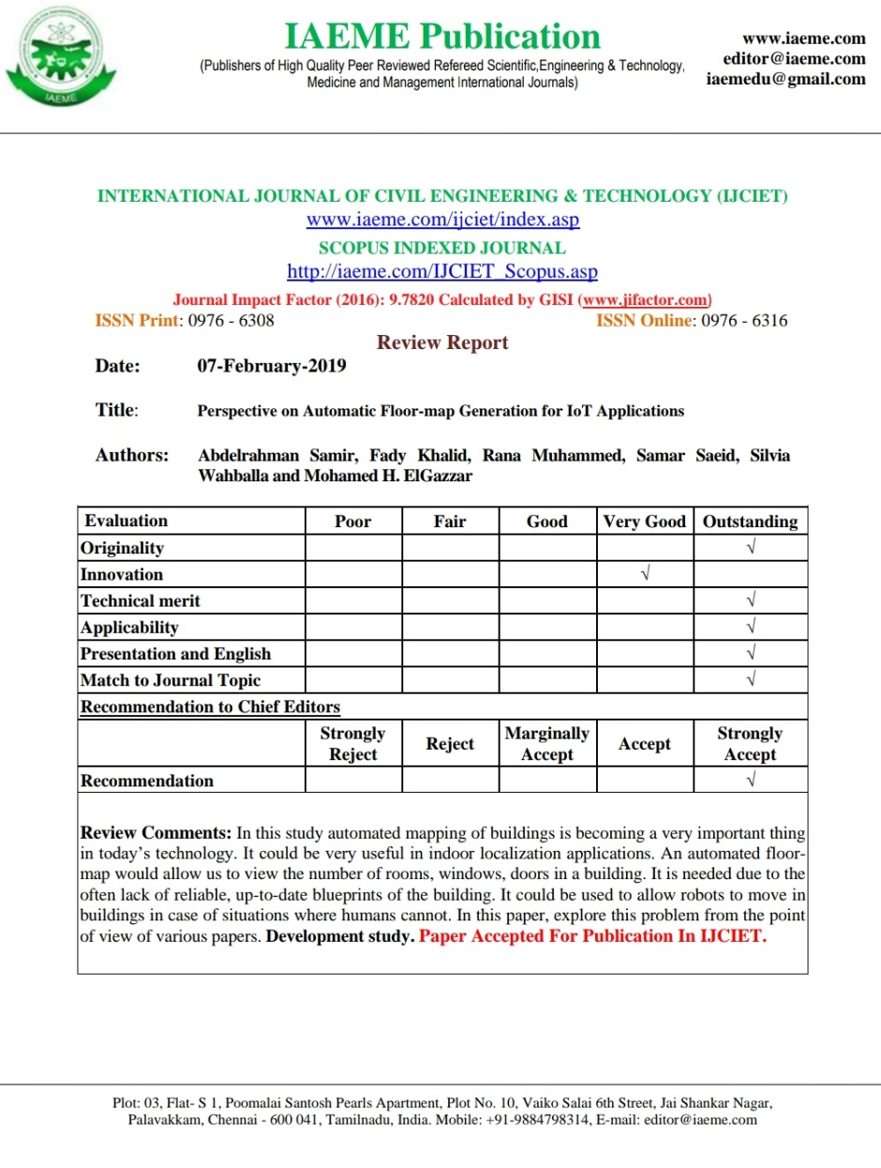
Feedback

Slide 20
Achievements and stakeholder status
Ranked 5th place in Emirates NBD Future Intelligence program competition.
Based on recommendation from the CEO of Bodo-cloud we started finding our clients.

Slide 21
References
[1] J. Lu, Y. T. Shams, and K. Whitehouse, “Smart blueprints: how simplesensors can collaboratively map out their own locations in the home,”ACMTransactions on Sensor Networks (TOSN), vol. 11, no. 1, p. 19, 2014.
[2] M. S. Golanbari and M. B. Tahoori, “Runtime adjustment of iot system-on-chips for minimum energy operation,” in2018 55th ACM/ESDA/IEEEDesign Automation Conference (DAC), pp. 1–6, IEEE, 2018.

