Slide 1
Enhancing Indoor IOT Network Design to support energy Saving
By: Abdelrahman Samir, Fady Khaled, Rana Muhammed, Samar Saeid
Supervised by: Dr. Mohamed Elgazzar, Eng. Silvia Soliman

Slide 2
Objective
Recommending placement of IOT devices, based on the historical data of each device.
Saving power and increasing battery life.

Slide 3
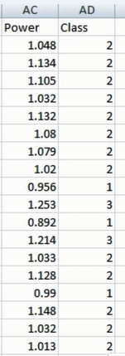
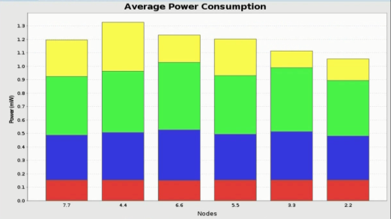
Introduction
Randomized Model
Readings
Classes (Low, Average, High)
Calculate Average Power Consumption

Slide 4
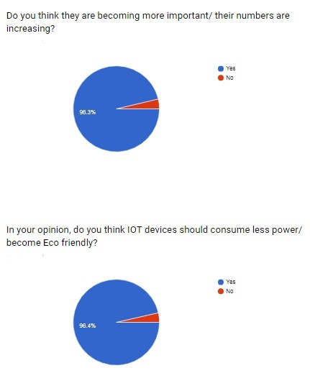
Business Model

Slide 5
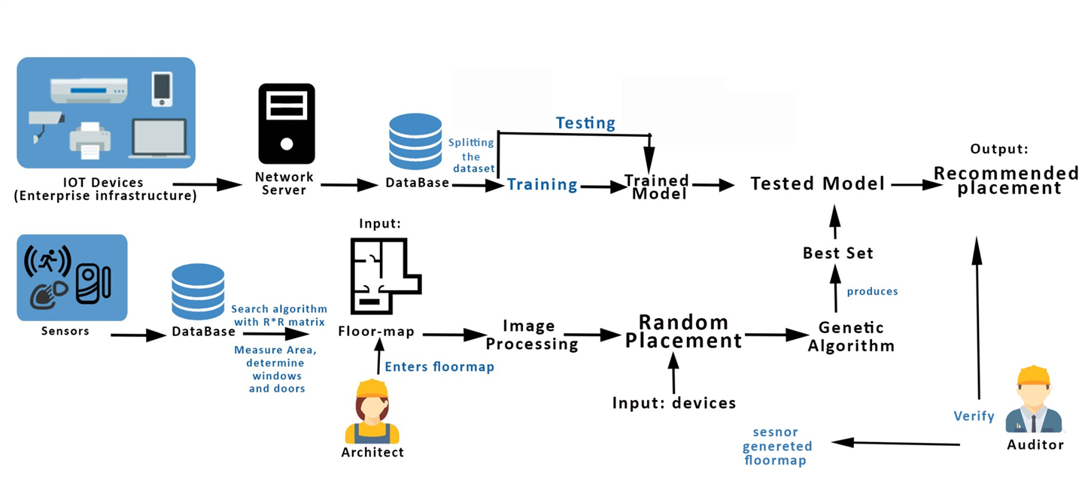
System Overview

Slide 6
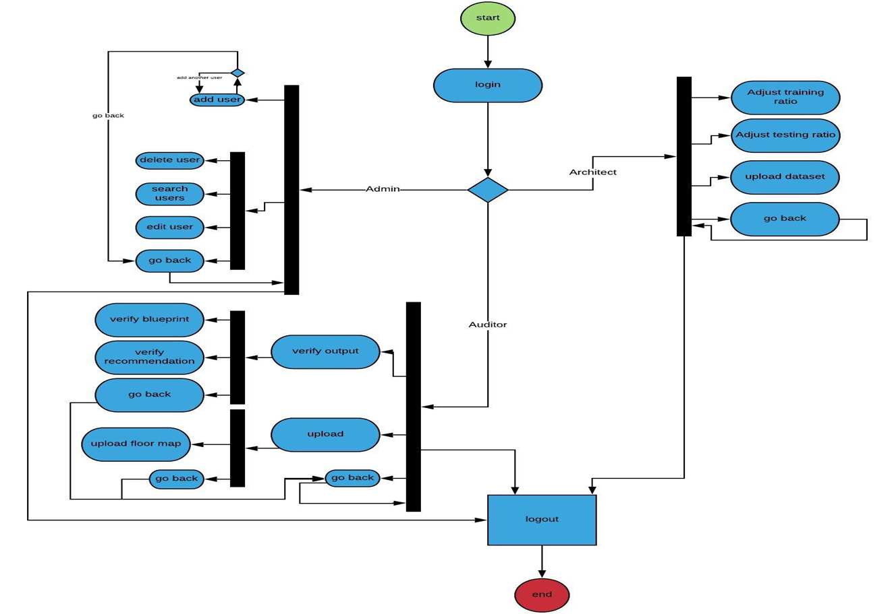
Block Diagram

Slide 7
Most Important Algorithms
Random Forest used in the classification and the model training process.
Canny Edge Detection used in processing the entered floor map, to illustrate the edges or walls to measure the distance between them.

Slide 8
Functional Requirements
Add new readings
Add/edit/delete user
Verify Results , Verify Blueprint
Upload data set , Upload Blueprint
Upload/edit/delete data from sensors
Analyze Features
Retrieve blueprint’s specifications
Edit filtering module
Get Readings from file
Sketch blue print from sensors

Slide 9
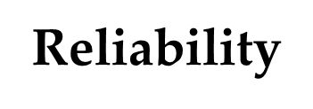
Non-Functional Requirements
Maintain-ability

Slide 10
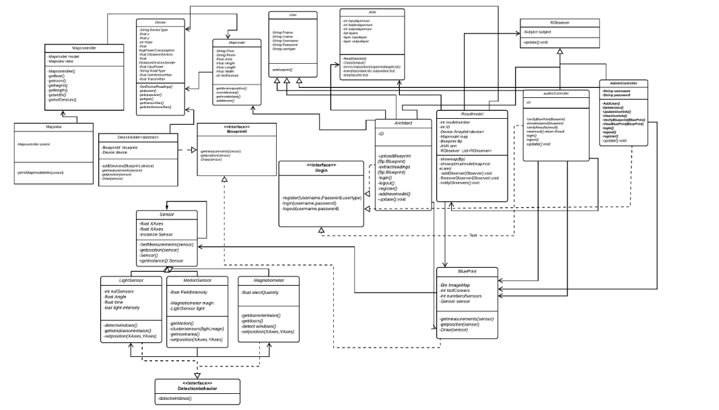
Class Diagram

Slide 11
Demo

Slide 12
Stockholders references
System would be used by communication services companies like Vodafone.
System is also applicable for banks as we discussed the idea with someone at NBD and they liked it and said it’s applicable.

Slide 13
Survey Paper Status
Survey paper on Map Generation is done.
Survey paper on saving power consumption in Iot devices is in progress.

Slide 14
Refrences
[1] J. Lu, Y. T. Shams, and K. Whitehouse, “Smart blueprints: how simplesensors can collaboratively map out their own locations in the home,”ACMTransactions on Sensor Networks (TOSN), vol. 11, no. 1, p. 19, 2014.
[2] M. S. Golanbari and M. B. Tahoori, “Runtime adjustment of iot system-on-chips for minimum energy operation,” in2018 55th ACM/ESDA/IEEEDesign Automation Conference (DAC), pp. 1–6, IEEE, 2018.

