Slide 1
Enhancing Indoor IOT Network Design to support energy Saving
By: Abdelrahman Samir, Fady Khaled, Rana Muhammed, Samar Saeid
Supervised by: Dr. Mohamed Elgazzar, Eng. Silvia Soliman

Slide 2
Agenda
Introduction
Related Work
Problem Statement
System overview
Input
Processing
Output
5) Expected results and contribution

Slide 3
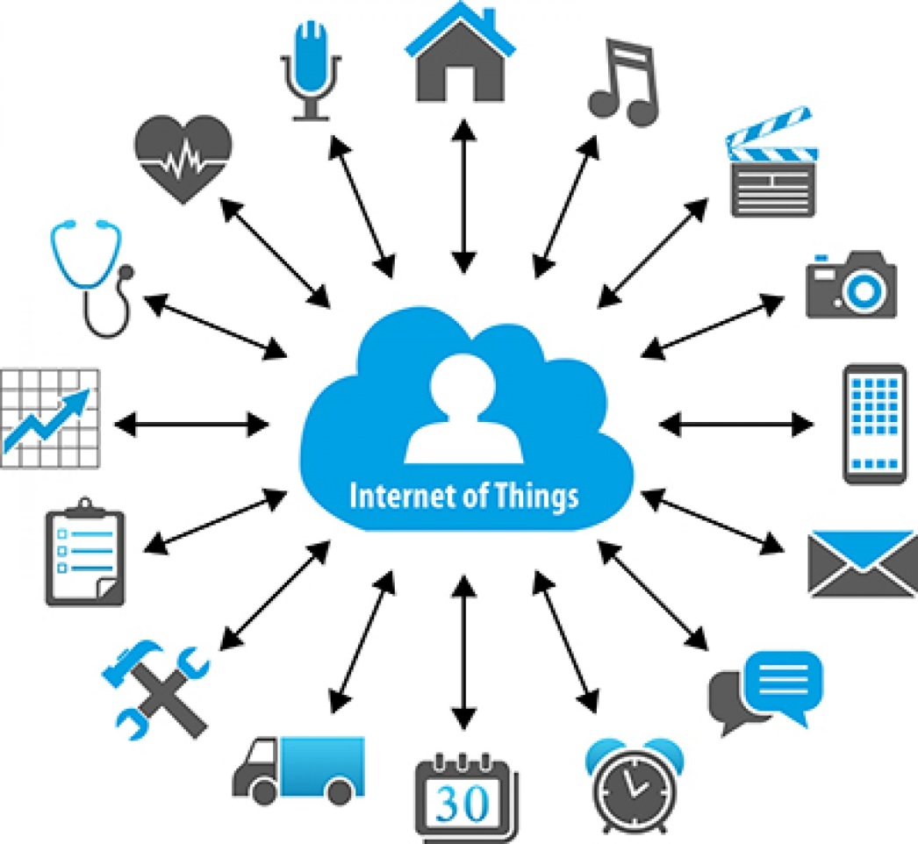
Introduction:
What is IOT

Slide 4
Introduction:
Estimated number of connected IOT devices

Slide 5
Introduction:
Electric power consumption (kWh per capita).

Slide 6
Related Work
Paper | Author | Problem Statement | Contribution | Algorithm | Results | Pros | Cons
Justification of the Choice of Neural Networks Learning Algorithms for Indoor Mobile Positioning | Pavel A. Novikov, Anatoly D. Khomonenko, Evgeny L. Yakovlev | GPS either doesn’t work indoors or provide location data with a very high error of about 100-150 meters. | system may work on the mobile devices as well as on desktop computers. | RProp | A Navigation software package that uses the model ANN | the software package can run on the existing infrastructure of Wi- Fi networks that are deployed in a variety of areas. | must manually map the radio fingerprint.
Measuring Sensor to Cloud Energy Consumption | A H Azni, Abdul Fuad Abdul Rahman, Najwa Hayaati Mohd Alwi. | IoT devices must provide seamless connectivity while obeying strict power and size constraints. | series of simple experiments which measure the energy consumption of two IoT Sensor Nodes transmitting data to the cloud. They will be used to view the best one between wire and wireless for IoT Sensor Nodes implementation. | __ | the differences between wire and wireless is only 100 Minutes of battery life. | Wired consumed less power than the wireless | uses only 2.4GHz wireless protocol

Slide 7
Related Work
Paper | Author | Problem Statement | Contribution | Algorithm | Results | Pros | Cons
Poster: Twirl: On the Benefits of Adapting Orientation of a WiFi Access-Point | Yubing Jian, Shruti Lall, and Raghupathy Sivakumar | The main problem is how poorly the network performs as a consequence of poor placement of wifi's access point. | experiments on the performance of the network, in different places with different antenna angles. | __ | improve the network performance up to 1:5x. Using Antenna, and by 1.8x using twirl. | Simple method of increasing performance. | __
Characterizing and Modeling the Impact of Wireless SignalStrength on Smartphone Battery Drain | Ning Ding, Daniel Wagner, Xiaomeng Chen, Abhinav Pathak, Y. Charlie Hu, Andrew Rice. | many cell phone users experience frequent poor signal strength, and how negatively it could impact the battery. | the first measurement study of 3G and WiFi signal strength experienced by (3785) smart phone users over 1 to 19 months of daily usage. | __ | The 3785 users on which the study was conducted, had 43\% and 21\% of their data sent in the time of poor 3G and WiFi signal strength, respectively. | The new model prediction error stays within 5.4%. Similarly, for 3G the new model has an error rate of less than 7.2%, in | __

Slide 8
Problem Statement
Misplacement of indoor IOT devices causes different issues such as: overlapping of their ranges, long distance between devices, poor coverage, etc. which may cause higher power consumption.

Slide 9
System Overview

Slide 10
System Overview
Scope:
The system will create a map of the room using Wi-Fi
IT will give the optimal corner placement of the given IOT devices with the least power consumption.
extended battery life of IOT devices.

Slide 11
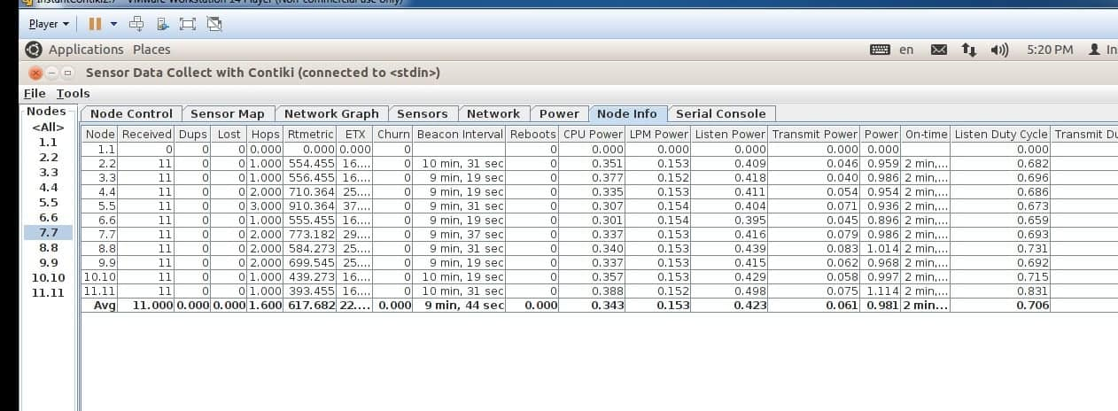
System Overview
Input:
Phase 1: Historical data.

Slide 12
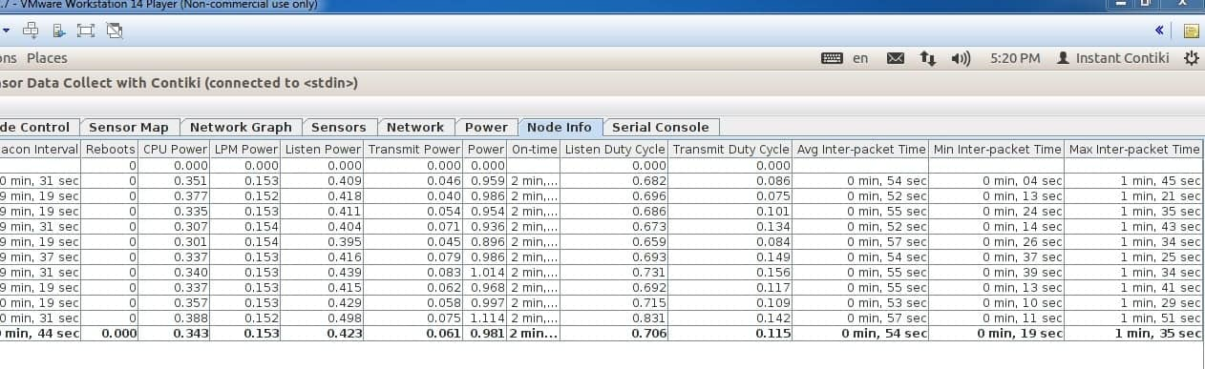
System Overview
Input:
Phase 1: Historical data.

Slide 13
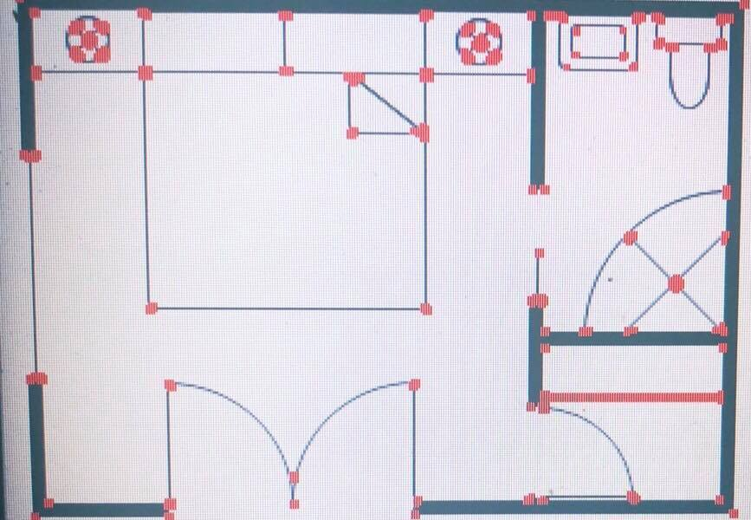
System Overview
Input:
Phase 2: Processed image.

Slide 14
System Overview
Processing:
Model is trained by Random Forest the using the parameters(Distance, Transmission Rate, etc.).
Image processing (Canny Edge detection).

Slide 15
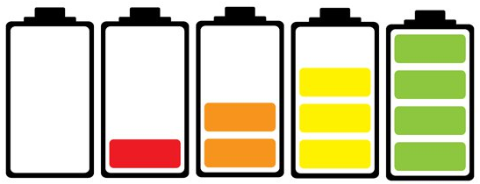
Expected results and contribution
Placement recommendation of IOT devices, based on the historical data of each device.
Saving power and increasing battery life.

Slide 16
Demo

Slide 17
Works Cited
"Electric Power Consumption (Kwh Per Capita) | Data." Data.worldbank.org. N.p., 2018. Web. 23 Sept. 2018.
“B. Xie, G. Tan, and T. He, “Spinlight: A high accuracy and robust lightpositioning system for indoor applications,” inProceedings of the 13th ACM14
Conference on Embedded Networked Sensor Systems, pp. 211–223, ACM,2015”
“P. A. Novikov, A. D. Khomonenko, and E. L. Yakovlev, “Justification ofthe choice of neural networks learning algorithms for indoor mobile posi-tioning,” inProceedings of the 11th Central & Eastern European SoftwareEngineering Conference in Russia, p. 9, ACM, 2015.”
“N. Ding, D. Wagner, X. Chen, A. Pathak, Y. C. Hu, and A. Rice, “Char-acterizing and modeling the impact of wireless signal strength on smart-phone battery drain,”ACM SIGMETRICS Performance Evaluation Re-view, vol. 41, no. 1, pp. 29–40, 2013.”
“Y. Jian, S. Lall, and R. Sivakumar, “Poster: Twirl:: On the benefits ofadapting orientation of a wifi access-point,” inProceedings of the 15th An-nual International Conference on Mobile Systems, Applications, and Ser-vices, pp. 174–174, ACM, 2017.”

