Slide 1
Fake tweets detection
Mariam Khaled / Radwa Mostafa / Abdelrahman Gamal / John Gerges
Supervisor: Diaa Salama
Teacher Assistant: Eng. Youmna Ibrahem

Slide 2
Introduction
The problem associated with the propagation of fake news continues to grow at an alarming scale. This trend has generated much interest from politics to academia and industry alike. We propose a framework that detects and classifies fake news messages from Twitter using Twitter Features and combining two classifiers

Slide 3
Problem Statment
The extensive use of social media made it one of the main sources of news and it has no restrictions on what people write so it produce many fake news.
This fake news have a huge impact on society , politics and economy.

Slide 4
Objective
Enhance the human ability to differentiate between real and fake tweets or news through help of AI (artificial intelligence) and ML(Machine Learning).

Slide 5
Related works
Fake News Analysis Modeling Using Quote Retweet
Features: Tweet features and Classifier.
URL: https://www.researchgate.net/publication/337622106_Fake_News_Analysis_Modeling_Using_Quote_Retweet
Credibility Detection in Twitter Using Word N-gram Analysis and Supervised Machine Learning Techniques
Features: Pre-processing, Tweet features and Classifier
URL:http://inass.org/2020/2020022927.pdf
SENTIMENT AWARE FAKE NEWS DETECTION ON ONLINE SOCIAL NETWORKS
Features: Sentiment analysis and classifier.
URL: http://cs.stir.ac.uk/~dbh/downloads/Fake_News_ICASSP_2019.pdf

Slide 6
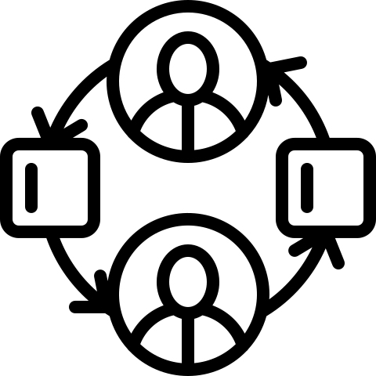
System Overview

Slide 7
Features

Slide 8
Block Diagram

Slide 9
Sequence Diagram
Searching Tweets

Slide 10
Sequence Diagram
Searching Username

Slide 11
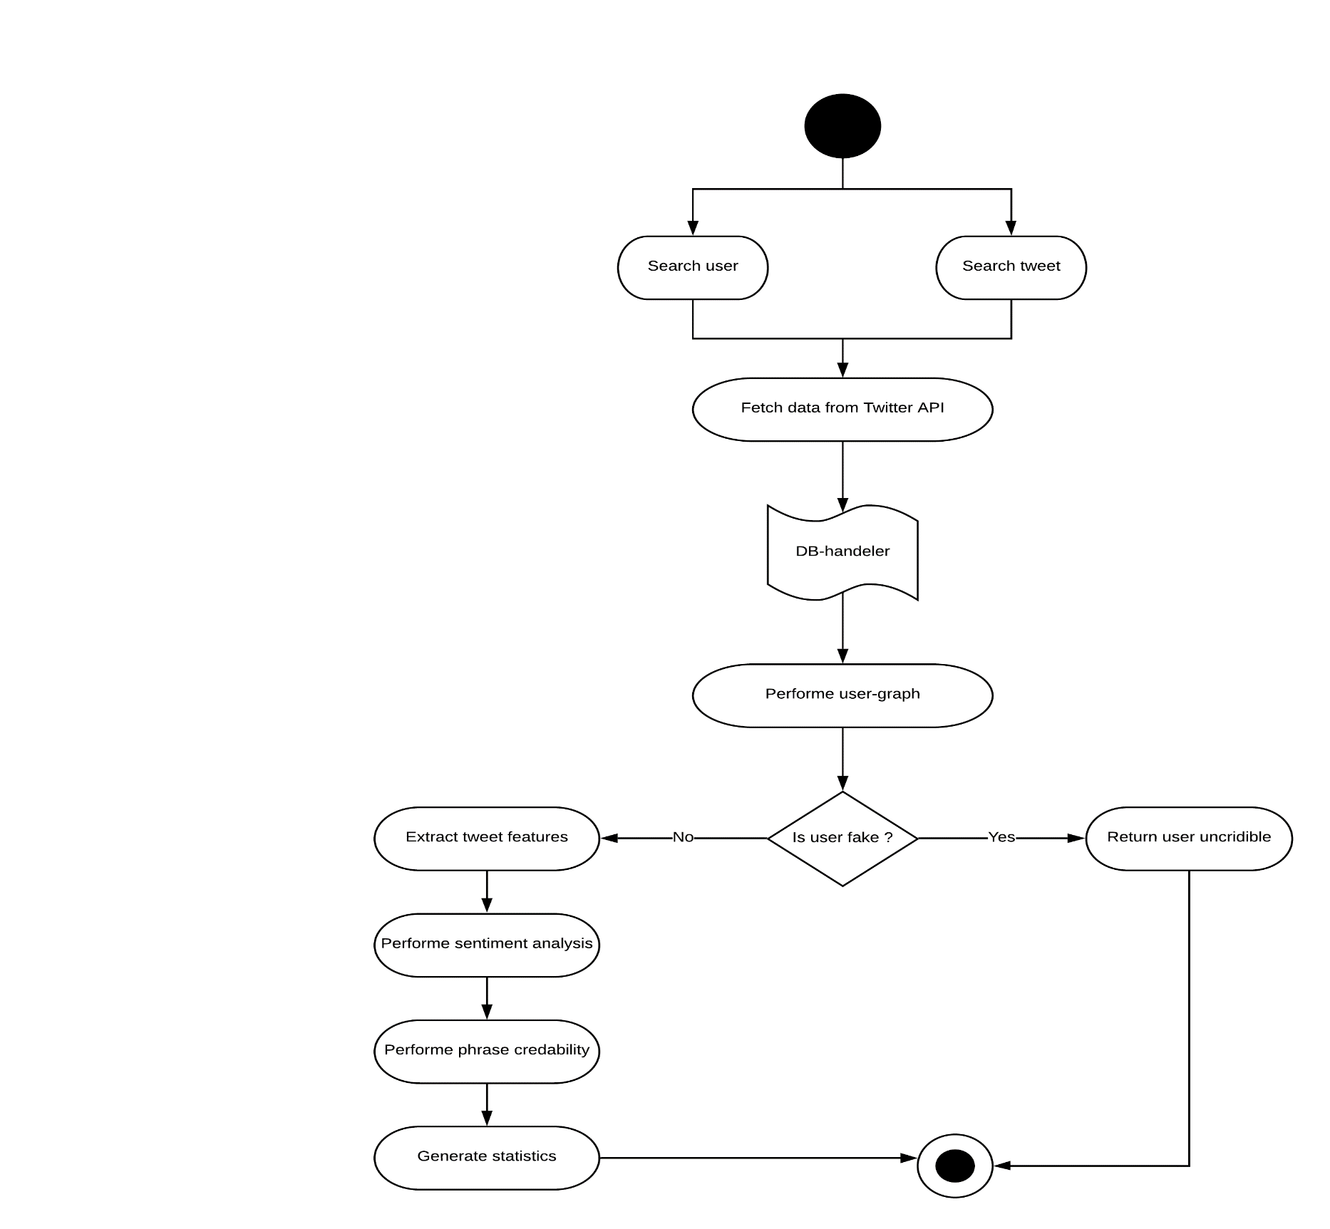
Process Diagram

Slide 12
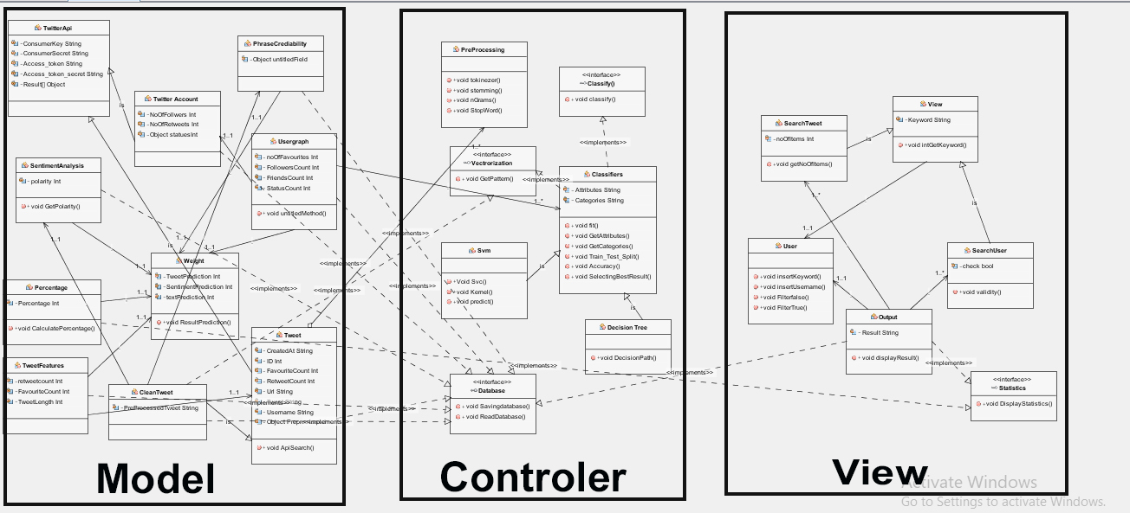
Class
Diagram
Objective

Slide 13
Architecture
Design

Slide 14
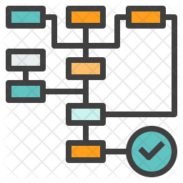
Activity Diagram

Slide 15
Database

Slide 16
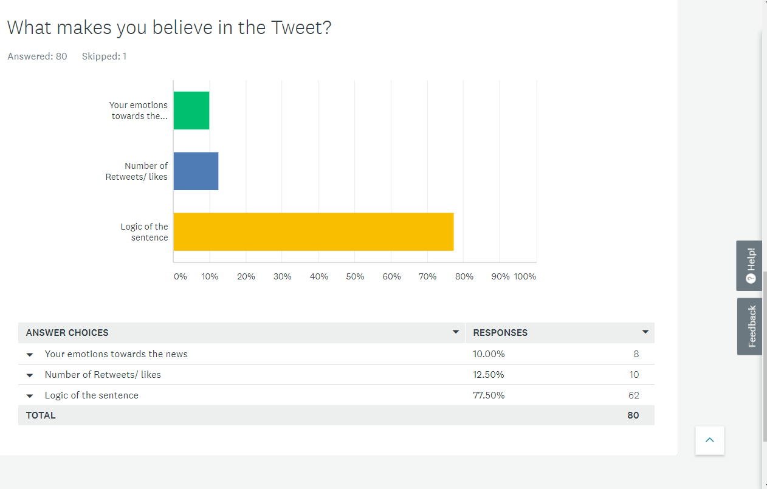
Survey
We asked the people what makes
Them believe in tweet
Logic of the sentence scored 77%
Number of tweet feature scored 12.5%
Emotion of tweet scored 10%

Slide 17
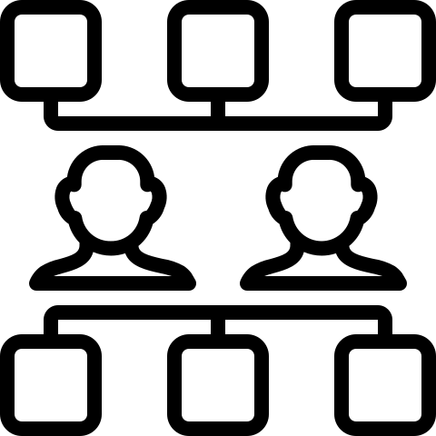
Possible Stakeholders
Anyone who can be affected by the spread of fake news or anyone interested in news

Slide 18
Tasks done
WE achieved Phase 2 in “Dell Competition”.
We submitted the paper needed for Phase 2

Slide 19
Future Work
Neglect tweets owned by a fake user.
Retrieve data from data base not from twitter API if user entered a keyword system searched for it before.
Combining our classifiers to enhance our percentage.

Slide 20
Demo

Slide 21
Thank You

